Slide 1
Green and Sustainability Bonds and Environmental Performance
Hiroaki Kurachi and Luis Señires
03 December 2024

Slide 2
Background
Green, Social, and Sustainability Bonds
Financial securities issued by organizations to raise funding for a portfolio of projects…
…that are expected to generate “green” or “social” (or both!) benefits
Borrowers are expected to provide allocation and impact reports
Environmental Performance Index (EPI)
Provided by Yale and Columbia
Uses 58 performance indicators across 11 issue categories
Ranks 180 countries on climate change performance, environmental health, and ecosystem vitality

Slide 3
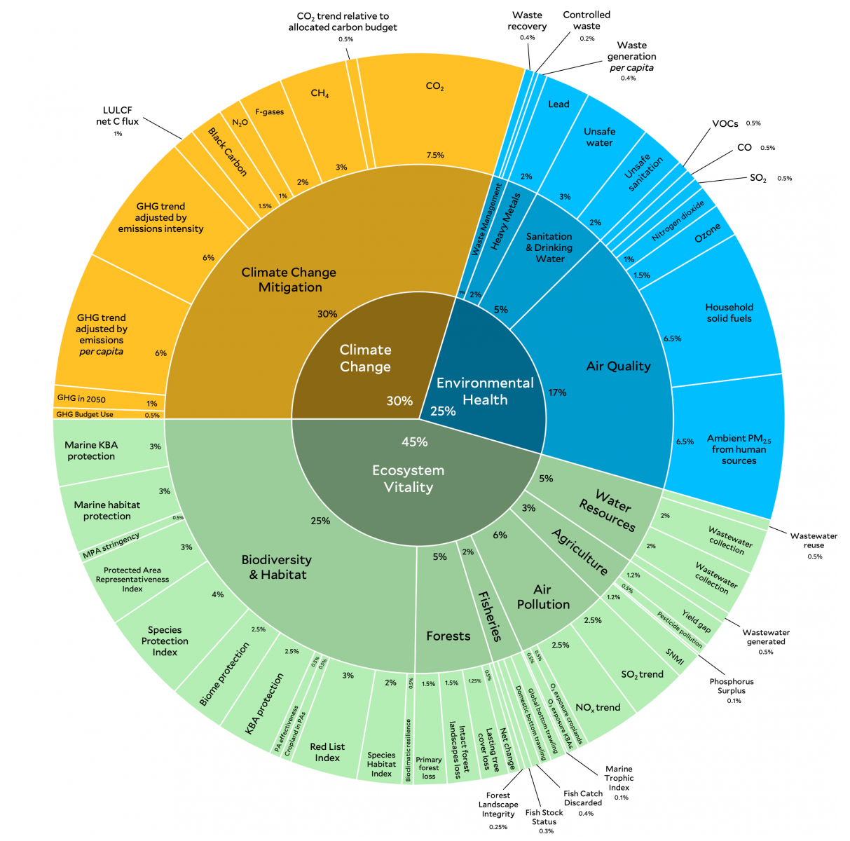
image from https://epi.yale.edu/about-epi

Slide 4
Research Question
What is the relationship between the amount of funding raised through Green and Sustainability bonds and a country’s EPI score?

Slide 5
Dataset 1: Bond issuances
Green and Sustainability bond issuance volumes (USD millions)
Total local currency bond issuance volumes (USD millions)
Broken down per issuer (Government and Corporate) and bond label (Green and Sustainability)
Limited to ASEAN+3 economies
Taken from the Asian Development Bank’s AsianBondsOnline portal

Slide 6
Dataset 2: EPI
Aggregated into a score
Comprehensively covers a wide range of environmental issues, not just a single or limited issues
Though this analysis is focused on ASEAN+3, dataset contains global information which can be useful especially when comparing against world standards
Two-year time horizon which does not directly match Bond data

Slide 7
Dataset 2: EPI
Aggregated into a score
Comprehensively covers a wide range of environmental issues, not just a single or limited issues
Though this analysis is focused on ASEAN+3, dataset contains global information which can be useful especially when comparing against world standards
Two-year time horizon which does not directly match Bond data

Slide 8
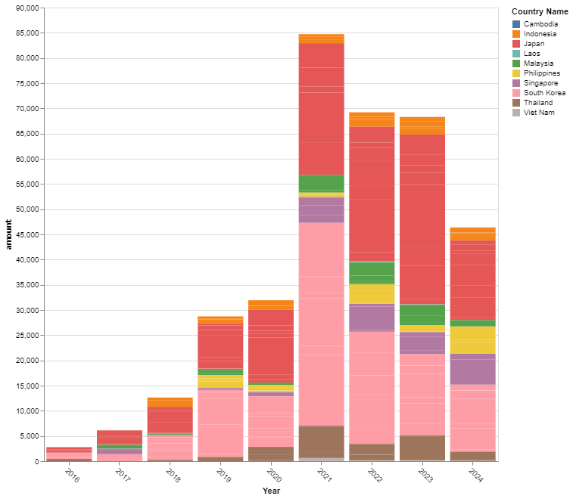
Finding: Rising issuance volume
Upward trending (in nominal terms)
Possible reasons:
Paris commitments
Energy crisis due to geopolitical conflicts
Growth of ESG market segment
More generally, higher deficits due to the pandemic

Slide 9
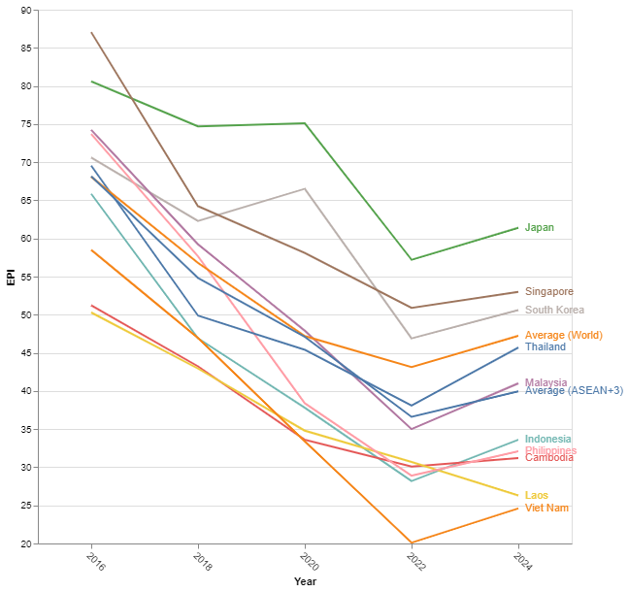
Finding: Global downtrend in EPI
Regional (and global) drop in EPI scores
Possible reasons:
Higher standards for performance
More developments focused on economic growth rather than environmental targets

Slide 10
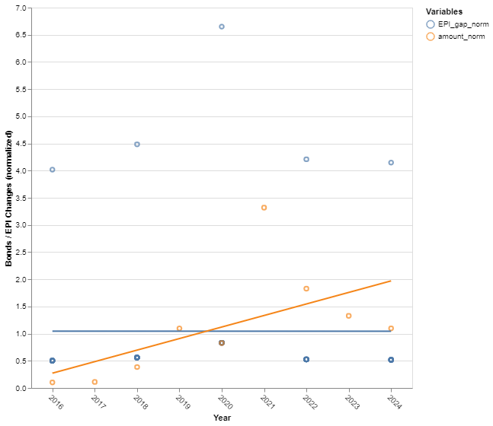
Finding: Weak to negative relation
Example: South Korea
Linear regression on time series data to draw trend lines
Normalized data for more meaningful comparison
Bonds are expressed in USD millions
EPI scores are 0 to 100

Slide 11
Summary and areas for further research
Lower scores observed despite higher issuance volumes
Possible that EPI scores would have decreased even more if not for these investments
Could be a signal of “greenwashing”
Use of project-level data or more specific categorization of use of proceeds
Other potential determinants of EPI scores (e.g. GDP, specific investments into renewable energy, etc.)
Other peer comparisons aside from region

