Slide 1
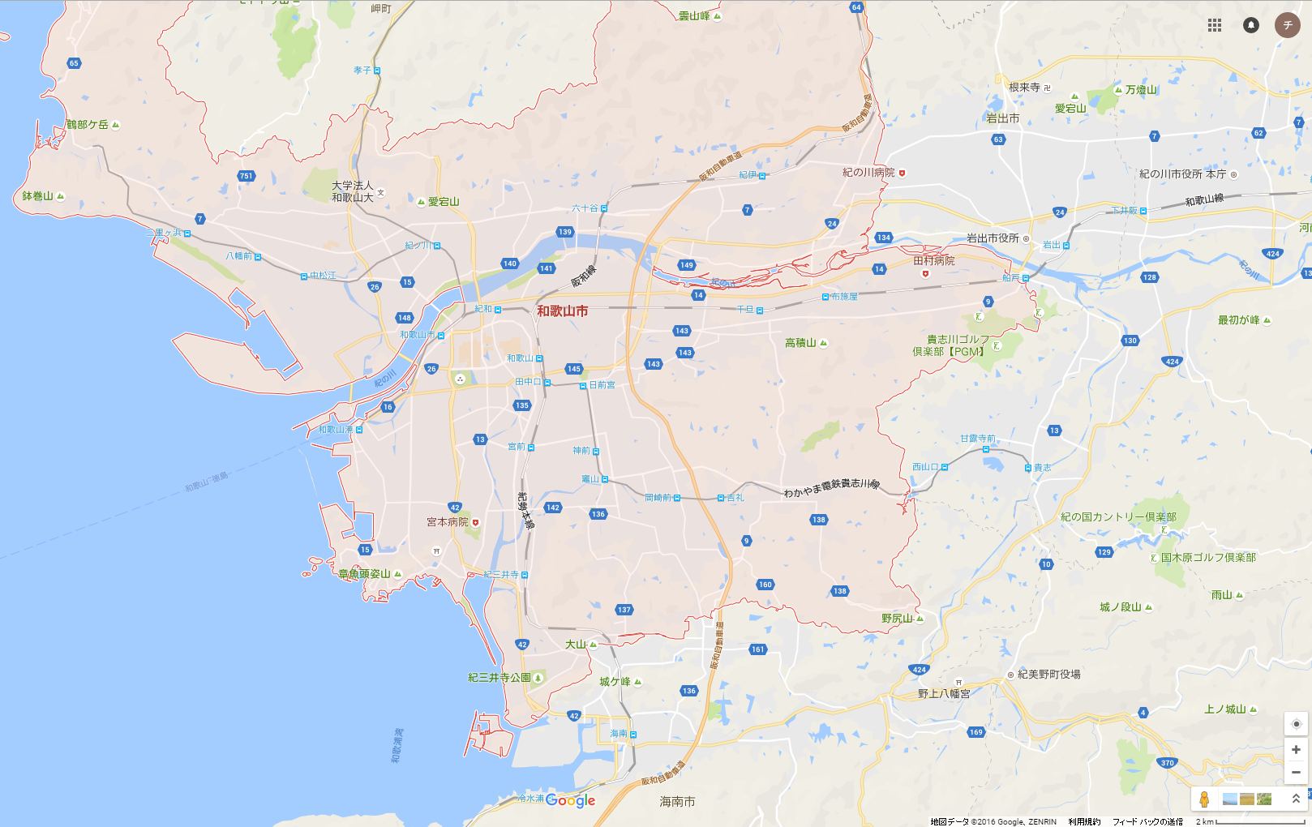
34.296332, 135.061091
3
4
5
3
4
1
1
2
5
6
2
9
8
7
34.143423, 135.339895
Notes:
外枠
34.296332, 135.061091
34.143423, 135.339895
追加領域
1
34.284311, 135.183871
34.140970, 135.278189
2
34.217739, 135.265546
34.141232, 135.311170
3
34.297741, 135.241681
34.223232, 135.339878
4
34.223232, 135.339878
34.150343, 135.192901
5
34.296332, 135.061091
34.224480, 135.140605
削除領域
1
34.224480, 135.140605
34.216726, 135.090817
2
34.251027, 135.085241
34.217182, 135.098910
3
34.303788, 135.083578
34.278084, 135.142001
4
34.301980, 135.236779
34.287886, 135.294815
5
34.235600, 135.304050
34.217238, 135.348713
6
34.225734, 135.283667
34.203705, 135.320705
7
34.163086, 135.279536
34.132188, 135.327012
8
34.180746, 135.296754
34.157178, 135.329913

Slide 2
外枠
34.296332, 135.061091
34.143423, 135.339895
追加領域
1
34.284311, 135.183871
34.140970, 135.278189
2
34.217739, 135.265546
34.141232, 135.311170
3
34.297741, 135.241681
34.223232, 135.339878
4
34.223232, 135.339878
34.150343, 135.192901
5
34.296332, 135.061091
34.224480, 135.140605
削除領域
1
34.224480, 135.140605
34.216726, 135.090817
2
34.251027, 135.085241
34.217182, 135.098910
3
34.303788, 135.083578
34.278084, 135.142001
4
34.301980, 135.236779
34.287886, 135.294815
5
34.235600, 135.304050
34.217238, 135.348713
6
34.225734, 135.283667
34.203705, 135.320705
7
34.163086, 135.279536
34.132188, 135.327012
8
34.180746, 135.296754
34.157178, 135.329913
9
34.180980, 135.109406
34.143055, 135.169831

Slide 3
領域は（最北西, 最南東）の緯度経度のペアで定義されます。(Area is defined by a pair of a north-west position and a south-east position.)
複雑な営業領域は以下のように定義します。(A business zone is defined by the following steps.)
・外枠（赤）を定義します。(define an outside frame of red)
・追加領域（紫）を定義します。(define added area of purple)
・削除領域（緑）を定義します。(define removed area of green)
和歌山での例は1ページ目と2ページ目にあります。(An example of A business zone of Wakayama is at page 1 and 2.)

