Slide 1
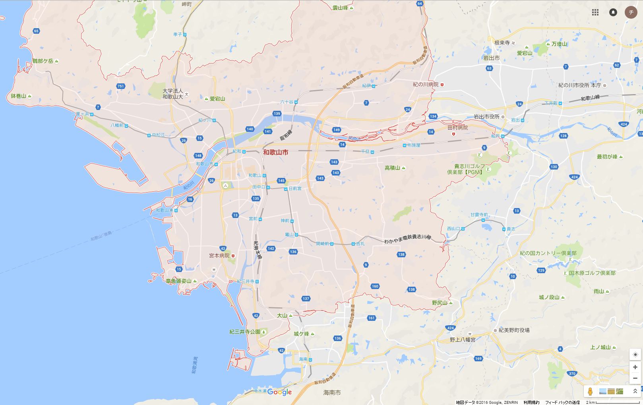
1
2
1
2
Notes:
外枠
34.296332, 135.061091
34.143423, 135.339895
追加領域
1
34.284311, 135.183871
34.140970, 135.278189
2
34.217739, 135.265546
34.141232, 135.311170
3
34.297741, 135.241681
34.223232, 135.339878
4
34.223232, 135.339878
34.150343, 135.192901
5
34.296332, 135.061091
34.224480, 135.140605
削除領域
1
34.224480, 135.140605
34.216726, 135.090817
2
34.251027, 135.085241
34.217182, 135.098910
3
34.303788, 135.083578
34.278084, 135.142001
4
34.301980, 135.236779
34.287886, 135.294815
5
34.235600, 135.304050
34.217238, 135.348713
6
34.225734, 135.283667
34.203705, 135.320705
7
34.163086, 135.279536
34.132188, 135.327012
8
34.180746, 135.296754
34.157178, 135.329913

Slide 2
外枠
34.275080, 135.138074
34.178566, 135.242616
追加領域
1
34.276499, 135.177899
34.184814, 135.236264
2
34.271675, 135.146657
34.182542, 135.190602
削除領域
1
34.276782, 135.129233
34.242164, 135.162535
2
34.200859, 135.193864
34.174944, 135.221072

