Slide 1

Language as a Clinical Interface: NLP-Based Assessment, Illness Monitoring, and Responsible AI in Schizophrenia
Hironobu Nakamura, M.D., Ph.D.
Department of Psychiatry and Behavioral Sciences, Institute of Science Tokyo, Japan
16th Mind-Body Interface International Symposium · Symposium 24 · Taichung, 15 November 2026
Notes:
[0. Opening]
Thank you, Professor Kishimoto. Good afternoon, everyone. I am Hironobu Nakamura, a psychiatrist at the Institute of Science Tokyo. Today I would like to talk about language as a clinical interface: how natural language processing can help us assess and monitor schizophrenia, and what it takes to use this technology responsibly.

Slide 2
MBI 2026
ＣＯI Disclosure
Presenter： Hironobu Nakamura
There are no companies, etc. in a relation of conflict of interest requiring disclosure by the presenter(s) in relation to the contents of the presentation.
The name of the ethics review organization: Medical Research Institute Tokyo Medical and Dental University.
The approval number: M2020-057
Notes:
[0. Opening]
I have no conflicts of interest to disclose, and the study was approved by the relevant ethics committees.

Slide 3
NLP × Psychiatry: Recent Trends
2015–2018
Proof of concept
2019–2022
Dimensions & mechanisms
2023–2024
Scale & the LLM shock
2025–2026
Toward the clinic
• Free speech predicts psychosis onset in high-risk youth (Bedi 2015; Corcoran 2018)
• Small English samples, few features
• Semantic density = poverty of content (Rezaii 2019)
• NLP detects sub-clinical changes (Tang 2021)
• Large cohorts start: UNDERPIN (2022)
• Semantic trajectories linked to hippocampal ripples (Nour 2023)
• DISCOURSE consortium: cross-linguistic agenda
• ChatGPT era: promise and risk of LLMs (Østergaard 2023; Obradovich 2024)
• LLMs rate thought disorder, detect loose associations
• Composite index tracks symptoms over time (Palominos 2025)
• Multicentre speech-based relapse prediction in 6 languages (TRUSTING, 2026)
• Multilevel phenotype in Japanese (Nakamura 2026)
What is shifting
Single feature → multidimensional
Cross-sectional → longitudinal
English → multilingual
Handcrafted → LLM
Detection → relapse prevention
Notes:
[1. Introduction]
Before I begin, let me show where this field stands today. Over the past decade, NLP research in psychiatry has moved through four waves. From 2015, small studies showed that free speech could predict the onset of psychosis. From 2019, researchers began to ask which dimensions of language are affected and why, and large cohorts such as UNDERPIN started. In 2023 and 2024, international consortia formed, mechanistic links to brain activity emerged, and large language models arrived, bringing both promise and new risks. Now, in 2025 and 2026, the field is moving toward the clinic: language models can rate thought disorder, composite indices track symptoms over time, and multicentre studies are testing speech-based relapse prediction in six languages. The overall direction is from single features to multidimensional profiles, from English to many languages, and from detection to prevention.

Slide 4
Why I Measure Language
About me
Psychiatrist and epileptologist; Assistant Professor and Chief Ward Physician, Dept. of Psychiatry, Institute of Science Tokyo Hospital
Ph.D. (2024), Tokyo Medical and Dental University
UNDERPIN project (Keio University, Prof. Kishimoto): NLP of psychiatric speech
Awards: Association for Natural Language Processing (2024); Japanese Society for Artificial Intelligence (2023)
“Language is where psychopathology becomes observable.”
Words are our richest clinical data, yet for a century we could only describe them. NLP lets us measure them.
Today
1
History
2
Methods
3
Our study
4
The map
5
Promise & peril
Notes:
[1. Introduction]
Let me start with a simple question: why does a psychiatrist measure language? In daily practice, on the ward, in the outpatient clinic, and in my work in epilepsy, the words of our patients are our richest source of information. Yet for more than a century we could only describe them: tangential, impoverished, loosened. Natural language processing now allows us to measure them. For several years I have worked on this question within the UNDERPIN project led by Professor Kishimoto. Today's talk has five parts: a brief history, the basic methods, our study, a map of the field, and finally the promise and the risks of bringing these tools into the clinic.

Slide 5
Two Histories Converge
1900s–1960s
1970s–1990s
2000s–2012
2013–2019
2020–now
Psychiatry
& psycho-
pathology
Bleuler (1911): loosening of associations
Andreasen (1979): TLC scale, clinician-rated thought disorder
LSA coherence in schizophrenia (Elvevåg 2007); speech graphs (Mota 2012)
Speech predicts psychosis onset (Bedi 2015; Corcoran 2018)
Multilevel, multilingual, longitudinal; UNDERPIN (2022); our study (2026)
Convergence: computational psychiatry of language
Natural
language
processing
Rule-based systems; ELIZA (1966)
Statistical NLP; latent semantic analysis (1990)
Machine learning; parsers and corpora
Word2Vec (2013), Transformer (2017), BERT (2018), SentenceBERT (2019)
Large language models: GPT-3 (2020), ChatGPT (2022); multimodal, agentic AI
Notes:
[1. Introduction]
These are two histories that developed in parallel. In psychiatry, Bleuler described the loosening of associations in 1911, and Andreasen later turned thought disorder into a clinician-rated scale. In computer science, natural language processing moved from hand-written rules, through statistical methods and latent semantic analysis, to word embeddings such as Word2Vec in 2013, the Transformer in 2017, and BERT. Since 2020, large language models such as ChatGPT have made language technology part of everyday life. The two lines began to converge around 2007, when latent semantic analysis was used to measure coherence in schizophrenia, and later when speech features predicted the onset of psychosis in high-risk youth. Our work belongs to this most recent phase.

Slide 6
Conceptual Diagram : Past and Present
From Classical Psychopathology to NLP
Psychopathology / Linguistics
Natural Language Processing
Poverty of thoughts
Redundant, empty conversations
Neologisms
New words not in a dictionary
Incoherence
Syntactic abnormalities
Loosening of associations, Tangentiality
abnormalities of semantic associations
Morphological analysis
Vocabulary, the ratio of fillers, and Perseveration
Named Entity Recognition
Number of pronouns and nouns related to diexis
Syntax analysis
Syntactic complexity, the depth of central embeddings
Semantic similarity
word2Vec / sentenceBERT
Transition: from descriptive interpretation -> integrative, quantitative NLP
Goal: bridge classical insights with modern computational tools, combining hypothesis-driven and data-driven approaches (a hybrid).
Notes:
[1. Introduction]
Our study builds a bridge between these two traditions. On the left are classical descriptions from psychopathology and linguistics: poverty of thought, neologisms, incoherence, and loosening of associations. On the right are the NLP methods that can quantify each of them. We treated the classical observations as hypotheses and tested them quantitatively, combining hypothesis-driven and data-driven approaches. For example, poverty of thought can be quantified as the ratio of fillers and empty words; neologisms as words absent from a dictionary; incoherence as syntactic abnormality; and loosening of associations as abnormal semantic similarity between words. In this sense, NLP does not replace psychopathology. It gives its classical concepts a measurable form.

Slide 7
Introduction
Language in schizophrenia has long been studied.
Natural Language Processing (NLP) enables quantitative analysis of linguistic abnormalities.
  Clinical applications: detection, monitoring, prediction (onset, prognosis, relapse).
Findings so far:
  ↓ Syntactic complexity
  ↓ Semantic coherence
  Other features: poverty of content, cohesion, metaphor, emotion, pronouns.
Computational models:
  Speech graph (positive FTD)
  Semantic density (negative FTD)
  Vector-based models (LSA, coherence).
Limitations:
  Narrow focus, small samples, single-task designs.
Our study:
  Large-scale, multi-feature NLP analysis
  Hypothesis: reduced syntactic complexity & increased semantic proximity as core abnormalities.
Notes:
[1. Introduction]
Previous NLP studies have reported reduced syntactic complexity and reduced semantic coherence in schizophrenia, along with poverty of content, altered cohesion, and changes in pronoun use. Computational models include speech graphs, linked to positive thought disorder, and semantic density, linked to negative thought disorder. However, most studies examined a few features, in small samples, with a single task. We therefore conducted a large-scale, multi-feature analysis, hypothesising that reduced syntactic differentiation and increased semantic proximity are core abnormalities. In addition, almost all of this evidence comes from English. Whether the same abnormalities appear in a language with a very different grammar, such as Japanese, was largely unknown.

Slide 8
Conceptual Diagram 1: Integrative Approach
Levels of Linguistic Analysis in NLP for Schizophrenia
Morphological level
Syntactic level
Semantic level
Contextual level
Word count, Part-of-speech, pronouns
Dependency structure, tree depth, complexity
Semantic density
Coherence, tangentiality, referential cohesion
Prior studies often used these in isolation.
Our approach: integrative, comprehensive, large-sample
Notes:
[2. NLP fundamentals]
To do this, we first need to decide what to measure. Language can be analysed at four levels. The morphological level covers word classes and word counts. The syntactic level covers sentence structure, such as dependency trees. The semantic level covers how words relate in meaning. And the contextual level covers coherence between sentences. Prior studies usually picked one level; our approach covered all four at once. The important point is that each level corresponds to a classical clinical concept, so that a number on a screen can be translated back into the language of psychopathology.

Slide 9
Four Families of NLP Models
Rules & counts
Static embeddings
Contextual embeddings
Large language models
Examples
Dictionaries (LIWC), POS tagging & parsing (GiNZA), TF-IDF
Captures
Which words and structures are used
Interpretability
High
Examples
Word2Vec, GloVe
Captures
How close words are in meaning
Interpretability
High–medium
Examples
BERT, SentenceBERT
Captures
Meaning in context; coherence between sentences
Interpretability
Medium
Examples
GPT-class and other foundation models
Captures
Zero-shot rating, summarising, generating text
Interpretability
Low (black box)
More interpretable
More representational power
Our study combined the first three families so that every marker can be explained to a clinician.
Notes:
[2. NLP fundamentals]
Next, we need to decide how to measure it. Roughly, there are four families of models. Rule- and count-based methods, such as dictionaries, parsers, and TF-IDF, tell us which words and structures are used. Static embeddings such as Word2Vec place words in a semantic space, so we can measure how close they are. Contextual models such as BERT and SentenceBERT represent meaning in context, which is useful for coherence. Finally, large language models can rate, summarise, and generate text without task-specific training. Moving to the right, representational power increases, but interpretability decreases. Because our goal was clinical understanding, we deliberately combined the first three families, so that every marker can be explained to a clinician.

Slide 10
Material & Method: Participants
Nakamura H, et al. Psychological Medicine 2026;56:e193. doi:10.1017/S0033291726104668
Sample
  104 patients with schizophrenia (diagnosed by DSM-5 or ICD-10), and 101 healthy controls
  Age ≥ 20 years
  All fluent in Japanese
Interview sessions (30–60 min)
  Free conversation: illness, daily life, hobbies, news
  Picture description: standardized images (VPTA, COGNISTAT, WAB)
  Storytelling: Cinderella or Kaguya-Hime
Study framework
  UNDERPIN project; 7 hospitals + 3 outpatient clinics in Japan; 2018–2024
  2–5 visits per participant; PANSS for symptom severity
Ethics
  Written informed consent; approved by the IRBs of Keio University and participating institutions
(b)
(a)
(c)
Notes:
[3. Our study]
Now to our study, recently published in Psychological Medicine. Within the UNDERPIN project, we recruited 104 patients with schizophrenia and 101 healthy controls from seven hospitals and three clinics in Japan between 2018 and 2024. Participants completed two to five visits, each with three semi-structured tasks: free conversation about daily life; picture description using standardised images; and storytelling, retelling Cinderella or the Japanese folktale Kaguya-hime. Using three tasks matters, because each task places different demands on the speaker. Free conversation is open and spontaneous; picture description is anchored to a visual stimulus; and storytelling requires narrative planning and memory. Interviews lasted thirty to sixty minutes, and interviewers kept a neutral style to minimise their influence on speech.

Slide 11
Method: Speech Analyses
Transcription & Corpus
  All speech data were transcribed into text.
  Only patients’ speech was analyzed (the interviewer was excluded).
Feature Extraction
  Morphology:
    Part-of-speech tagging, and Named Entity Recognition related to time, place, person, and god (GiNZA).
  Syntax
    Dependency distance, Tree depth, Depth of central embeddings, and Other measures of syntactic complexity
  Semantics:
    Word similarity (Word2Vec) , Semantic network analysis (Word2Vec + TF-IDF)
  Contextual level:
    Sentence similarity (cosine distance, sentenceBERT), and Perseveration
Notes:
[3. Our study]
All speech was transcribed verbatim, and only the participant's speech was analysed. We extracted 76 features: parts of speech and named entities with the GiNZA parser; syntactic measures such as dependency distance and tree depth; word similarity and semantic networks with Word2Vec and TF-IDF; and sentence similarity and perseveration with SentenceBERT. In total, this gave us a broad profile covering the four levels of language that I introduced earlier.

Slide 12
Methods: ANALYSIS PIPELINE
Feature Processing
76 NLP features per task & visit
Exploratory Analyses
Group comparisons (SCZ vs HC, univariate GEEs)
Ratio-defined(length adjusted), z-standardized(train set parameters)
Dimensionality Reduction
Exploratory factor analysis
Representative feature = largest absolute loading (adjusted for correlations/multicollinearity)
Validation (Training set)
Task-specific GEEs (Outcome: SCZ (1) vs HC (0))
Predictors: Representative features + age, sex
Predictive Evaluation (Test set)
AUC, sensitivity, specificity
All preprocessing & feature selection confined to training set
Results descriptive only (not used for final selection)
Notes:
[3. Our study]
This is our analysis pipeline. First, features were adjusted for speech length and standardised. Second, exploratory group comparisons used generalised estimating equations, or GEEs, to account for repeated visits. Third, because many features are correlated, we used exploratory factor analysis and selected one representative feature per factor. Fourth, we fitted GEE models on the training set. Finally, we evaluated performance on a held-out test set, with every step confined to the training data to prevent information leakage.

Slide 13
Results: Demographics
 | SCZ | HC | difference
Sample size | 104 | 101 | N/A
Age (years) | 48.3 ± 12.7 | 51.3 ± 18.1 | p = 0.166
Gender (female, %) | 48.1 | 55.4 | p = 0.360
PANSS total | 63.3 ± 18.0 | 30.7 ± 1.3 | p < 0.001
PANSS positive | 15.4 ± 6.0 | 7.2 ± 0.5 | p < 0.001
PANSS negative | 16.4 ± 6.3 | 7.3 ± 0.4 | p < 0.001
PANSS general psychopathology | 31.4 ± 8.6 | 16.3 ± 0.7 | p < 0.001
Task participation - Free conversation | 104 | 101 | -
Task participation - Picture description | 102 | 101 | -
Task participation - Storytelling | 101 | 100 | -
years of education ( mean ± SD) (Available N) | 13.3 ± 2.4 (N = 51) | 15.4 ± 2.8 (N=70) | p < 0.001
SCZ = schizophrenia. HC = healthy controls.
Notes:
[3. Our study]
The two groups were similar in age and sex. As expected, patients had higher PANSS scores; the mean total score was 63, indicating mostly mild to moderate illness. Years of education were lower in patients, but were available only for a subset; a sensitivity analysis adjusting for education gave consistent results.

Slide 14
Methods: ANALYSIS PIPELINE
Feature Processing
76 NLP features per task & visit
Exploratory Analyses
Group comparisons (SCZ vs HC, univariate GEEs)
Ratio-defined(length adjusted), z-standardized(train set parameters)
Dimensionality Reduction
Exploratory factor analysis
Representative feature = largest absolute loading (adjusted for correlations/multicollinearity)
Validation (Training set)
Task-specific GEEs (Outcome: SCZ (1) vs HC (0))
Predictors: Representative features + age, sex
Predictive Evaluation (Test set)
AUC, sensitivity, specificity
All preprocessing & feature selection confined to training set
Results descriptive only (not used for final selection)
Notes:
[3. Our study]
First, the exploratory comparisons.

Slide 15
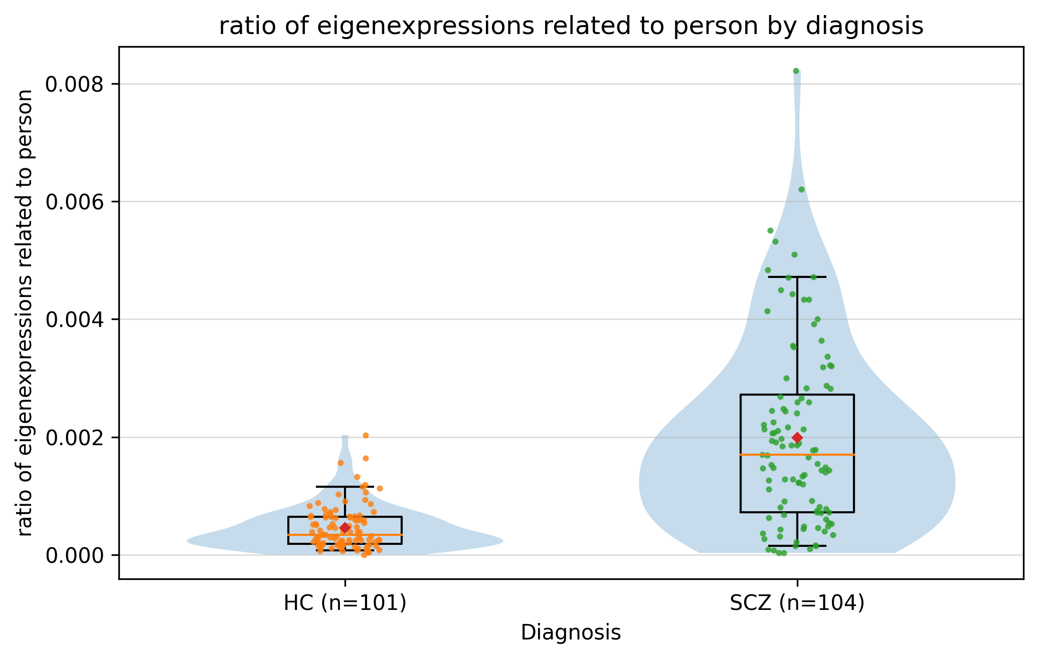
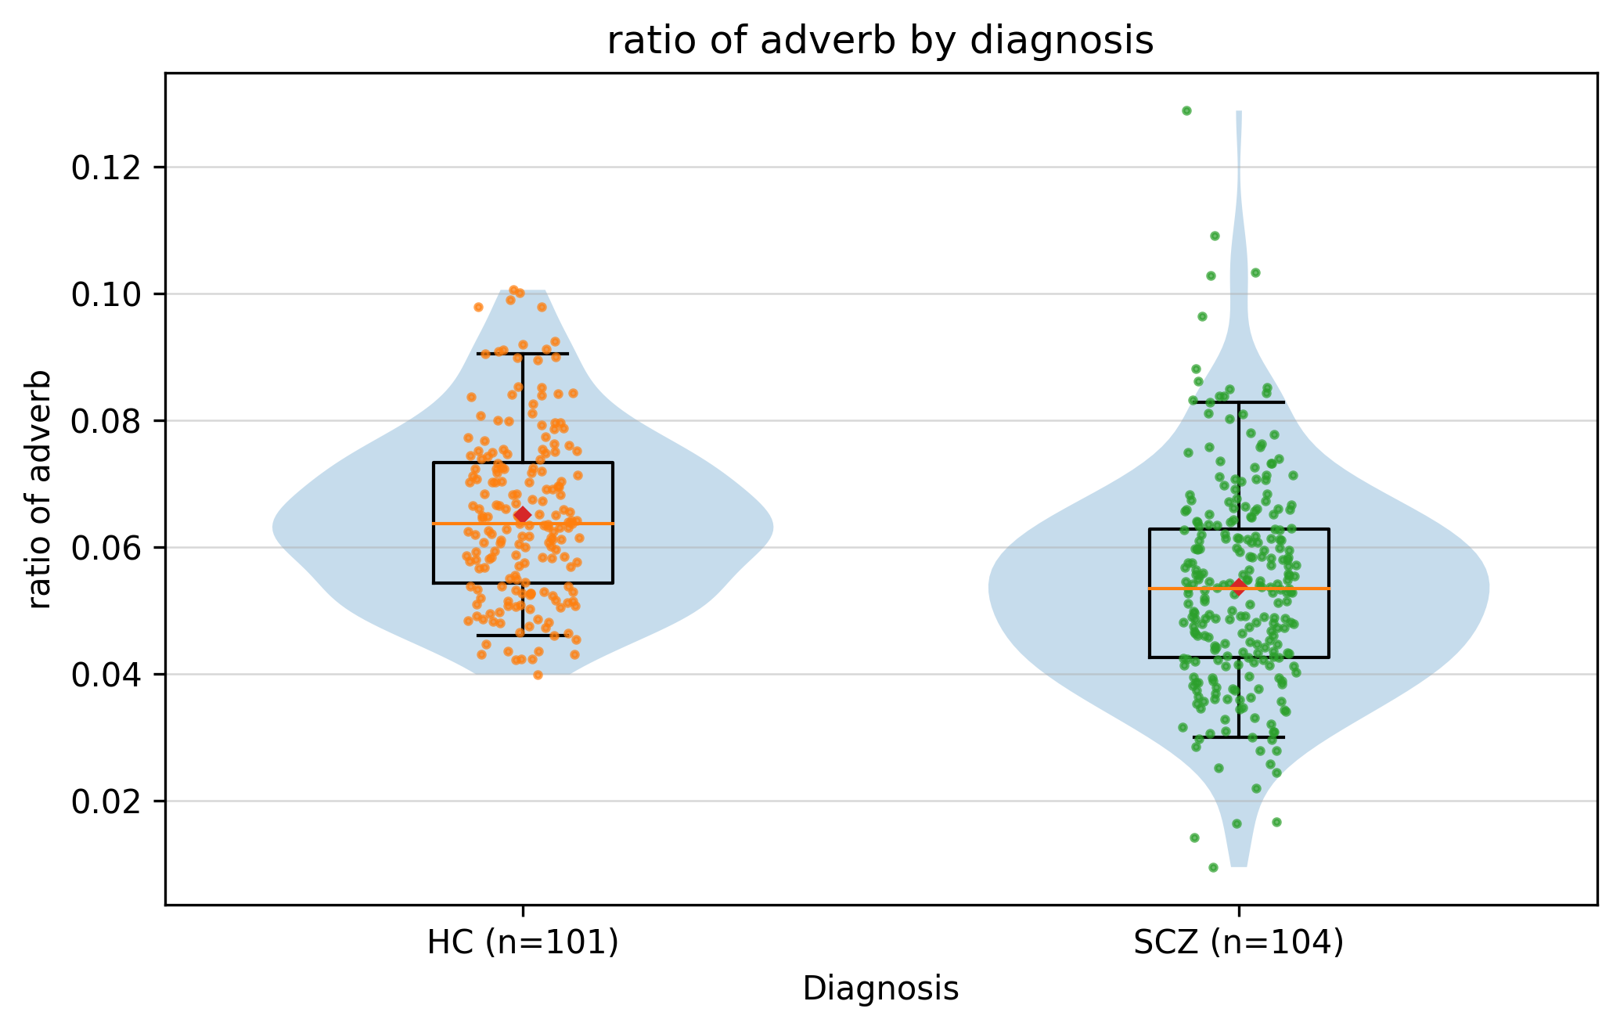
Results: Exploratory Analyses
Group differences in Task 1: Free conversation
Group Comparison (SCZ vs HC, univariate GEE): 35/76 features significant (FDR-corrected)
***
***
*** p < 0.001
*** p < 0.001
Notes:
[3. Our study]
In free conversation, 35 of the 76 features differed significantly after FDR correction, across all levels of language. Here are two examples: patients used more person-related named entities, and fewer adverbs. These exploratory results are descriptive only. They tell us that the abnormalities are widespread, but they do not tell us which ones are essential.

Slide 16
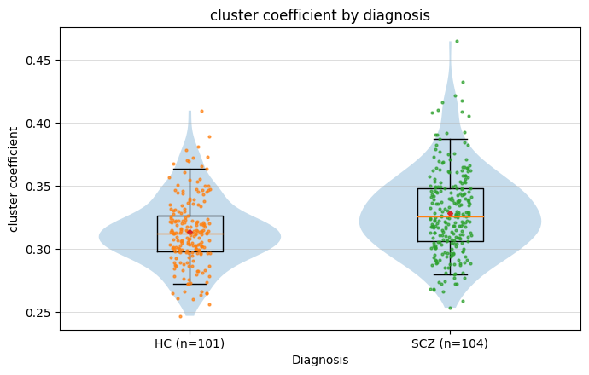
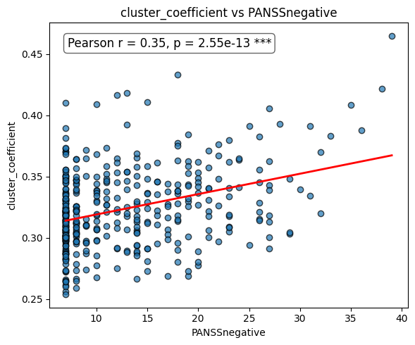
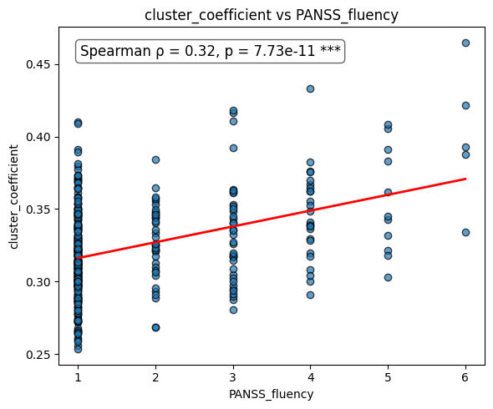
Results: Exploratory Analyses
Group differences in Task 1: Free conversation
The “cluster coefficient”, a semantic network feature, also reveals group differences and is correlated with the PANSS negative score and the Fluency of speech (PANSS subcale).
***
*** p < 0.001
Notes:
[3. Our study]
Semantic network measures also differed. The clustering coefficient was higher in patients, and it correlated with PANSS negative symptoms and with a PANSS item on the fluency of speech.

Slide 17
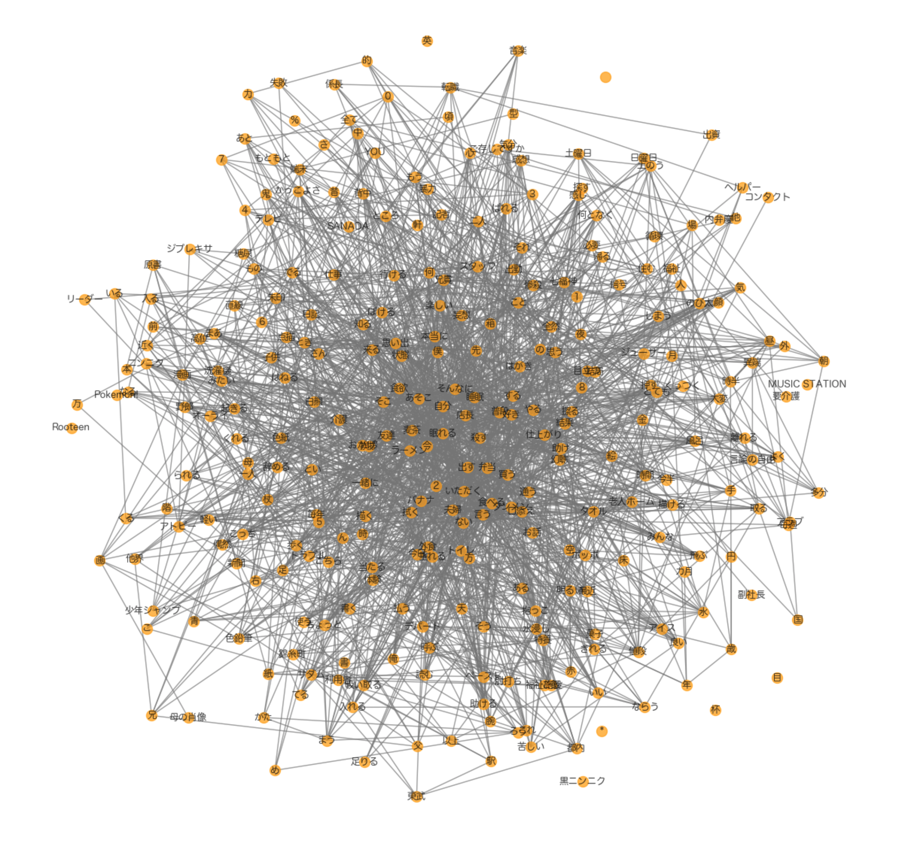
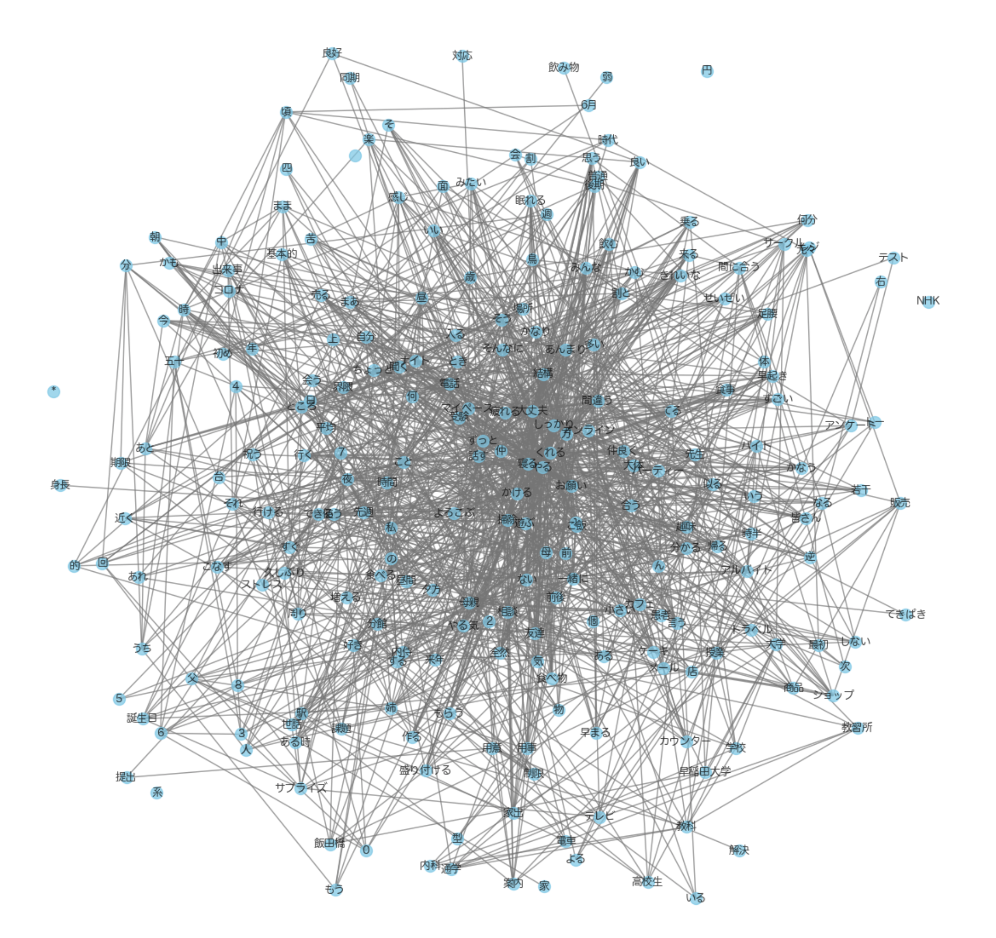
Semantic Network Analysis Using a TF-IDF Framework
Using the comprehensive UNDERPIN dataset, develop a Term Frequency–Inverse Document Frequency (TF-IDF) model, which calculates a measure of frequency and importance of a word in a document.
Extract the top 10% high-score (TF-IDF score) words from the subject’s speech.
Form graphs (Fig. 1) with content words as nodes; connect N=10 words exceeding the sth = 0.3 similarity threshold until fewer than N=10 remain (Utilize NetworkX in Python for graph creation).
Calculate the following indicators using network analysis methods: the cluster coefficient, the diameter, the average distance, and the average closeness centrality.
A subject with severe SCZ
A healthy control
Fig 1. Examples of Semantic Graphs
Notes:
[3. Our study]
Briefly, here is how these networks are built. Using TF-IDF, we pick each speaker's most characteristic content words, connect the words whose Word2Vec similarity exceeds a threshold, and compute graph measures such as the clustering coefficient, diameter, average distance, and closeness centrality. By eye, a patient's network and a control's network look similar, so we rely on the numbers. The idea behind this analysis is simple: if a speaker keeps returning to closely related words, the network becomes tight and clustered; if a speaker moves freely between topics, the network becomes wider.

Slide 18
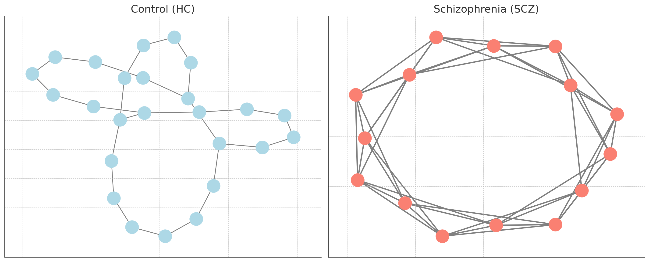
Summary of Results: Semantic Network Analysis
Group differences in Task 1: Free conversation
In schizophrenia
  ↑ increase: Cluster coefficient *, density *
  ↓ decrease: average distance *, diameter, average closeness centrality
Semantic Network in SCZ:
Semantic connections are too tightly linked both locally and globally, but this over-connectedness does not enhance information transfer efficiency.
Notes:
[3. Our study]
In schizophrenia, clustering and density increased, while average distance, diameter, and closeness centrality decreased. In other words, the semantic network is locally dense but globally poorly integrated: patients tend to stay within close semantic neighbourhoods and rarely travel to distant ones.

Slide 19
Methods: ANALYSIS PIPELINE
Feature Processing
76 NLP features per task & visit
Exploratory Analyses
Group comparisons (SCZ vs HC, univariate GEEs)
Ratio-defined(length adjusted), z-standardized(train set parameters)
Dimensionality Reduction
Exploratory factor analysis
Representative feature = largest absolute loading (adjusted for correlations/multicollinearity)
Validation (Training set)
Task-specific GEEs (Outcome: SCZ (1) vs HC (0))
Predictors: Representative features + age, sex
Predictive Evaluation (Test set)
AUC, sensitivity, specificity
All preprocessing & feature selection confined to training set
Results descriptive only (not used for final selection)
Notes:
[3. Our study]
With so many features differing, we asked which dimensions are truly essential. To answer this in an interpretable way, we reduced the features with factor analysis.

Slide 20
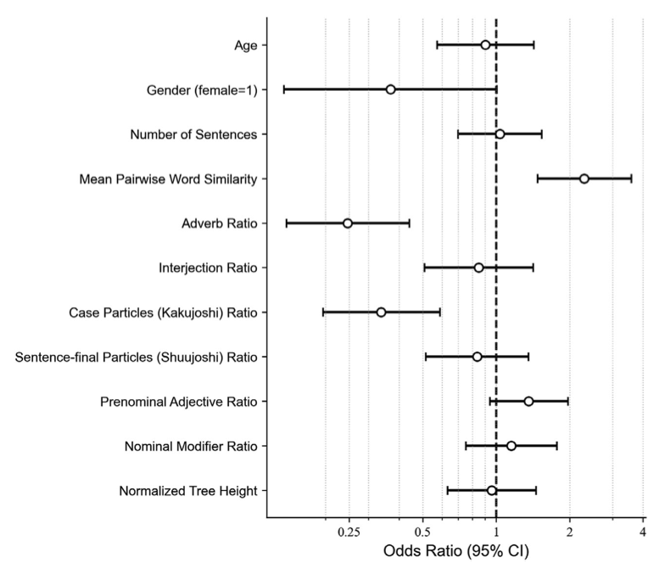
Result: Factor analysis & GEE (Task 1)
Robust Factor Structure and Diagnostic Performance
Nine-factor solution identified; nine representative features retained (all VIF < 3).
SCZ was associated with higher mean pairwise word similarity and lower case-particle and adverb ratios.
GEE model showed strong independent-set discrimination: AUC 0.87 (95% CI, 0.74–0.97; permutation p < 0.001).
Notes:
[3. Our study]
In free conversation, factor analysis gave a stable nine-factor solution, and we kept one representative feature per factor, with low collinearity. In the multivariable GEE model, three features remained significant. First, higher mean pairwise word similarity: a one-standard-deviation increase was associated with about a 2.3-fold increase in the odds of schizophrenia. Second and third, lower ratios of case particles and adverbs. In Japanese, case particles such as ga, o, and ni mark who did what to whom. In the independent test set, the model reached an AUC of 0.87, with a sensitivity of 0.76 and a specificity of 0.90. Notably, among the major parts of speech, only adverbs were significantly reduced, not nouns, verbs, or adjectives. In Japanese, adverbs modify not only verbs but whole sentences, adding manner, degree, and the speaker's stance.

Slide 21
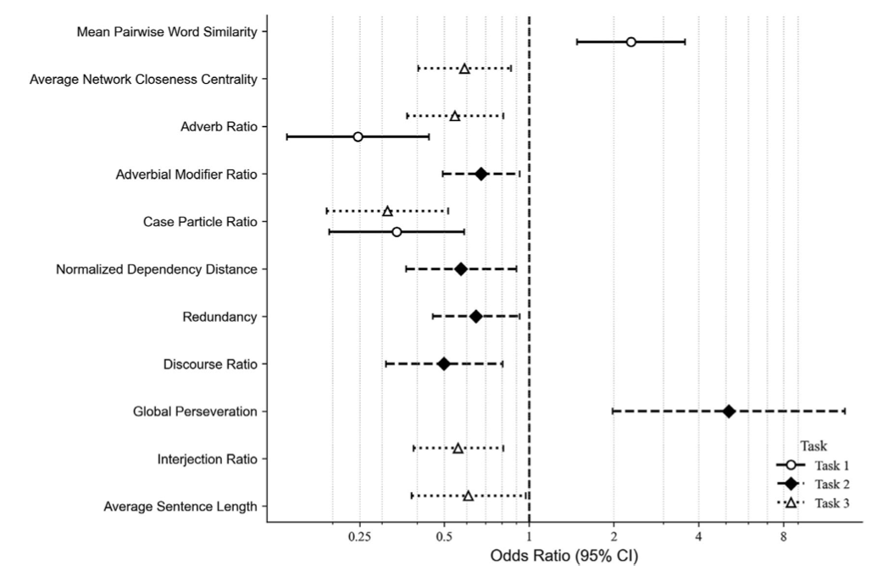
Result: Comparison of Tasks
Cross-Task Comparison of Speech Features
Adverbial, semantic-network, case-particle, and discourse features showed diagnostic relevance across tasks.
Adverb Ratio was cross-task consistent but task-dependent, with the strongest effect in free conversation (qPC = 0.021; interaction p < 0.001).
Case Particle (Kakujoshi) Ratio showed robust, task-invariant syntactic simplification (qPC = 0.014); age and sex were non-significant.
Notes:
[3. Our study]
We then applied the same pipeline to storytelling and picture description. Adverbial features were significant in every task, and case particles were reduced in a task-invariant way. Semantic-network and discourse features also contributed across tasks. Interestingly, perseveration was strongly elevated in storytelling, mirroring the clinical phenomenon of perseveration. Sensitivity analyses showed that the adverb effect was strongest in free conversation, whereas the reduction in case particles did not depend on the task. This suggests that case-particle reduction reflects a stable, task-general simplification, while reduced modification is most visible when speech is spontaneous.

Slide 22
Discussion
Core interpretation: Our findings suggest a tripartite linguistic phenotype of reduced morphosyntactic explicitness, constrained semantic exploration, and weakened contextual modulation. These separable but interacting dimensions extend beyond the positive–negative FTD dichotomy.
Language typology: Japanese’s broad adverbial functions and segmentable grammatical markers may increase the detectability of these disturbances. Convergence with Turkish suggests shared vulnerabilities whose expression depends on language typology.
Semantic networks: Locally dense but globally less integrated networks suggest restricted movement across distant semantic domains. This pattern parallels neuroimaging findings (Hayashi et al., 2024; Matsumoto et al., 2023) and may contribute to tangential, perseverative, or impoverished speech.
Limitations and future: Findings characterize established, predominantly mild–moderate SCZ rather than predict onset. Cross-linguistic, longitudinal, and multimodal studies, alongside direct cognitive, functional, and FTD assessments, are needed to test these interpretations.
Notes:
[3. Our study]
Taken together, we propose a tripartite linguistic phenotype of schizophrenia. First, reduced morphosyntactic explicitness: fewer case particles, so less overt marking of who did what to whom. Second, semantic narrowing: words drawn from close neighbourhoods. Third, weakened contextual modulation: fewer adverbs, which add manner, degree, and nuance. These dimensions are separable but interacting, and they go beyond the positive-negative dichotomy of thought disorder. Similar findings in Turkish, another agglutinative language, suggest shared vulnerabilities whose expression depends on language type, and the semantic findings parallel neuroimaging studies of network integration. Clinically, these markers are simple, interpretable, and related to PANSS severity, so they could serve as accessible proxies of illness burden. But these interpretations remain hypotheses that need to be tested with cognitive and functional measures.

Slide 23
Mapping the Field
Interpretable × longitudinal
Repeated remote speech tasks; relapse and treatment-response monitoring
Large models × longitudinal
Multimodal monitoring (voice, language, wearables); conversational AI agents
Five trends
Single feature → multidimensional
English → cross-linguistic
Lab interview → smartphone & remote
Text only → voice, language & wearables
Handcrafted features → large language models
Next step
Cross-sectional diagnosis → longitudinal care
Interpretable × cross-sectional
Speech graphs, LSA coherence, semantic density; our multilevel phenotype
Large models × cross-sectional
Fine-tuned BERT classifiers; LLM-based symptom rating
Our study
Interpretable features → large models
Notes:
[4. Trends and the map]
Let me step back and place this work on a map of the field. The horizontal axis runs from interpretable features to large models; the vertical axis runs from cross-sectional diagnosis to longitudinal monitoring and intervention. Our study sits here: interpretable and cross-sectional. The field is moving up and to the right: from single features to multidimensional profiles, from English to many languages, from the laboratory to smartphones, from text to multimodal data including voice and wearables, as Dr. Liang has just shown, and from handcrafted features to large language models. Our own next step is upward: longitudinal monitoring with the same interpretable markers.

Slide 24
Limitations: What Is Missing
Sample composition
  Only schizophrenia patients (no clinical high-risk group)
Severity
  Mean PANSS total = 63.3 → mostly mild to moderate cases
  More severe cases might show additional abnormalities
Language & generalizability
  Data in Japanese (agglutinative language)
  Need cross-linguistic validation for broader applicability
Speech modality
  Written data may better capture semantic coherence
Notes:
[5. Prospects and challenges]
Before moving to the clinic, we must be honest about what is still missing. Our sample had established, mostly mild to moderate illness, with no clinical high-risk group, so we cannot predict onset. All data were in Japanese, so cross-linguistic validation is needed. We relied on PANSS rather than dedicated thought-disorder scales, and on spoken language only. Finally, our semantic measures were based on a single Word2Vec model trained on Wikipedia, so they should be replicated with other embeddings, including transformer-based models.

Slide 25
Promise and Peril
Promise
Peril
• Objective, reproducible severity assessment
• Early warning of relapse
• Tracking treatment response
• Continuous monitoring between visits
• Less inter-rater variability; scalable screening
• Privacy: voice and words identify the person
• Consent, a sense of surveillance, loss of trust
• Bias across languages, dialects, education, culture
• Opacity of large models; hallucination
• Overdiagnosis, labelling, automation bias
• Generative AI echoing or reinforcing delusional content
Language data are intimate data: the signal that informs care can also expose the person.
Notes:
[5. Prospects and challenges]
So, what are the promises and the perils? On the promise side: objective assessment of severity, early warning of relapse, tracking of treatment response, continuous monitoring between visits, and less variability between raters. On the peril side: voice and words can identify a person, so privacy is critical, and patients may feel watched. Models can be biased across languages, dialects, and levels of education. Large models are opaque and can hallucinate, and generative AI may even echo or reinforce delusional content. There is also a risk of overdiagnosis, and of clinicians trusting the machine too much. Language data are intimate data: the same signal that informs care can also expose the person. In psychiatry this matters even more, because the content of speech is often about the most private parts of a person's life: their fears, their beliefs, and their relationships.

Slide 26
Toward Responsible Use
Goal: AI that augments, not replaces, clinical understanding
Evidence
Ethics & governance
Clinical integration
• External and cross-linguistic validation
• Longitudinal, prospective designs
• Clinical high-risk cohorts
• Links to function, cognition, and thought-disorder scales
• Privacy by design; de-identification
• Informed, revocable consent
• Bias audits across groups
• Transparency and explainability
• Alignment with medical-device and AI regulation
• Human-in-the-loop decisions
• Education for clinicians and patients
• Patients and families in tool design
• Judge benefit to care, not AUC alone
Notes:
[5. Prospects and challenges]
Responsible implementation rests on three pillars. Evidence: external, cross-linguistic, longitudinal, and prospective validation, including high-risk cohorts and links to real-world function. Ethics and governance: privacy by design, consent that can be withdrawn, audits for bias, transparency, and alignment with medical-device and AI regulations. And clinical integration: humans stay in the loop, clinicians and patients are educated, patients and families help design the tools, and success is measured by benefit to care, not by AUC alone.

Slide 27
Conclusion: Take-Home Messages
1
Language is a clinical interface
NLP turns everyday speech into measurable, interpretable markers of psychopathology.
2
A tripartite linguistic phenotype of schizophrenia
Fewer case particles, semantic narrowing, and fewer adverbs: AUC 0.87 in free conversation, consistent across tasks.
3
Responsible AI: augment, not replace
Validation, privacy, fairness, and human responsibility come before clinical use.
Thank you to the UNDERPIN participants and collaborating institutions, Prof. Taishiro Kishimoto, Prof. Hidehiko Takahashi, and Dr. Yoshinobu Kano.
Notes:
[6. Conclusion]
To conclude, I have three messages. First, language is a clinical interface, and NLP can turn it into measurable, interpretable markers. Second, in Japanese speech, schizophrenia shows a tripartite phenotype, with fewer case particles, semantic narrowing, and fewer adverbs, giving strong discrimination and cross-task consistency. Third, the path to the clinic runs through validation and responsibility: AI should augment, not replace, clinical understanding, the therapeutic relationship, and human responsibility. Thank you for your attention.

