Slide 1
Mcalibrator2
Display Calibration Results
181003

Slide 2
Parameters
colorimeter : Admesy Brontes-LL (32bit)
Sampling : 32
Interval : equally spaced
Repetition : 3 (mean)
Flare Correction: 1
Fitting Model : Gain-offset-gamma

Slide 3
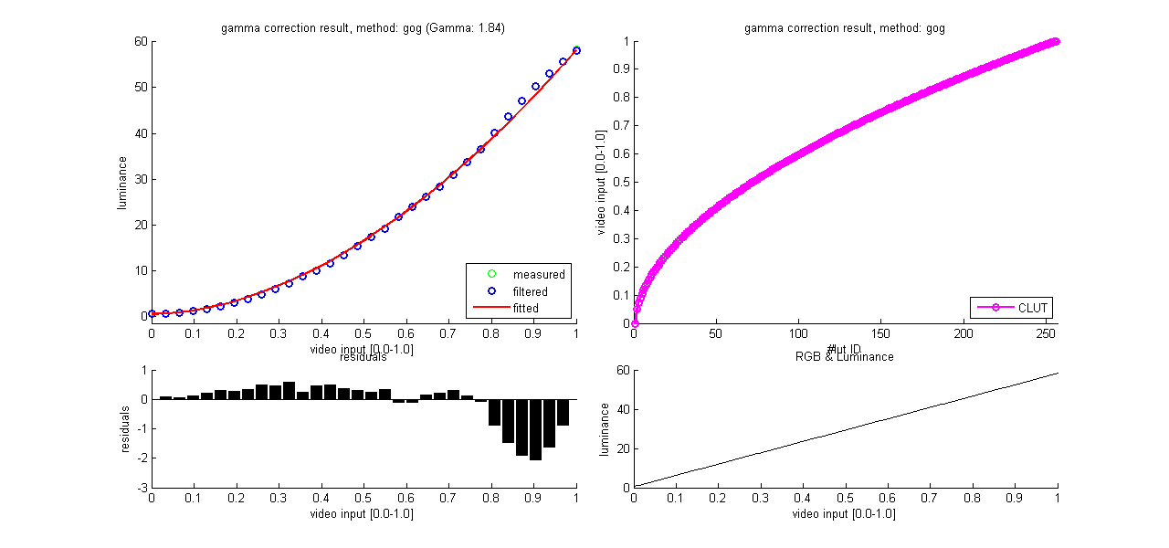
red

Slide 4
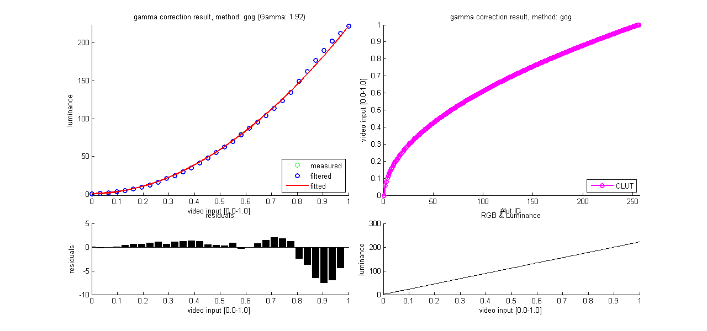
green

Slide 5
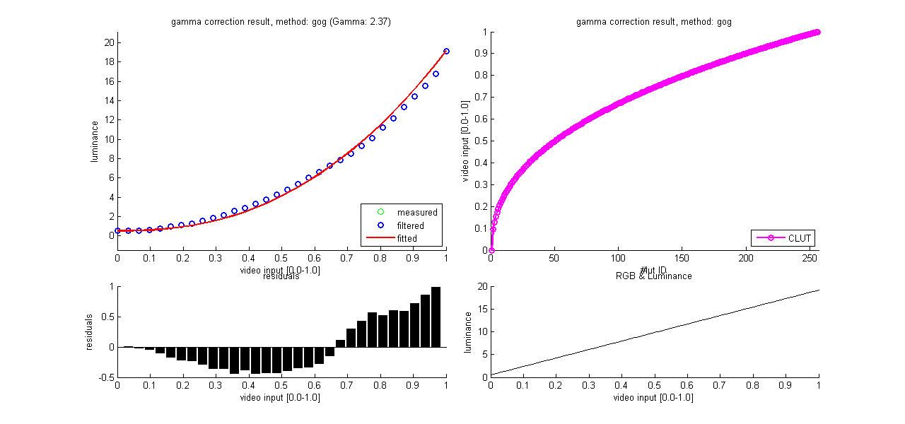
blue

Slide 6
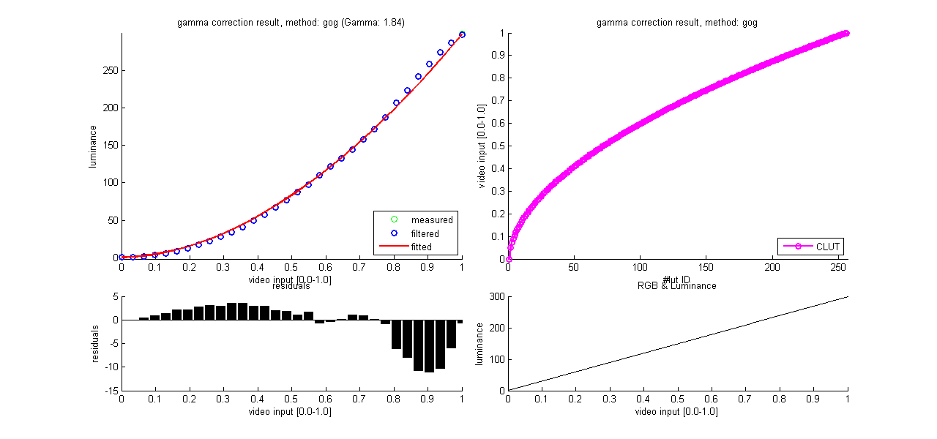
gray

