Slide 1
Chapter 8 Inference for Proportions Clicker Questions
Introduction to the Practice of Statistics Tenth Edition David S. Moore George P. McCabe Bruce Craig

Slide 2
8.1-1
The correct rule for proportions is that we can create confidence intervals for p if
a. n is at least 10.
b. there are at least 15 successes and 15 failures.
c. n ≥ 30.

Slide 3
8.1-1 answer
The correct rule for proportions is that we can create confidence intervals for p if
a. n is at least 10.
b. there are at least 15 successes and 15 failures. (correct)
c. n ≥ 30.

Slide 4
8.1-2
In a sample of 20 items, I found six to be defective. In constructing a confidence interval for the proportion of defectives, I should use
a. the plus four method.
b. the large-sample interval.
c. neither of these.

Slide 5
8.1-2 answer
In a sample of 20 items, I found six to be defective. In constructing a confidence interval for the proportion of defectives, I should use
a. the plus four method. (correct)
b. the large-sample interval.
c. neither of these.
The sample size is larger than 10, but there are fewer than 10 defectives, so the plus four method will be best.

Slide 6
8.1-3
It was found that in a sample of 75 students, 55 of them had cell phones. The margin of error for a 95% confidence interval estimate for the proportion of all students with cell phones is
a. 0.084.
b. (0.633, 0.833).
c. 0.100.

Slide 7
8.1-3 answer
It was found that in a sample of 75 students, 55 of them had cell phones. The margin of error for a 95% confidence interval estimate for the proportion of all students with cell phones is
a. 0.084.
b. (0.633, 0.833).
c. 0.100. (correct)

Slide 8
8.1-4
Suppose a sample of 155 students at a university were asked their grade in statistics, and 21 said they made A’s. Is the use of the Normal approximation justified in this case?
a. Yes, because successes and failures are both more than 10.
b. Yes, because the total sample size is greater than 30.
c. No, because the number of successes is less than 30.

Slide 9
8.1-4 answer
Suppose a sample of 155 students at a university were asked their grade in statistics, and 21 said they made A’s. Is the use of the Normal approximation justified in this case?
a. Yes, because successes and failures are both more than 10. (correct)
b. Yes, because the total sample size is greater than 30.
c. No, because the number of successes is less than 30.

Slide 10
8.1-5
It is thought that 12% of all students taking a particular course received a grade of A. In a sample of 155 students, it is found that 21 made an A. What is the test statistic for testing whether the true proportion is 12%?
a. 0.53
b. 0.01
c. 0.59

Slide 11
8.1-5 answer
It is thought that 12% of all students taking a particular course received a grade of A. In a sample of 155 students, it is found that 21 made an A. What is the test statistic for testing whether the true proportion is 12%?
a. 0.53
b. 0.01
c. 0.59 (correct)

Slide 12
8.1-6
You buy a package of 122 Smarties and 19 of them are red. What is a 95% confidence interval for the true proportion of red Smarties?
a. (0.092, 0.220)
b. (0.103, 0.230)
c. (0.085, 0.199)

Slide 13
8.1-6 answer
You buy a package of 122 Smarties and 19 of them are red. What is a 95% confidence interval for the true proportion of red Smarties?
a. (0.092, 0.220) (correct)
b. (0.103, 0.230)
c. (0.085, 0.199)

Slide 14
8.1-7
We want to construct a 95% confidence interval for the true proportion of all adult males who have spent time in prison, with a margin of error of 0.02. From previous studies, we believe the proportion to be somewhere around 0.07. The required sample size is therefore
a. 620.
b. 626.
c. 632.

Slide 15
8.1-7 answer
We want to construct a 95% confidence interval for the true proportion of all adult males who have spent time in prison, with a margin of error of 0.02. From previous studies, we believe the proportion to be somewhere around 0.07. The required sample size is therefore
a. 620.
b. 626. (correct)
c. 632.

Slide 16
8.1-8
In a sample of 446 students, 246 ate breakfast. Can we conclude that more than 50% of all students eat breakfast?
We will test H₀: p = 0.50 versus H_{a}: p > 0.50.
What is the value of the test statistic?
a. 2.18
b. 5.62
c. 2.31

Slide 17
8.1-8 answer
In a sample of 446 students, 246 ate breakfast. Can we conclude that more than 50% of all students eat breakfast?
We will test H₀: p = 0.50 versus H_{a}: p > 0.50.
What is the value of the test statistic?
a. 2.18 (correct)
b. 5.62
c. 2.31

Slide 18
8.1-9
In a sample of 446 students, 246 ate breakfast. Can we conclude that more than 50% of all students eat breakfast?
We will test H₀: p = 0.50 versus H_{a}: p > 0.50.
What is the p-value of the test?
a. 0.0174
b. 0.1765
c. 0.2876

Slide 19
8.1-9 answer
In a sample of 446 students, 246 ate breakfast. Can we conclude that more than 50% of all students eat breakfast?
We will test H₀: p = 0.50 versus H_{a}: p > 0.50.
What is the p-value of the test?
a. 0.0174 (correct)
b. 0.1765
c. 0.2876

Slide 20
8.1-10
An article about a new drug stated that “the incidence of side effects was similar to placebo, P-value > 0.05.”
What should we conclude?
a. We should reject the null hypothesis of no difference at 10%.
b. We should not reject the null hypothesis of no difference at 10%.
c. There is not enough information given.

Slide 21
8.1-10 answer
An article about a new drug stated that “the incidence of side effects was similar to placebo, P-value > 0.05.”
What should we conclude?
a. We should reject the null hypothesis of no difference at 10%.
b. We should not reject the null hypothesis of no difference at 10%.
c. There is not enough information given. (correct)
We know the P-value is more than 5%, but we do not know how much more. Without the actual P-value for the test, we cannot make a determination.

Slide 22
8.1-11
A sample of 42 parts from an assembly line are checked, and four are found to be defective. Find a 90% confidence interval for the true proportion of defectives.
a. (0.021, 0.170)
b. (0.019, 0.155)
c. (0.049, 0.212)

Slide 23
8.1-11 answer
A sample of 42 parts from an assembly line are checked, and four are found to be defective. Find a 90% confidence interval for the true proportion of defectives.
a. (0.021, 0.170)
b. (0.019, 0.155)
c. (0.049, 0.212) (correct)
Use the plus four estimate …

Slide 24
8.1-12
Drug-sniffing dogs must be 95% accurate. A new dog is being tested and is right in 46 of 50 trials. Find a 95% confidence interval for the proportion of times the dog will be correct.
a. (0.845, 0.995)
b. (0.805, 0.973)
c. (0.819, 0.959)

Slide 25
8.1-12 answer
Drug-sniffing dogs must be 95% accurate. A new dog is being tested and is right in 46 of 50 trials. Find a 95% confidence interval for the proportion of times the dog will be correct.
a. (0.845, 0.995)
b. (0.805, 0.973) (correct)
c. (0.819, 0.959)
Use the plus four estimate …

Slide 26
8.1-13
A poll finds that 54% of the 600 people polled favor the incumbent. Shortly after the poll is taken, it is disclosed that he had an extramarital affair. A new poll finds that 50% of the 1030 polled now favor the incumbent.
The standard error for a confidence interval for the candidate’s latest support level is
a. 0.016.
b. 0.020.
c. 0.025.

Slide 27
8.1-13 answer
A poll finds that 54% of the 600 people polled favor the incumbent. Shortly after the poll is taken, it is disclosed that he had an extramarital affair. A new poll finds that 50% of the 1030 polled now favor the incumbent.
The standard error for a confidence interval for the candidate’s latest support level is
a. 0.016. (correct)
b. 0.020.
c. 0.025.

Slide 28
8.1-14
A sample of 425 products off an assembly line are checked, and 21 are found to be defective. The margin of error for a 95% confidence interval for the proportion of defectives is
a. 0.021.
b. 0.011.
c. 0.001.

Slide 29
8.1-14 answer
A sample of 425 products off an assembly line are checked, and 21 are found to be defective. The margin of error for a 95% confidence interval for the proportion of defectives is
a. 0.021. (correct)
b. 0.011.
c. 0.001.

Slide 30
8.1-15
In a random sample of 600 television viewers contacted by phone in a certain suburban area, 210 were watching the movie on Channel 12. Give a 95% confidence interval for the total proportion of viewers watching the movie.
a. (0.31, 0.39)
b. (0.32, 0.38)
c. (0.34, 0.36)

Slide 31
8.1-15 answer
In a random sample of 600 television viewers contacted by phone in a certain suburban area, 210 were watching the movie on Channel 12. Give a 95% confidence interval for the total proportion of viewers watching the movie.
a. (0.31, 0.39) (correct)
b. (0.32, 0.38)
c. (0.34, 0.36)

Slide 32
8.2-1
Suppose you want to know which of two manufacturing methods is better. You create 10 prototypes using the first process and 10 using the second. There are three defectives in the first batch and five in the second.
A 90% confidence interval for the difference in the two proportions is
(–0.493, 0.159). What conclusion should you make about the two manufacturing processes?
a. The first method is better.
b. The second method is better.
c. The two methods may be equivalent.

Slide 33
8.2-1 answer
Suppose you want to know which of two manufacturing methods is better. You create 10 prototypes using the first process and 10 using the second. There are three defectives in the first batch and five in the second.
A 90% confidence interval for the difference in the two proportions is
(–0.493, 0.159). What conclusion should you make about the two manufacturing processes?
a. The first method is better.
b. The second method is better.
c. The two methods may be equivalent. (correct)

Slide 34
8.2-2
You want to know which of two manufacturing methods is better. You create 10 prototypes using the first process and 10 using the second. There are three defectives in the first batch and five in the second.
Find a 95% confidence interval for the difference in the proportion of defectives.
a. (–0.62, 0.22)
b. (–0.56, 0.22)
c. (–0.493, 0.160)

Slide 35
8.2-2 answer
You want to know which of two manufacturing methods is better. You create 10 prototypes using the first process and 10 using the second. There are three defectives in the first batch and five in the second.
Find a 95% confidence interval for the difference in the proportion of defectives.
a. (–0.62, 0.22)
b. (–0.56, 0.22) (correct)
c. (–0.493, 0.160)
The numbers of trials and defectives are small, so we should use the plus four estimates, where we add two trials to each sample and one defective to each sample.

Slide 36
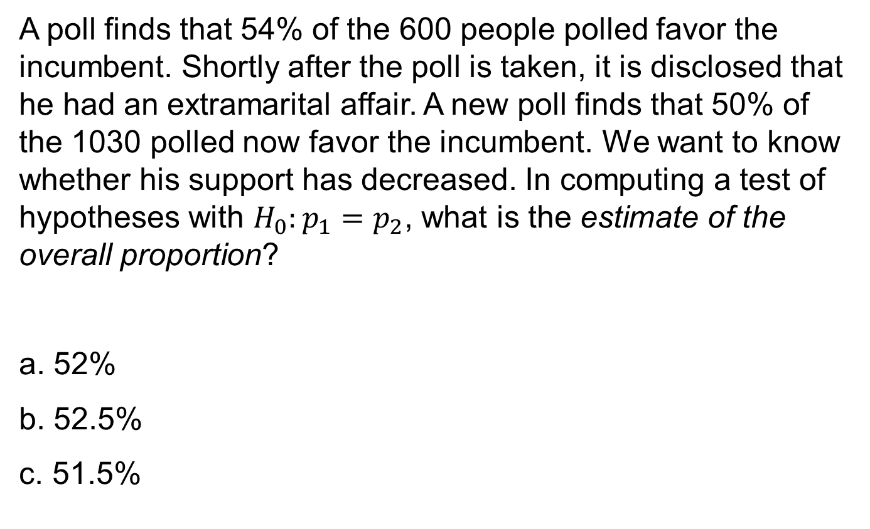
8.2-3
A poll finds that 54% of the 600 people polled favor the incumbent. Shortly after the poll is taken, it is disclosed that he had an extramarital affair. A new poll finds that 50% of the 1030 polled now favor the incumbent. We want to know whether his support has decreased. In computing a test of hypotheses with $H_{0}:p_{1}=p_{2}$, what is the estimate of the overall proportion?
a. 52%
b. 52.5%
c. 51.5%

Slide 37
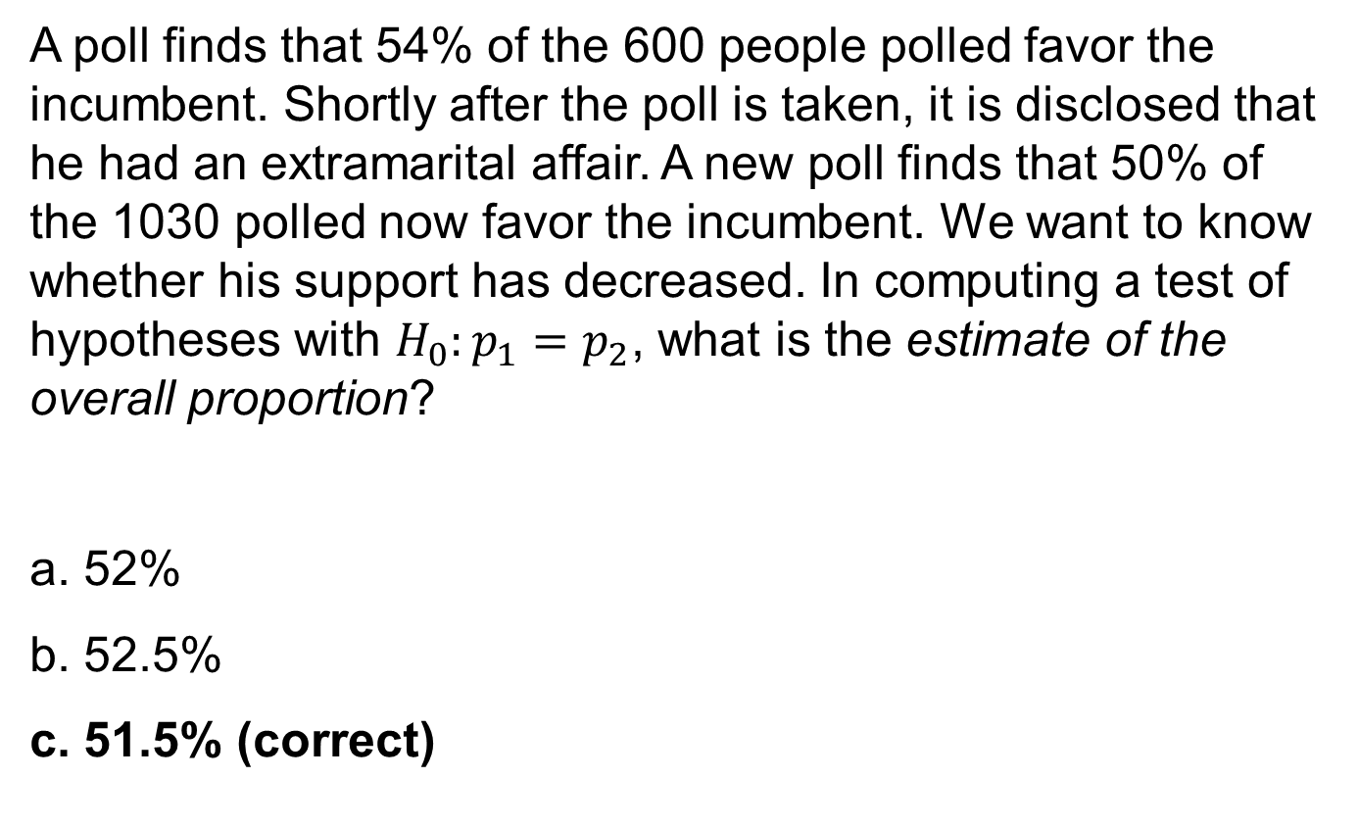
8.2-3 answer
A poll finds that 54% of the 600 people polled favor the incumbent. Shortly after the poll is taken, it is disclosed that he had an extramarital affair. A new poll finds that 50% of the 1030 polled now favor the incumbent. We want to know whether his support has decreased. In computing a test of hypotheses with $H_{0}:p_{1}=p_{2}$, what is the estimate of the overall proportion?
a. 52%
b. 52.5%
c. 51.5% (correct)

Slide 38
8.2-4
A poll finds that 54% of the 600 people polled favor the incumbent. Shortly after the poll is taken, it is disclosed that he had an extramarital affair. A new poll finds that 50% of the 1030 polled now favor the incumbent.
We want to know whether his support has decreased. The test statistic is
a. z = 1.56.
b. z = –2.57.
c. z = –1.55.

Slide 39
8.2-4 answer
A poll finds that 54% of the 600 people polled favor the incumbent. Shortly after the poll is taken, it is disclosed that he had an extramarital affair. A new poll finds that 50% of the 1030 polled now favor the incumbent.
We want to know whether his support has decreased. The test statistic is
a. z = 1.56. (correct)
b. z = –2.57.
c. z = –1.55.

Slide 40
8.2-5
Based on surveys conducted in 1989 and 1999, a researcher compared the proportion of high-school-age females interested in a career in science in 1989 with the proportion in 1999.
He concluded that the proportions were not significantly different at the α = 0.05 level because the P-value was 0.121. Assuming that the surveys were simple random samples from the appropriate populations, we may conclude
a. that the probability of observing a difference at least as large as that observed by the researcher if, in fact, the two proportions were equal is 0.121.
b. that in repeated sampling, the researcher would obtain the difference actually observed in approximately 12.1% of the samples.
c. very little. Without knowing whether the observed difference is practically significant, we cannot assess whether the results are statistically significant.

Slide 41
8.2-5 answer
Based on surveys conducted in 1989 and 1999, a researcher compared the proportion of high-school-age females interested in a career in science in 1989 with the proportion in 1999.
He concluded that the proportions were not significantly different at the α = 0.05 level because the P-value was 0.121. Assuming that the surveys were simple random samples from the appropriate populations, we may conclude
a. that the probability of observing a difference at least as large as that observed by the researcher if, in fact, the two proportions were equal is 0.121. (correct)
b. that in repeated sampling, the researcher would obtain the difference actually observed in approximately 12.1% of the samples.
c. very little. Without knowing whether the observed difference is practically significant, we cannot assess whether the results are statistically significant.

Slide 42
8.2-6
A psychologist claims she has developed a cognitive-therapy program that is more effective in helping smokers quit smoking than other currently available programs. In particular, she claims that her program is more effective than the nicotine patch, which is widely used by smokers trying to quit.
A sample of 75 adult smokers who had indicated a desire to quit were located. The subjects were randomized into two groups. The cognitive-therapy program was administered to the 38 smokers in the first group, and the 37 smokers in the second group used the nicotine patch. After a period of 1 year, each subject indicated whether he or she had successfully quit smoking.
In the therapy group, 22 people said they had quit smoking, and 17 people who used the patch said they had quit. What is the value of the test statistic for this claim?
a. 1.04
b. 1.14
c. 1.24

Slide 43
8.2-6 answer
A psychologist claims she has developed a cognitive-therapy program that is more effective in helping smokers quit smoking than other currently available programs. In particular, she claims that her program is more effective than the nicotine patch, which is widely used by smokers trying to quit.
A sample of 75 adult smokers who had indicated a desire to quit were located. The subjects were randomized into two groups. The cognitive-therapy program was administered to the 38 smokers in the first group, and the 37 smokers in the second group used the nicotine patch. After a period of 1 year, each subject indicated whether he or she had successfully quit smoking.
In the therapy group, 22 people said they had quit smoking, and 17 people who used the patch said they had quit. What is the value of the test statistic for this claim?
a. 1.04 (correct)
b. 1.14
c. 1.24

Slide 44
8.2-7
A nutritionist wants to determine whether males consume more calcium than females. Of the 180 males in her sample, 99 indicated that they consumed the recommended daily intake of calcium, compared with 232 of the 320 females.
The nutritionist wants to test whether the proportions of males and females who consume the recommended daily intake of calcium are the same. What null and alternative hypotheses should the nutritionist establish?
a. H₀: p_{f} = p_{m} vs. H_{a}: p_{f} > p_{m}
b. H₀: p_{f} = p_{m} vs. H_{a}: p_{f} < p_{m}
c. H₀: p_{f} < p_{m} vs. H_{a}: p_{f} = p_{m}

Slide 45
8.2-7 answer
A nutritionist wants to determine whether males consume more calcium than females. Of the 180 males in her sample, 99 indicated that they consumed the recommended daily intake of calcium, compared with 232 of the 320 females.
The nutritionist wants to test whether the proportions of males and females who consume the recommended daily intake of calcium are the same. What null and alternative hypotheses should the nutritionist establish?
a. H₀: p_{f} = p_{m} vs. H_{a}: p_{f} > p_{m}
b. H₀: p_{f} = p_{m} vs. H_{a}: p_{f} < p_{m} (correct)
c. H₀: p_{f} < p_{m} vs. H_{a}: p_{f} = p_{m}

Slide 46
8.2-8
A nutritionist wants to determine whether males consume more calcium than females. Of the 180 males in her sample, 99 indicated they consumed the recommended daily intake of calcium, compared with 232 of the 320 females.
What is the absolute value of the test statistic?
a. 8.27
b. 8.14
c. 3.97

Slide 47
8.2-8 answer
A nutritionist wants to determine whether males consume more calcium than females. Of the 180 males in her sample, 99 indicated they consumed the recommended daily intake of calcium, compared with 232 of the 320 females.
What is the absolute value of the test statistic?
a. 8.27
b. 8.14
c. 3.97 (correct)

Slide 48
8.2-9
We are interested in determining whether a new treatment has a higher success probability than a standard treatment.
150 people are given the new treatment, and 100 are given the standard. What are the null and alternative hypotheses?
a. H₀: p_{n} = p_{s} vs. H_{a}: p_{n} < p_{s}
b. H₀: p_{n} = p_{s} vs. H_{a}: p_{n} > p_{s}
c. H₀: p_{n} < p_{s} vs. H_{a}: p_{n} = p_{s}

Slide 49
8.2-9 answer
We are interested in determining whether a new treatment has a higher success probability than a standard treatment.
150 people are given the new treatment, and 100 are given the standard. What are the null and alternative hypotheses?
a. H₀: p_{n} = p_{s} vs. H_{a}: p_{n} < p_{s}
b. H₀: p_{n} = p_{s} vs. H_{a}: p_{n} > p_{s (correct)}
c. H₀: p_{n} < p_{s} vs. H_{a}: p_{n} = p_{s}

Slide 50
8.2-10
There is interest in determining whether a new treatment has a higher success probability than a standard treatment.
150 people are given the new treatment (115 successes), and 100 are given the standard treatment (65 successes). What is the value of the test statistic?
a. 1.41
b. 2.01
c. 1.96

Slide 51
8.2-10 answer
There is interest in determining whether a new treatment has a higher success probability than a standard treatment.
150 people are given the new treatment (115 successes), and 100 are given the standard treatment (65 successes). What is the value of the test statistic?
a. 1.41
b. 2.01 (correct)
c. 1.96

