Slide 1
Review 4
From Part2-2, Conditional Probability
Bayes Theorem
Random Variable

Slide 2
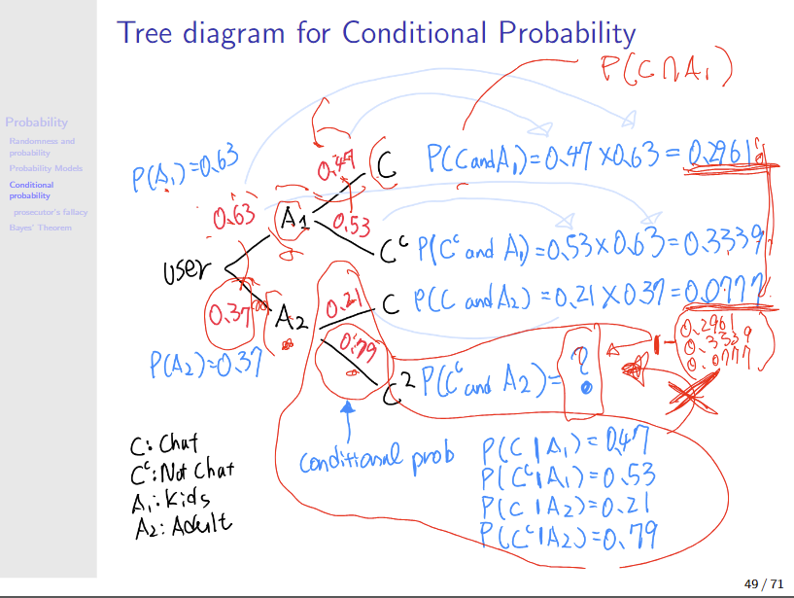

Slide 3
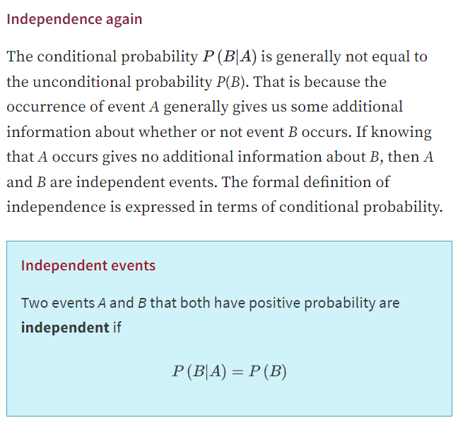

Slide 4
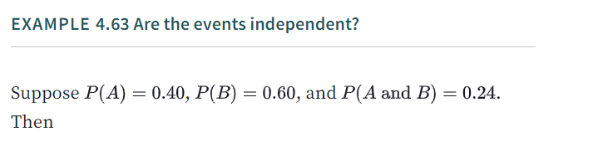
Are A and B independent?

Slide 5
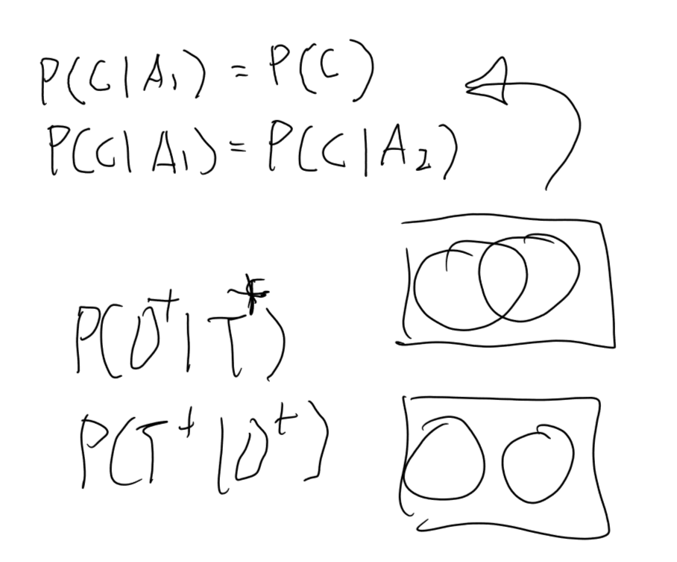
Independence

Slide 6
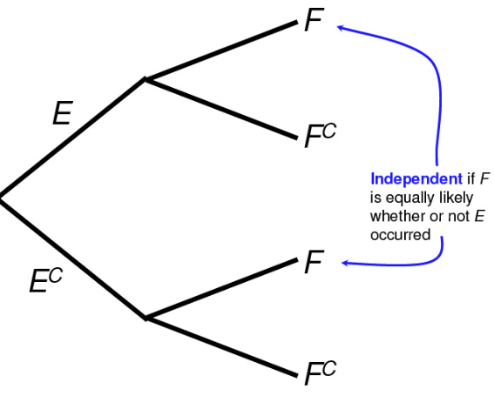
Independence

Slide 7
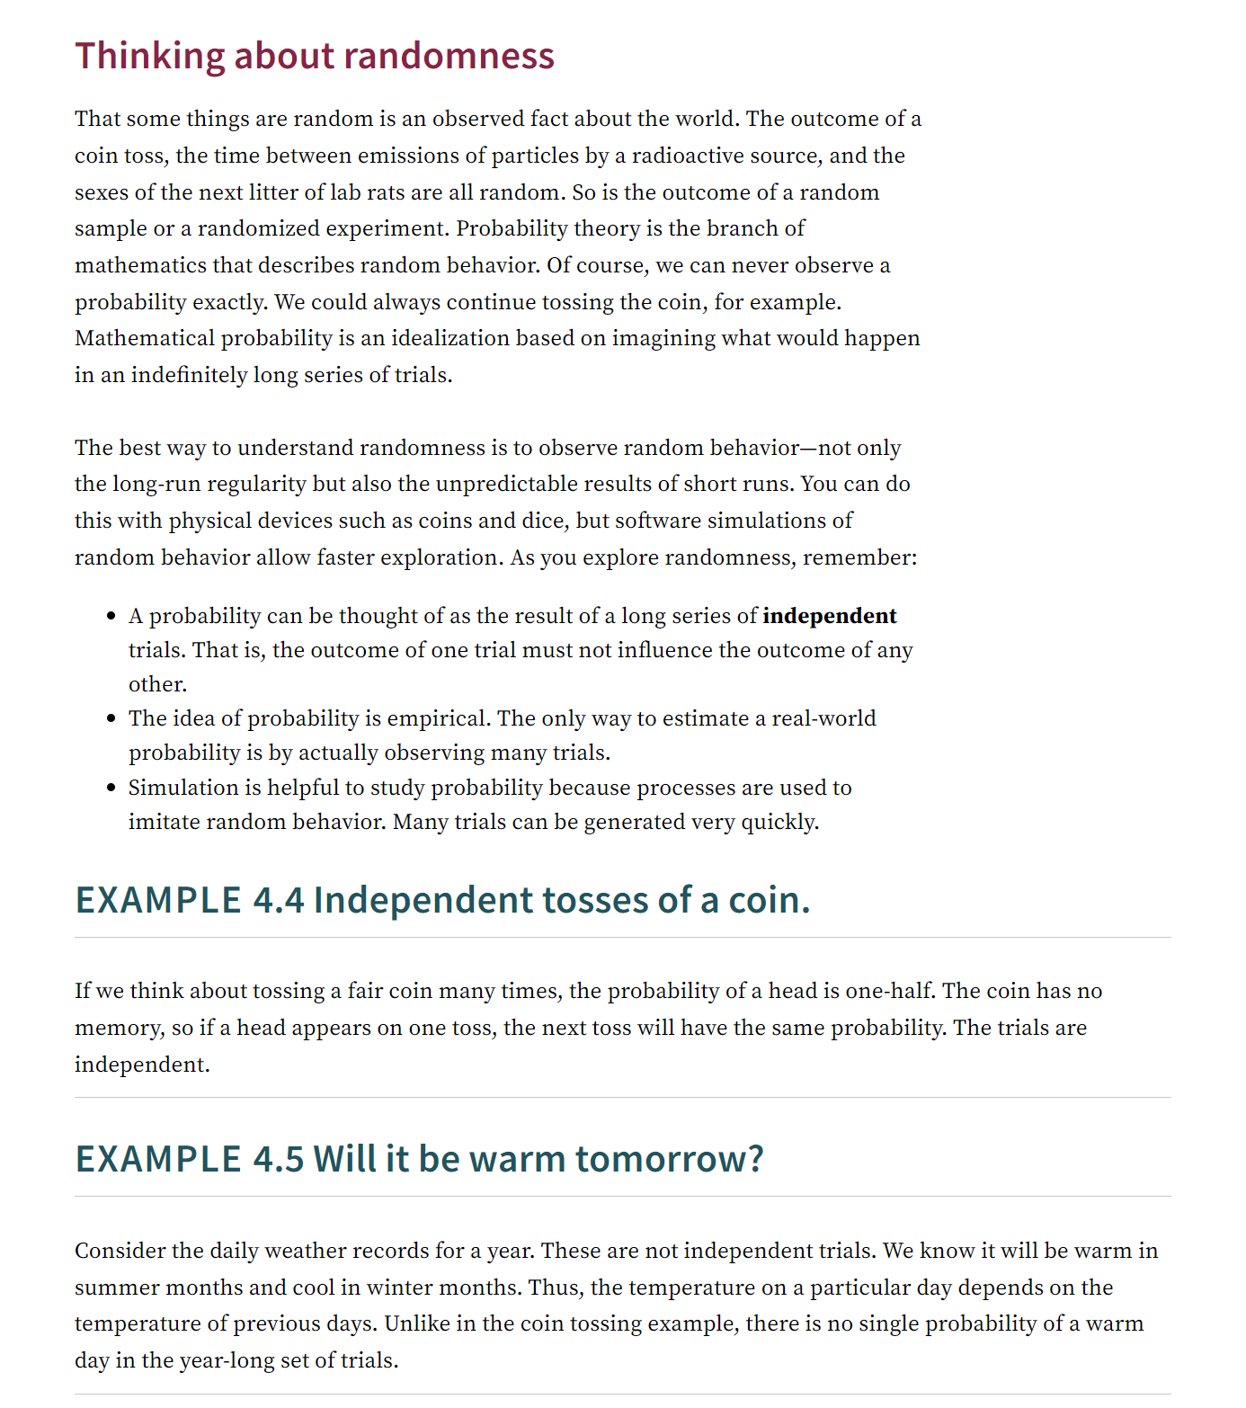
Yet another independence

Slide 8
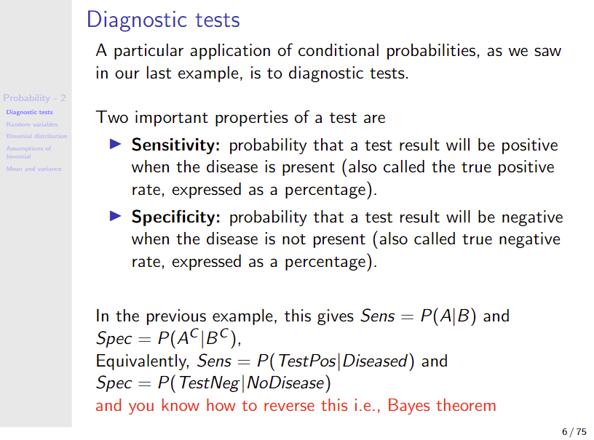

Slide 9
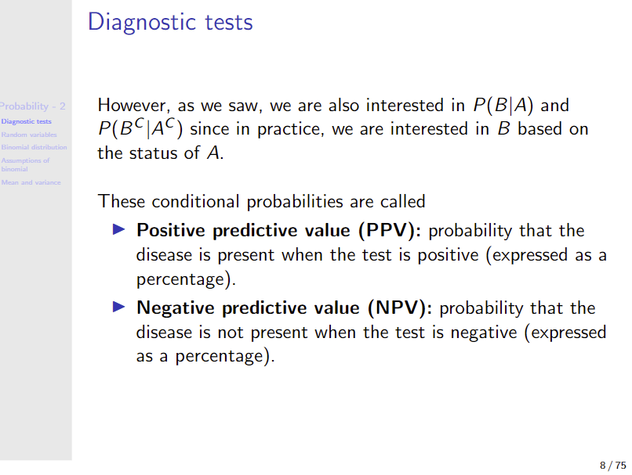

Slide 10
Random variable – Binomial

Slide 11
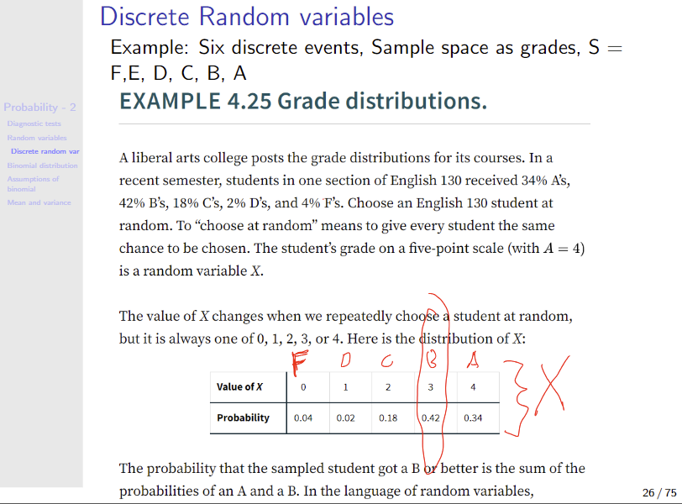

Slide 12
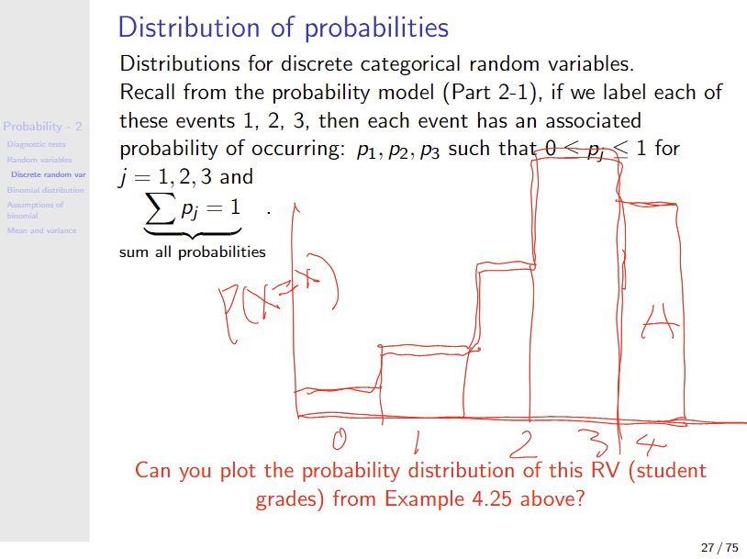

Slide 13
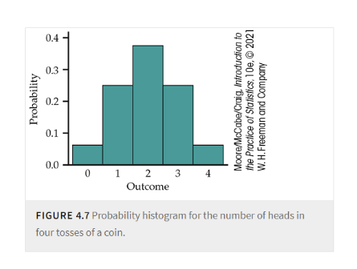

Slide 14
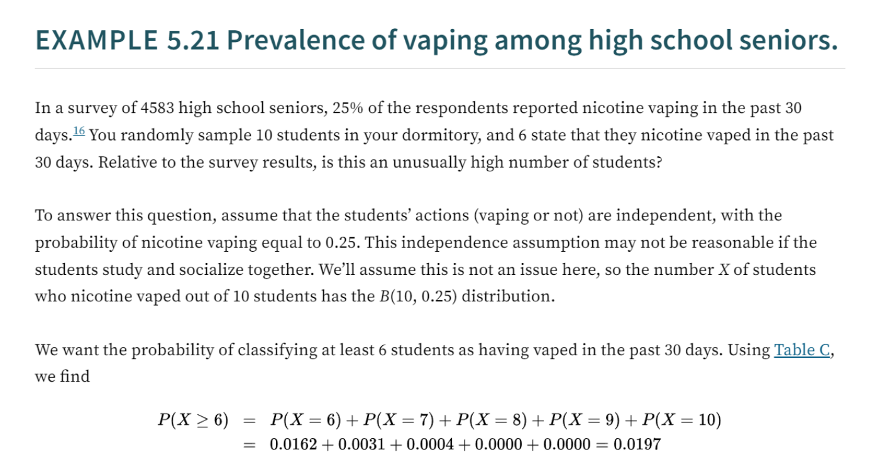

Slide 15
# Probability vaping among the population
P_vape_pop <- 1145/4583
P_vape_pop
# Now, your sample and observed (realized) outcome event, k = 6, out of n=10 sample size
dbinom(x = 6, size = 10, prob = P_vape_pop)
# and from 0 to 6 vaping outcomes
dbinom(x = 0:10, size = 10, prob = P_vape_pop)
plot(dbinom(x = 0:10, size = 10, prob = P_vape_pop), ylab = "P(X=x)", type = "h", main = "probability distribution of vaper among 10 students interviewed \n
this is not bargraph, but histogram")
#so, how likely is this obsevation of X=>6? if the prevalence of vaping is truly 25%?
# sum to 1, obviously
sum(dbinom(x = 0:10, size = 10, prob = P_vape_pop))
# add up P(X>5)
dbinom(x = 0:10, size = 10, prob = P_vape_pop)

