Slide 1
Review 4
From Part2-2, Conditional Probability
Bayes Theorem
Random Variable

Slide 2
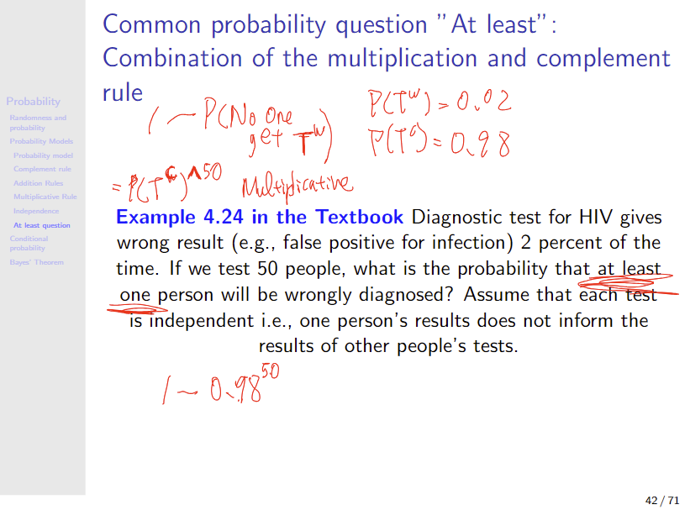


Slide 3
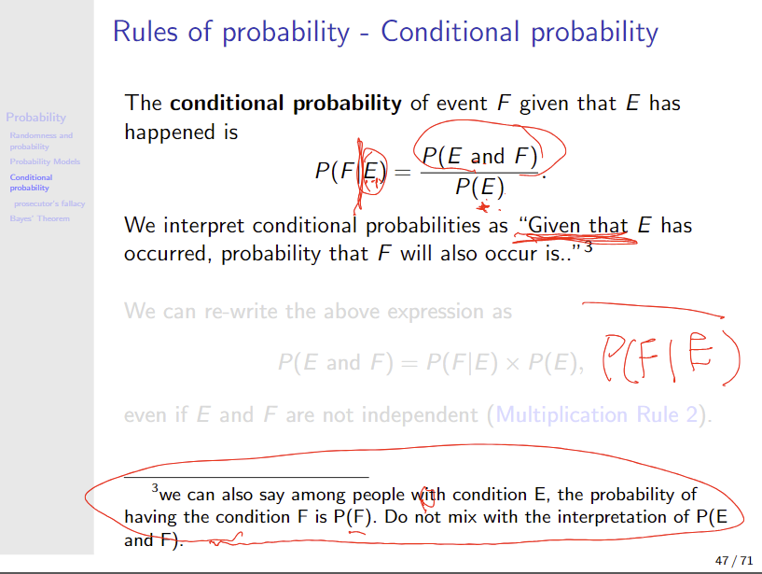

Pay attention to your interpretation

Slide 4
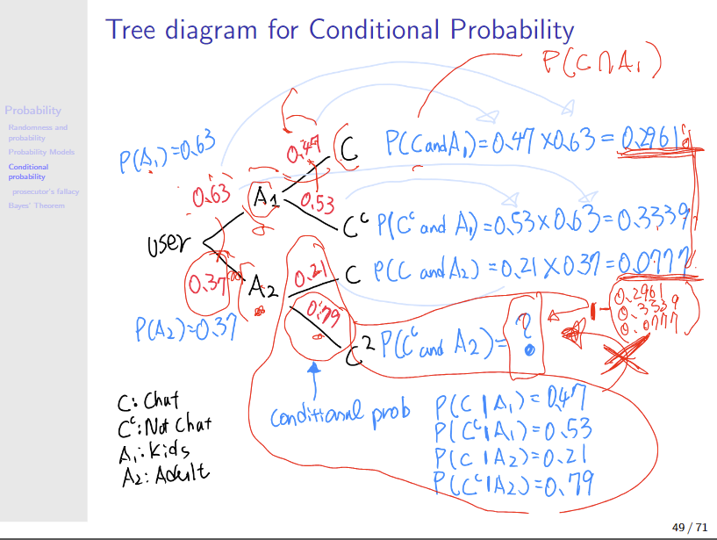


Slide 5
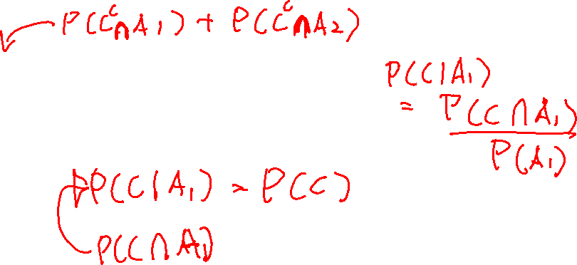
A₁ (youth) and A₂ (older adults) are disjoint. C and C^{c} are also disjoint, so no intersection.
P(C) and P(C^{c}) can be easily calculated
Lets check to see if C is independent of A

Slide 6
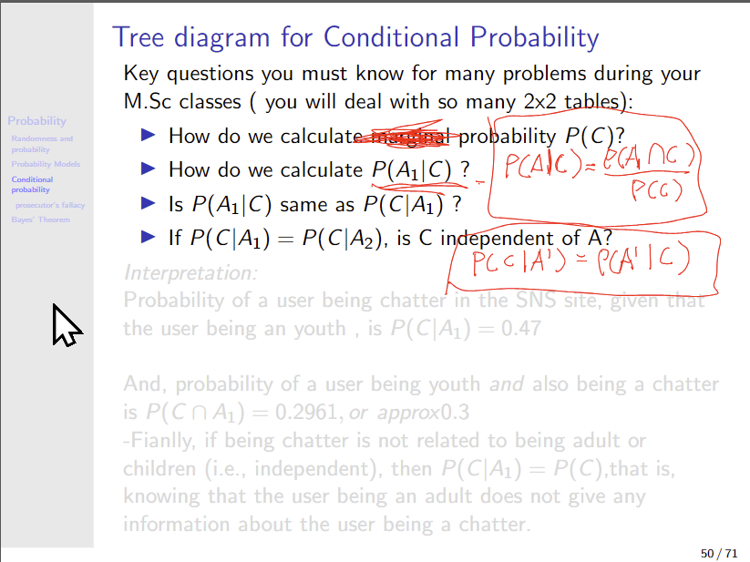

Slide 7
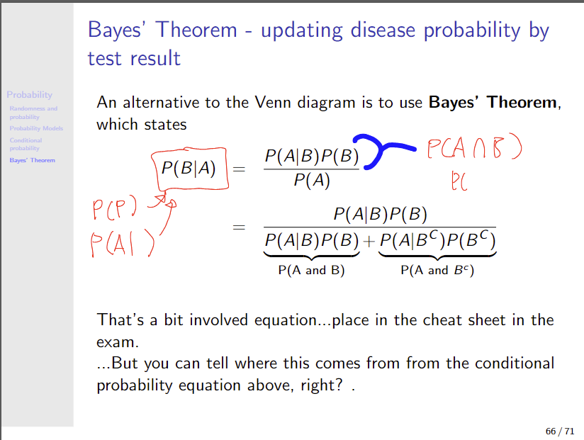



Slide 8




For our in-class example… Bayes theorem

Slide 9
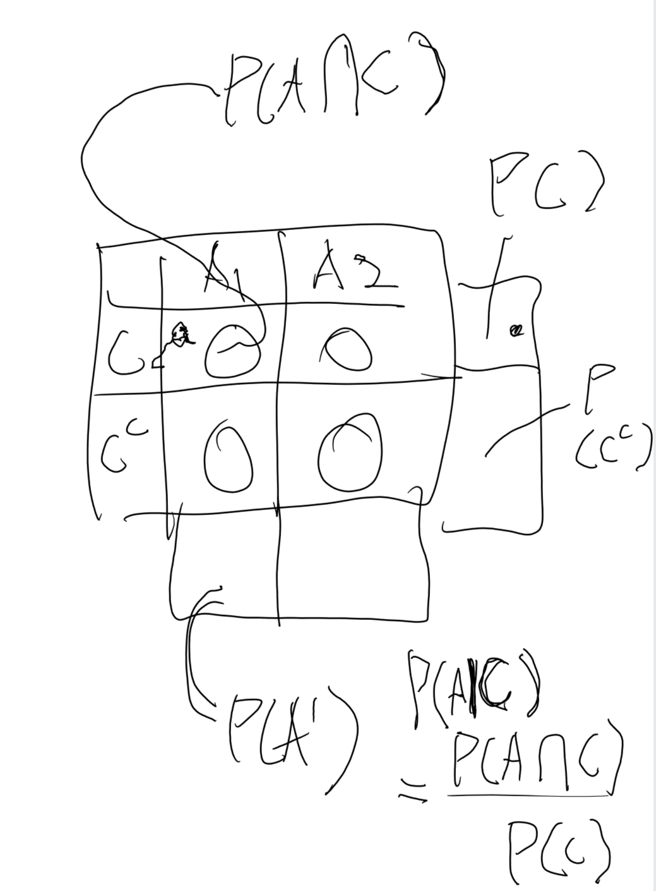
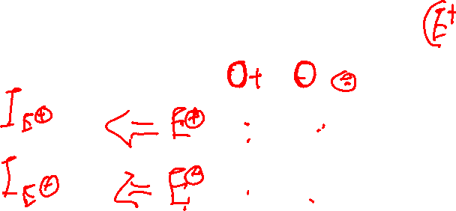
2x2 table and probabilities

Slide 10
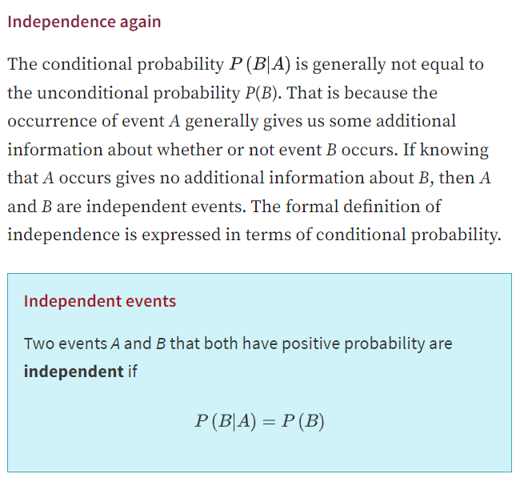

Slide 11
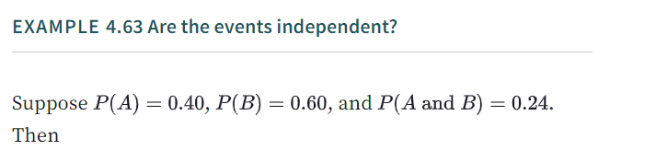
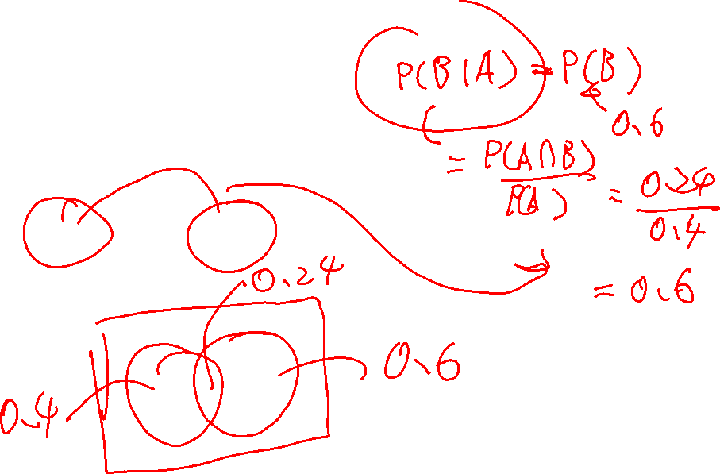
Are A and B independent?

Slide 12
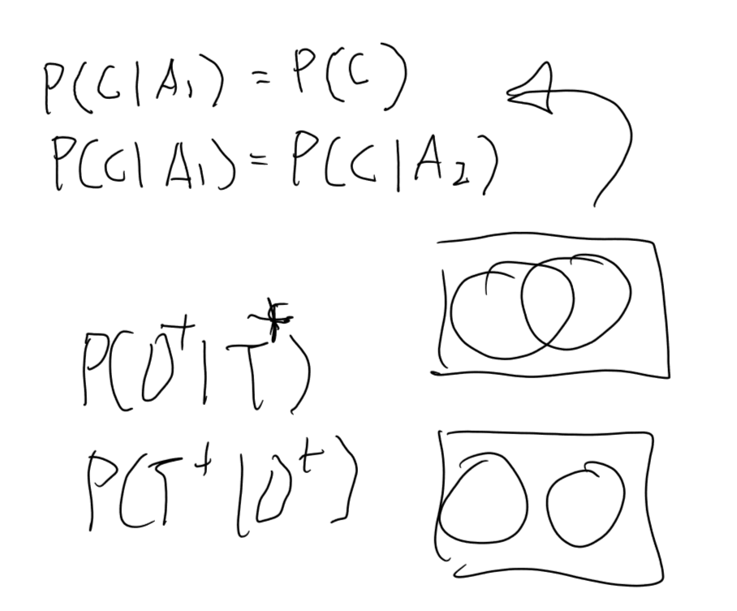
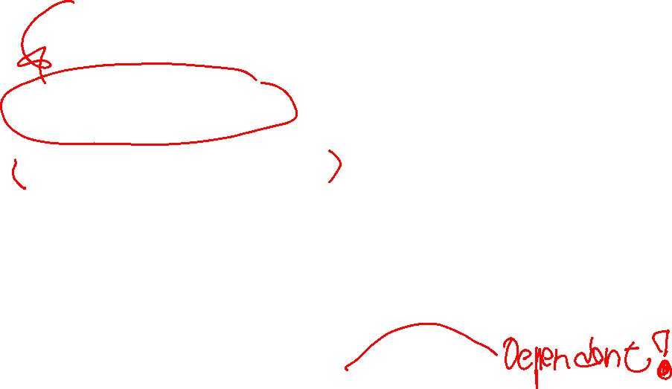


Independence

Slide 13
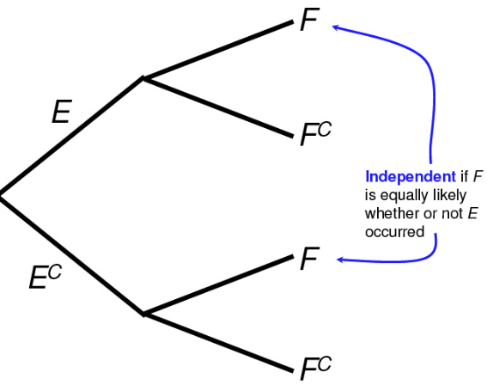
Independence

Slide 14
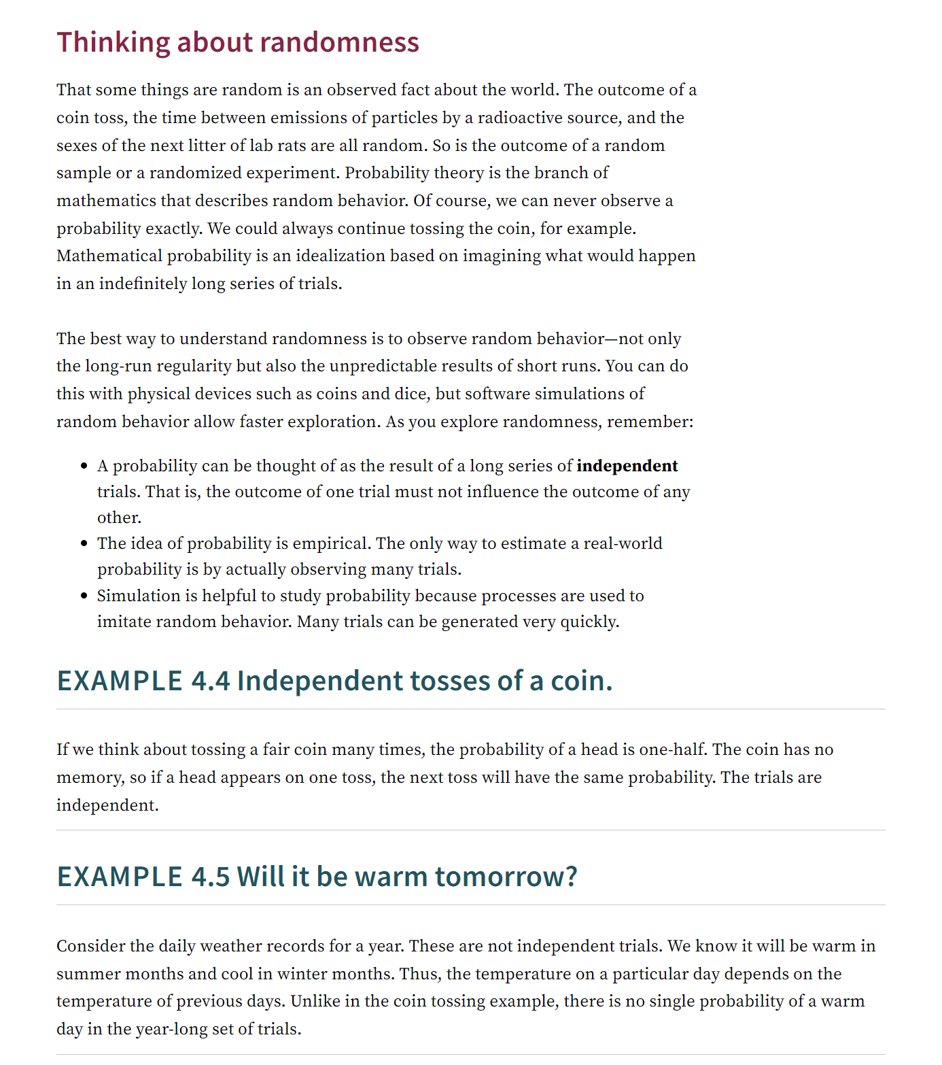
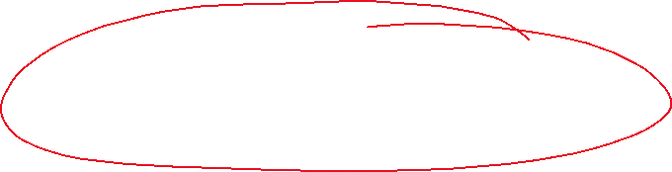
Yet another independence

Slide 15
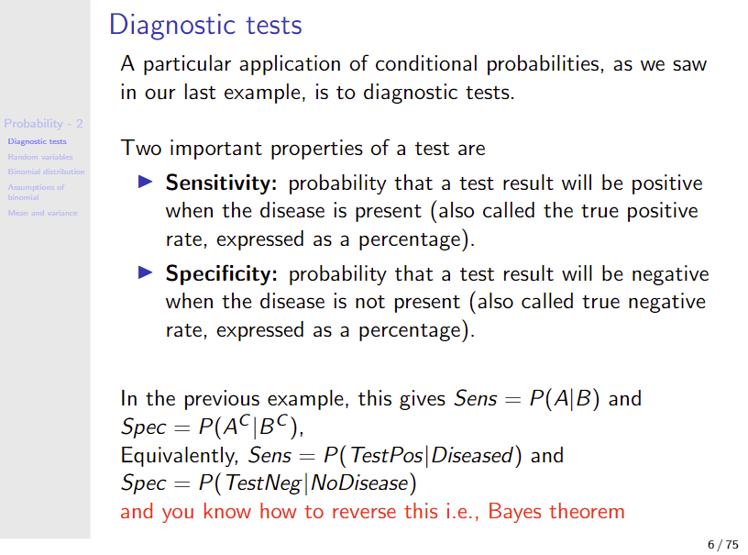

Slide 16
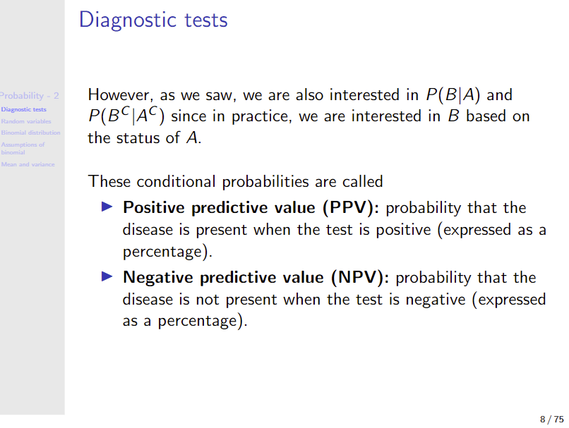

Slide 17
Random variable – Binomial

Slide 18
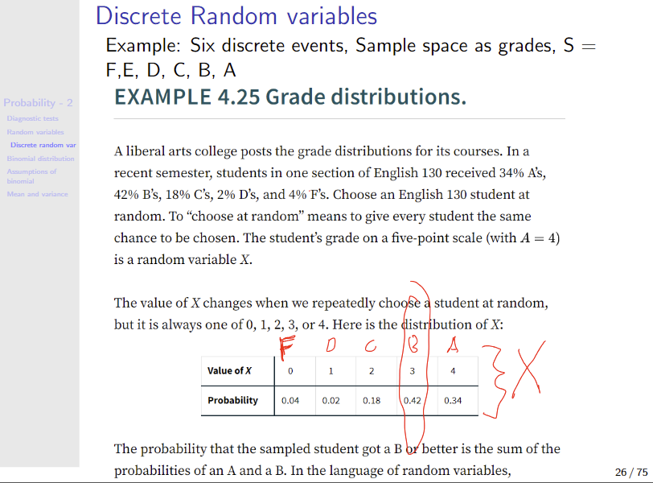

Slide 19
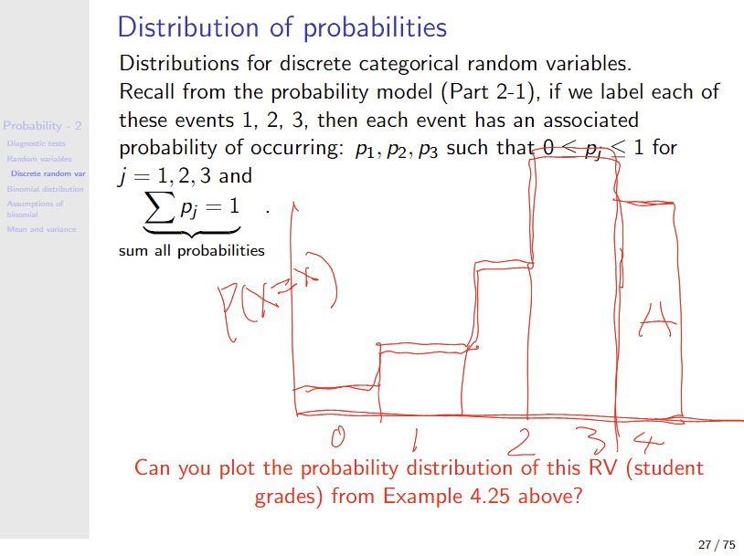

Slide 20
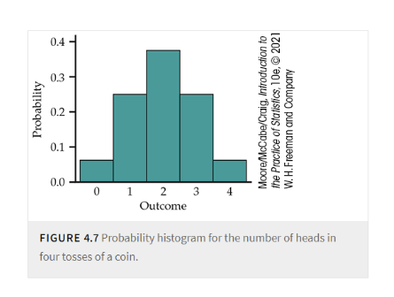

Slide 21
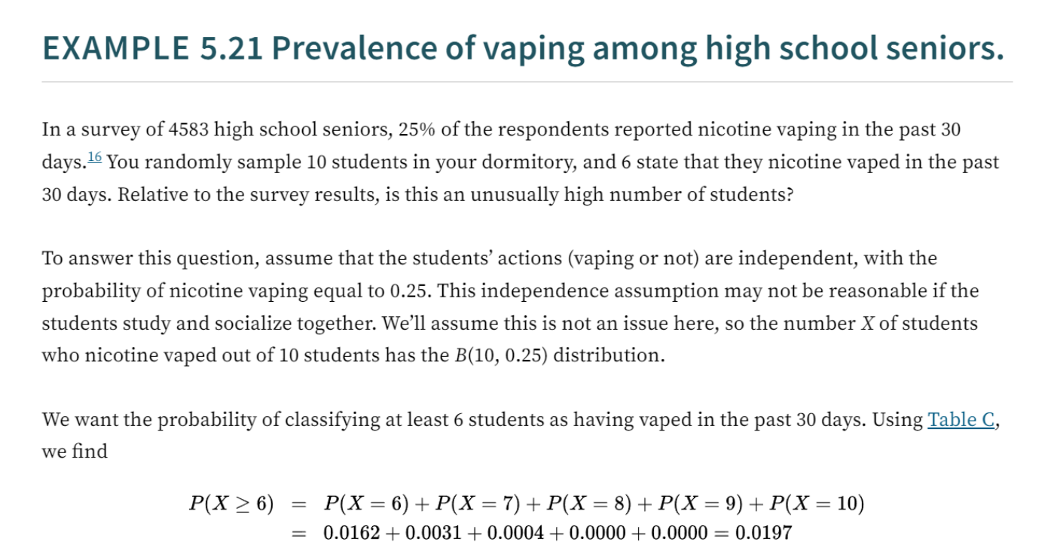


Slide 22
# Probability vaping among the population
P_vape_pop <- 1145/4583
P_vape_pop
# Now, your sample and observed (realized) outcome event, k = 6, out of n=10 sample size
dbinom(x = 6, size = 10, prob = P_vape_pop)
# and from 0 to 6 vaping outcomes
dbinom(x = 0:10, size = 10, prob = P_vape_pop)
plot(dbinom(x = 0:10, size = 10, prob = P_vape_pop), ylab = "P(X=x)", type = "h", main = "probability distribution of vaper among 10 students interviewed \n
this is not bargraph, but histogram")
#so, how likely is this obsevation of X=>6? if the prevalence of vaping is truly 25%?
# sum to 1, obviously
sum(dbinom(x = 0:10, size = 10, prob = P_vape_pop))
# add up P(X>5)
dbinom(x = 0:10, size = 10, prob = P_vape_pop)

