Slide 1
Review 5
From Binomial Random Variable (RV)

Slide 2
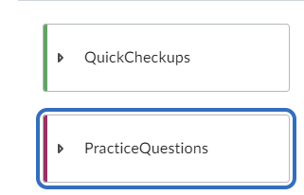
Practice and checkup questions uploaded

Slide 3
Practice and checkup questions uploaded
Checkups are shorter, multiple-choice questions to build understanding and solve longer (assignments and exam) questions.
I will upload the assignments and exams from the past years too.
Many assignment and exam questions will test the skills to pick the right random variable meeting a given question and to write an appropriate interpretation.

Slide 4
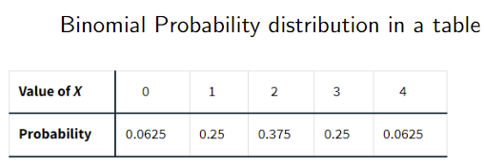
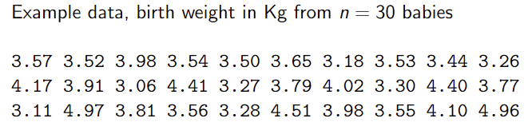
Random variables – what are they?
Random variable - the list of outcome events and probabilities
Regular variable –data you collect from subjects to compute the sample mean and standard deviation amongst other sample statistics

Slide 5
So, why do we need random variables?
Simple answer: everything we measure (including your sample mean itself) is random. We need to make conclusion re: how sure our findings are, based on these random numbers.
RV answers the key question: is our finding (prevalence of disease X from a small sample) simply due to random chance? - a common question you need to answer to knowledge users as an analyst.
In other words, how likely is your finding (e.g., mean) for your population? Can be answered by RV.

Slide 6
Example question (nearly identical to the vapting question last week):
Setting – Someone asked you to study the prevalence of COPD in a city X
The national proportion in year 2020 is 8%.
Question: is the count of COPD among the at-risk population in city X higher than the national average??
You recruited n=30 people randomly from city X. Your population of interest is all residents at risk in city X.
We got k = 10 out of n = 30 in our sample from the city X. The national average is p = 0.08.
How likely is your finding (likely, in terms of probability) –is this chance alone? You need to report this.

Slide 7
Real-world description of this question.
You are a public health practitioner/epidemiologist in city X, which suffers from heavy air pollution. You are asked to investigate the prevalence of Chronic Obstructive Pulmonary Disease (COPD) in this city. The local communities and city’s main interested is whether the prevalence of COPD in city X is higher than the national prevalence. In 2020, the count of prevalent COPD in the whole nation was 160,000/2 million residents.
Question a) You have randomly recruited 30 residents from the city, and 10 out of 30 had COPD. The city needs to know whether this number is different from the 2020 national prevalence (or count). Calculate the probability of observing your finding, if the prevalence of COPD in city X is the same as that of the whole nation.
Question b) Is your finding conclusive based on the sample size of n=30? Provide the result of statistical test of your choice and provide the corresponding interpretation. Show your work. Explain your choice for your statistical test of choice.
Question c) The city is population is 1000. Do you think your test is valid, in terms of its assumptions?
Note: You will not calculate P(X=x) during the exam, since a table for probability distribution will be given to you, but you need to calculate by yourself for the assignments (EPIB 613 this week and its corresponding assignment is especially critical).

Slide 8
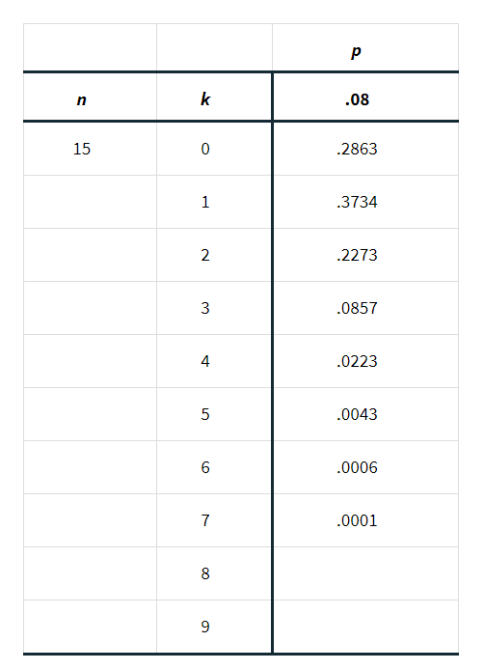
Binomial table

Slide 9
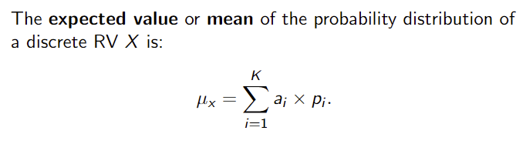
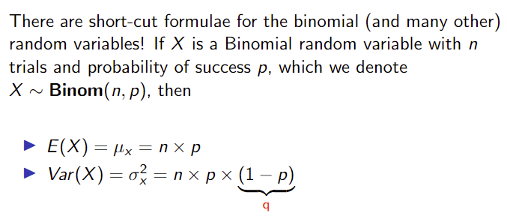
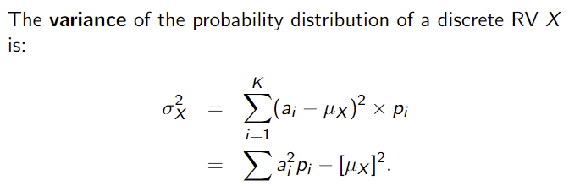
Sample mean and variance of Random Variable
You do not need to know the equations on the left , but you need to know the shortcut Binomial formulas
on the right for mean, variance, and SD.

Slide 10
Final note about Binomial
Some textbook and software use “x” in place of “k” as the number of outcome events for binomial RV.
From the textbook
“The most important skill for using binomial distributions, however, is the ability to recognize situations to which they do and do not apply. This can be done by checking all the facets of the binomial setting.”
This skill will be tested in the exams, aside from the ability to write proper interpretations from test results. The only way to gain this skill is practice with various questions.

Slide 11
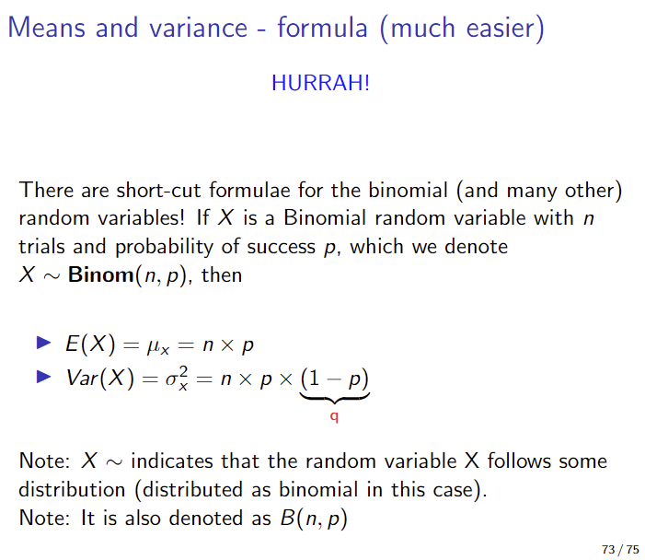
Correction about the Standard deviation of Binomial

