Slide 1
Chapter 5 Sampling Distributions Clicker Questions
Introduction to the Practice of Statistics Tenth Edition David S. Moore George P. McCabe Bruce Craig

Slide 2
Many non-binomial slides are dropped (not covered yet, normal distribution, sampling distribution, and normal approximation).
Red – hints
Blue – you can solve now, but there will be more information to work on these problems.
Answers can be distributed soon (though they may be in an e-version of your textbook already)

Slide 3
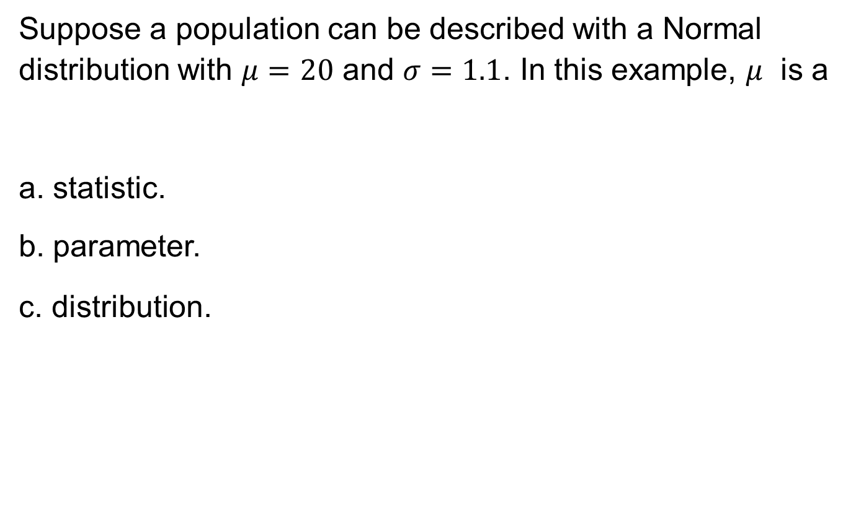
5.1-1
Suppose a population can be described with a Normal distribution with $μ=20$ and $σ=1.1$. In this example, $μ$ is a
a. statistic.
b. parameter.
c. distribution.

Slide 4
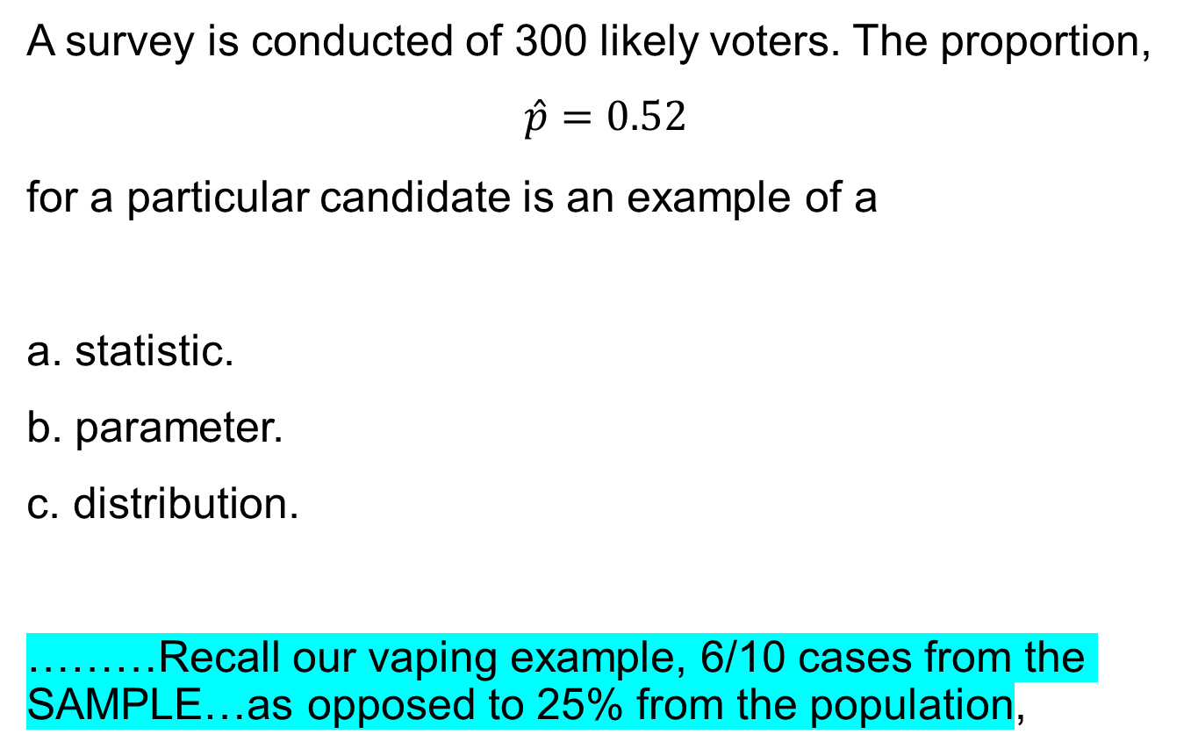
5.1-2
A survey is conducted of 300 likely voters. The proportion,
$$\hat{p}=0.52$$
for a particular candidate is an example of a
a. statistic.
b. parameter.
c. distribution.
………Recall our vaping example, 6/10 cases from the SAMPLE…as opposed to 25% from the population,

Slide 5
5.3-1
Which of the following situations follow(s) a binomial distribution?
I. A local hospital records the sex of 50 births.
II. A coin is flipped until there is a “head.”
III. A deck of 52 cards is flipped until we see a “heart.”
a. I only
b. I and II only
c. I, II, and III only

Slide 6
5.3-2
When a particular penny is held on its edge and spun, the probability that heads are face up when the coin comes to rest is 4/9. If the coin is spun four times, the probability that the coin will come up heads exactly twice is (assume trials are independent)
a. 16/81.
b. 0.366.
c. 0.061.

Slide 7
5.3-3
When a particular penny is held on its edge and spun, the probability that heads are face up when the coin comes to rest is 4/9. If the coin is spun four times, you would expect how many heads?
a. 9/16
b. 16/9
c. 2

Slide 8
5.3-4
You decide to test a friend for ESP using a standard deck of 52 playing cards. Such a deck contains 13 spades, 13 hearts, 13 diamonds, and 13 clubs. You shuffle the deck, select a card at random, and ask your friend to tell you whether the card is a spade, heart, diamond, or club. After the guess, you return the card to the deck, shuffle the cards, and repeat the above. You do this a total of 100 times. Let X be the number of correct guesses by your friend in the 100 trials. The standard deviation of X is (NOT VARIANCE) – recall the shortcut formula in the class Thursday – Also, consider the case where you do not return the card
a. 0.433.
b. 4.33.
c. 18.75.

Slide 9
5.3-5
Which of the following might be reasonably modeled by the binomial distribution?
a. the number of customers who enter a store in a 1-hour period, assuming customers enter independently
b. the number of questions you get correct on a 100-question multiple-choice exam in which each question has only four possible answers (assume you have studied extensively for the test)
c. none of the above

Slide 10
5.3-6
There are 20 multiple-choice questions on an exam, each having responses a, b, c, or d. Each question is worth 5 points, and only one response per question is correct. Suppose a student guesses the answer to each question, and her guesses from question to question are independent. If the student needs at least 40 points to pass the test, the probability that the student passes is closest to
…HINT: you want P(X>=8) right ?– how did I get this from the Stattreck or the dbinom from R ? This is the right side of the Binomial probability distribution plot.
a. 0.0609.
b. 0.1019.
c. 0.9590.

Slide 11
5.3-7
A backpacking party carries five emergency flares, each of which will light with a probability of 0.80. What is the probability that, at most, two will light?
a. 0.056
b. 0.058
c. 0.060
Be sure to distinguish at least and at most in our probability calculation, this is critical.

Slide 12
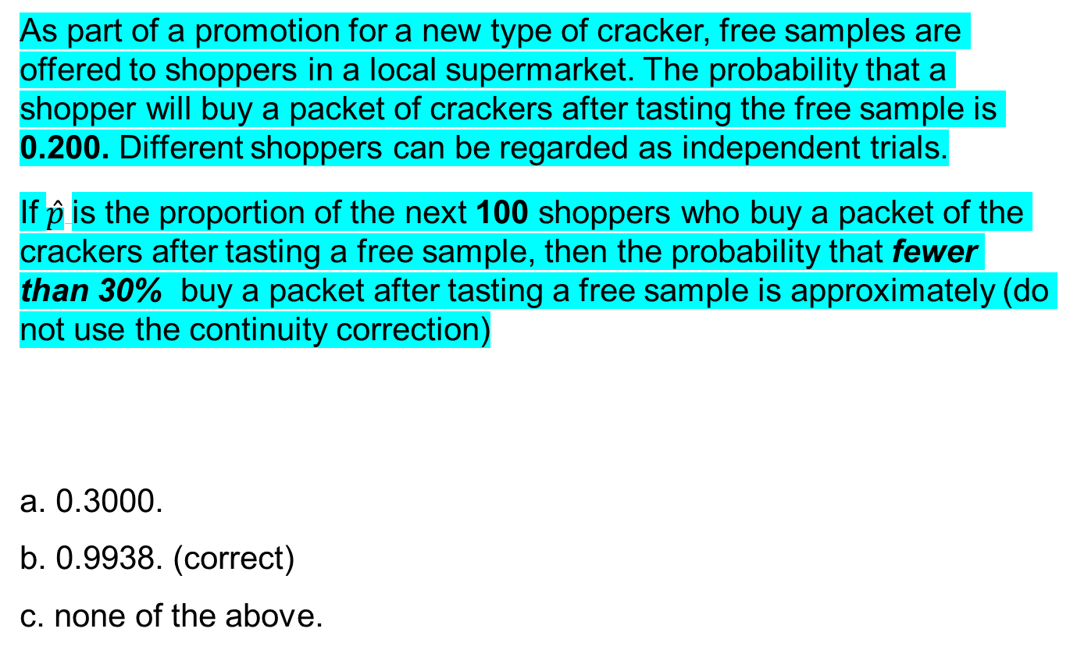
5.3-9 answer
As part of a promotion for a new type of cracker, free samples are offered to shoppers in a local supermarket. The probability that a shopper will buy a packet of crackers after tasting the free sample is 0.200. Different shoppers can be regarded as independent trials.
If $\hat{p}$is the proportion of the next 100 shoppers who buy a packet of the crackers after tasting a free sample, then the probability that fewer than 30% buy a packet after tasting a free sample is approximately (do not use the continuity correction)
a. 0.3000.
b. 0.9938. (correct)
c. none of the above.

Slide 13
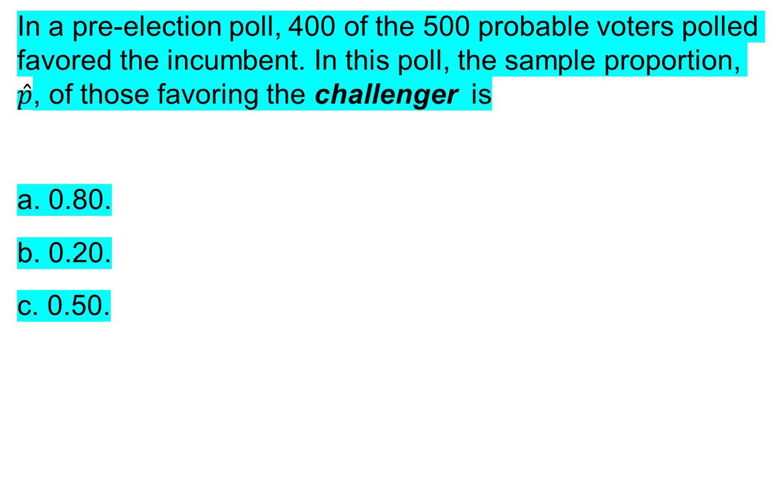
5.3-10
In a pre-election poll, 400 of the 500 probable voters polled favored the incumbent. In this poll, the sample proportion, $\hat{p}$, of those favoring the challenger is
a. 0.80.
b. 0.20.
c. 0.50.

Slide 14
5.3-12
It is known that 20% of a certain type of scratch-and-win tickets are winners. If you buy 10 tickets, what is the probability that at least two of them are winners?
a. 0.107
b. 0.625
c. 0.268

Slide 15
5.3-12 answer
It is known that 20% of a certain type of scratch-and-win tickets are winners. If you buy 10 tickets, what is the probability that at least two of them are winners?
Recall the vaping example. Check the codes
a. 0.107
b. 0.625
c. 0.268
Type in R: dbinom(p=0.2, size = 10, x = 0:10)
…You will get bionmial prob of P(X =0), P(X=2),….P(X=10)
Also you will get these probabilities outputs from R in Exam, where you don’t have R.
= 1 – (0.107 + 0.268)

Slide 16
5.3-13
It is known that 20% of a certain type of scratch-and-win tickets are winners. If you buy 100 tickets, what is the approximate probability that at least 25 of them are winners?
a. 0.1056
b. 0.1539
c. 0.2061

Slide 17
5.3-14
We want to take a sample of 100 items out of a large batch for quality control purposes. Based on past history, the proportion of defective items is 4%.
Can we use the Normal approximation to the binomial distribution to find the probability of finding more than five defective items in the sample of 100?
a. Yes, because n is large.
b. No.
c. We do not have enough information.

Slide 18
5.3-15
A national poll of 600 men announced that the proportion in the survey who claimed to help their wives at home was 85%. If we took a larger poll of 1200 men, what would be the standard deviation of the number of men who help at home, based on the first survey? (NOT VARIANCE)
a. 12.37
b. 17.32
c. 153

Slide 19
5.3-16
From previous polls, it is believed that 66% of likely voters prefer the incumbent. A new poll of 500 likely voters will be conducted. In the new poll, if the proportion favoring the incumbent has not changed, what will be the mean and standard deviation of the number preferring the incumbent?
a. μ = 330, σ = 10.59
b. μ = 0.66, σ = 0.021
c. μ = 330, σ = 18.17

Slide 20
5.3-17
A communication-monitoring company claims that 45% of email messages are spam. Suppose you randomly select 12 messages from your inbox. What is the probability that at least seven of them are spam?
a. 0.2607
b. 0.1489
c. 0.8882

Slide 21
5.3-18
A communication-monitoring company claims that 45% of email messages are spam. After being on vacation, you return to 250 emails in your inbox. What is the probability that at least 40% are spam? You could wait until normal approximation, but can be solved from today’s material.
a. 0.9441
b. 0.7500
c. 0.6341

Slide 22
5.3-19
The proportion of students who own a cell phone on the university campus is approximately 90%. In a random sample of 15 students, what is the probability that exactly 11 of them own a cell phone?
a. 0.0428
b. 0.0567
c. 0.0678

