Slide 1
Chapter 4 Probability: The Study of Randomness Clicker Questions
Introduction to the Practice of Statistics Tenth Edition David S. Moore George P. McCabe Bruce Craig

Slide 2
4.1-1
Suppose you toss a thumbtack 60 times, and it lands point up on 35 of the tosses. The approximate probability of landing point up is
a. 35.
b. 0.35.
c. 0.58.

Slide 3
4.1-1 answer
Suppose you toss a thumbtack 60 times, and it lands point up on 35 of the tosses. The approximate probability of landing point up is
a. 35.
b. 0.35.
c. 0.58. (correct)

Slide 4
4.1-2
Two trials in an experiment are independent if
a. an outcome occurs on the first trial; then that particular outcome cannot occur on the second trial.
b. an outcome occurs on the first trial; then that particular outcome has no effect on what outcome occurs on the second trial.
c. outcomes in the first trial are mutually exclusive of the outcomes in the second trial.

Slide 5
4.1-2 answer
Two trials in an experiment are independent if
a. an outcome occurs on the first trial; then that particular outcome cannot occur on the second trial.
b. an outcome occurs on the first trial; then that particular outcome has no effect on what outcome occurs on the second trial. (correct)
c. outcomes in the first trial are mutually exclusive of the outcomes in the second trial.

Slide 6
4.1-3
Would the SAT scores of a student who takes the test in January and again in June be independent?
a. no
b. yes

Slide 7
4.1-3 answer
Would the SAT scores of a student who takes the test in January and again in June be independent?
a. no (correct)
b. yes

Slide 8
4.1-4
A phenomenon is observed many, many times under identical conditions. The proportion of times a particular event A occurs is recorded. What does this proportion represent?
a. the probability of event A
b. the distribution of event A
c. the correlation of event A
d. the variance of event A

Slide 9
4.1-4 answer
A phenomenon is observed many, many times under identical conditions. The proportion of times a particular event A occurs is recorded. What does this proportion represent?
a. the probability of event A (correct)
b. the distribution of event A
c. the correlation of event A
d. the variance of event A

Slide 10
4.1-5
The statistics of a particular basketball player state that he makes four out of five free-throw attempts.
The basketball player is just about to attempt a free throw. Is this a random phenomenon?
a. no
b. yes

Slide 11
4.1-5 answer
The statistics of a particular basketball player state that he makes four out of five free-throw attempts.
The basketball player is just about to attempt a free throw. Is this a random phenomenon?
a. no
b. yes (correct)

Slide 12
4.1-6
The statistics of a particular basketball player state that he makes four out of five free-throw attempts.
The basketball player is just about to attempt a free throw. What do you estimate the probability that the player makes this next free throw to be?
a. 0.16
b. 50-50 (either he makes it or he does not)
c. 0.80
d. 1.2

Slide 13
4.1-6 answer
The statistics of a particular basketball player state that he makes four out of five free-throw attempts.
The basketball player is just about to attempt a free throw. What do you estimate the probability that the player makes this next free throw to be?
a. 0.16
b. 50-50 (either he makes it or he does not)
c. 0.80 (correct)
d. 1.2

Slide 14
4.2-1
A fair coin is tossed, and a fair six-sided die is rolled. Suppose the outcomes for the coin and die are independent. The probability of getting a head and rolling a six is
a. 1/12.
b. 2/3.
c. 1/3.

Slide 15
4.2-1 answer
A fair coin is tossed, and a fair six-sided die is rolled. Suppose the outcomes for the coin and die are independent. The probability of getting a head and rolling a six is
a. 1/12. (correct)
b. 2/3.
c. 1/3.

Slide 16
4.2-2
An event A occurs with probability 0.3. Event B occurs with probability 0.5. If A and B are disjoint, then P(A or B) =
a. 0.80.
b. 0.15.
c. 0.65.

Slide 17
4.2-2 answer
An event A occurs with probability 0.3. Event B occurs with probability 0.5. If A and B are disjoint, then P(A or B) =
a. 0.80. (correct)
b. 0.15.
c. 0.65.

Slide 18
4.2-3
Suppose P(A) = 0.2, P(B) = 0.4, and P(A and B) = 0.05. Are these events independent?
a. no
b. yes

Slide 19
4.2-3 answer
Suppose P(A) = 0.2, P(B) = 0.4, and P(A and B) = 0.05. Are these events independent?
a. no (correct)
b. yes

Slide 20
4.2-4
Suppose we toss a penny and a nickel. Let A be the event that the penny is a head and B be the event that the nickel is a tail. The events A and B are
a. disjoint.
b. complements.
c. independent.

Slide 21
4.2-4 answer
Suppose we toss a penny and a nickel. Let A be the event that the penny is a head and B be the event that the nickel is a tail. The events A and B are
a. disjoint.
b. complements.
c. independent. (correct)

Slide 22
4.2-5
A gas station recently sent out “scratch and save” coupons through the mail. The coupons offer customers varying discounts off a 30-liter fuel purchase. The discounts, and the probabilities of receiving them, are shown below.
Discount $1 $2 $3 $4 $5
Probability 0.41 0.26 3k 0.13 k
What is the probability of receiving a discount of at least $4?
a. 0.15
b. 0.05
c. 0.20

Slide 23
4.2-5 answer
A gas station recently sent out “scratch and save” coupons through the mail. The coupons offer customers varying discounts off a 30-liter fuel purchase. The discounts, and the probabilities of receiving them, are shown below.
Discount $1 $2 $3 $4 $5
Probability 0.41 0.26 3k 0.13 k
What is the probability of receiving a discount of at least $4?
0.15
0.05 (correct)
c. 0.20

Slide 24
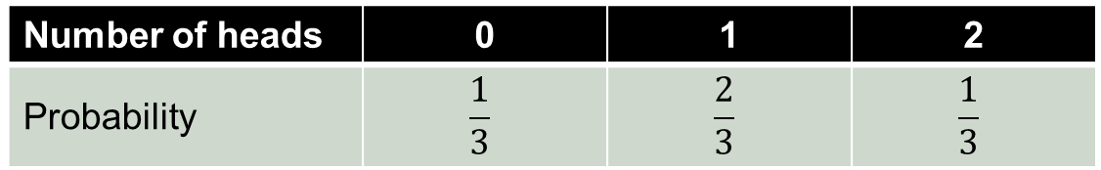


4.2-6
Two coins are tossed, and the total number of heads is counted. Which of the following would be a legitimate probability model for the total number of heads? That is, which of the following models satisfies the rules of probability?
Number of heads | 0 | 1 | 2
Probability | $$\frac{1}{3}$$ | $$\frac{2}{3}$$ | $$\frac{1}{3}$$
a.
Number of heads | 0 | 1 | 2
Probability | $$\frac{1}{16}$$ | $$\frac{5}{8}$$ | $$\frac{5}{16}$$
b.
Number of heads | 0 | 1 | 2
Probability | $$\frac{1}{2}$$ | $$\frac{3}{4}$$ | $$−\frac{1}{4}$$
c.

Slide 25
4.2-6 answer
Two coins are tossed, and the total number of heads is counted. Which of the following would be a legitimate probability model for the total number of heads? That is, which of the following models satisfies the rules of probability?
Number of heads | 0 | 1 | 2
Probability | $$\frac{1}{3}$$ | $$\frac{2}{3}$$ | $$\frac{1}{3}$$
a.
Number of heads | 0 | 1 | 2
Probability | $$\frac{1}{16}$$ | $$\frac{5}{8}$$ | $$\frac{5}{16}$$
b.
(correct)
Number of heads | 0 | 1 | 2
Probability | $$\frac{1}{2}$$ | $$\frac{3}{4}$$ | $$−\frac{1}{4}$$
c.

Slide 26
4.2-7
The following table shows the distribution of blood types in the general population.
A B AB O
Rh+ 34% 9% 4% 38%
Rh– 6% 2% 1% 6%
What is the probability that a randomly selected person will have type-O blood?
a. 0.24
b. 0.34
c. 0.44

Slide 27
4.2-7 answer
The following table shows the distribution of blood types in the general population.
A B AB O
Rh+ 34% 9% 4% 38%
Rh– 6% 2% 1% 6%
What is the probability that a randomly selected person will have type-O blood?
a. 0.24
b. 0.34
c. 0.44 (correct)
0.38 + 0.06 = 0.44

Slide 28
4.2-8
An event A occurs with probability 0.3. Event B occurs with probability 0.5. If A and B are disjoint (mutually exclusive), then P (A and B) =
a. 0.80.
b. 0.15.
c. 0.00.

Slide 29
4.2-8 answer
An event A occurs with probability 0.3. Event B occurs with probability 0.5. If A and B are disjoint (mutually exclusive), then P (A and B) =
a. 0.80.
b. 0.15.
c. 0.00. (correct)

Slide 30
4.2-9
An event A occurs with probability 0.3. Event B occurs with probability 0.5. If A and B are independent, P(A or B) =
a. 0.80.
b. 0.15.
c. 0.65.

Slide 31
4.2-9 answer
An event A occurs with probability 0.3. Event B occurs with probability 0.5. If A and B are independent, P(A or B) =
a. 0.80.
b. 0.15.
c. 0.65. (correct)

Slide 32
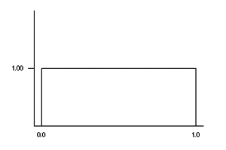
4.3-1
Let the random variable X be a random number with the uniform density curve given below. What proportion of observations are between 0.3 and 1.0?
P(0.3 < X < 1) has value
a. 0.70
b. 0.40
c. 0.30

Slide 33
4.3-1 answer
Let the random variable X be a random number with the uniform density curve given below. What proportion of observations are between 0.3 and 1.0?
P(0.3 < X < 1) has value
a. 0.70 (correct)
b. 0.40
c. 0.30

Slide 34
4.3-2
Let the random variable X represent the profit made on a randomly selected day by a small clothing store on Main Street. Assume X is Normal with a mean of $360 and a standard deviation of $50.
What is P (X > $400)?
a. 0.2119
b. 0.2881
c. 0.7881
d. 0.8450

Slide 35
4.3-2 answer
Let the random variable X represent the profit made on a randomly selected day by a small clothing store on Main Street. Assume X is Normal with a mean of $360 and a standard deviation of $50.
What is P (X > $400)?
a. 0.2119 (correct)
b. 0.2881
c. 0.7881
d. 0.8450

Slide 36
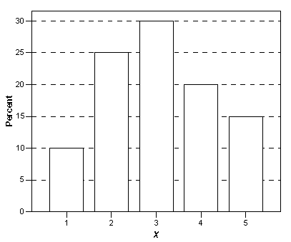
4.3-3
Consider the following probability histogram for a discrete random variable X.
What is P(X < 3)?
a. 0.10
b. 0.25
c. 0.35
d. 0.65

Slide 37
4.3-3 answer
Consider the following probability histogram for a discrete random variable X.
What is P(X < 3)?
a. 0.10
b. 0.25
c. 0.35 (correct)
d. 0.65

Slide 38
4.3-4
Consider the following probability histogram for a discrete random variable X. This probability histogram corresponds to which of the following distributions for X?
X | 1 | 2 | 3 | 4 | 5
P(X) | 0.06 | .025 | .038 | .025 | 0.06
a.
X | 1 | 2 | 3 | 4 | 5
P(X) | 0.10 | 0.25 | 0.30 | 0.20 | 0.15
b.
X | 1 | 2 | 3 | 4 | 5
P(X) | 0.10 | 0.25 | 0.30 | 0.25 | 0.10
c.
d. none of the above

Slide 39
4.3-4 answer
Consider the following probability histogram for a discrete random variable X. This probability histogram corresponds to which of the following distributions for X?
X | 1 | 2 | 3 | 4 | 5
P(X) | 0.06 | .025 | .038 | .025 | 0.06
a.
b.
(correct)
X | 1 | 2 | 3 | 4 | 5
P(X) | 0.10 | 0.25 | 0.30 | 0.20 | 0.15
X | 1 | 2 | 3 | 4 | 5
P(X) | 0.10 | 0.25 | 0.30 | 0.25 | 0.10
c.
d. none of the above

Slide 40
4.3-5
The time it takes for downhill skiers to finish a race follows a Normal distribution with a mean of 59 seconds and a standard deviation of 1.45 seconds. What proportion of skiers will finish the race in exactly 1 minute?
a. 0.6897
b. 0.2451
c. 0.7549
d. 0.0000

Slide 41
4.3-5 answer
The time it takes for downhill skiers to finish a race follows a Normal distribution with a mean of 59 seconds and a standard deviation of 1.45 seconds. What proportion of skiers will finish the race in exactly 1 minute?
a. 0.6897
b. 0.2451
c. 0.7549
d. 0.0000 (correct)

Slide 42
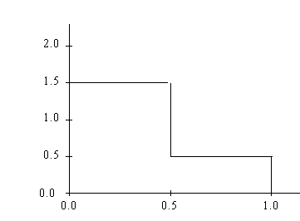
4.3-6
Suppose X is a continuous random variable taking values between 0 and 1 and having a probability distribution described by the following density curve. The probability that X takes a value between 0 and 3/4 is
a. 0.875.
b. 0.75.
c. 3/8.

Slide 43
4.3-6 answer
Suppose X is a continuous random variable taking values between 0 and 1 and having a probability distribution described by the following density curve. The probability that X takes a value between 0 and 3/4 is
a. 0.875. (correct)
b. 0.75.
c. 3/8.

Slide 44
4.4-1
A college basketball player makes 80% of his free throws. At the beginning of a game, he misses his first two free throws. We may correctly conclude that
a. he will make his next eight shots.
b. he will make eight shots in a row sometime during the season, but not necessarily in this game.
c. none of the above

Slide 45
4.4-1 answer
A college basketball player makes 80% of his free throws. At the beginning of a game, he misses his first two free throws. We may correctly conclude that
a. he will make his next eight shots.
b. he will make eight shots in a row sometime during the season, but not necessarily in this game.
c. none of the above (correct)

Slide 46
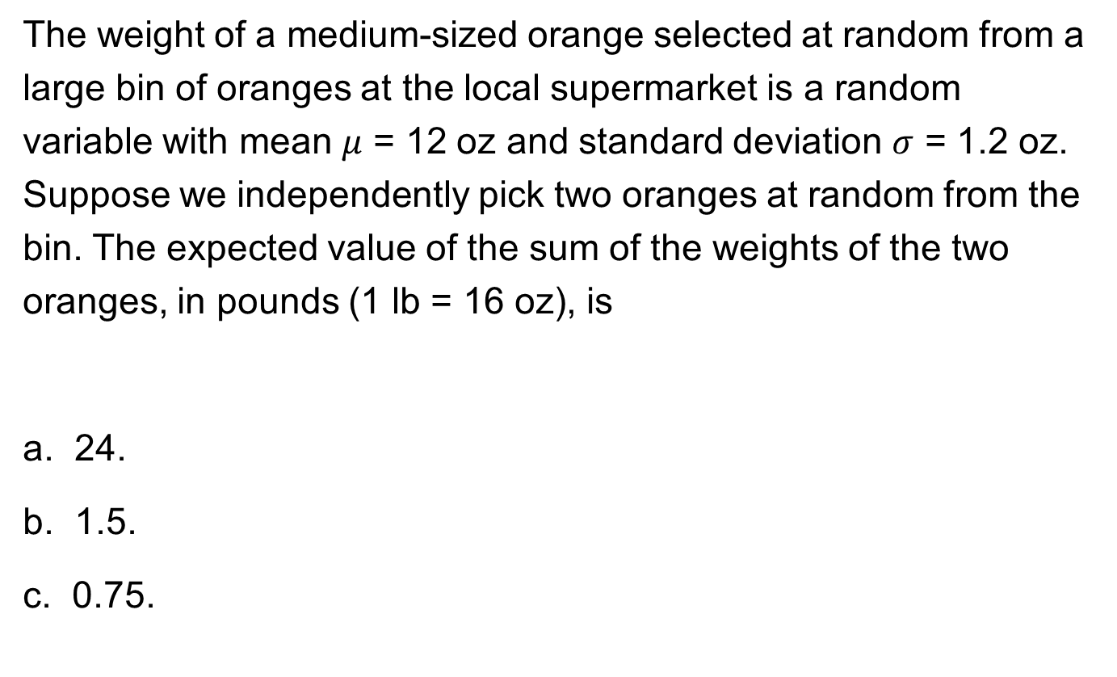
4.4-2
The weight of a medium-sized orange selected at random from a large bin of oranges at the local supermarket is a random variable with mean $μ$ = 12 oz and standard deviation $σ$ = 1.2 oz. Suppose we independently pick two oranges at random from the bin. The expected value of the sum of the weights of the two oranges, in pounds (1 lb = 16 oz), is
a. 24.
b. 1.5.
c. 0.75.

Slide 47
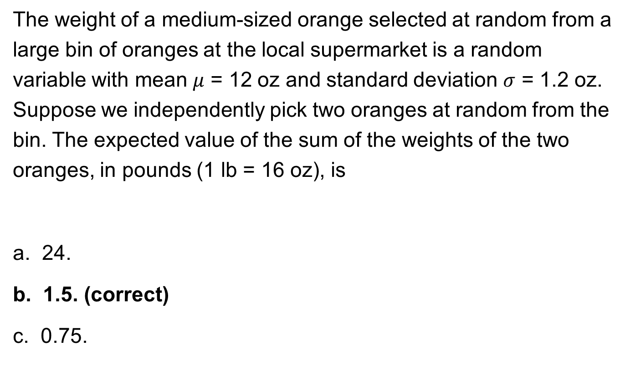
4.4-2 answer
The weight of a medium-sized orange selected at random from a large bin of oranges at the local supermarket is a random variable with mean $μ$ = 12 oz and standard deviation $σ$ = 1.2 oz. Suppose we independently pick two oranges at random from the bin. The expected value of the sum of the weights of the two oranges, in pounds (1 lb = 16 oz), is
a. 24.
b. 1.5. (correct)
c. 0.75.
24/16 = 1.5 lb

Slide 48
4.4-3
A fourth-grade teacher gives homework every night in mathematics and language arts. The time to complete the mathematics homework has a mean of 10 minutes and a standard deviation of 3 minutes. The time to complete the language arts assignment has a mean of 12 minutes and a standard deviation of 4 minutes. The time to complete the math homework and the time to complete the language arts homework have a correlation ρ = –0.375. The standard deviation of the time to complete the entire homework assignment is
a. 25 minutes.
b. 7 minutes.
c. 4 minutes.

Slide 49
4.4-3 answer
A fourth-grade teacher gives homework every night in mathematics and language arts. The time to complete the mathematics homework has a mean of 10 minutes and a standard deviation of 3 minutes. The time to complete the language arts assignment has a mean of 12 minutes and a standard deviation of 4 minutes. The time to complete the math homework and the time to complete the language arts homework have a correlation ρ = –0.375. The standard deviation of the time to complete the entire homework assignment is
a. 25 minutes.
b. 7 minutes.
c. 4 minutes. (correct)

Slide 50
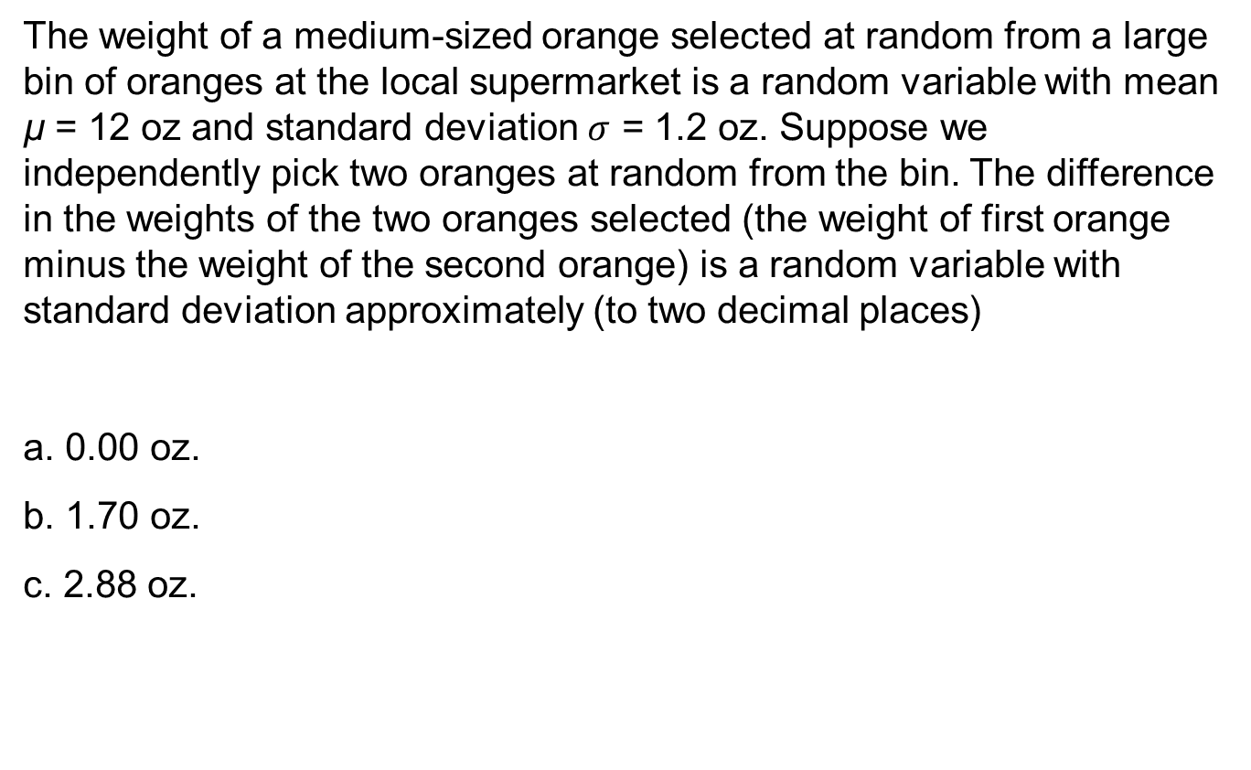
4.4-4
The weight of a medium-sized orange selected at random from a large bin of oranges at the local supermarket is a random variable with mean µ = 12 oz and standard deviation $σ$ = 1.2 oz. Suppose we independently pick two oranges at random from the bin. The difference in the weights of the two oranges selected (the weight of first orange minus the weight of the second orange) is a random variable with standard deviation approximately (to two decimal places)
a. 0.00 oz.
b. 1.70 oz.
c. 2.88 oz.

Slide 51
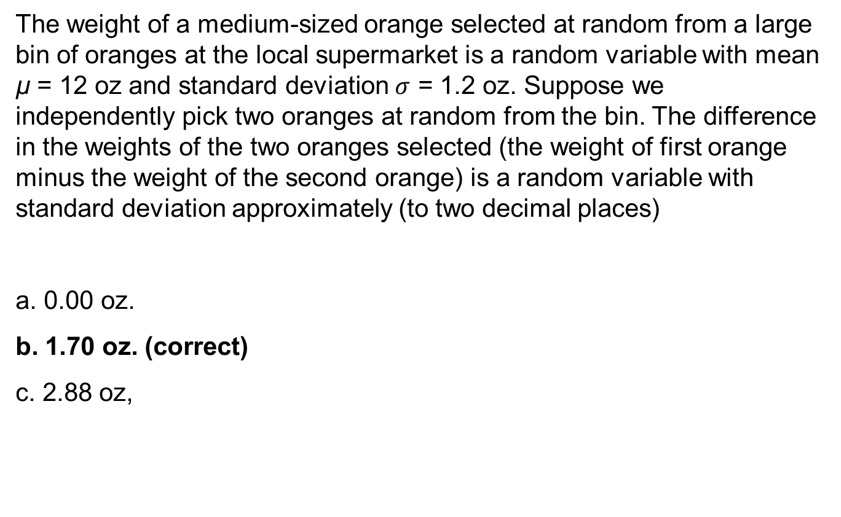
4.4-4 answer
The weight of a medium-sized orange selected at random from a large bin of oranges at the local supermarket is a random variable with mean µ = 12 oz and standard deviation $σ$ = 1.2 oz. Suppose we independently pick two oranges at random from the bin. The difference in the weights of the two oranges selected (the weight of first orange minus the weight of the second orange) is a random variable with standard deviation approximately (to two decimal places)
a. 0.00 oz.
b. 1.70 oz. (correct)
c. 2.88 oz,

Slide 52
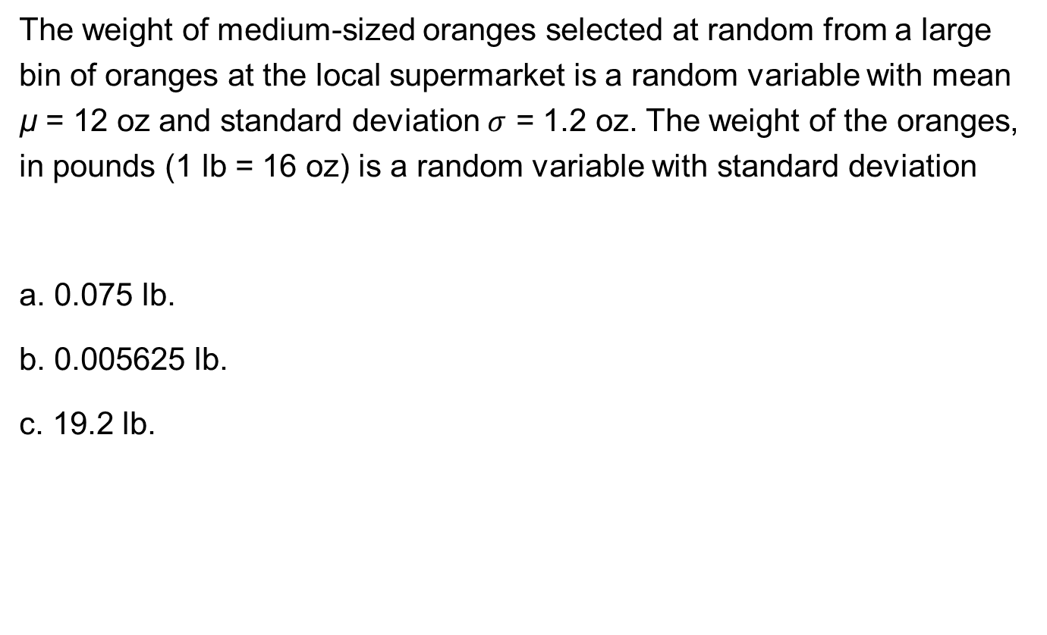
4.4-5
The weight of medium-sized oranges selected at random from a large bin of oranges at the local supermarket is a random variable with mean µ = 12 oz and standard deviation $σ$ = 1.2 oz. The weight of the oranges, in pounds (1 lb = 16 oz) is a random variable with standard deviation
a. 0.075 lb.
b. 0.005625 lb.
c. 19.2 lb.

Slide 53
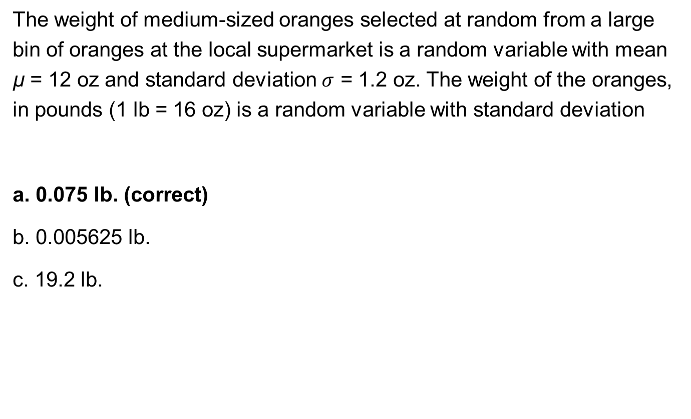
4.4-5 answer
The weight of medium-sized oranges selected at random from a large bin of oranges at the local supermarket is a random variable with mean µ = 12 oz and standard deviation $σ$ = 1.2 oz. The weight of the oranges, in pounds (1 lb = 16 oz) is a random variable with standard deviation
a. 0.075 lb. (correct)
b. 0.005625 lb.
c. 19.2 lb.

Slide 54
4.4-6
A psychology instructor asked the 100 students in her class to rate their intelligence on a scale of 1 to 10. The ratings are summarized in the table below. What was the mean rating for the students in this class?
a. 7.5
b. 6.66
c. 612

Slide 55
4.4-6 answer
A psychology instructor asked the 100 students in her class to rate their intelligence on a scale of 1 to 10. The ratings are summarized in the table below. What was the mean rating for the students in this class?
a. 7.5
b. 6.66 (correct)
c. 612

Slide 56
4.4-7
A psychology instructor asked the 100 students in her class to rate their intelligence on a scale of 1 to 10. The ratings age given in the table below.
The variance of the intelligence scores is
a. 1.29.
b. 1.66.
c. 1.71.

Slide 57
4.4-7 answer
A psychology instructor asked the 100 students in her class to rate their intelligence on a scale of 1 to 10. The ratings age given in the table below.
The variance of the intelligence scores is
a. 1.29.
b. 1.66. (correct)
c. 1.71.

Slide 58
4.4-8
Let X be the number of demerits a person has on his or her driver’s license. Suppose the probability distribution of X is the following:
x | 0 | 1 | 2 | 3 | 4 | 5
p(x) | 0.15 | 0.05 | 0.05 | 0.15 | 0.25 | 0.35
What is the mean of X?
a. 3.01
b. 3.35
c. 3.55

Slide 59
4.4-8 answer
Let X be the number of demerits a person has on his or her driver’s license. Suppose the probability distribution of X is the following:
x | 0 | 1 | 2 | 3 | 4 | 5
p(x) | 0.15 | 0.05 | 0.05 | 0.15 | 0.25 | 0.35
What is the mean of X?
a. 3.01
b. 3.35 (correct)
c. 3.55

Slide 60
4.4-9
The weighted average of the possible values that a discrete random variable X can take, where the weights are the probabilities of occurrence, is referred to as the
a. variance.
b. standard deviation.
c. expected value.

Slide 61
4.4-9 answer
The weighted average of the possible values that a discrete random variable X can take, where the weights are the probabilities of occurrence, is referred to as the
a. variance.
b. standard deviation.
c. expected value. (correct)

Slide 62
4.4-10
Suppose we have two independent random variables X and Y. Which of the following statements about X and Y are TRUE?
I. E(X + Y) = E(X) + E(Y)
II. VAR(X + Y) = VAR(X) + VAR(Y)
III. E(X – Y) = E(X) – E(Y)
IV. VAR(X – Y) = VAR(X) – VAR(Y)
a. I, II, and III only
b. II and IV only
c. I, II, III, and IV

Slide 63
4.4-10 answer
Suppose we have two independent random variables X and Y. Which of the following statements about X and Y are TRUE?
I. E(X + Y) = E(X) + E(Y)
II. VAR(X + Y) = VAR(X) + VAR(Y)
III. E(X – Y) = E(X) – E(Y)
IV. VAR(X – Y) = VAR(X) – VAR(Y)
a. I, II, and III only (correct)
b. II and IV only
c. I, II, III, and IV

Slide 64
4.4-11
The variance of the sum of two correlated random variables is always greater than the variance for the sum of two independent random variables.
a. true
b. false
c. It depends on the sign of the correlation.

Slide 65
4.4-11 answer
The variance of the sum of two correlated random variables is always greater than the variance for the sum of two independent random variables.
a. true
b. false
c. It depends on the sign of the correlation. (correct)

Slide 66
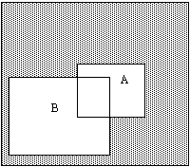
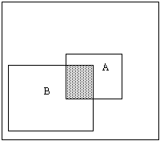
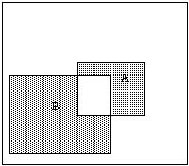
4.5-1
A plumbing contractor puts in bids on two large jobs. Let the event that the contractor wins the first contract be A and the event that the contractor wins the second contract be B. Which of the following Venn diagrams has shaded the event in which the contractor wins exactly one of the contracts?
a.
b.
c.

Slide 67
4.5-1 answer
A plumbing contractor puts in bids on two large jobs. Let the event that the contractor wins the first contract be A and the event that the contractor wins the second contract be B. Which of the following Venn diagrams has shaded the event in which the contractor wins exactly one of the contracts?
a.
b.
c. (correct)
Gets B but not A
Gets A but not B

Slide 68
4.5-2
Students at University X must be in one of the following class ranks: freshman, sophomore, junior, or senior.
At this university, 35% of the students are freshmen and 30% are sophomores. If a student is selected at random, the probability that she or he is either a junior or a senior is
a. 35%.
b. 65%.
c. 70%.

Slide 69
4.5-2 answer
Students at University X must be in one of the following class ranks: freshman, sophomore, junior, or senior.
At this university, 35% of the students are freshmen and 30% are sophomores. If a student is selected at random, the probability she or he is either a junior or a senior is
a. 35%. (correct)
b. 65%.
c. 70%.

Slide 70
4.5-3
When rolling a fair die twice, consider these two events:
A = sum is greater than 8
B = first number is 4
What is the probability of the sum being greater than 8 given that the first roll is a 4? (In other words, find the conditional probability.)
a. 1/3
b. 3/36
c. 10/36

Slide 71
4.5-3 answer
When rolling a fair die twice, consider these two events:
A = sum is greater than 8
B = first number is 4
What is the probability of the sum being greater than 8 given that the first roll is a 4? (In other words, find the conditional probability.)
a. 1/3 (correct)
b. 3/36
c. 10/36
P(B) = 6/36 and P(A and B) = 2/36

Slide 72
4.5-4
The table below shows the political affiliation of 1000 randomly selected American voters and their positions on the school-of-choice program.
Position | Democrat | Republican | Other
Favor | 260 | 120 | 240 | 620
Oppose | 40 | 240 | 100 | 480
 | 300 | 360 | 340 | 1000
Let the event:
D = {voter is a Democrat}
R = {voter is a Republican}
F = {voter favors the school-of-choice program}
What is the probability that a randomly selected voter who favors the school-of-choice program is a Democrat?
a. P(D|F) = 0.26
b. P(D|F) = 0.42
c. P(F|D) = 0.48
d. P(F|D) = 0.87

Slide 73
4.5-4 answer
The table below shows the political affiliation of 1000 randomly selected American voters and their positions on the school-of-choice program.
Position | Democrat | Republican | Other
Favor | 260 | 120 | 240 | 620
Oppose | 40 | 240 | 100 | 480
 | 300 | 360 | 340 | 1000
Let the event:
D = {voter is a Democrat}
R = {voter is a Republican}
F = {voter favors the school-of-choice program}
What is the probability that a randomly selected voter who favors the school-of-choice program is a Democrat?
a. P(D|F) = 0.26
b. P(D|F) = 0.42 (correct)
c. P(F|D) = 0.48
d. P(F|D) = 0.87

Slide 74
4.5-5
The table below shows the political affiliation of 1000 randomly selected American voters and their positions on the school-of-choice program.
Position | Democrat | Republican | Other
Favor | 260 | 120 | 240 | 620
Oppose | 40 | 240 | 100 | 480
 | 300 | 360 | 340 | 1000
Let the event:
D = {voter is a Democrat}
R = {voter is a Republican}
F = {voter favors the school-of-choice program}
What is the probability that a randomly selected Republican favors the school-of-choice program?
a. 0.12
b. 0.19
c. 0.33
d. 0.36

Slide 75
4.5-5 answer
The table below shows the political affiliation of 1000 randomly selected American voters and their positions on the school-of-choice program.
Position | Democrat | Republican | Other
Favor | 260 | 120 | 240 | 620
Oppose | 40 | 240 | 100 | 480
 | 300 | 360 | 340 | 1000
Let the event:
D = {voter is a Democrat}
R = {voter is a Republican}
F = {voter favors the school-of-choice program}
What is the probability that a randomly selected Republican favors the school-of-choice program?
a. 0.12
b. 0.19
c. 0.33 (correct)
d. 0.36

Slide 76
4.5-6
The table below shows the political affiliation of 1000 randomly selected American voters and their positions on the school-of-choice program.
Position | Democrat | Republican | Other
Favor | 260 | 120 | 240 | 620
Oppose | 40 | 240 | 100 | 480
 | 300 | 360 | 340 | 1000
Let the event:
D = {voter is a Democrat}
R = {voter is a Republican}
F = {voter favors the school-of-choice program}
What is the probability that a randomly selected American voter is a Republican and favors the school-of-choice program?
a. 0.12
b. 0.19
c. 0.33
d. 0.62

Slide 77
4.5-6 answer
The table below shows the political affiliation of 1000 randomly selected American voters and their positions on the school-of-choice program.
Position | Democrat | Republican | Other
Favor | 260 | 120 | 240 | 620
Oppose | 40 | 240 | 100 | 480
 | 300 | 360 | 340 | 1000
Let the event:
D = {voter is a Democrat}
R = {voter is a Republican}
F = {voter favors the school-of-choice program}
What is the probability that a randomly selected American voter is a Republican and favors the school-of-choice program?
a. 0.12 (correct)
b. 0.19
c. 0.33
d. 0.62

Slide 78
4.5-7
Consider the following survey given to students about majors.
Let the event:
F = {student is female}
B = {student majors in business}
What is the probability that a randomly selected student is a female and majors in business?
a. P(F and B) = 0.31
b. P(F and B) = 0.17
c. P(F and B) = 0.56

Slide 79
4.5-7 answer
Consider the following survey given to students about majors.
Let the event:
F = {student is female}
B = {student majors in business}
What is the probability that a randomly selected student is a female and majors in business?
a. P(F and B) = 0.31
b. P(F and B) = 0.17 (correct)
c. P(F and B) = 0.56

