Slide 1
Chapter 5 Sampling Distributions Clicker Questions
Introduction to the Practice of Statistics Tenth Edition David S. Moore George P. McCabe Bruce Craig

Slide 2
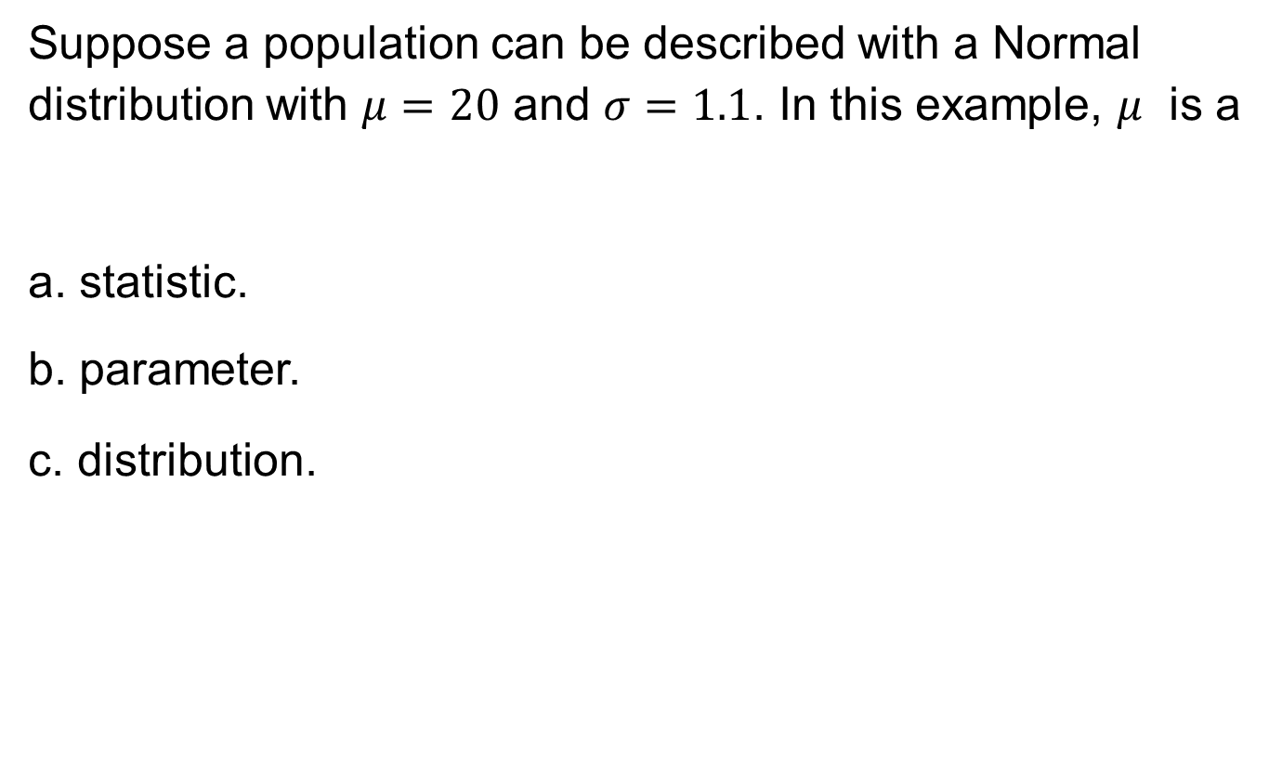
5.1-1
Suppose a population can be described with a Normal distribution with $μ=20$ and $σ=1.1$. In this example, $μ$ is a
a. statistic.
b. parameter.
c. distribution.

Slide 3
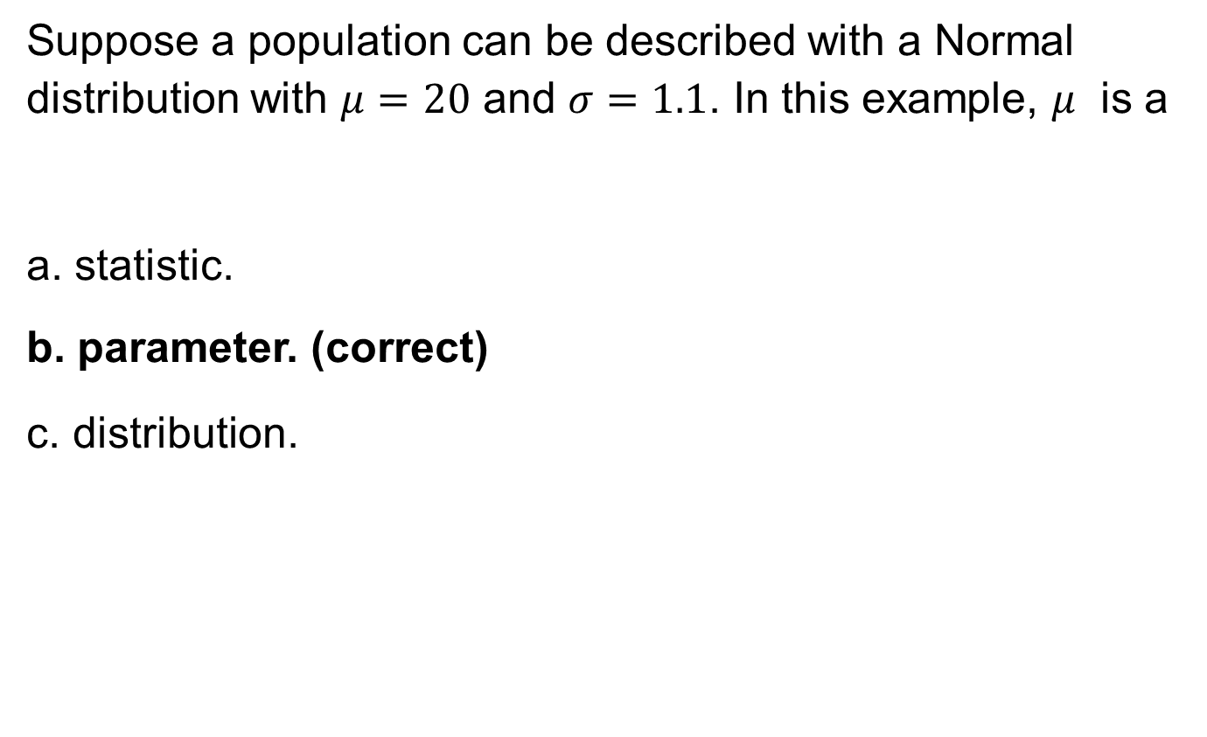
5.1-1 answer
Suppose a population can be described with a Normal distribution with $μ=20$ and $σ=1.1$. In this example, $μ$ is a
a. statistic.
b. parameter. (correct)
c. distribution.

Slide 4
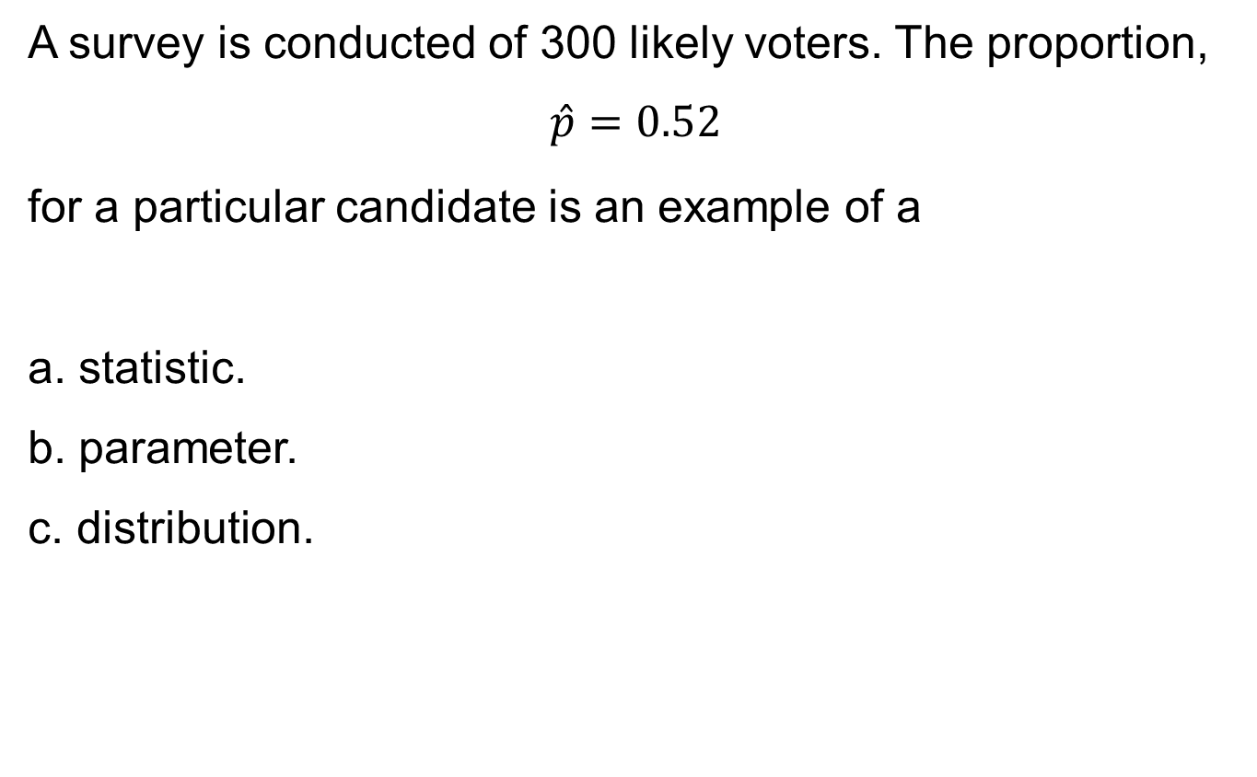
5.1-2
A survey is conducted of 300 likely voters. The proportion,
$$\hat{p}=0.52$$
for a particular candidate is an example of a
a. statistic.
b. parameter.
c. distribution.

Slide 5
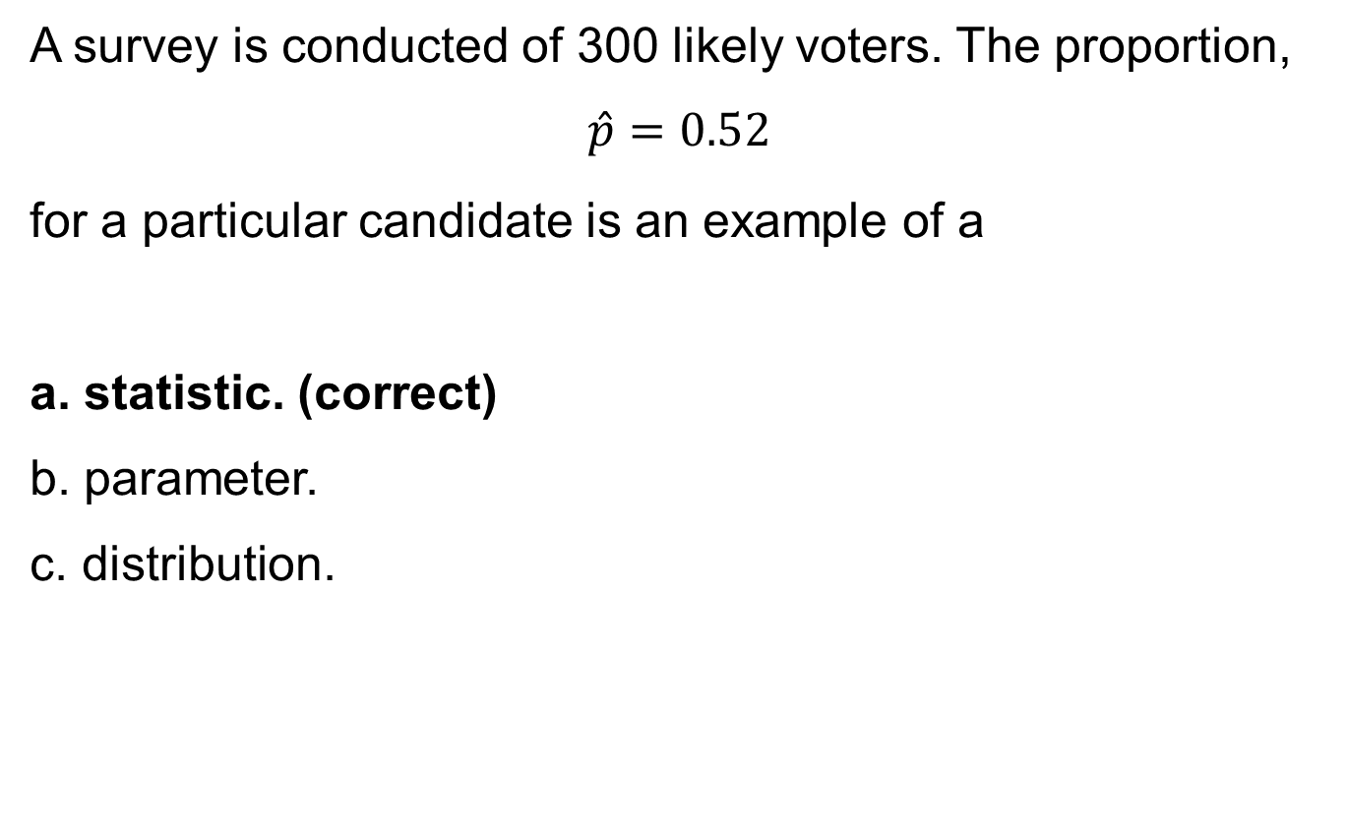
5.1-2 answer
A survey is conducted of 300 likely voters. The proportion,
$$\hat{p}=0.52$$
for a particular candidate is an example of a
a. statistic. (correct)
b. parameter.
c. distribution.

Slide 6
5.1-3
If the sampling distribution of a statistic is centered near the true parameter being estimated, we say it has small
a. bias.
b. variability.
c. margin of error.

Slide 7
5.1-3 answer
If the sampling distribution of a statistic is centered near the true parameter being estimated, we say it has small
a. bias. (correct)
b. variability.
c. margin of error.

Slide 8
5.1-4
If we were estimating a population mean, which of the following sample sizes would have the lowest variability in the sampling distribution?
a. 10
b. 100
c. 1000

Slide 9
5.1-4 answer
If we were estimating a population mean, which of the following sample sizes would have the lowest variability in the sampling distribution?
a. 10
b. 100
c. 1000 (correct)

Slide 10
5.2-1
A population distribution has a mean of 100 and variance of 16. The standard deviation of the sampling distribution with a sample of size 25 would be
a. 0.64.
b. 4.
c. 0.8.

Slide 11
5.2-1 answer
A population distribution has a mean of 100 and variance of 16. The standard deviation of the sampling distribution with a sample of size 25 would be
a. 0.64.
b. 4.
c. 0.8. (correct)

Slide 12
5.2-2
The scores of individual students on the ACT Program composite college entrance examination have a Normal distribution with mean 18.6 and standard deviation 6.0. At Northside High, 36 seniors take the test. If the scores at this school have the same distribution as national scores, the sampling distribution of the average (sample mean) score for the 36 students is
a. approximately Normal, but the approximation is poor.
b. approximately Normal, and the approximation is good.
c. exactly normal.

Slide 13
5.2-2 answer
The scores of individual students on the ACT Program composite college entrance examination have a Normal distribution with mean 18.6 and standard deviation 6.0. At Northside High, 36 seniors take the test. If the scores at this school have the same distribution as national scores, the sampling distribution of the average (sample mean) score for the 36 students is
a. approximately Normal, but the approximation is poor.
b. approximately Normal, and the approximation is good.
c. exactly normal. (correct)

Slide 14
5.2-3
Incomes in a certain town are strongly right-skewed with mean $36,000 and standard deviation $7000. A random sample of 75 households is taken. What is the standard deviation of the sample mean?
a. $808.29
b. $93.33
c. $7000

Slide 15
5.2-3 answer
Incomes in a certain town are strongly right-skewed with mean $36,000 and standard deviation $7000. A random sample of 75 households is taken. What is the standard deviation of the sample mean?
a. $808.29 (correct)
b. $93.33
c. $7000

Slide 16
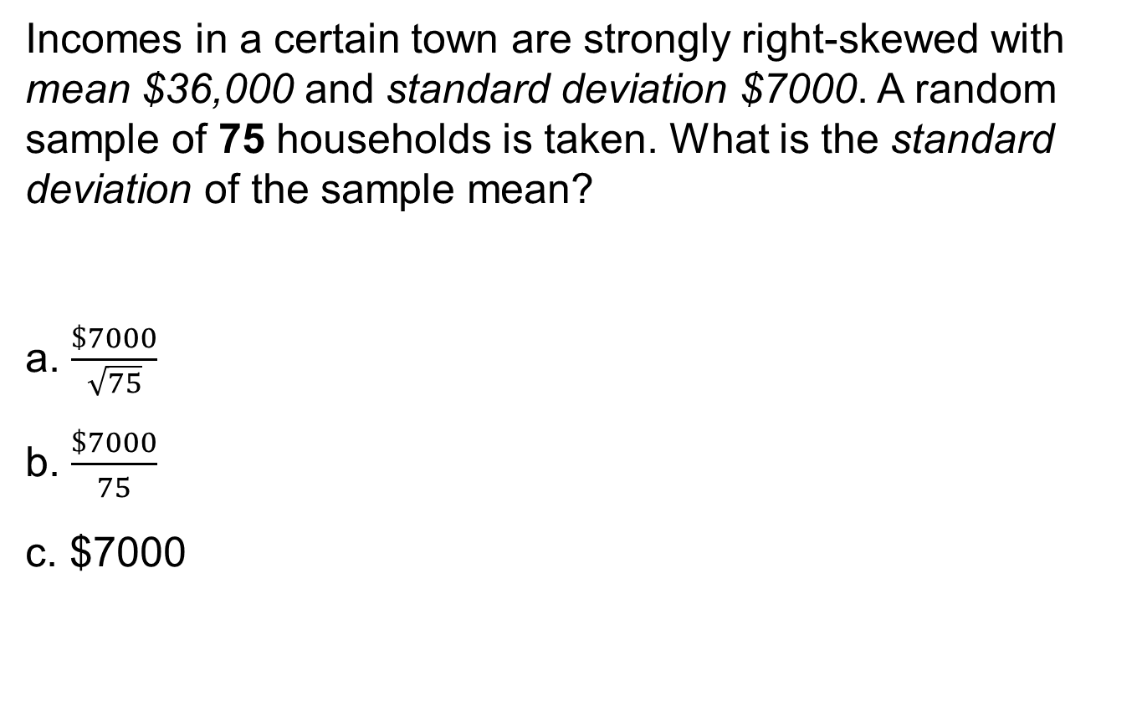
5.2-4
Incomes in a certain town are strongly right-skewed with mean $36,000 and standard deviation $7000. A random sample of 75 households is taken. What is the standard deviation of the sample mean?
a. $\frac{\$7000}{\sqrt{75}}$
b. $\frac{\$7000}{75}$
c. $7000

Slide 17
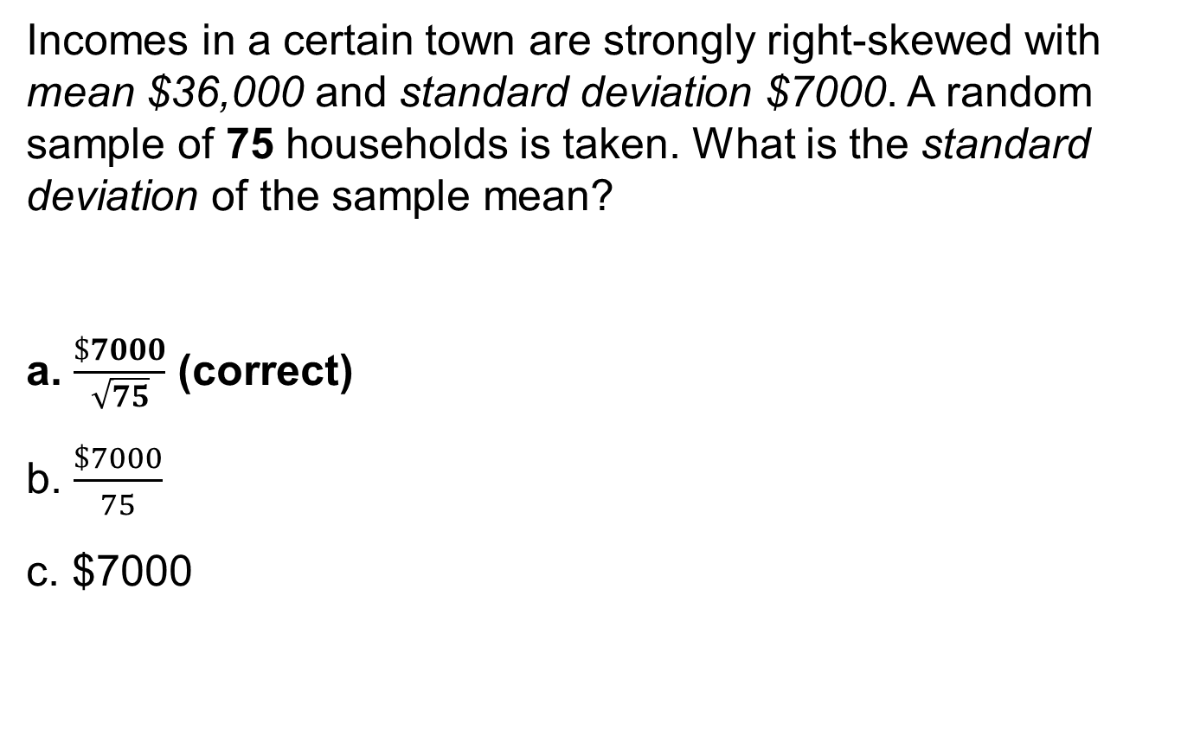
5.2-4 answer
Incomes in a certain town are strongly right-skewed with mean $36,000 and standard deviation $7000. A random sample of 75 households is taken. What is the standard deviation of the sample mean?
a. $\frac{\$7000}{\sqrt{75}}$ (correct)
b. $\frac{\$7000}{75}$
c. $7000

Slide 18
5.2-5
Incomes in a certain town are strongly right-skewed with mean $36,000 and standard deviation $7000. A random sample of 75 households is taken.
What is the probability that the sample mean is greater than $37,000?
a. 0.4432
b. 0.1080
c. 0

Slide 19
5.2-5 answer
Incomes in a certain town are strongly right-skewed with mean $36,000 and standard deviation $7000. A random sample of 75 households is taken.
What is the probability that the sample mean is greater than $37,000?
a. 0.4432
b. 0.1080 (correct)
c. 0

Slide 20
5.2-6
The sodas in a can are supposed to contain an average of 12 oz. This particular brand has a standard deviation of 0.1 oz, with an average of 12.1 oz. If the can’s contents follow a Normal distribution, what is the probability that the mean contents of a six-pack are less than 12 oz?
a. 0.007
b. 0.1587
c. 0.9928

Slide 21
5.2-6 answer
The sodas in a can are supposed to contain an average of 12 oz. This particular brand has a standard deviation of 0.1 oz, with an average of 12.1 oz. If the can’s contents follow a Normal distribution, what is the probability that the mean contents of a six-pack are less than 12 oz?
a. 0.007 (correct)
b. 0.1587
c. 0.9928

Slide 22
5.2-7
The contents of bottles of beer are Normally distributed with a mean of 300 ml and a standard deviation of 5 ml.
What is the probability that the contents of an individual bottle exceed 303 ml?
a. 0.1743
b. 0.2743
c. 0.3714

Slide 23
5.2-7 answer
The contents of bottles of beer are Normally distributed with a mean of 300 ml and a standard deviation of 5 ml.
What is the probability that the contents of an individual bottle exceed 303 ml?
a. 0.1743
b. 0.2743 (correct)
c. 0.3714

Slide 24
5.2-8
The contents of bottles of beer are Normally distributed with a mean of 300 ml and a standard deviation of 5 ml.
What is the probability that the total contents of a six-pack exceed 1776 ml?
a. 0.9750
b. 0.1876
c. 0.3348

Slide 25
5.2-8 answer
The contents of bottles of beer are Normally distributed with a mean of 300 ml and a standard deviation of 5 ml.
What is the probability that the total contents of a six-pack exceed 1776 ml?
a. 0.9750 (correct)
b. 0.1876
c. 0.3348

Slide 26
5.2-9
The contents of bottles of beer are Normally distributed with a mean of 300 ml and a standard deviation of 5 ml.
There is a 6.3% chance that the average contents of a six-pack will exceed how many milliliters?
a. 301.11
b. 302.12
c. 303.12

Slide 27
5.2-9 answer
The contents of bottles of beer are Normally distributed with a mean of 300 ml and a standard deviation of 5 ml.
There is a 6.3% chance that the average contents of a six-pack will exceed how many millliters?
a. 301.11
b. 302.12
c. 303.12 (correct)

Slide 28
5.2-10
The contents of bottles of beer are Normally distributed with a mean of 300 ml and a standard deviation of 5 ml.
What is the probability that the contents of an individual bottle will be between 294 ml and 306 ml?
a. 0.5392
b. 0.8419
c. 0.7698

Slide 29
5.2-10 answer
The contents of bottles of beer are Normally distributed with a mean of 300 ml and a standard deviation of 5 ml.
What is the probability that the contents of an individual bottle will be between 294 ml and 306 ml?
a. 0.5392
b. 0.8419
c. 0.7698 (correct)

Slide 30
5.2-11
The contents of bottles of beer are Normally distributed with a mean of 300 ml and a standard deviation of 5 ml.
What is the probability that the total contents of a six-pack will be between 1758 ml and 1842 ml?
a. 0.9994
b. 0.9996
c. 0.9998

Slide 31
5.2-11 answer
The contents of bottles of beer are Normally distributed with a mean of 300 ml and a standard deviation of 5 ml.
What is the probability that the total contents of a six-pack will be between 1758 ml and 1842 ml?
a. 0.9994 (correct)
b. 0.9996
c. 0.9998

Slide 32
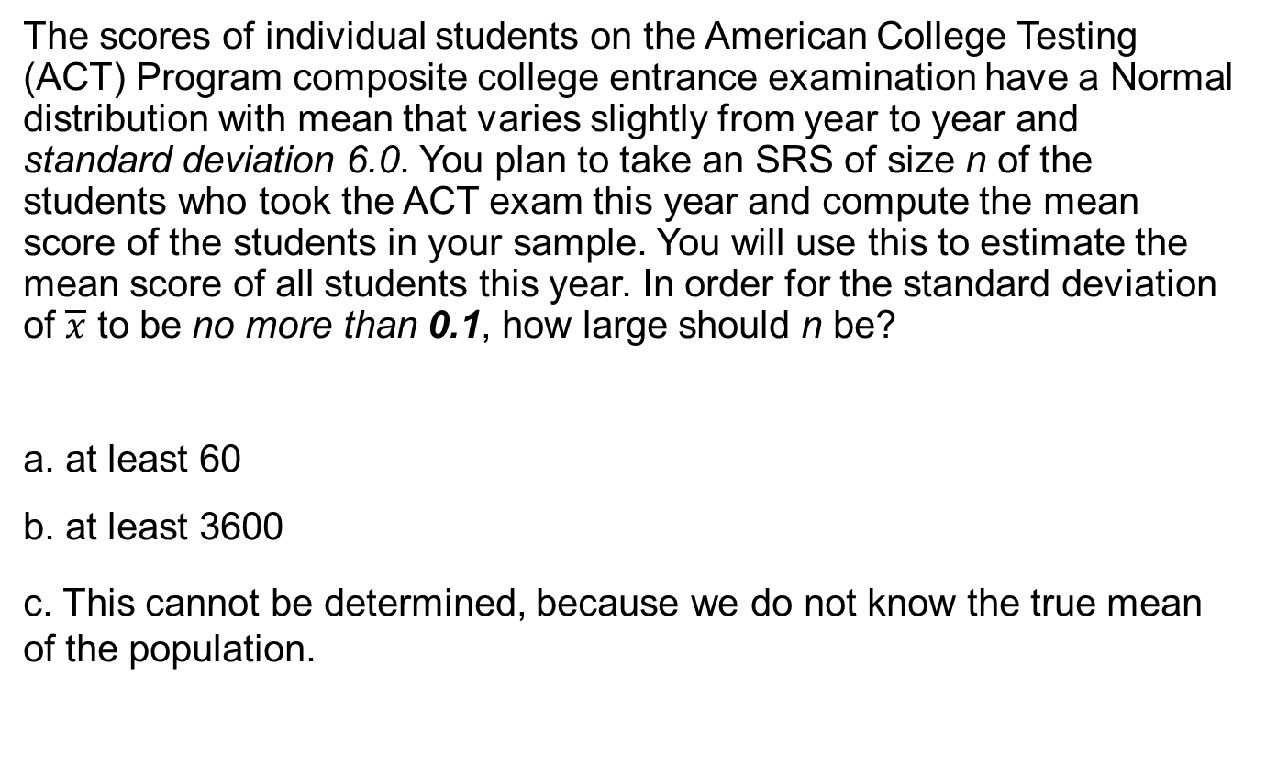
5.2-12
The scores of individual students on the American College Testing (ACT) Program composite college entrance examination have a Normal distribution with mean that varies slightly from year to year and standard deviation 6.0. You plan to take an SRS of size n of the students who took the ACT exam this year and compute the mean score of the students in your sample. You will use this to estimate the mean score of all students this year. In order for the standard deviation of $\overline{x}$ to be no more than 0.1, how large should n be?
a. at least 60
b. at least 3600
c. This cannot be determined, because we do not know the true mean of the population.

Slide 33
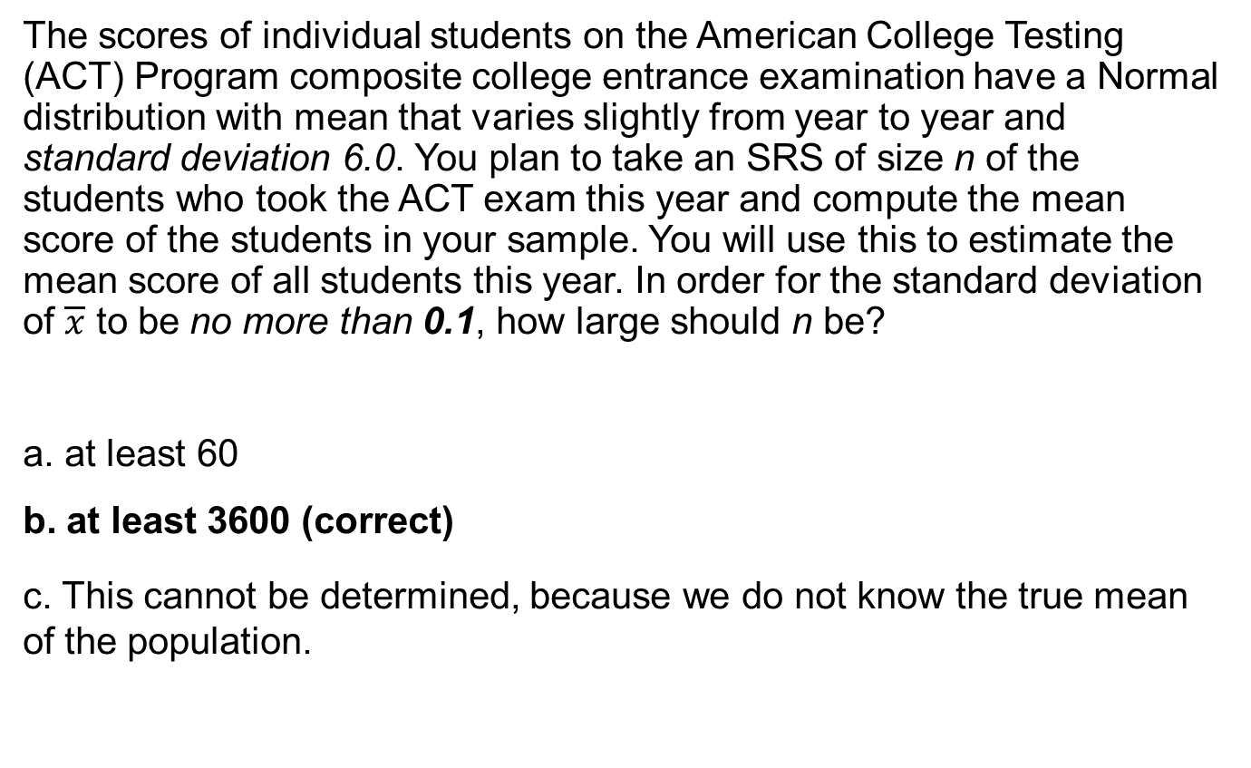
5.2-12 answer
The scores of individual students on the American College Testing (ACT) Program composite college entrance examination have a Normal distribution with mean that varies slightly from year to year and standard deviation 6.0. You plan to take an SRS of size n of the students who took the ACT exam this year and compute the mean score of the students in your sample. You will use this to estimate the mean score of all students this year. In order for the standard deviation of $\overline{x}$ to be no more than 0.1, how large should n be?
a. at least 60
b. at least 3600 (correct)
c. This cannot be determined, because we do not know the true mean of the population.

Slide 34
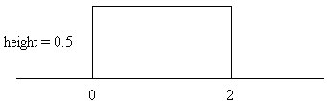
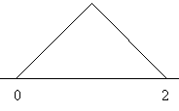
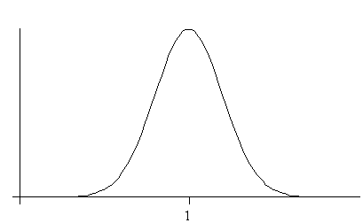
5.2-13
Suppose that the random variable X has a distribution with a density curve that looks like the following:
The sampling distribution of the mean of a random sample of 100 observations from this distribution will have a density curve that looks most like which of the following?
a.
b.
c.

Slide 35
5.2-13 answer
Suppose that the random variable X has a distribution with a density curve that looks like the following:
The sampling distribution of the mean of a random sample of 100 observations from this distribution will have a density curve that looks most like which of the following?
c.
(correct)
a.
b.

Slide 36
5.3-1
Which of the following situations follow(s) a binomial distribution?
I. A local hospital records the sex of 50 births.
II. A coin is flipped until there is a “head.”
III. A deck of 52 cards is flipped until we see a “heart.”
a. I only
b. I and II only
c. I, II, and III only

Slide 37
5.3-1 answer
Which of the following situations follow(s) a binomial distribution?
I. A local hospital records the sex of 50 births.
II. A coin is flipped until there is a “head.”
III. A deck of 52 cards is flipped until we see a “heart.”
a. I only (correct)
b. I and II only
c. I, II, and III only

Slide 38
5.3-2
When a particular penny is held on its edge and spun, the probability that heads are face up when the coin comes to rest is 4/9. If the coin is spun four times, the probability that the coin will come up heads exactly twice is (assume trials are independent)
a. 16/81.
b. 0.366.
c. 0.061.

Slide 39
5.3-2 answer
When a particular penny is held on its edge and spun, the probability that heads are face up when the coin comes to rest is 4/9. If the coin is spun four times, the probability that the coin will come up heads exactly twice is (assume trials are independent)
a. 16/81.
b. 0.366. (correct)
c. 0.061.

Slide 40
5.3-3
When a particular penny is held on its edge and spun, the probability that heads are face up when the coin comes to rest is 4/9. If the coin is spun four times, you would expect how many heads?
a. 9/16
b. 16/9
c. 2

Slide 41
5.3-3 answer
When a particular penny is held on its edge and spun, the probability that heads are face up when the coin comes to rest is 4/9. If the coin is spun four times, you would expect how many heads?
a. 9/16
b. 16/9 (correct)
c. 2

Slide 42
5.3-4
You decide to test a friend for ESP using a standard deck of 52 playing cards. Such a deck contains 13 spades, 13 hearts, 13 diamonds, and 13 clubs. You shuffle the deck, select a card at random, and ask your friend to tell you whether the card is a spade, heart, diamond, or club. After the guess, you return the card to the deck, shuffle the cards, and repeat the above. You do this a total of 100 times. Let X be the number of correct guesses by your friend in the 100 trials. The standard deviation of X is
a. 0.433.
b. 4.33.
c. 18.75.

Slide 43
5.3-4 answer
You decide to test a friend for ESP using a standard deck of 52 playing cards. Such a deck contains 13 spades, 13 hearts, 13 diamonds, and 13 clubs. You shuffle the deck, select a card at random, and ask your friend to tell you whether the card is a spade, heart, diamond, or club. After the guess, you return the card to the deck, shuffle the cards, and repeat the above. You do this a total of 100 times. Let X be the number of correct guesses by your friend in the 100 trials. The standard deviation of X is
a. 0.433.
b. 4.33. (correct)
c. 18.75.

Slide 44
5.3-5
Which of the following might be reasonably modeled by the binomial distribution?
a. the number of customers who enter a store in a 1-hour period, assuming customers enter independently
b. the number of questions you get correct on a 100-question multiple-choice exam in which each question has only four possible answers (assume you have studied extensively for the test)
c. none of the above

Slide 45
5.3-5 answer
Which of the following might be reasonably modeled by the binomial distribution?
a. the number of customers who enter a store in a 1-hour period, assuming customers enter independently
b. the number of questions you get correct on a 100-question multiple-choice exam in which each question has only four possible answers (assume you have studied extensively for the test)
c. none of the above (correct)

Slide 46
5.3-6
There are 20 multiple-choice questions on an exam, each having responses a, b, c, or d. Each question is worth 5 points, and only one response per question is correct. Suppose a student guesses the answer to each question, and her guesses from question to question are independent. If the student needs at least 40 points to pass the test, the probability that the student passes is closest to
a. 0.0609.
b. 0.1019.
c. 0.9590.

Slide 47
5.3-6 answer
There are 20 multiple-choice questions on an exam, each having responses a, b, c, or d. Each question is worth 5 points, and only one response per question is correct. Suppose a student guesses the answer to each question, and her guesses from question to question are independent. If the student needs at least 40 points to pass the test, the that probability the student passes is closest to
a. 0.0609.
b. 0.1019. (correct)
c. 0.9590.

Slide 48
5.3-7
A backpacking party carries five emergency flares, each of which will light with a probability of 0.80. What is the probability that, at most, two will light?
a. 0.056
b. 0.058
c. 0.060

Slide 49
5.3-7 answer
A backpacking party carries five emergency flares, each of which will light with a probability of 0.80. What is the probability that, at most, two will light?
a. 0.056
b. 0.058 (correct)
c. 0.060

Slide 50
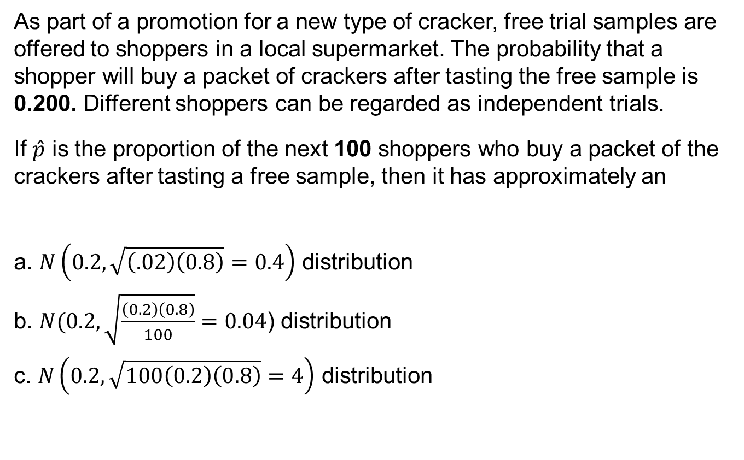
5.3-8
As part of a promotion for a new type of cracker, free trial samples are offered to shoppers in a local supermarket. The probability that a shopper will buy a packet of crackers after tasting the free sample is 0.200. Different shoppers can be regarded as independent trials.
If $\hat{p}$ is the proportion of the next 100 shoppers who buy a packet of the crackers after tasting a free sample, then it has approximately an
a. $N\left(0.2,\sqrt{\left(.02\right)\left(0.8\right)}=0.4\right)$ distribution
b. $N(0.2,\sqrt{\frac{\left(0.2\right)\left(0.8\right)}{100}}=0.04$) distribution
c. $N\left(0.2,\sqrt{100\left(0.2\right)\left(0.8\right)}=4\right)$ distribution

Slide 51
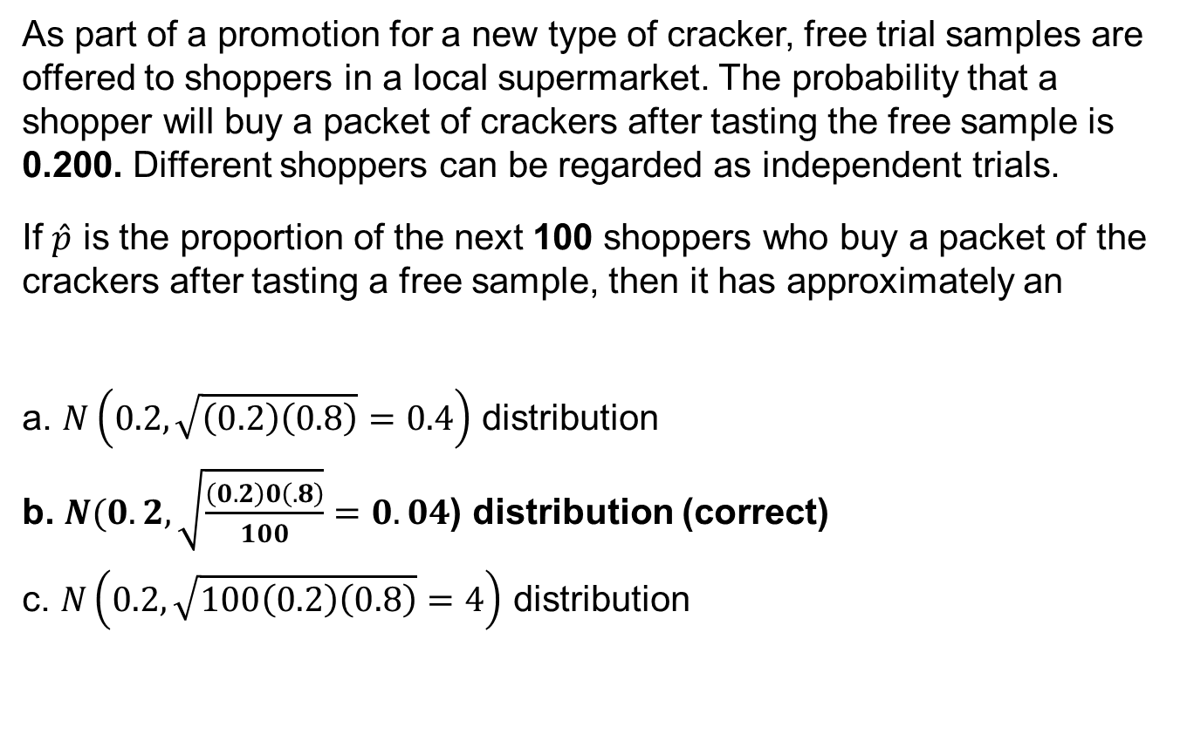
5.3-8 answer
As part of a promotion for a new type of cracker, free trial samples are offered to shoppers in a local supermarket. The probability that a shopper will buy a packet of crackers after tasting the free sample is 0.200. Different shoppers can be regarded as independent trials.
If $\hat{p}$ is the proportion of the next 100 shoppers who buy a packet of the crackers after tasting a free sample, then it has approximately an
a. $N\left(0.2,\sqrt{\left(0.2\right)\left(0.8\right)}=0.4\right)$ distribution
b. $N(0.2,\sqrt{\frac{\left(0.2\right)0\left(.8\right)}{100}}=0.04$) distribution (correct)
c. $N\left(0.2,\sqrt{100\left(0.2\right)\left(0.8\right)}=4\right)$ distribution

Slide 52
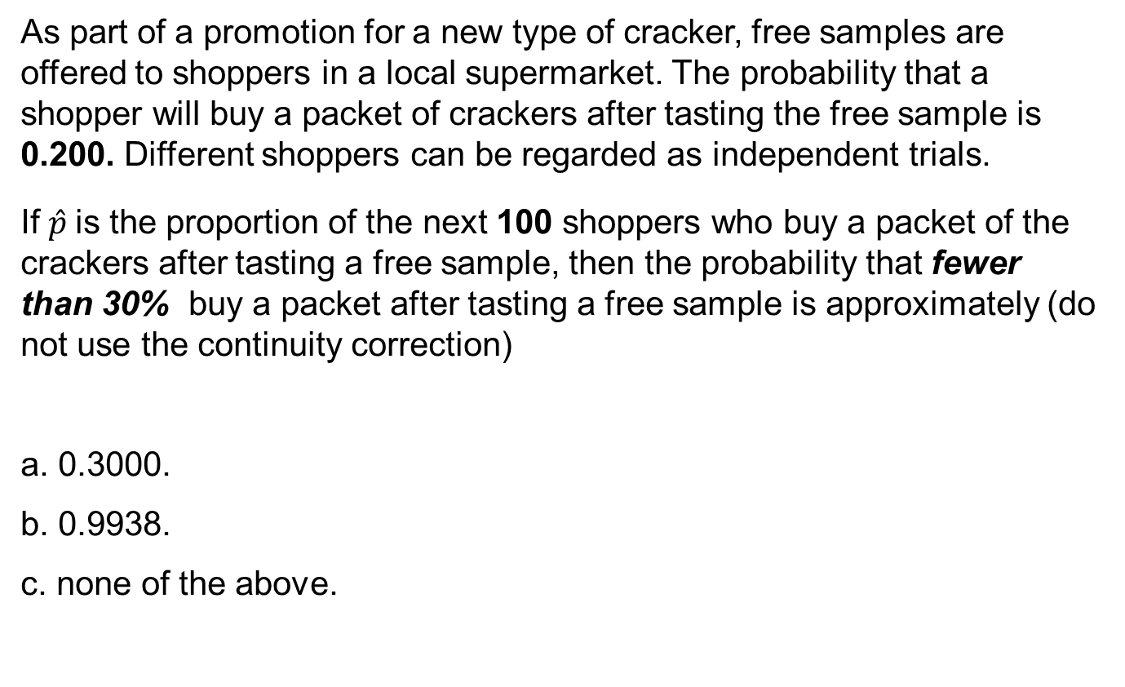
5.3-9
As part of a promotion for a new type of cracker, free samples are offered to shoppers in a local supermarket. The probability that a shopper will buy a packet of crackers after tasting the free sample is 0.200. Different shoppers can be regarded as independent trials.
If $\hat{p}$is the proportion of the next 100 shoppers who buy a packet of the crackers after tasting a free sample, then the probability that fewer than 30% buy a packet after tasting a free sample is approximately (do not use the continuity correction)
a. 0.3000.
b. 0.9938.
c. none of the above.

Slide 53
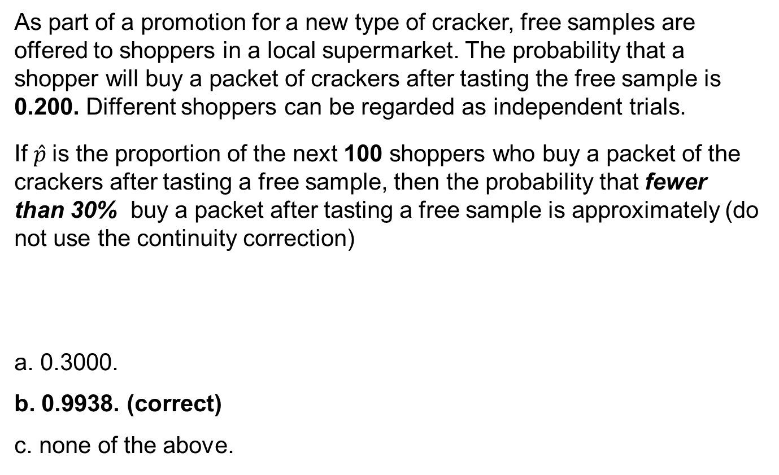
5.3-9 answer
As part of a promotion for a new type of cracker, free samples are offered to shoppers in a local supermarket. The probability that a shopper will buy a packet of crackers after tasting the free sample is 0.200. Different shoppers can be regarded as independent trials.
If $\hat{p}$is the proportion of the next 100 shoppers who buy a packet of the crackers after tasting a free sample, then the probability that fewer than 30% buy a packet after tasting a free sample is approximately (do not use the continuity correction)
a. 0.3000.
b. 0.9938. (correct)
c. none of the above.

Slide 54
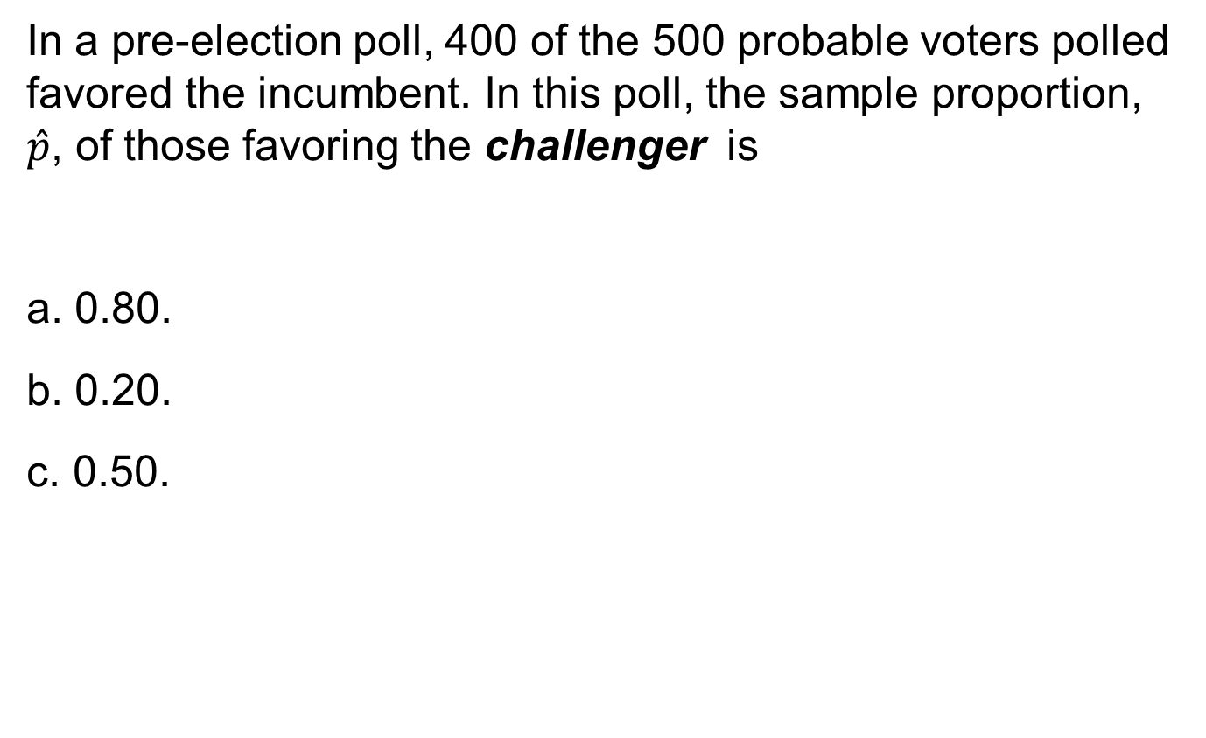
5.3-10
In a pre-election poll, 400 of the 500 probable voters polled favored the incumbent. In this poll, the sample proportion, $\hat{p}$, of those favoring the challenger is
a. 0.80.
b. 0.20.
c. 0.50.

Slide 55
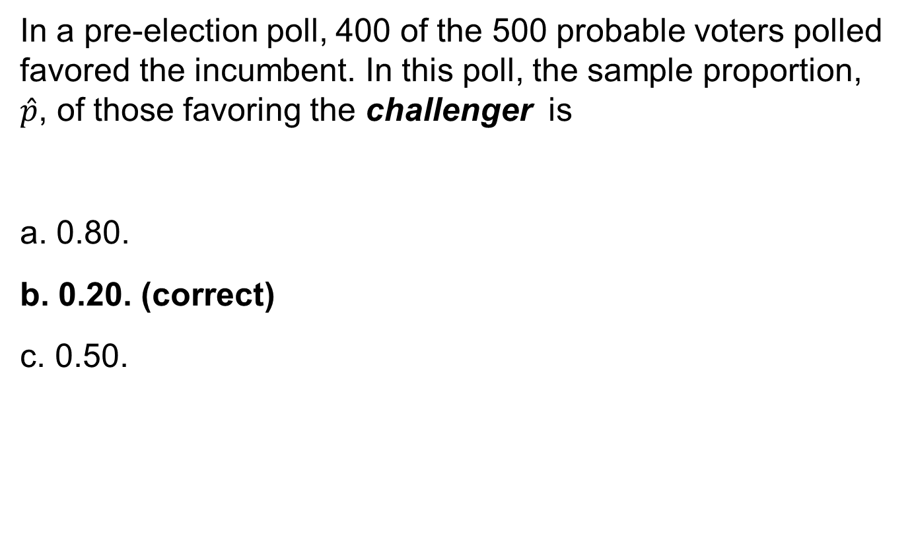
5.3-10 answer
In a pre-election poll, 400 of the 500 probable voters polled favored the incumbent. In this poll, the sample proportion, $\hat{p}$, of those favoring the challenger is
a. 0.80.
b. 0.20. (correct)
c. 0.50.

Slide 56
5.3-12
It is known that 20% of a certain type of scratch-and-win tickets are winners. If you buy 10 tickets, what is the probability that at least two of them are winners?
a. 0.107
b. 0.625
c. 0.268

Slide 57
5.3-12 answer
It is known that 20% of a certain type of scratch-and-win tickets are winners. If you buy 10 tickets, what is the probability that at least two of them are winners?
a. 0.107
b. 0.625 (correct)
c. 0.268
= 1 – (0.107 + 0.268)

Slide 58
5.3-13
It is known that 20% of a certain type of scratch-and-win tickets are winners. If you buy 100 tickets, what is the approximate probability that at least 25 of them are winners?
a. 0.1056
b. 0.1539
c. 0.2061

Slide 59
5.3-13 answer
It is known that 20% of a certain type of scratch-and-win tickets are winners. If you buy 100 tickets, what is the approximate probability that at least 25 of them are winners?
a. 0.1056 (correct)
b. 0.1539
c. 0.2061
Z = 1.25, area = 0.8944, then (1 – 0.8944) = 0.1056

Slide 60
5.3-14
We want to take a sample of 100 items out of a large batch for quality control purposes. Based on past history, the proportion of defective items is 4%.
Can we use the Normal approximation to the binomial distribution to find the probability of finding more than five defective items in the sample of 100?
a. Yes, because n is large.
b. No.
c. We do not have enough information.

Slide 61
5.3-14 answer
We want to take a sample of 100 items out of a large batch for quality control purposes. Based on past history, the proportion of defective items is 4%.
Can we use the Normal approximation to the binomial distribution to find the probability of finding more than five defective items in the sample of 100?
a. Yes, because n is large.
b. No. (correct)
c. We do not have enough information.

Slide 62
5.3-15
A national poll of 600 men announced that the proportion in the survey who claimed to help their wives at home was 85%. If we took a larger poll of 1200 men, what would be the standard deviation of the number of men who help at home, based on the first survey?
a. 12.37
b. 17.32
c. 153

Slide 63
5.3-15 answer
A national poll of 600 men announced that the proportion in the survey who claimed to help their wives at home was 85%. If we took a larger poll of 1200 men, what would be the standard deviation of the number of men who help at home, based on the first survey?
a. 12.37 (correct)
b. 17.32
c. 153

Slide 64
5.3-16
From previous polls, it is believed that 66% of likely voters prefer the incumbent. A new poll of 500 likely voters will be conducted. In the new poll, if the proportion favoring the incumbent has not changed, what will be the mean and standard deviation of the number preferring the incumbent?
a. μ = 330, σ = 10.59
b. μ = 0.66, σ = 0.021
c. μ = 330, σ = 18.17

Slide 65
5.3-16 answer
From previous polls, it is believed that 66% of likely voters prefer the incumbent. A new poll of 500 likely voters will be conducted. In the new poll, if the proportion favoring the incumbent has not changed, what will be the mean and standard deviation of the number preferring the incumbent?
a. μ = 330, σ = 10.59 (correct)
b. μ = 0.66, σ = 0.021
c. μ = 330, σ = 18.17

Slide 66
5.3-17
A communication-monitoring company claims that 45% of email messages are spam. Suppose you randomly select 12 messages from your inbox. What is the probability that at least seven of them are spam?
a. 0.2607
b. 0.1489
c. 0.8882

Slide 67
5.3-17 answer
A communication-monitoring company claims that 45% of email messages are spam. Suppose you randomly select 12 messages from your inbox. What is the probability that at least seven of them are spam?
a. 0.2607 (correct)
b. 0.1489
c. 0.8882

Slide 68
5.3-18
A communication-monitoring company claims that 45% of email messages are spam. After being on vacation, you return to 250 emails in your inbox. What is the approximate probability that at least 40% are spam?
a. 0.9441
b. 0.7500
c. 0.6341

Slide 69
5.3-18 answer
A communication-monitoring company claims that 45% of email messages are spam. After being on vacation, you return to 250 emails in your inbox. What is the approximate probability that at least 40% are spam?
a. 0.9441 (correct)
b. 0.7500
c. 0.6341

Slide 70
5.3-19
The proportion of students who own a cell phone on the university campus is approximately 90%. In a random sample of 15 students, what is the probability that exactly 11 of them own a cell phone?
a. 0.0428
b. 0.0567
c. 0.0678

Slide 71
5.3-19 answer
The proportion of students who own a cell phone on the university campus is approximately 90%. In a random sample of 15 students, what is the probability that exactly 11 of them own a cell phone?
a. 0.0428 (correct)
b. 0.0567
c. 0.0678

Slide 72
5.3-20
A manufacturing plant has an accident rate of 1.8 accidents per month. What is the probability of having at most one accident next month?
a. 0.1653
b. 0.4628
c. 0.2975

Slide 73
5.3-20 answer
A manufacturing plant has an accident rate of 1.8 accidents per month. What is the probability of having at most one accident next month?
a. 0.1653
b. 0.4628 (correct)
c. 0.2975

Slide 74
5.3-21
A manufacturing plant has an accident rate of 1.8 accidents per month. What is the probability of having at least one accident next month?
a. 0.2975
b. 0.1653
c. 0.8347

Slide 75
5.3-21 answer
A manufacturing plant has an accident rate of 1.8 accidents per month. What is the probability of having at least one accident next month?
a. 0.2975
b. 0.1653
c. 0.8347 (correct)

Slide 76
5.3-22
A car dealership sells a particular luxury car at a rate of 1.1 per week. What is the probability that it will sell three cars next week?
a. 0.9743
b. 0.2717
c. 0.0738

Slide 77
5.3-22 answer
A car dealership sells a particular luxury car at a rate of 1.1 per week. What is the probability that it will sell three cars next week?
a. 0.9743
b. 0.2717
c. 0.0738 (correct)

