Slide 1
Review 6
From Continuous Random Variable(RV) –
The Normal Distribution
Class 6

Slide 2
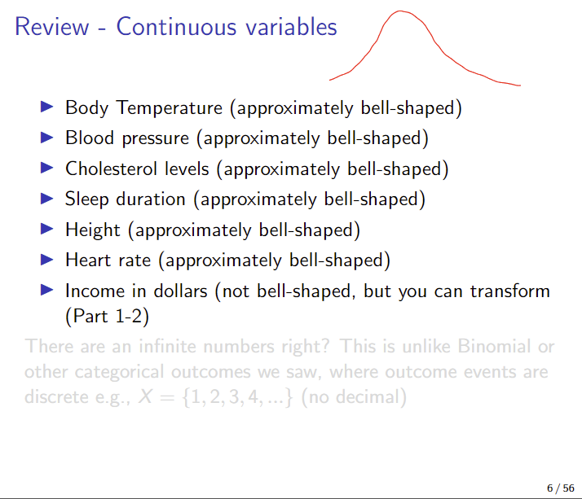

Slide 3
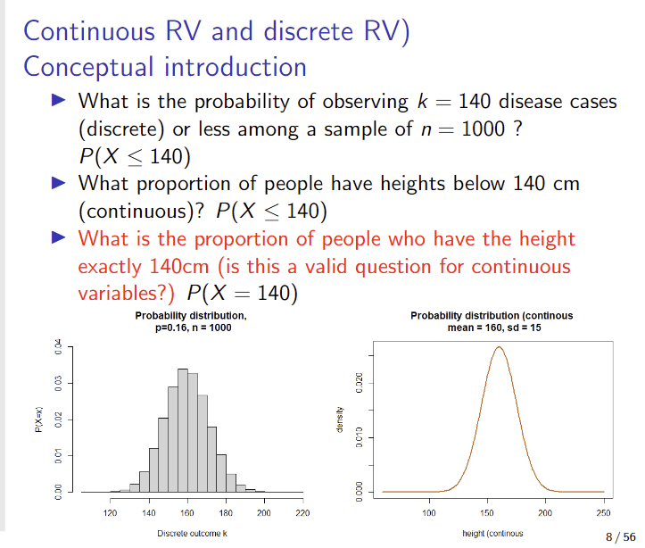

Slide 4
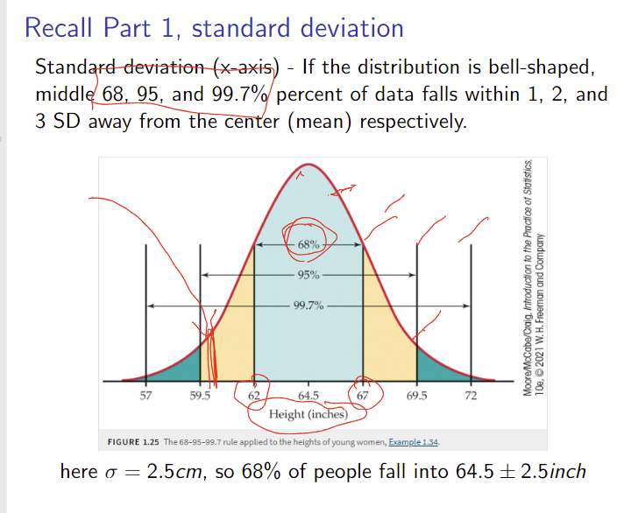

Slide 5
Normal Distribution - Motivation in population risk assessment
You need to assess the proportion (or probability) of people falling into a risk group for intervention, based on a threshold defining.
Example: blood pressure (~ 135 mm Hg for systolic blood pressure for Stage 1 Hypertension).
To calculate the proportion falling into risk groups, you need the Normal distribution, with its mean and SD provided by someone (e.g., national mean such as 114mm Hg and SD about 20 mm Hg, if applicable to your own target population).

Slide 6
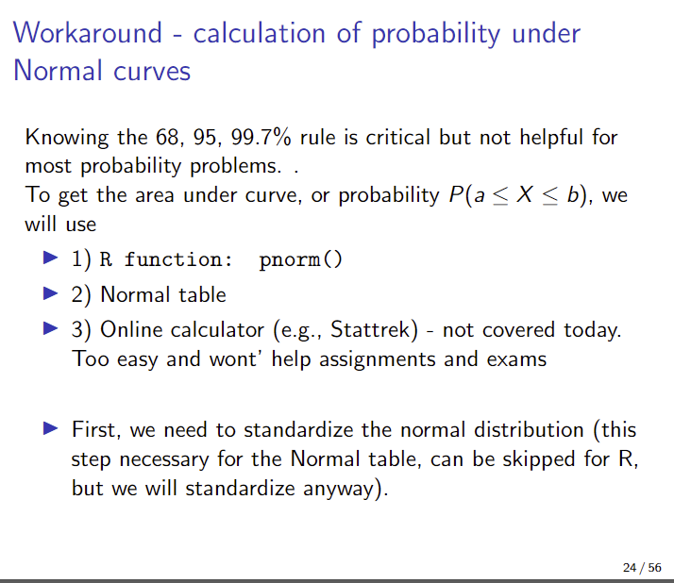

Slide 7
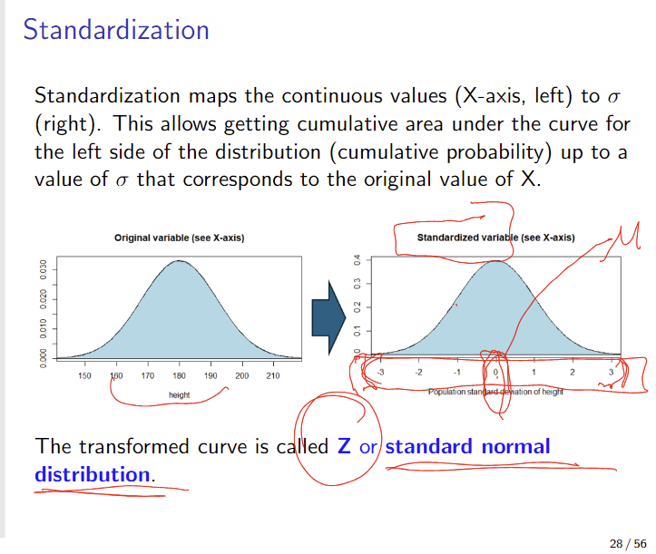

Slide 8
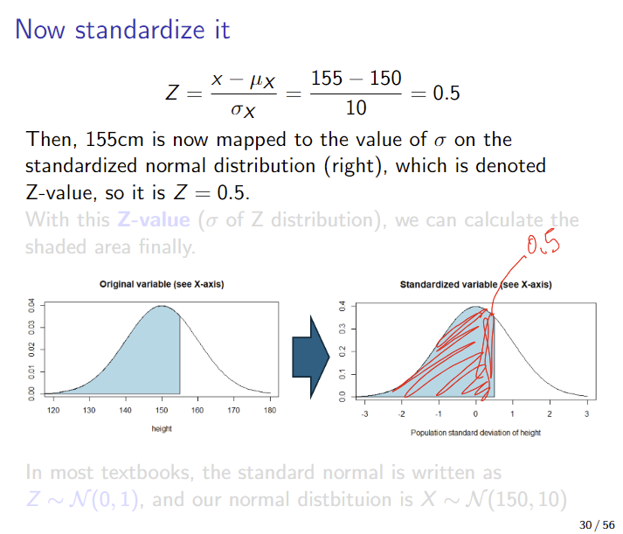

Slide 9
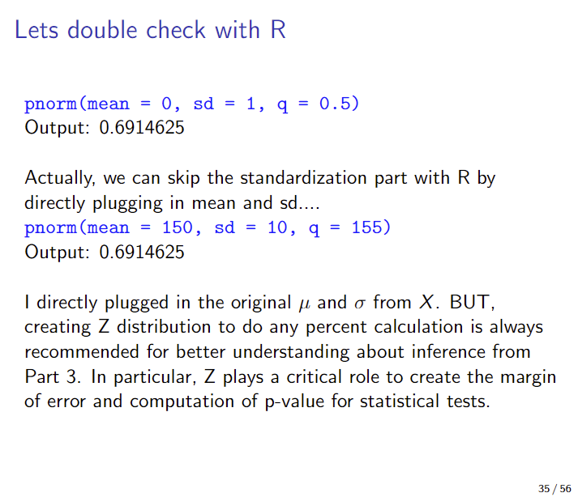

Slide 10
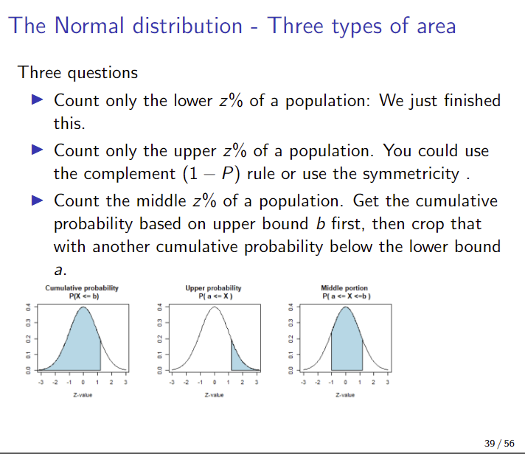

Slide 11
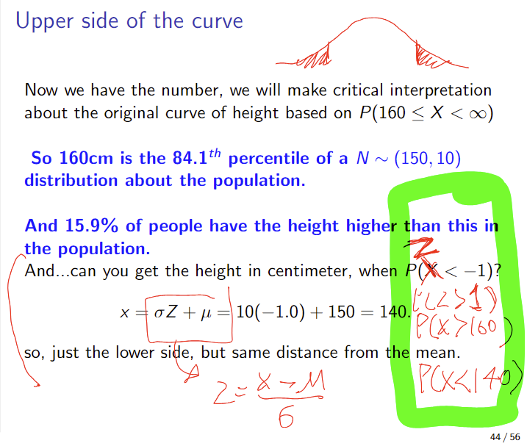

Slide 12
