Slide 1
Review 7
Central Limit Theorem (CLT)
Law of Large Numbers (LLN)
Poisson RV for count data

Slide 2
TA hours and locations from September 11th
Joseph Junior Damba joseph.damba@mcgill.ca
Mondays 1:30-2:30PM
Audrey Michell audrey.mitchell@mcgill.ca
Tuesdays 2:30 - 3:30PM
Jessica Dekker jessica.dekker@mcgill.ca
Wednesdays 1:30-2:30PM
Amaar Lila amaar.lila@mcgill.ca
Thursdays 10:30-11:30 AM
Rooms will be
Room 1206 (SPGH building) Except Thursdays
Room 129 (Here) on Thursdays
* We will notify if we need to change hours and rooms during the semester.

Slide 3
Poisson Distribution

Slide 4
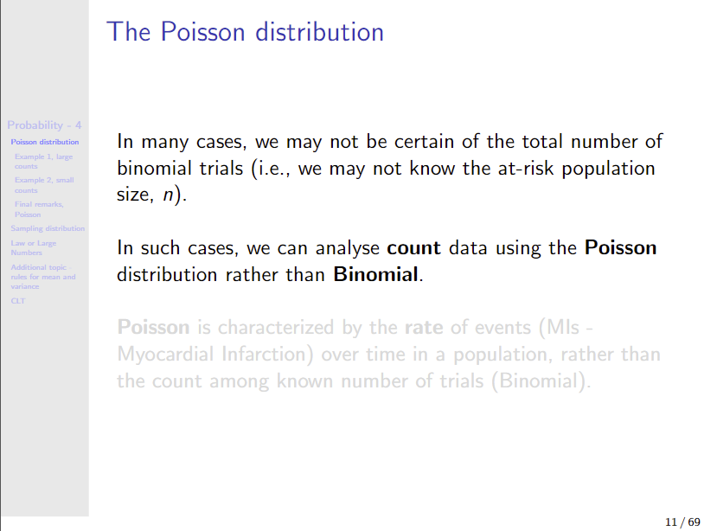

Slide 5
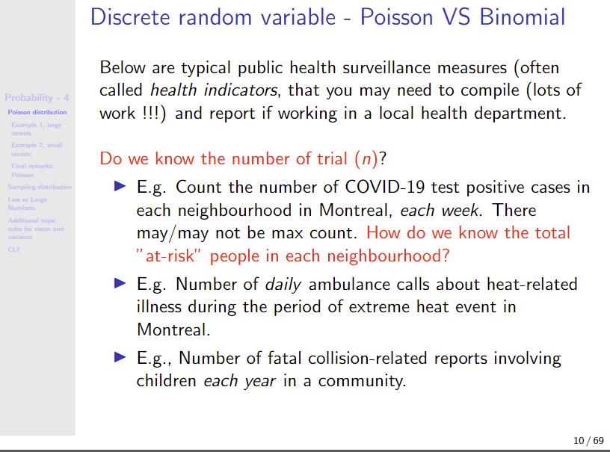

Slide 6
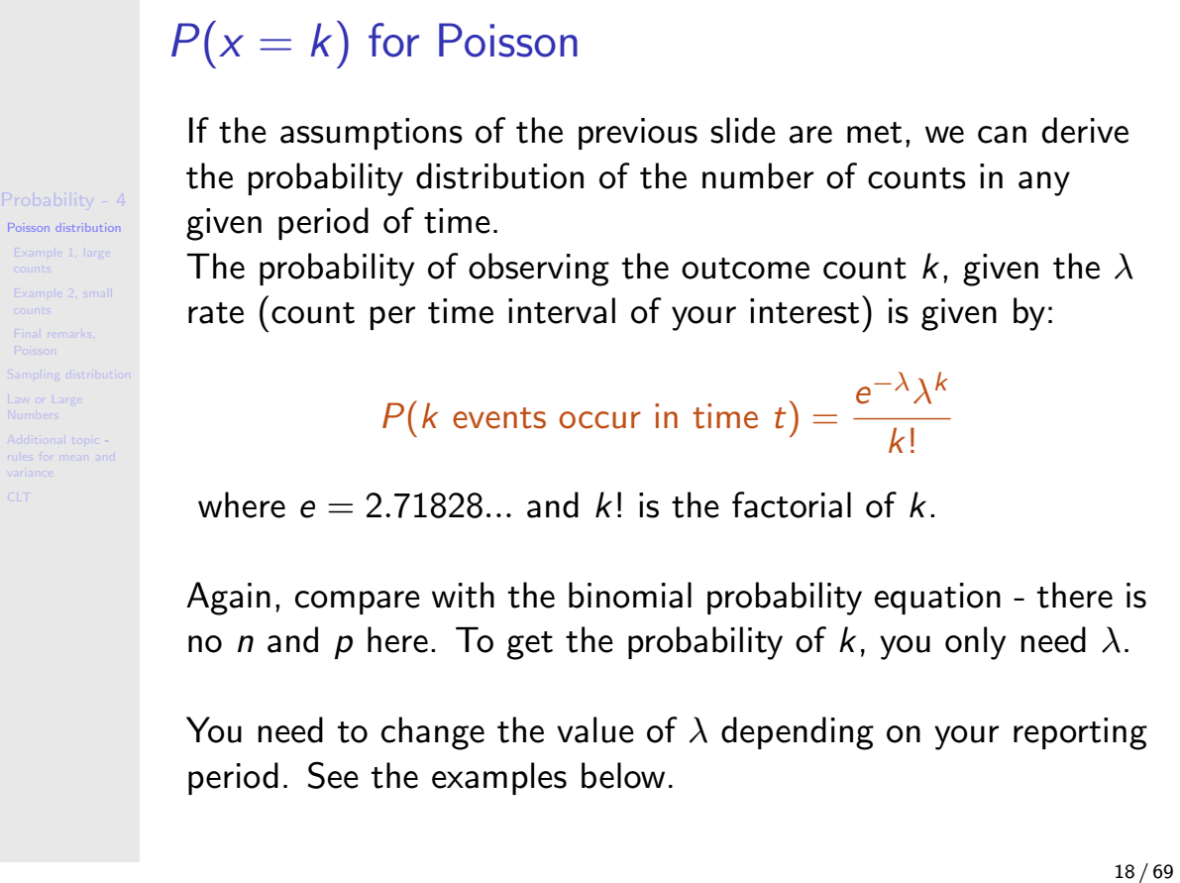

Slide 7
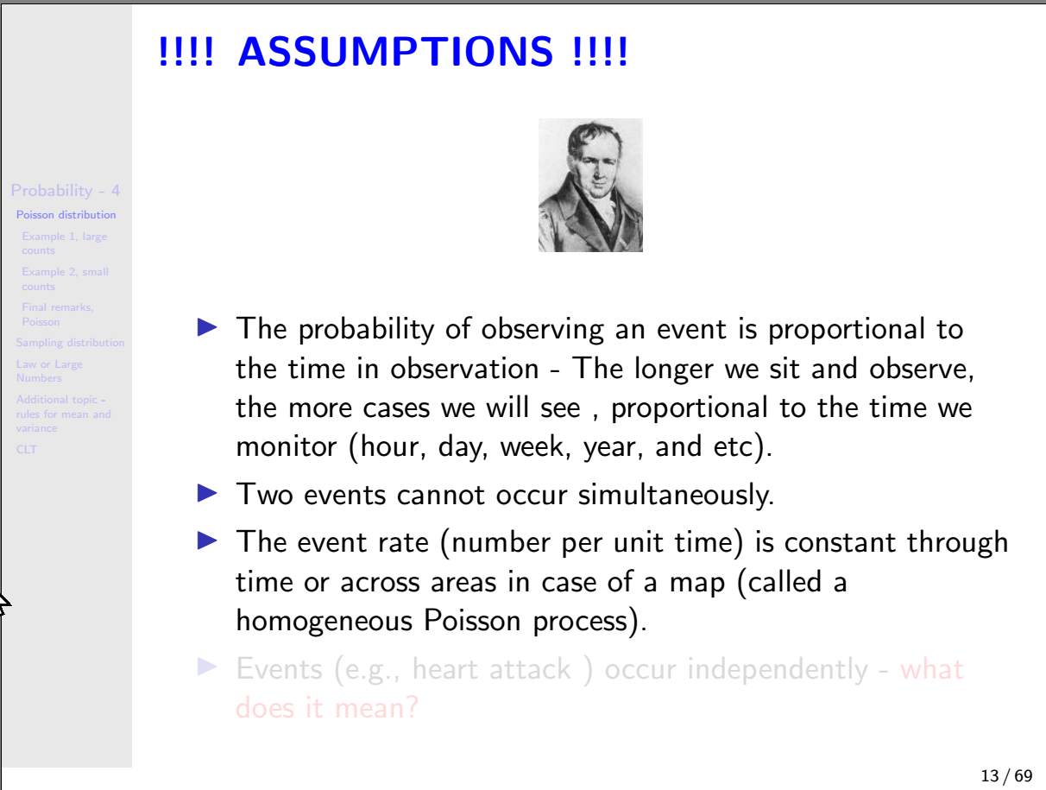

Slide 8
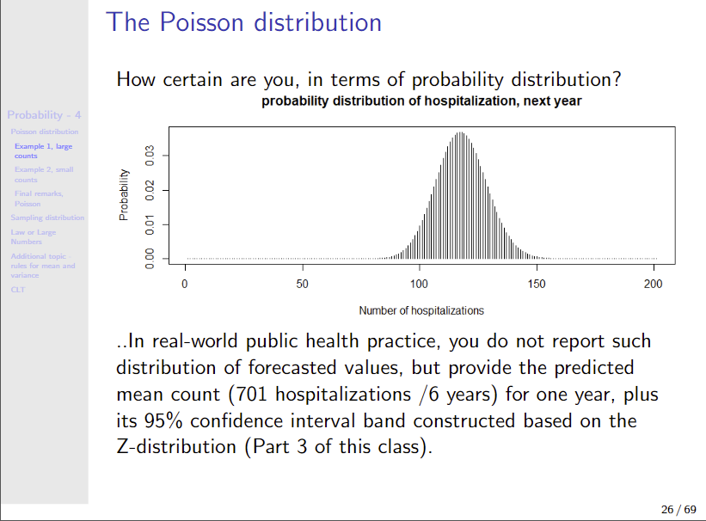

Slide 9
Addition of random variables

Slide 10
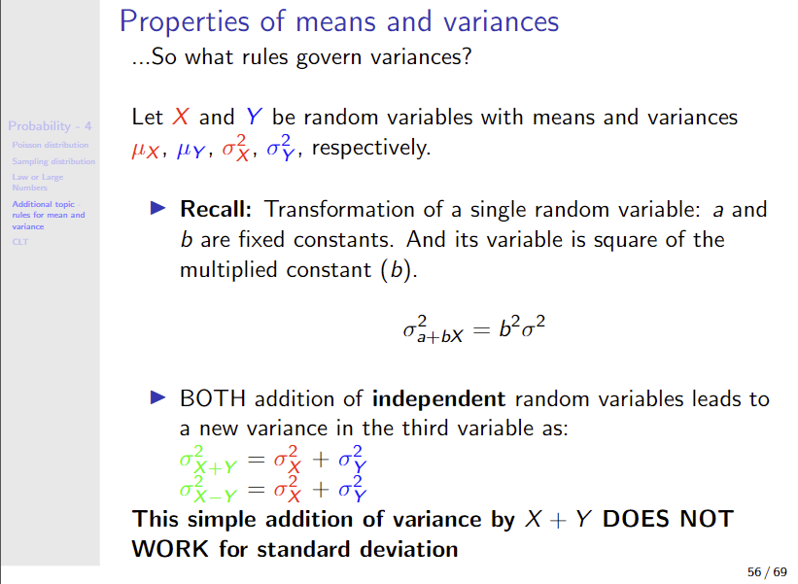

Slide 11
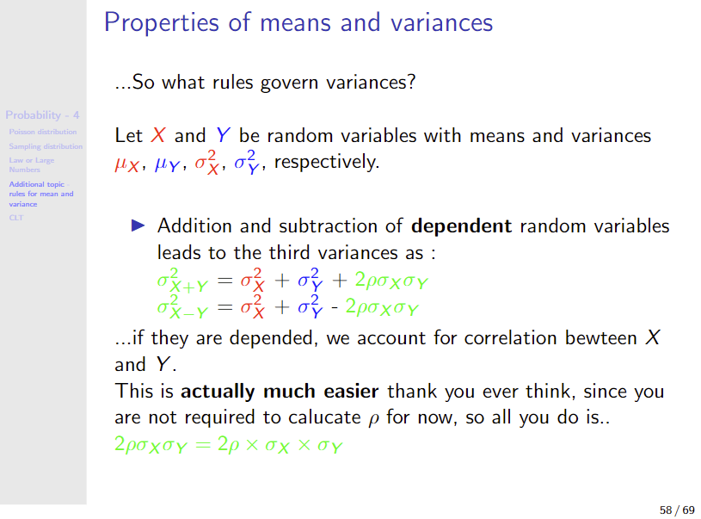

Slide 12
Sampling distribution Law of Large Numbers (LLN), and Central Limit Theorem (CLT)

Slide 13
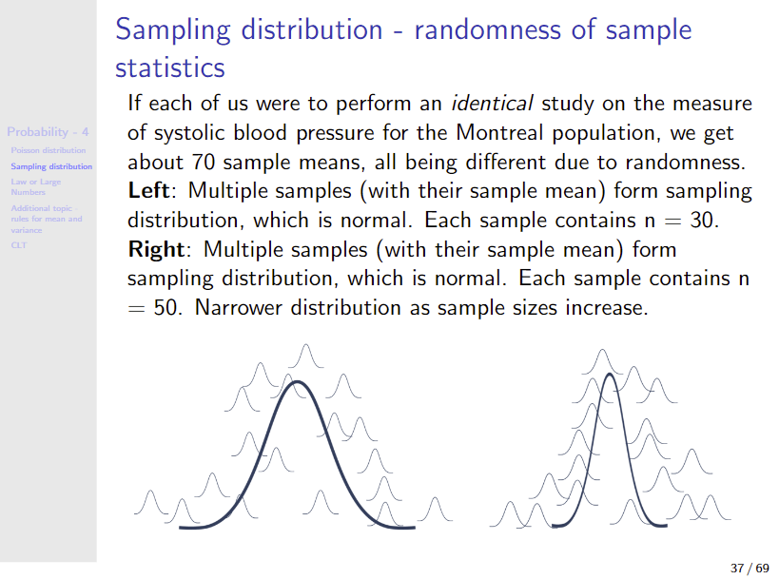

Slide 14
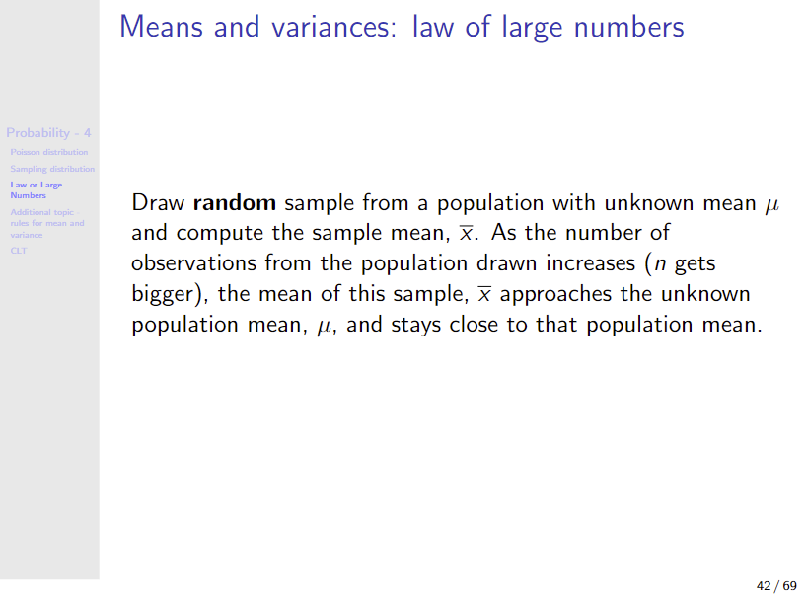

Slide 15
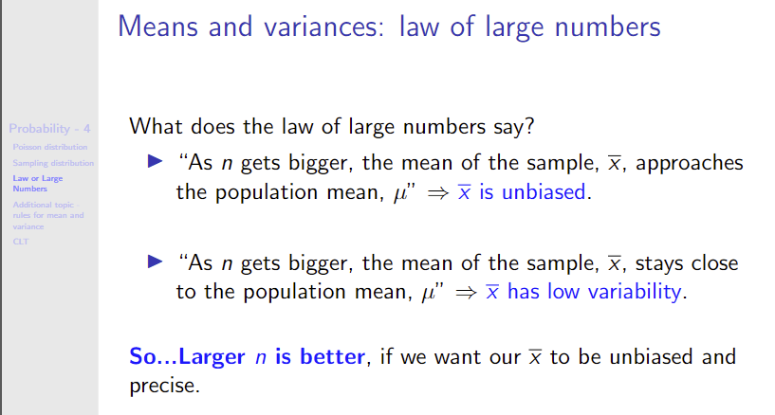


Slide 16
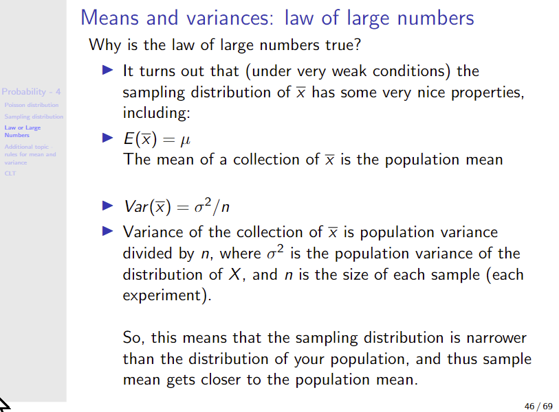


Slide 17
