Slide 1
Review 7
Normal approximation
Confidence Interval for single mean

Slide 2
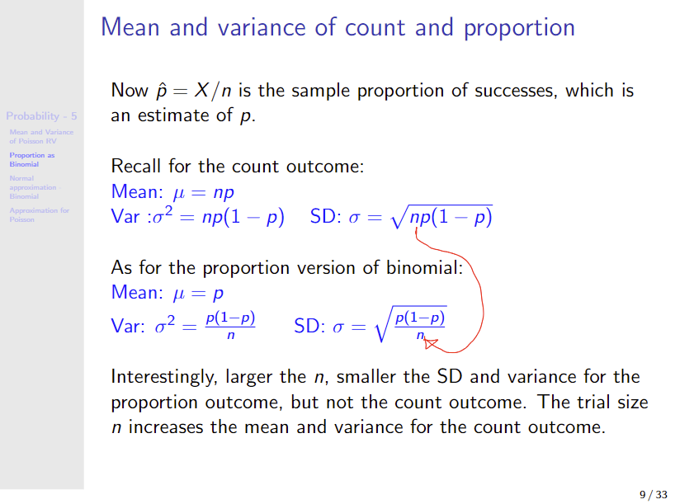


Binomial as proportion

Slide 3
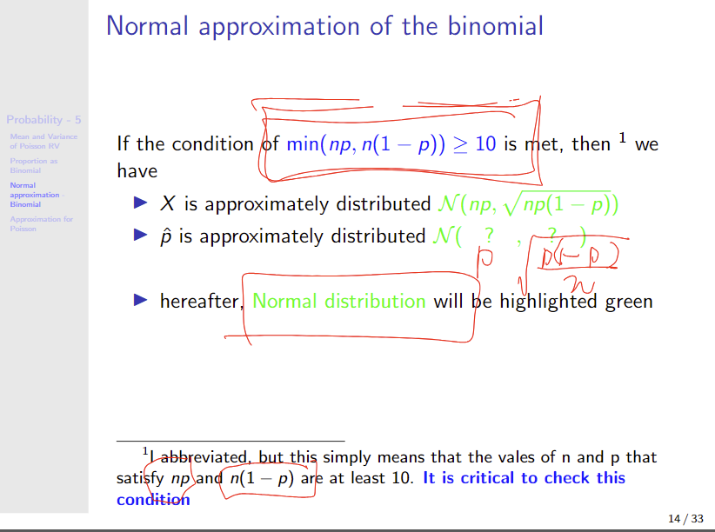




Slide 4
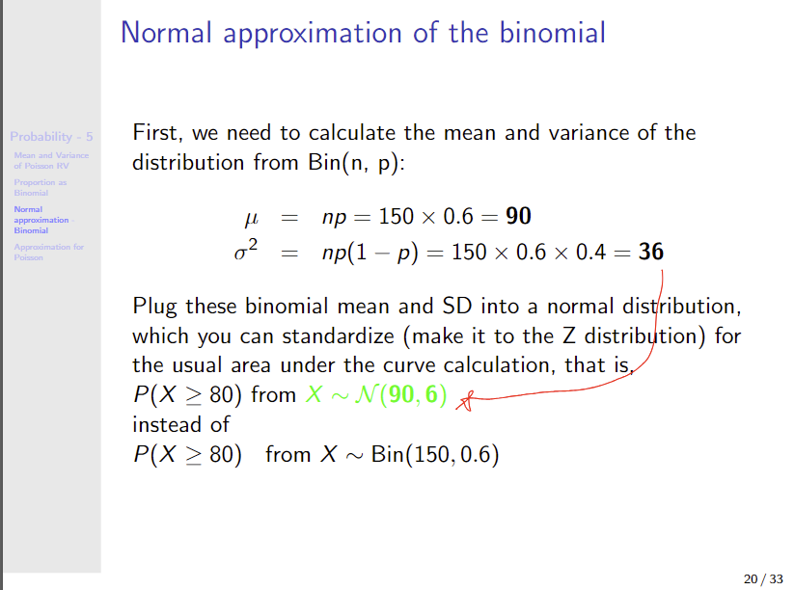

Slide 5
Use a continuity correction If you need to get the probability corresponding to the exact count value P(X =1), i.e., one specific count value, rather than a range P(X < 2). Otherwise, continuity correction applies when the number of counts is small, which will not be asked in this class.

Slide 6
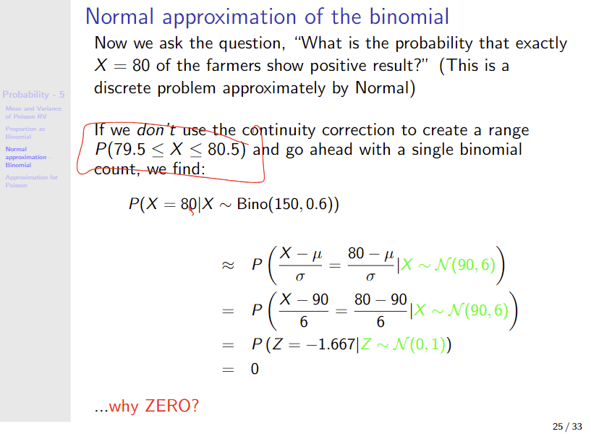

Slide 7
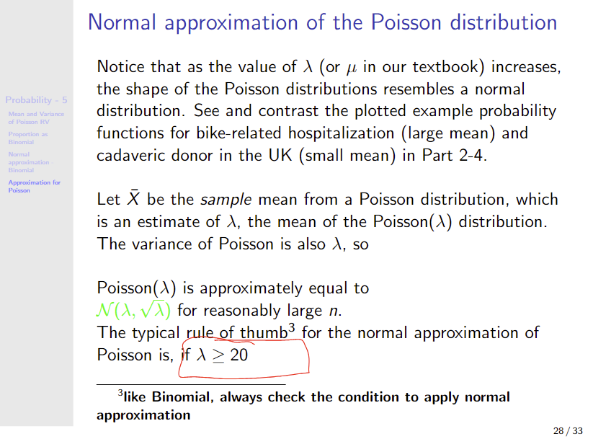

Slide 8
Inference – confidence interval

Slide 9
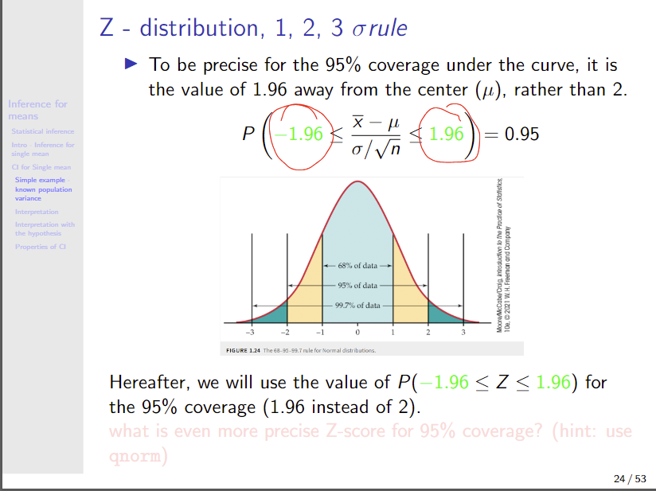

Slide 10
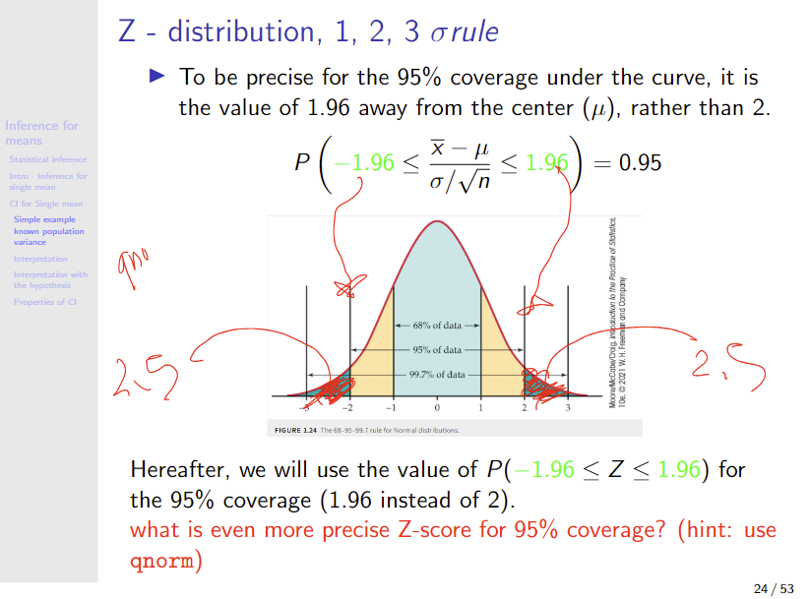

Slide 11
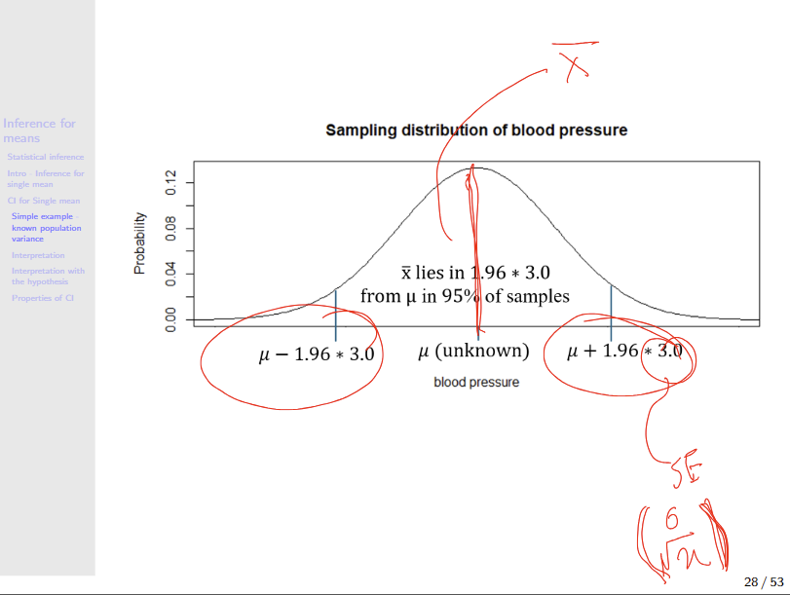

Slide 12
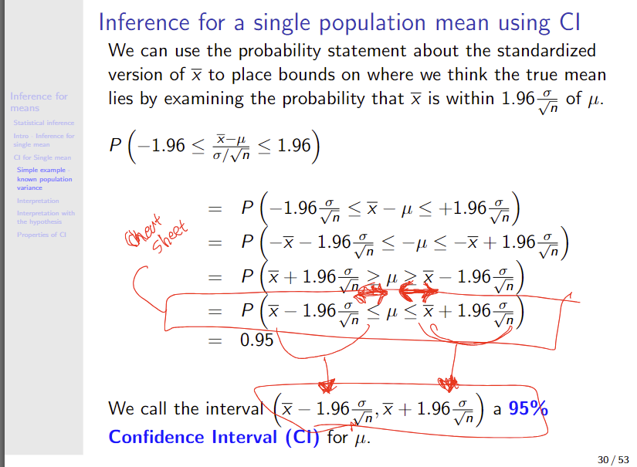

Slide 13
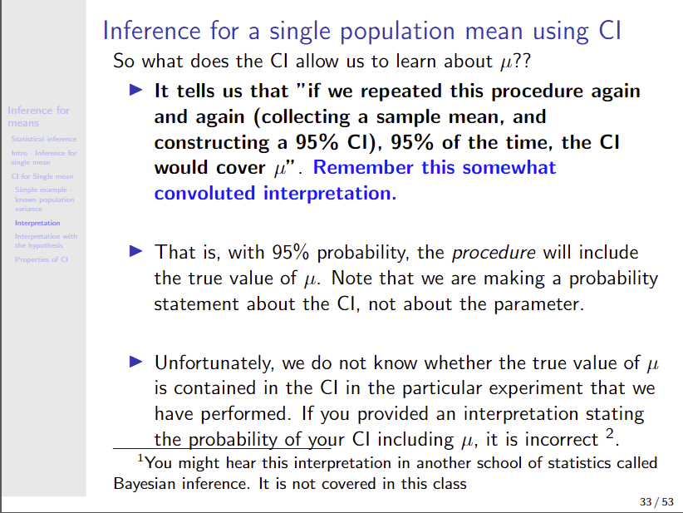

Slide 14
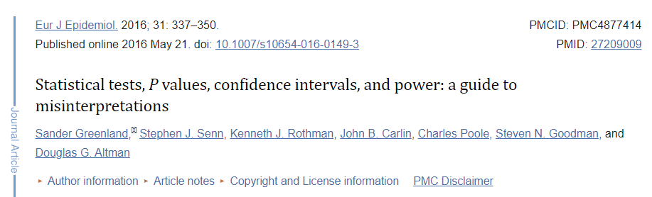
You will be asked to make interpretations based on CI and p-values. The interpretations flagged in this paper should be avoided.
https://www.ncbi.nlm.nih.gov/pmc/articles/PMC4877414/

