Slide 1
Review 9
Interpretation of CI
Introduction to hypothesis testing

Slide 2
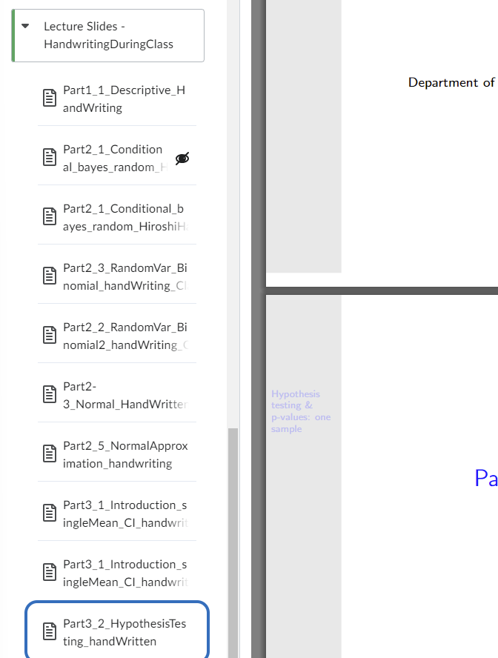
Annotated slides

Slide 3
Review of Confidence Interval

Slide 4
Review of hypothesis testing
Process to construct, interpret, and report Confidence Intervals (CIs)
Write down research questions
Write down the sample mean, standard deviation, sample size, your confidence level (95% most commonly) and find the corresponding Z-score.
Compute the margin of error.
Interpret and report

Slide 5
Interpretation
If we repeat sampling repeatedly, the interval (lower value, higher value) constructed from the samples will cover the unknown true value 95% of the time in a long run.
Replace with the values at upper and lower CI bounds.
Commonly, we set the confidence level as 95%, meaning that the interval is constructed to cover the true value 95% of the time.

Slide 6
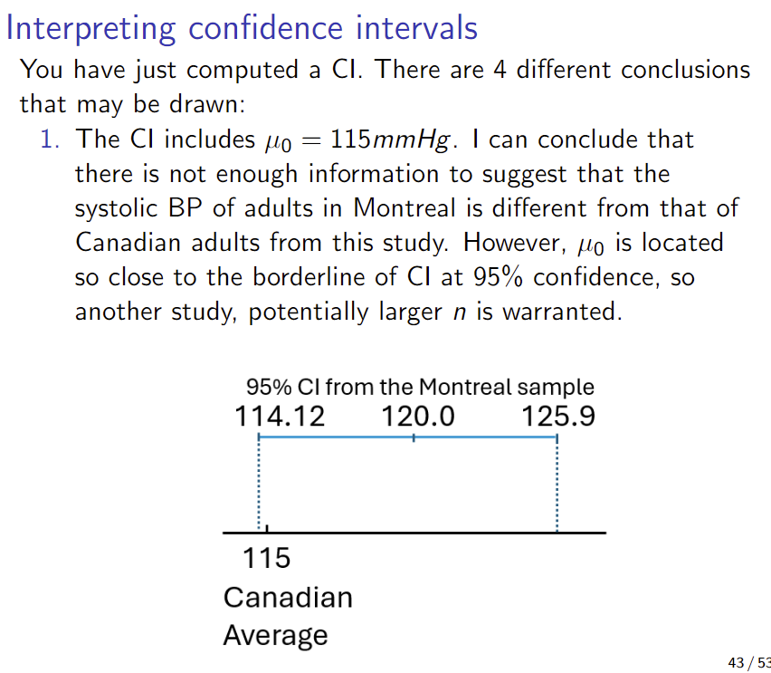
If we have a reference value to compare….

Slide 7
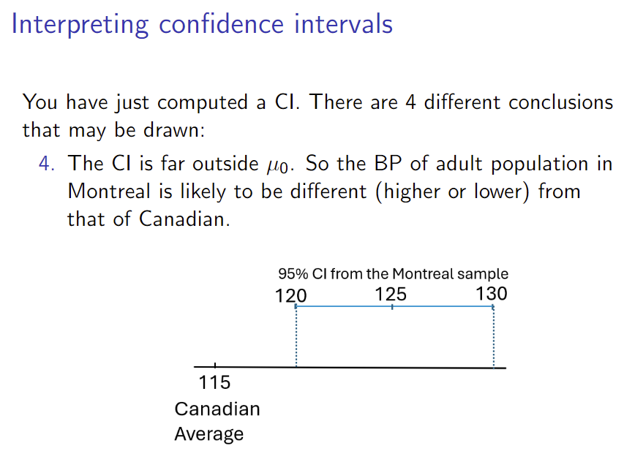
If we have a reference value to compare….

Slide 8

What factors impact the margin of error?
Sample size
Confidence level
Standard deviation

Slide 9
Assumptions for CI
Central Limit Theorem
Sampling is random

Slide 10
Bayesian credible interval (seminar yesterday) vs. Frequentist confidence interval (what you study)
Do not mix up the interpretation of intervals

Slide 11
Hypothesis testing (test of significance) The objective is to formally test the difference between the sample mean and a reference value

Slide 12
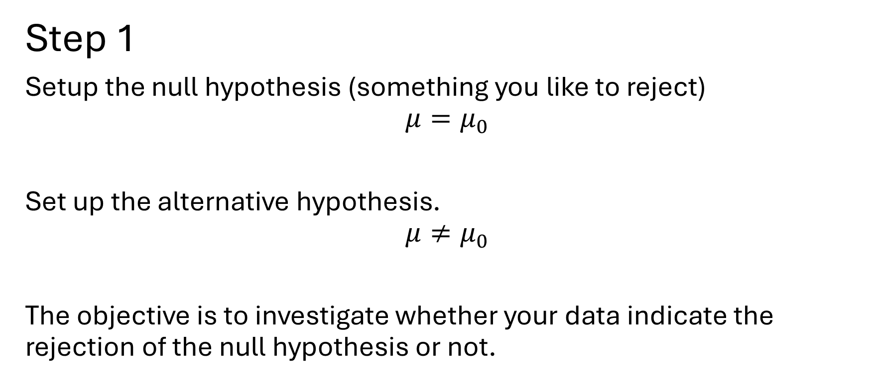
Steps for significance testing
Step 1
Setup the null hypothesis (something you like to reject)
$${μ=μ}_{0}$$
Set up the alternative hypothesis.
$$μ≠μ_{0}$$
The objective is to investigate whether your data indicate the rejection of the null hypothesis or not.

Slide 13
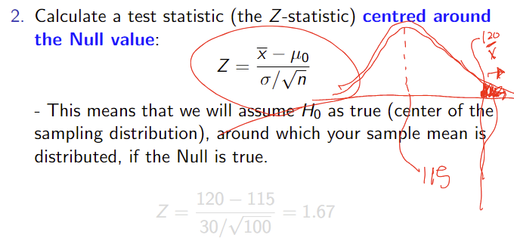
Step 2 – calculate the test statistic

Slide 14
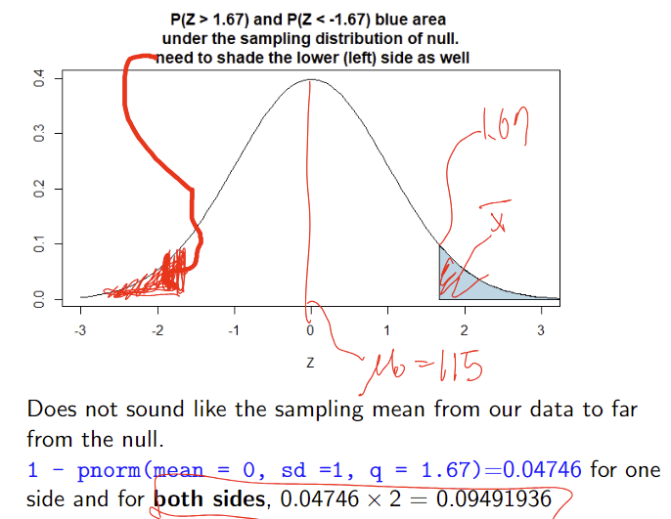
Step 3 – calculate the p-value based on the test statistic

Slide 15
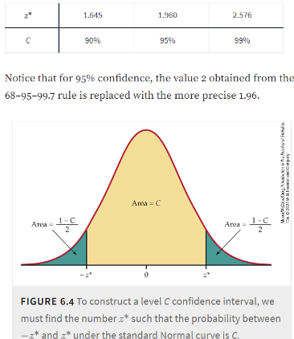
Step 4 – Evaluate the evidence against Null
Typically, the threshold probability to reject or retain the null hypothesis is 0.05 (equivalent to Z-score of 1.96) , but it depends on your risk perception (cost of false positive).

Slide 16
Step 5: Make an interpretation:
Definition of P-value: Assuming that the null hypothesis is true, it is the probability that the test statistic would take a value as extreme as or more extreme than that actually observed.
If the p-value is less than 0.05, or the test statistic is as extreme or more extreme than the pre-set Z-score corresponding to 0.05 (often called Critical Value), reject the null.
A list of critical values and the corresponding probabilities are here….
https://sphweb.bumc.bu.edu/otlt/mph-modules/bs/bs704_hypothesistest-means-proportions/bs704_hypothesistest-means-proportions3.html

Slide 17
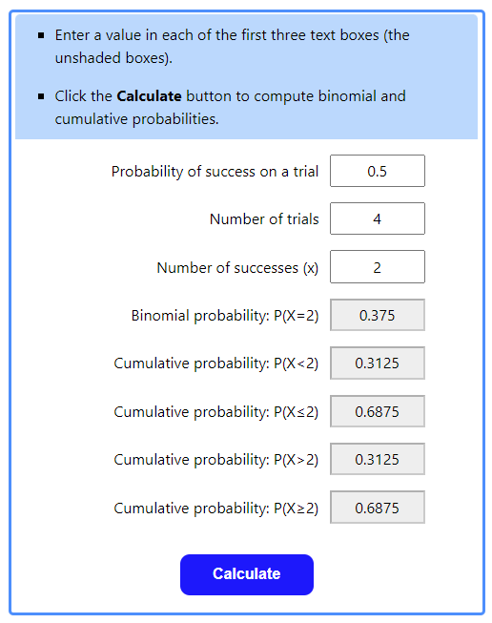
A note about R probability functions and Stattrek
pbinom(size = 4, prob = 0.5, q = 2)
0.6875
dbinom(size = 4, prob = 0.5, x = c(0,1,2))
0.0625 0.2500 0.3750

Slide 18
