Slide 1
Review 1
Part 0 – Descriptive statistics and housekeeping

Slide 2
Teaching assistant
TA office hours will be announced this week, most likely on Thursday

Slide 3
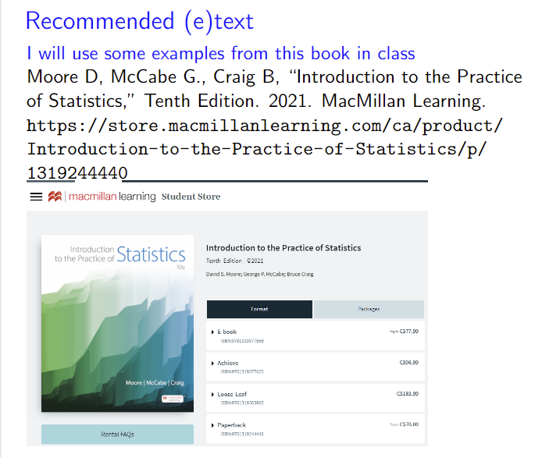
Textbook – very old editions would be useful as fundamental statistical concepts do not change much. Still, chapter order may vary, and examples are old

Slide 4
Another good reference book (not free)
Fundamentals of Biostatistics. 8th Edition (2021)
Bernard Rosner. Cengage Learning, Inc.

Slide 5
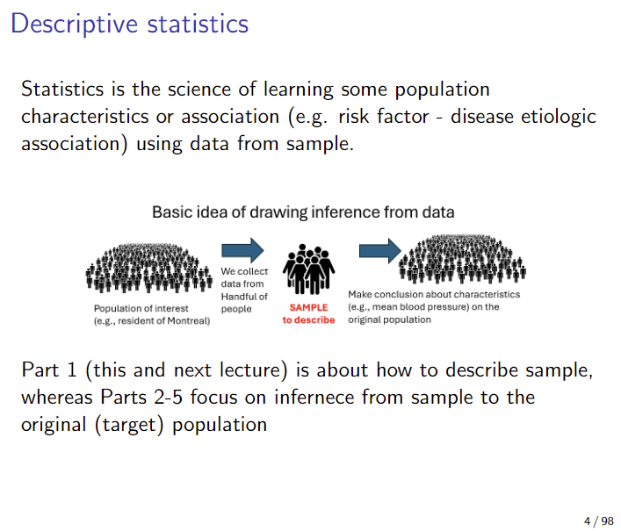
We covered the concept of population and sample

Slide 6
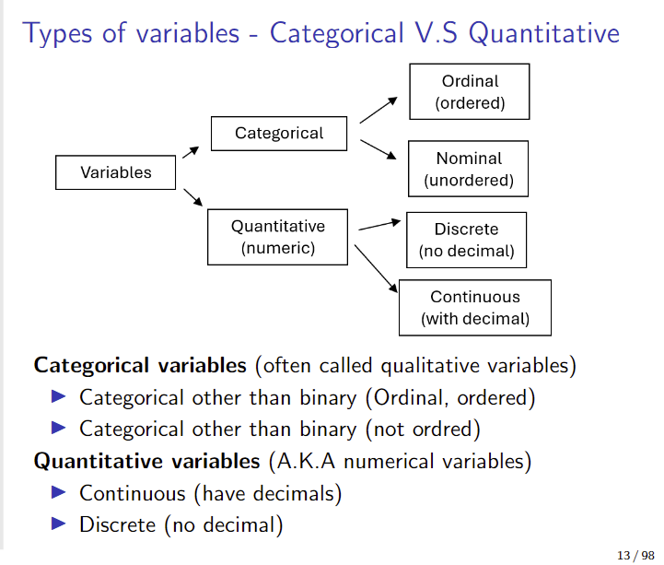
And the types of variables…

Slide 7
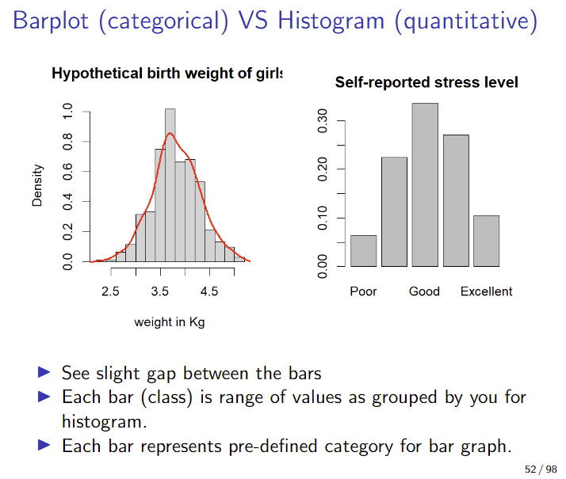
And histogram vs bar plot, and density plot

Slide 8
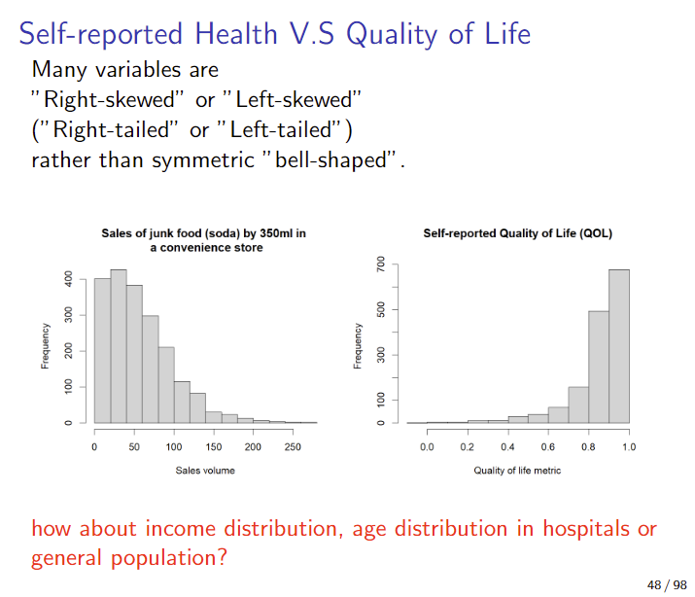
And skewed distributions (more later)

Slide 9
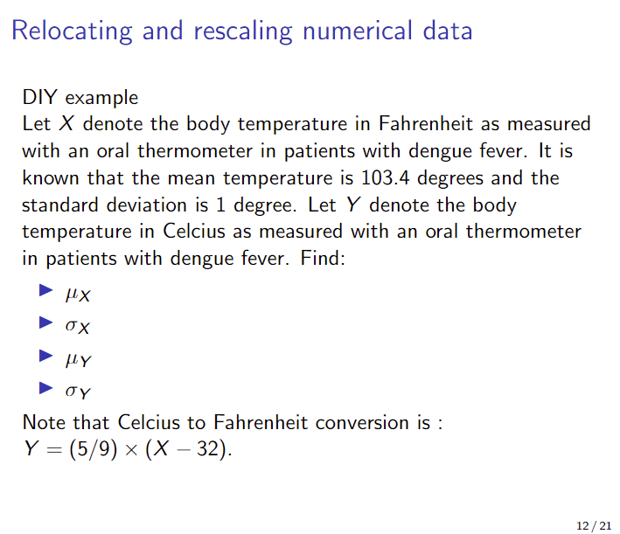
Correction in Slide Part 1-2
Fahrenheit to Celsius

