Slide 1
EPIB 607 Review 2
September 5, Thursday

Slide 2
Teaching assistants
Amaar Lila <amaar.lila@mcgill.ca>
Audrey Michel, Miss <audrey.michel@mcgill.ca>
Jessica Dekker <jessica.dekker@mcgill.ca>
Joseph Junior Damba, M <joseph.damba@mcgill.ca>
Hours to be announced shortly. Rooms will be
Room 1206 (SPGH building) Except Thursday
Room 129 (Educ building) on Thursday

Slide 3
Emailing – see the syllabus (email response will be delayed considerably if you do not use the correct heading, especially during the exam time )
Email
When sending an email about booking time, clarification of assignments, and questions about the course materials, please include in the subject heading (EPIB-607 – Inferential Statistics). It will be primarily the responsibility of the TAs to respond to emails and every effort will be made to respond as soon as possible.
For questions related to assignments and exams, remember to email well in advance of the due dates. Please be sure to only use your McGill institutional email for communications with the instructor and the TAs - we may not be able to respond to non-Mcgill email address.

Slide 4
Recording
Recording from week 1 is available publicly. If you do not think the quality (image and sound) is prohibitive to learning (it used to be terrible apparently), please inform and I will seek a way to improve videos, if possible.
Again, those who could not attend the class for the reason beyond their control or have accommodation policies from the SAA should reach me to obtain recordings.

Slide 5
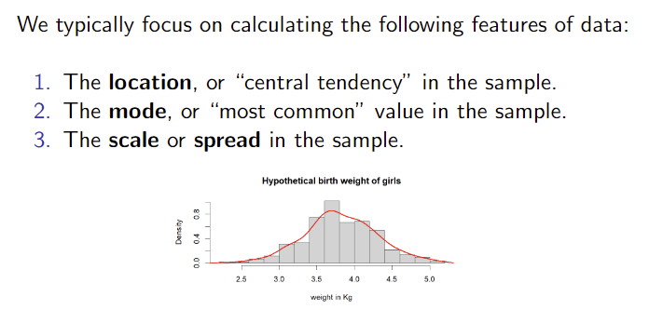
Review from Class 2

Slide 6
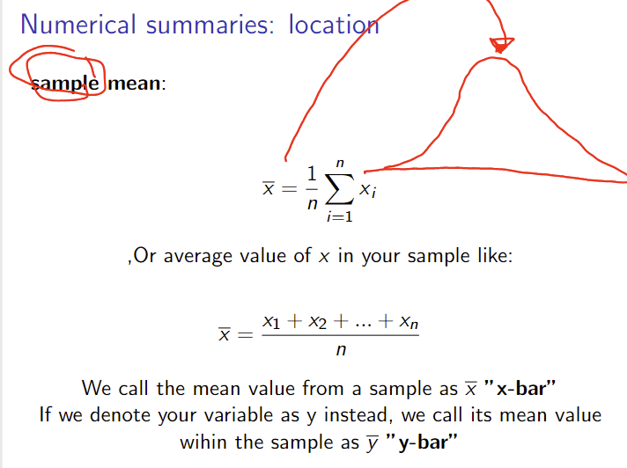
Sample mean

Slide 7
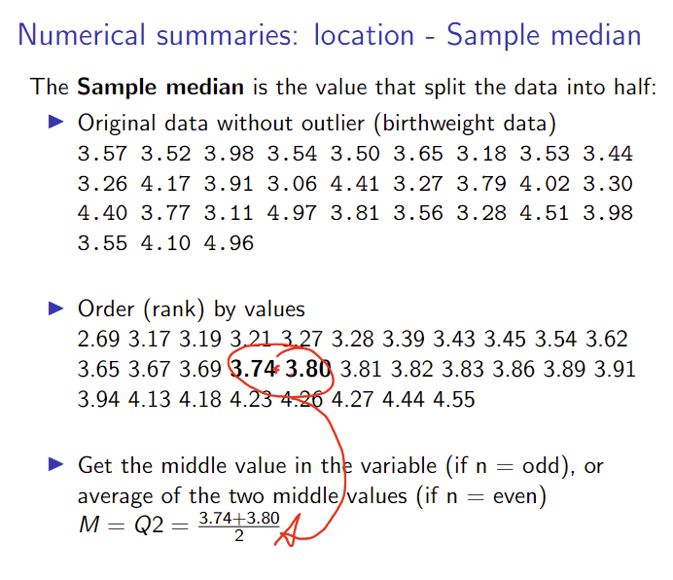
Sample median

Slide 8
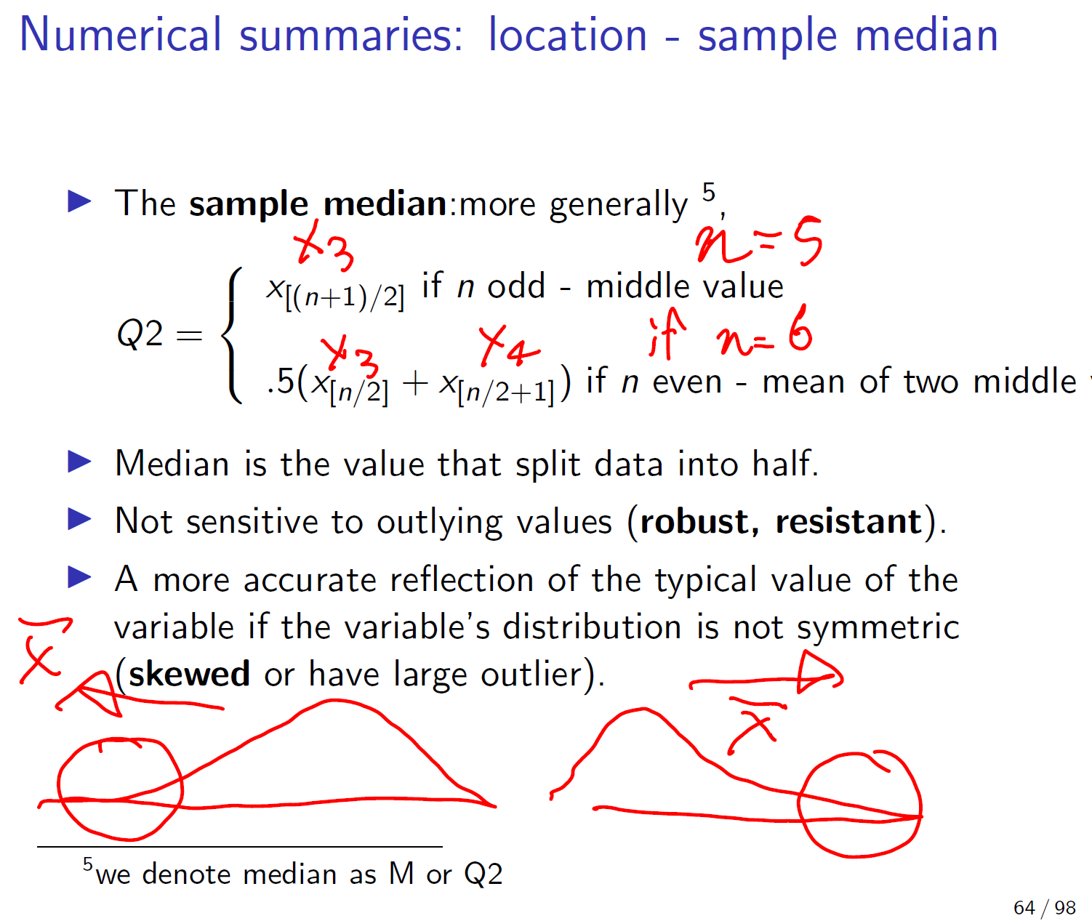
Further explanation about the computation

Slide 9
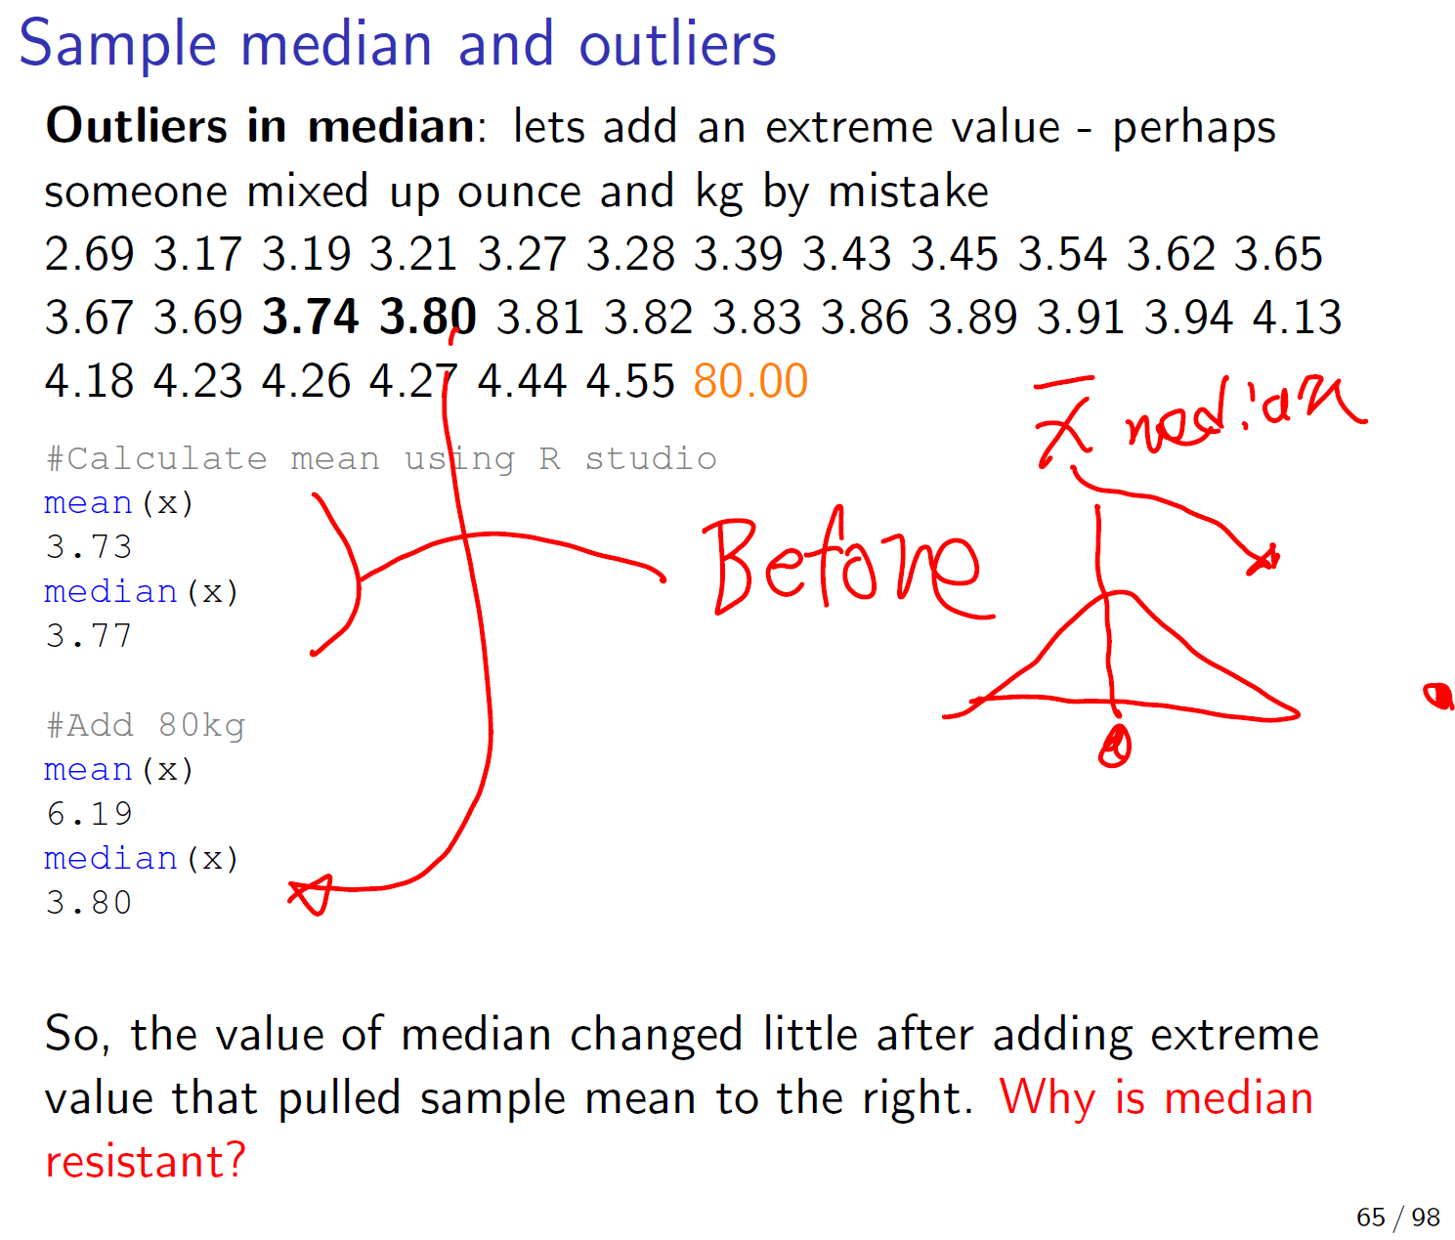

Slide 10
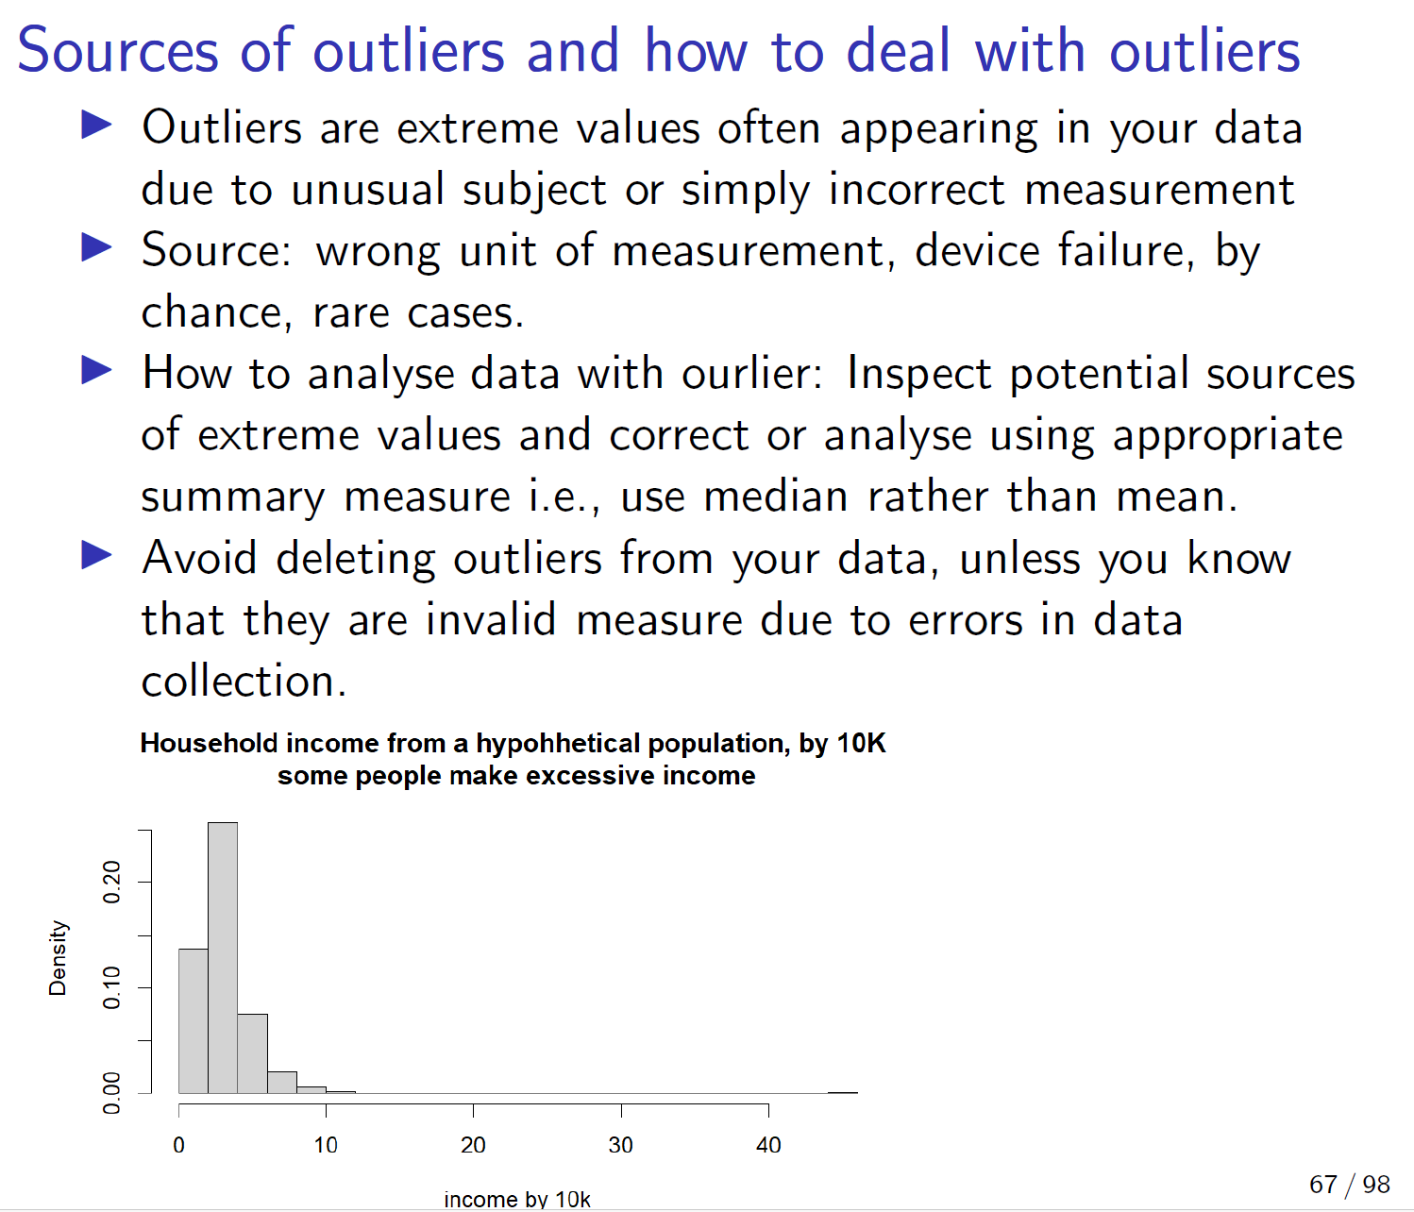

Slide 11
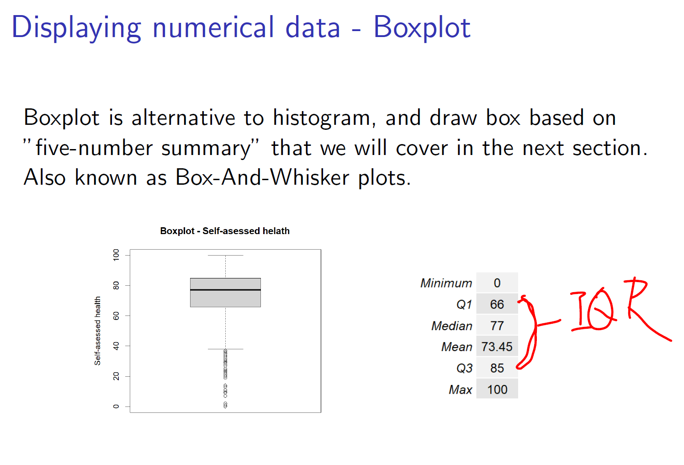
Boxplot and 1.5*IRQ rule…flagging suspected outliers

Slide 12
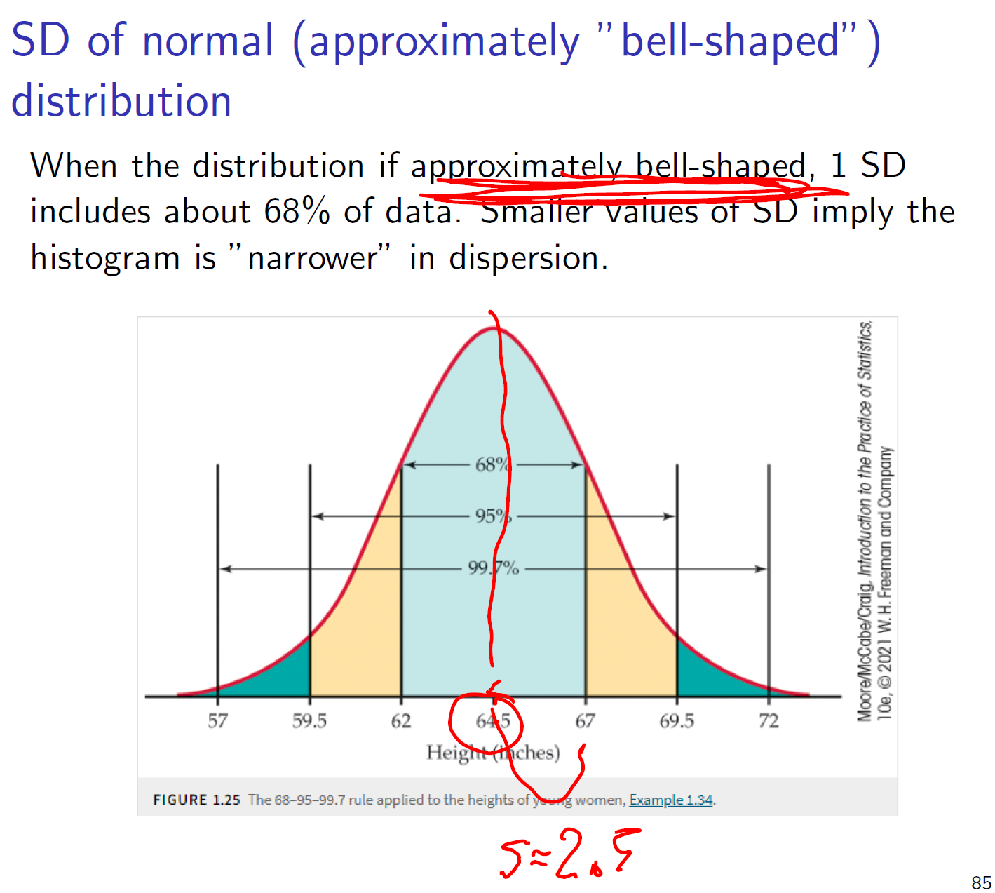
Standard deviation indicate the proportion of data that fall into a certain range from mean

Slide 13
So, what do you report as the measures of location and spread for your sample? Sample mean and SD, or sample median and IQR?

Slide 14
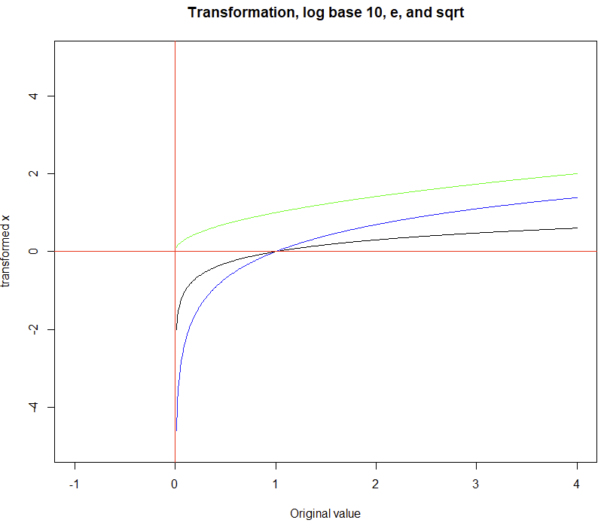
Quick review – transformation

Slide 15
# New variable, just a sequence of values
x <- seq(0.01, to = 4, by =0.01)
# display it!
x
# plot , log() is natural log (base e), log10() is log base 10, and sqrt is square root
plot(y = log(x), x = x, type = "l", xlim = c(-1, 4), ylim = c(-5,5), ylab = "transformed x", xlab = "Original value", main = "Transformation, log base 10, e, and sqrt", col = "blue")
lines(y = sqrt(x), x = x, col = "green")
lines(y = log10(x), x = x, col = "black")
# add x and y lines -- not so color blindness friendly !!! (do not do this)
abline(v=0, col="red")
abline(h=0, col="red")

