Slide 1
Project creation
Software development projects go through multiple processes, among these processes there are early processes that are important for a stable and easy development:
*Zoning.
* Wireframe.
* design (maquette).
* prototype.
* mockup.
Design (maquettage)

Slide 2
What is zoning?
Zoning is the defining and positioning of different functional areas on the layout which defines the structure of the user interface.

Slide 3
What is wireframing?
Is an early process by designers to outline and draw the early project design ideas to establish the structure and flow of design solutions.
.

Slide 4
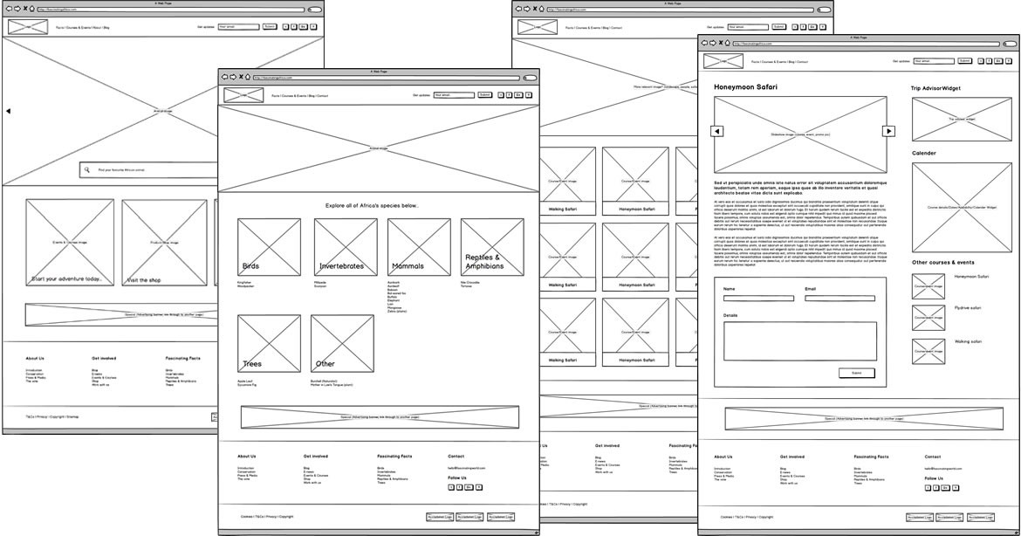

Slide 5
What is mockup(maquatte)?
Choosing a unified color palette and an adaptive font which changes the layout from a common static wireframe look to a beautified user interface .

Slide 6
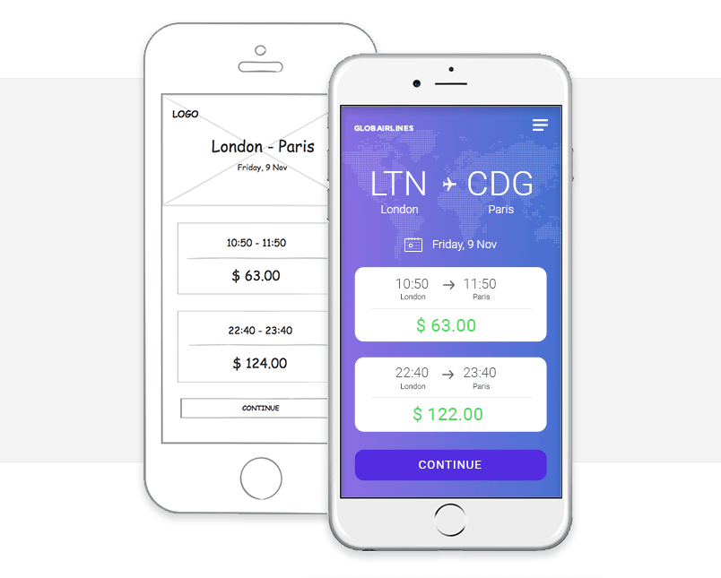

Slide 7
What is prototyping?
This step involves transforming each of the pages produced in the previous step into interactive pages. This step is generally following a mock-up, the aim of which is to present the final result of the site.

Slide 8
Tools to help with design processes
Many tools on the web but if we want to mention popular ones:
Sketch
Adobe XD
Figma

Slide 9
Adobe XD
Adobe XD :
XD is Created by a famous company “Adobe” specialized in creating design software.
Can be used on all the design processes (zoning, wireframing, design, prototyping and mockup).
Has a big community which provides a variety of plugins.
Only available on Windows and mac.

Slide 10
Figma
A multiplatform design application which specializes on all design processes.
Has a huge and ever growing community.

Slide 11
Sketch
A famous design application that is widely used by experienced organizations.
Specializes on working design processes.
Only available on mac.

Slide 12
Favorite tool “Figma”
Multi Platform can be used on all operating systems (linux, windows, mac).
Available on the browser also.
Have a multitude of plugins.

Slide 13
Conclusion
These design processes helps designers to reveal their imagination and how they understood the client requests, and also solve UI and UX problems before developers start coding, and avoid wasting time and resources during projects’ development.

