Slide 1
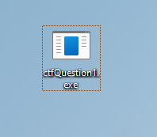
Patch Me If You Can
Hey, check out this annoying program I found! It just spams the screen with some weird art. The author must think they're clever, hiding a flag in here somewhere.
I took a quick look. The code is a mess, and I have a feeling it might even modify itself at runtime.To get the flag, you'll probably have to find a hidden key and manually slot it into the right place in memory while the program is running.
Think you can handle it? Good luck!

Slide 2
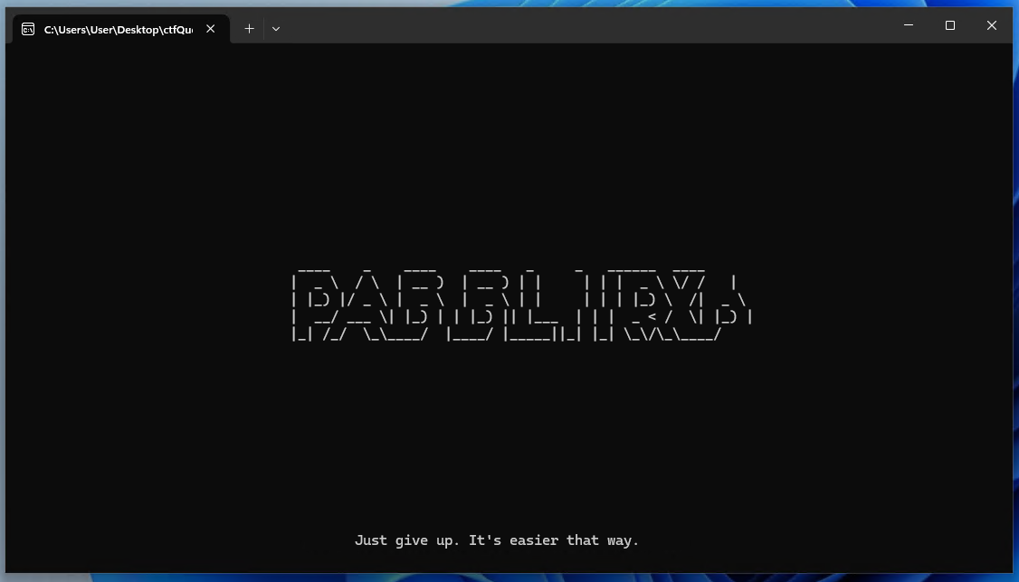
Just double click it to run.
Only shows this screen.
Looks like unlimited loop.
Nothing happens.

Slide 3
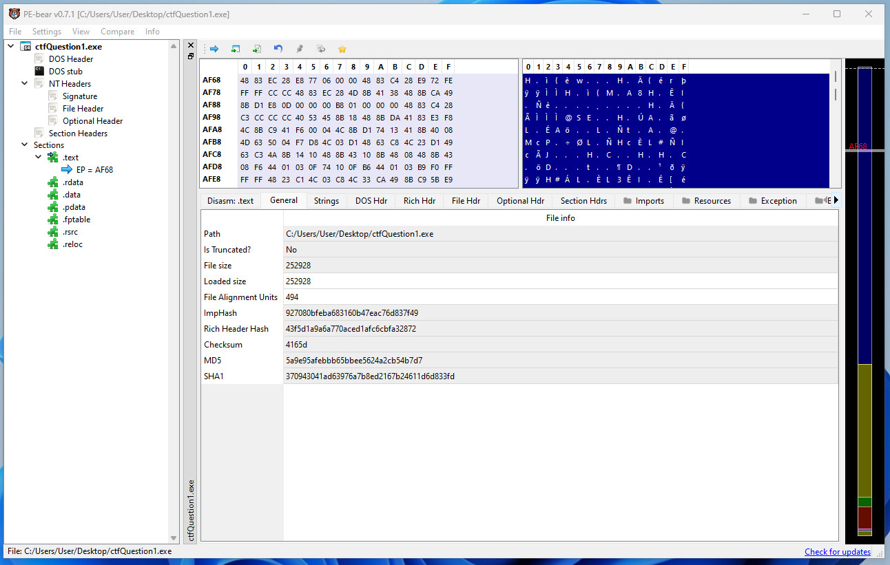
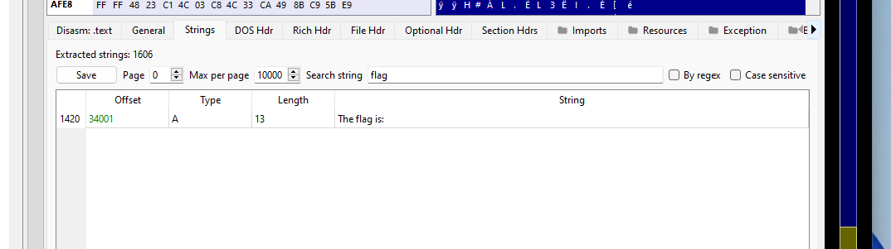
We have to see its meta data with PEbear first.
Looks like just exe console application.
Couldn’t find any flag in Strings view.

Slide 4
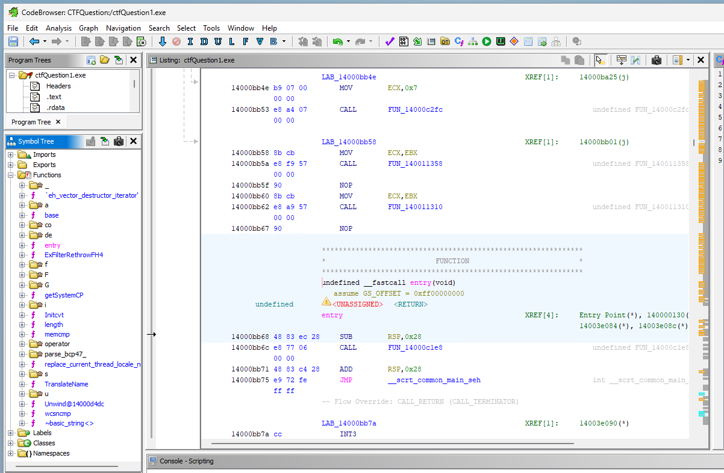
Find main function
Static analyze with Ghidra.
There is library functions other than entry point.
We need to find main function under entry point.

Slide 5
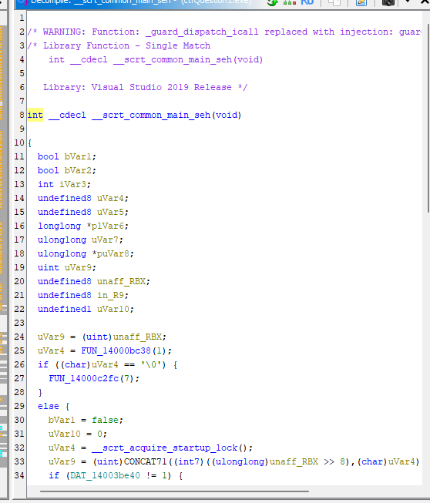
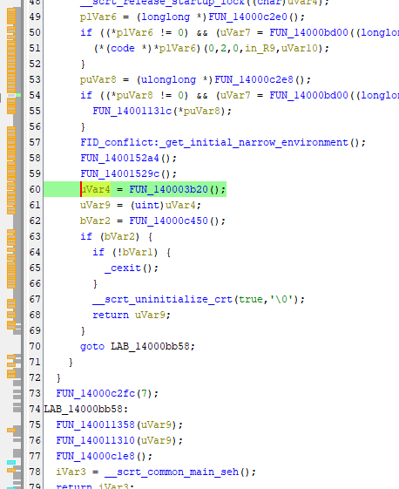
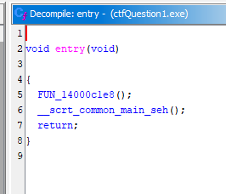
Line 5 is just default code.
Look into __scrt_common_main_seh
The line 60 FUN_140003b20 looks like main since its located between default codes above and below.

Slide 6
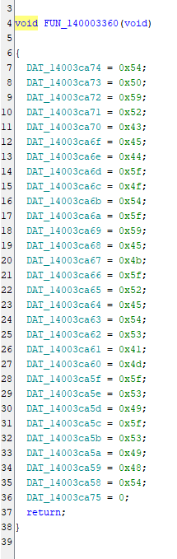
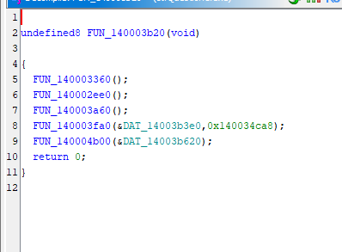
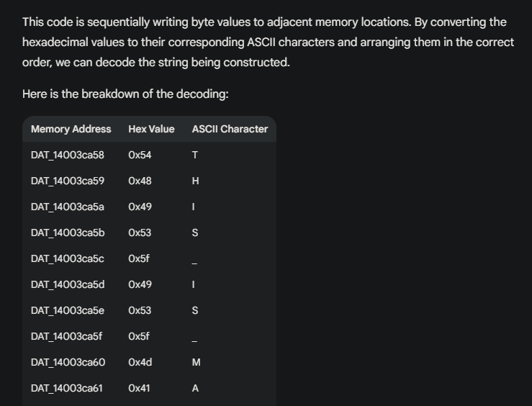
First one is just defining strings but does nothing.
This is main function.
It calls 5 functions.
Reading the characters from bottom to top (in order of memory address) and then the final two addresses, the decoded string is:
THIS_IS_MASTER_KEY_TO_DECRYPT
Gemini decrypted this one shows the master key. Okey?

Slide 7
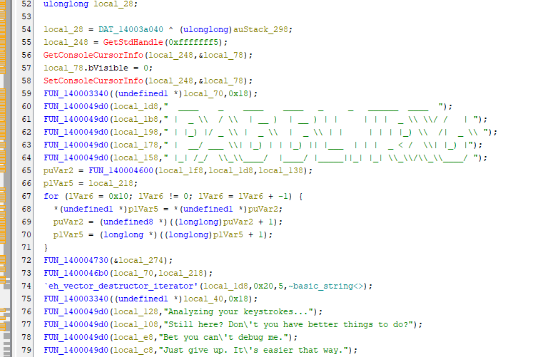
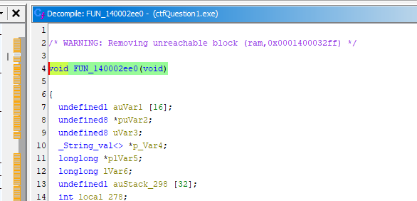
This one is second function that main called.
Looks the same as what I see on console.
do {
….
} while( true );
Program is unlimited loop here. But those code is just showing strings on the console…

Slide 8
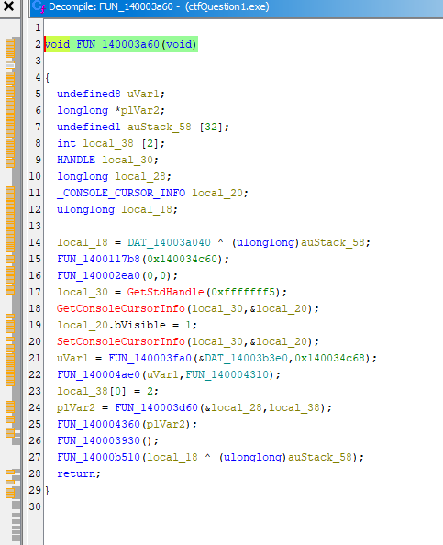
This one is third function that never called, because the program stacked on second function.
But why developer remain this function?
There is many logic inside and I don’t wanna take time to read it all.
Since its never called then just run for debugging.

Slide 9
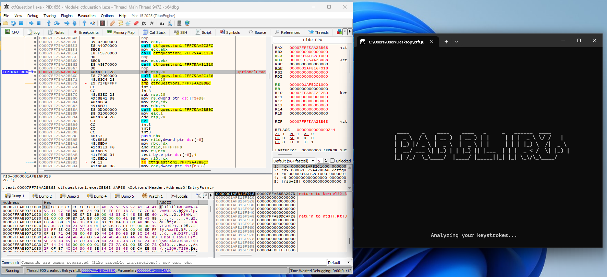
Just run it with x64dbg.
Need to make break point to see its flow.
For now, I just put break point for main function.

Slide 10
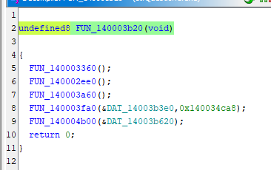
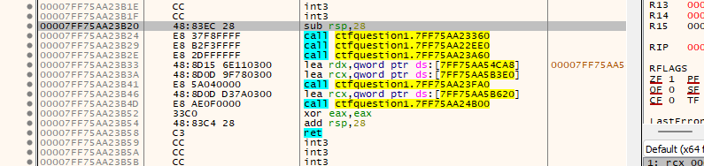
As I found main on Ghidra and its offset is 3b20.
So I just find it on x64dbg as well.
The location of it is here!
Looks same as what I saw on ghidra, it calls 5 functions.

Slide 11
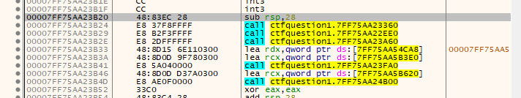
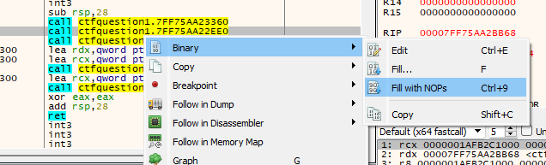
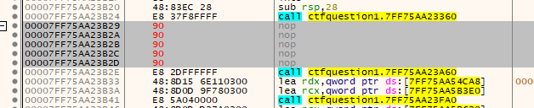
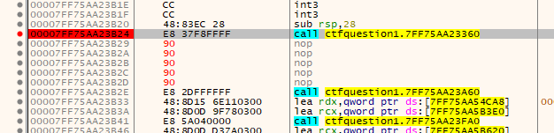
Since I just wanna run third function then, remove second function.
Can remove it by filling with NOPs.
Also made breakpoint on first function.

Slide 12
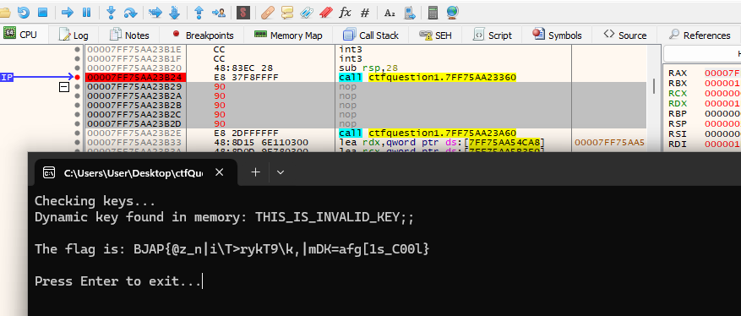
The second function is executed correctly.
It shows flag but broken.
But It shows “THIS_IS_INVALID_KEY;;”
Maybe need to use correct master key that I got at beginning.

Slide 13
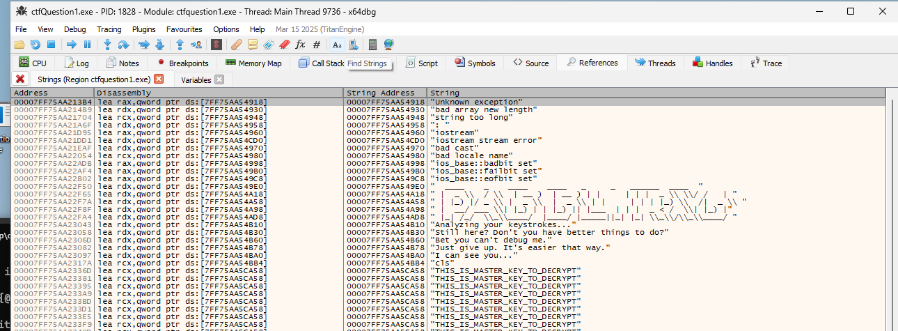
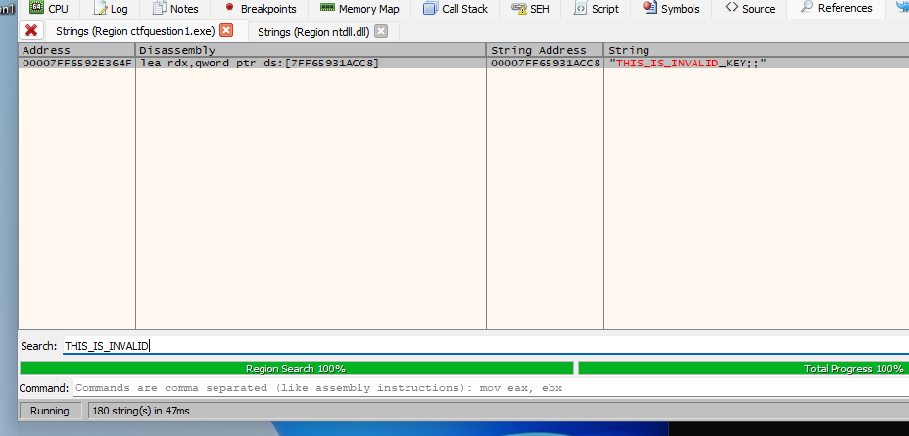
I can search strings on Find strings view.
After searched it then the memory address of it is 00007FF6592E364F.

Slide 14
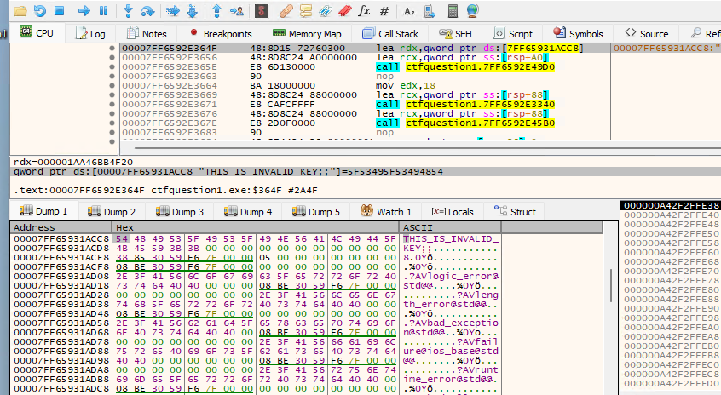
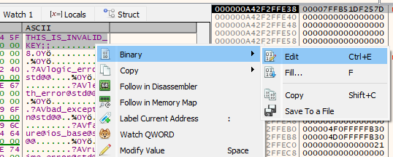
Since I find the location then change value to master key by editing binary.
Need to double click the yellow holder “[00007FF65931ACC8]” to see it on memory dump window!!!

Slide 15
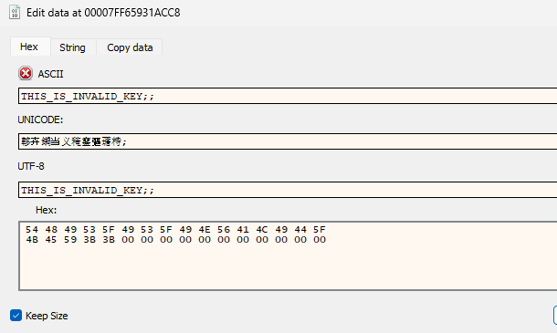
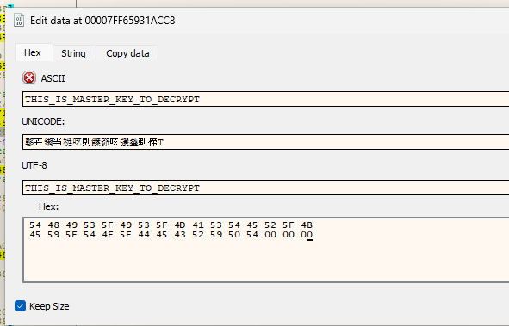
I changed it to correct master key.
Make sure to check “Keep Size” section.

Slide 16
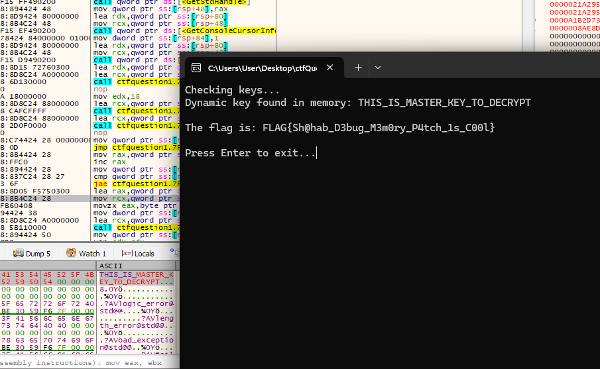
Congratulation!
I got flag!!

