Slide 1
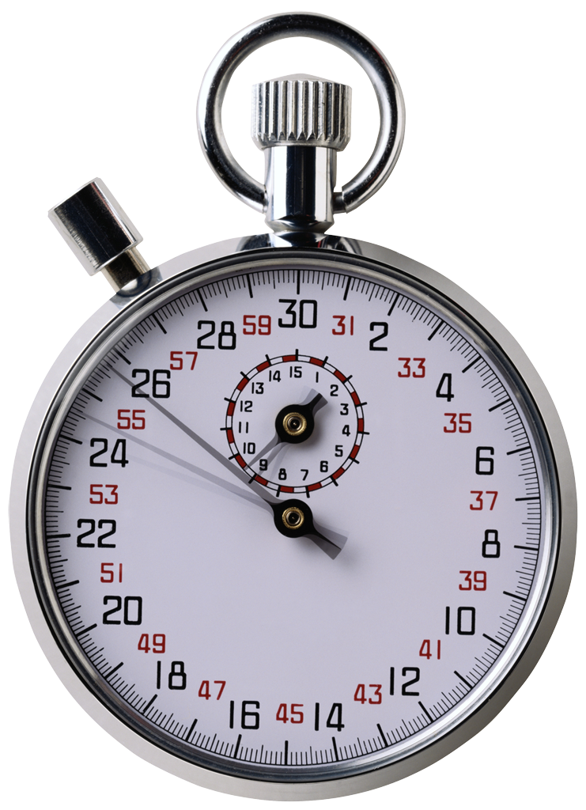
Time reporting server
Logout
Time entries
Start
Stop
Project
10:00
12:30
Project X

