Slide 1


The magic of regex Sarah Hirsch

Slide 2
What is regex?
Short for “regular expression”
System of codes used to generalize character strings
Used in many programming languages, with some differences between versions and languages
Extremely useful for data cleaning and automation.
​Find and remove or replace systematic typos
Perform fuzzy searches on data
Conditionally loop through character strings
Whatever else your coding heart desires!

Slide 3
A little more in depth…
PERL
perl = TRUE, fixed = FALSE
Generally considered the most powerful and versatile regex language
Supports lookarounds
Better support for non-English characters
Other options
TRE is R default
perl = FALSE, fixed = FALSE
Less powerful
fixed allows exact matching only
perl = FALSE, fixed = TRUE
Avoids complications with special characters, but has limited flexibility

Slide 4
So… how do I use it?
Use it (almost) anywhere—not a package
The regexp() wrapper will make any string into a regular expression
Common symbols:
\\d – digits
\\D – not digits
\\w – “word characters” (a-z, A-Z, 0-9, _)
\\s - whitespace
[[:alpha:]] – a-z or A-Z
+, *, {a}, {a,b} - one or more, 0 or more, a amount, a to b amount
^, $ - start of string, end of string

Slide 5
Lookaheads and lookbehinds

Slide 6
types
Lookaheads
Positive lookahead
(?=…)
“Followed by …”
Negative lookahead
(?!...)
“Not followed by …”
Lookbehinds
Positive lookbehind
(?<=…)
“Preceded by …”
Negative lookbehind
(?<!...)
“Not preceded by…”

Slide 7
Pull variables by pattern

Slide 8
Steps
Identify or generate naming conventions
Filter column names by pattern
Subset data by filtered column name vector

Slide 9
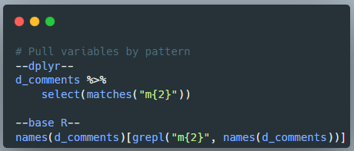

Slide 10
Correct systematic errors

Slide 11
Steps
Identify the pattern of interest and its variants
Determine preferred substitution
Subset
Replace

Slide 12
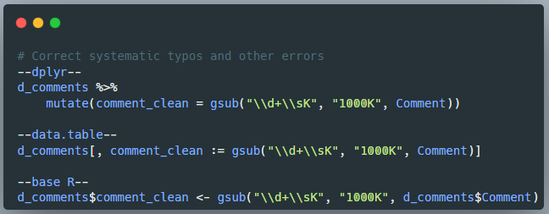

Slide 13
Filter by pattern

Slide 14
Steps
Identify pattern and its variants
Filter

Slide 15
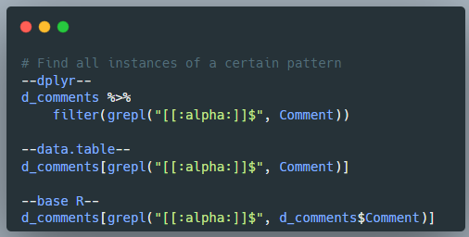

Slide 16
Troubleshooting
Perl = TRUE
Are your patterns returning strange results?
Error: invalid regular expression, reason ‘Invalid regexp’
Sub vs gsub
Did your code only fix the first error per cell instead of all of the errors within that cell (or vice-versa)?
\\
Error: ‘\d’ is an unrecognized escape in character string starting…
Grep vs grepl
Are dplyr functions failing? (use grepl)
Is invert = TRUE not working? (use grep)
Unicode 15.1 Character Code Charts
Regex 101: Code tester
Regex in R cheat sheet

