Slide 1
Task 07 --- Team Blue
Rafael Kapp, Patrick Hirschi

Slide 2
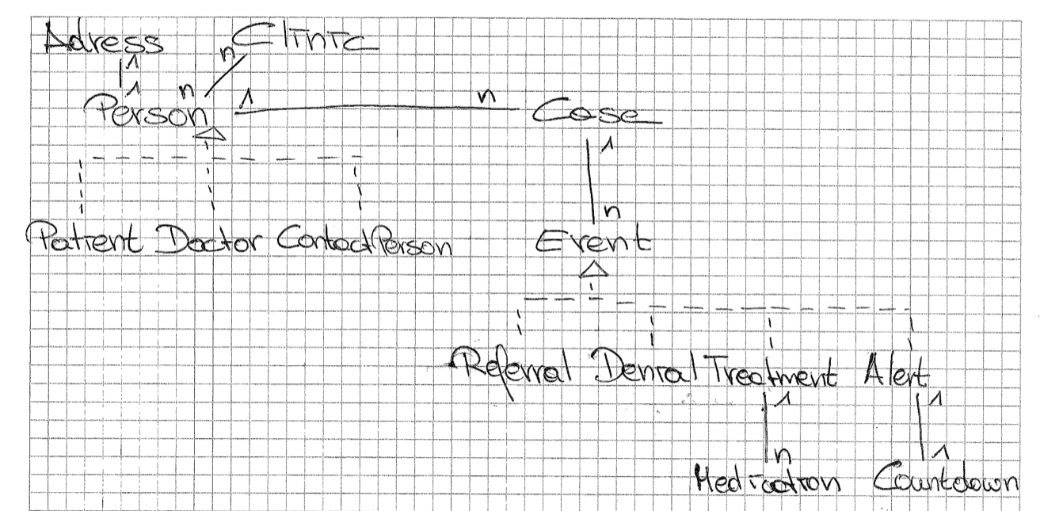

Slide 3
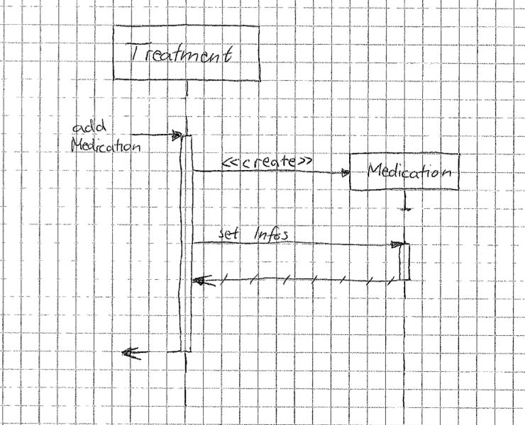

Slide 4
