Slide 1
UI/UX Training

Slide 2
UI/UX Training
1
HTML
2
CSS and Libraries

Slide 3
Introduction to HTML
What is HTML?
HyperText Markup Language (HTML)
HTML is the standard markup language used to create documents on the World Wide Web. It is the backbone of web content, providing the structural foundation for web pages. HTML utilizes a system of elements, represented by tags, that define the structure and content of a web page.
Markup Language: It uses a set of tags or codes to annotate text and provide structure. These tags define various elements such as headings, paragraphs, links, images, and more.
Document Structure: An HTML document is structured as a hierarchy of elements. The basic structure includes a head and a body. The head typically contains metadata, while the body contains the actual content displayed on the web page.
Elements and Tags: HTML elements are represented by tags enclosed in angle brackets (< >). Tags come in pairs: an opening tag and a closing tag, with content sandwiched in between. For example, a paragraph is represented by <p> and </p>.
Attributes: Tags can also have attributes, which provide additional information about an element. Attributes are added to the opening tag and typically come in name/value pairs. For instance, the <a> (anchor) tag can have an href attribute specifying the link.
Web Page Content: HTML allows you to include various types of content, such as text, images, links, forms, and multimedia elements. It provides the basic structure that browsers use to render and display content.

Slide 4
HTML syntax and structure
<!DOCTYPE html> <!-- Sets the document type to HTML5. -->
<html> <!-- The root element containing the entire HTML document. -->
<head> <!-- Contains meta-information about the document, such as the title, external file connection, CDN and SEO(Search Engine Optimization). -->
<title>My First Web Page</title>
</head>
<body> <!-- Contains the actual content displayed on the webpage. -->
<h1>Hello, World!</h1>
<p>This is a simple HTML document.</p>
<a href="https://www.example.com">Visit Example.com</a>
</body>
</html>

Slide 5
UI/UX Training
1
HTML
2
CSS and Libraries

Slide 6
Introduction to CSS
What is CSS?
Cascading Style Sheets (CSS)
CSS is a style sheet language used for describing the presentation and formatting of a document written in HTML. In simpler terms, CSS allows web developers to control the visual appearance of web pages by specifying how HTML elements should be displayed on different devices and screen sizes.
Styling HTML Elements:
Elevate your webpage aesthetics by customizing text, headings, links, and images, giving you control over colors, fonts, spacing, borders, and backgrounds for an appealing visual presentation.
Selectors and Declarations:
Utilize CSS selectors to target specific HTML elements, and apply declarations to establish styling rules, defining how the selected elements should visually appear
Responsive Design:
Adaptable websites that seamlessly adjust to various screens and devices; leverage media queries to apply styles based on screen characteristics such as width or height.
Animations and Transitions:
Create dynamic and interactive user experiences with support for animations and transitions, enabling seamless state changes and adding captivating animated effects.

Slide 7
Introduction to Bootstrap
What is Bootstrap?
Bootstrap is a popular front-end framework that streamlines web development by providing a responsive grid system, pre-designed components, and CSS styles, allowing for rapid and consistent design across various devices and screen sizes.
Responsive Grid System:
Bootstrap provides a responsive grid system based on a 12-column layout, making it easy to create responsive and fluid layouts.
Pre-designed Components:
Includes a collection of pre-designed UI components like navigation bars, buttons, forms, alerts, modals, and more, saving development time.
CSS Styles:
Comes with a set of customizable CSS styles that provide a consistent and visually appealing design across different elements.
Typography:
Offers a refined typography system with a variety of headings, fonts, and styles to enhance the readability and aesthetics of the content.
Extensive Documentation:
Bootstrap is an open-source project, allowing developers to use, modify, and contribute to its development freely.

Slide 8
Best Practices
Indentation and Formatting:
Use consistent indentation and formatting to enhance code readability. Consider tools or editors that can automatically format your HTML.
Use External CSS:
Prefer external stylesheets over inline styles for better separation of concerns and reusability.
Optimize Images:
Comes with a set of customizable CSS styles that provide a consistent and visually appealing design across different elements.
Consistent Naming Conventions:
Follow consistent and meaningful naming conventions for classes and IDs to improve code maintainability.
Writing Comments:
Use comments in your code to explain or provide context for future developers.

Slide 9
Materials and Assigment
References
HTML and CSS: https://www.youtube.com/playlist?list=PL4cUxeGkcC9ivBf_eKCPIAYXWzLlPAm6G
Bootstrap 5: https://getbootstrap.com/docs/5.2/getting-started/introduction/

Slide 10
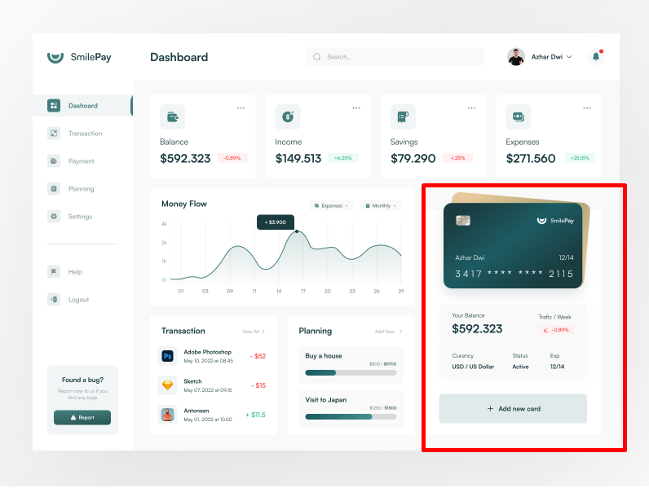
Materials and Assigment
Assignment:

