Slide 1
News Classification System

Slide 2

Introduction & System Overview
Broker.mqttdashboard.com
News API
Dashboard for Selecting Preferences
Top 5 News list of Selected Preferences

Slide 3
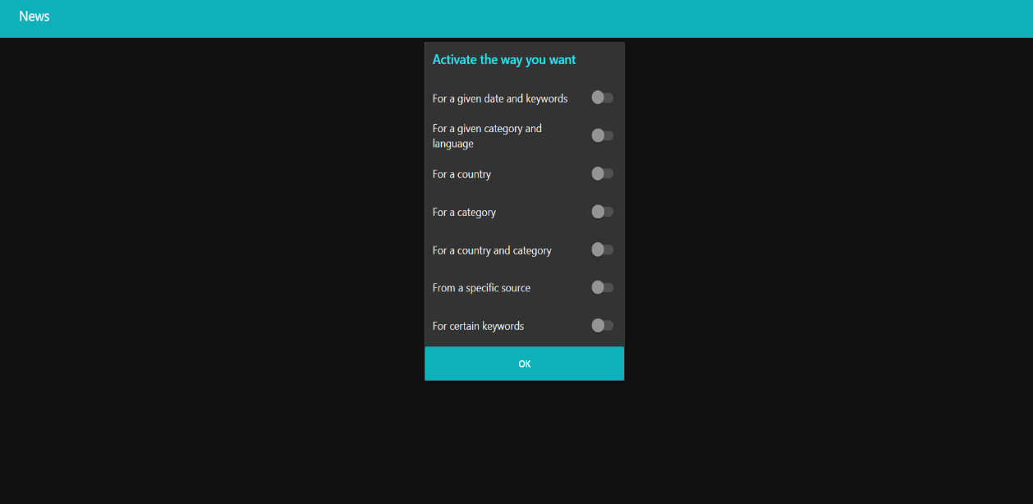
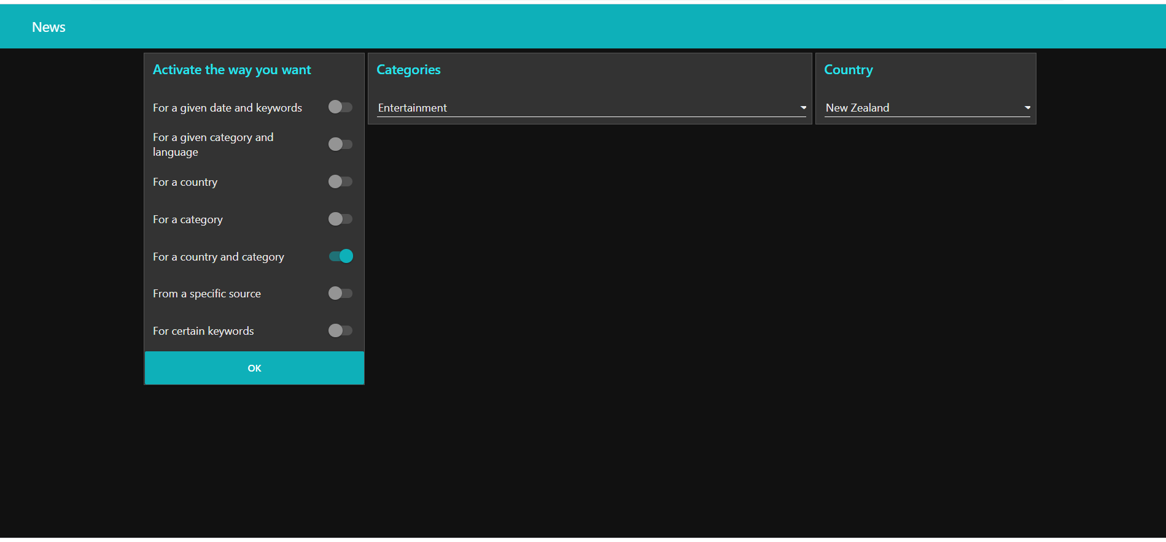
Node-RED Dashboard
There are seven ways to get news.
The user has ability to activate any one of the seven ways shown here at a time.
Once the user has activated the desired mode, the user has ability to enter the required inputs.

Slide 4
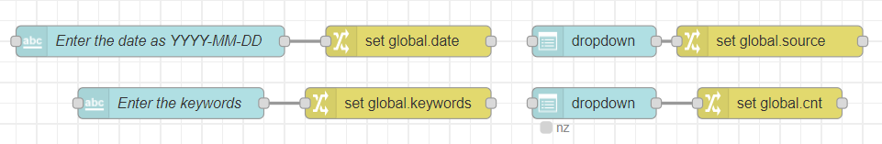
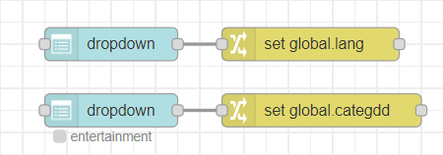
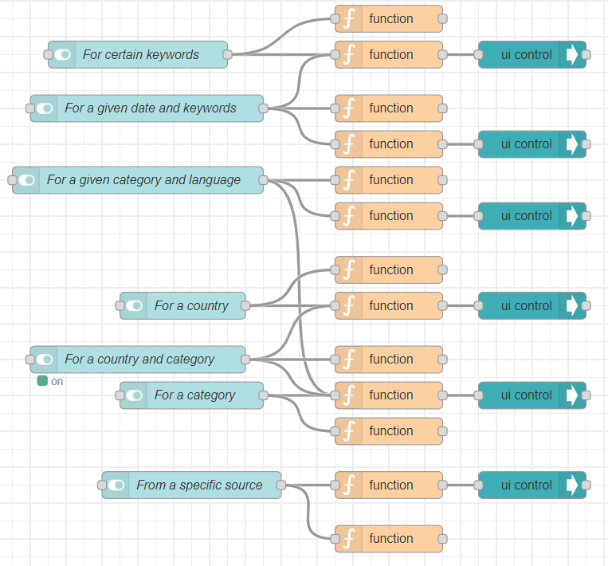
Node-RED Flows
The section for getting inputs entered by the user
The flow section that allows the user to activate the way they require news

Slide 5
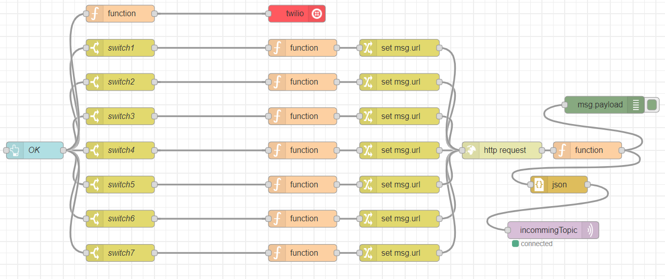
Node-RED Flows
URL is created as a string according to the requirements using the function nodes.
URL string is converted to the URL of the http request node using change nodes.
The news are taken using http request node.
Switches were used to activate only the user-selected path out of the total seven available ways.
MQTT out node is used to send the output to Node MCU using MQTT Broker.
Twilio node is used to send the link of the html page to user through a SMS.

Slide 6
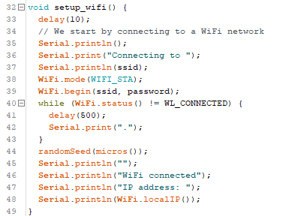
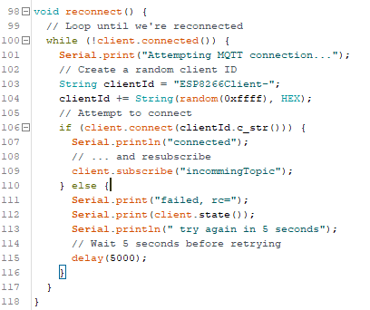
Message Queuing Telemetry Transport - Publish Subscribe Broker
Setting up the WiFi connection
For this Client have to provide the SSID and the Password of his/her WiFi Network.
This connects the Node MCU to the WiFi Access Point.
Subscribing to the MQTT Broker
The message sent from the Node-RED flows through MQTT broker ( https://broker.mqttdashboard.com/ ) under port 1883 are subscribed to the Node MCU by this part.
“Incomming topic” has been subscribed here.

Slide 7
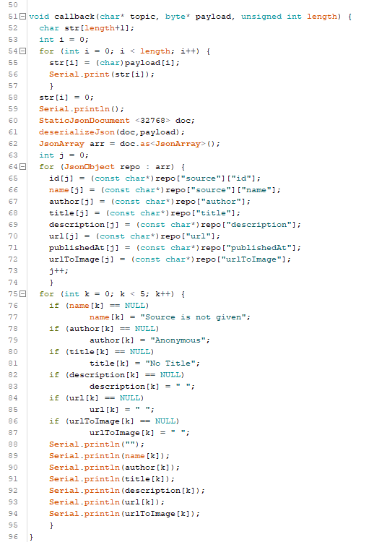
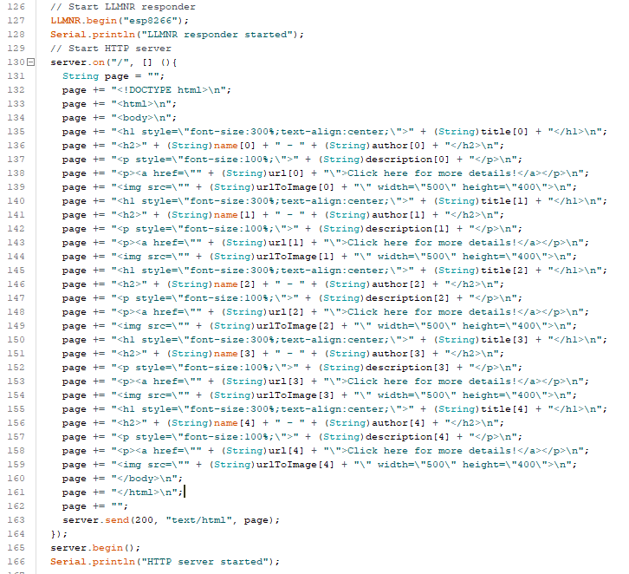
Improvements to received String……….
The array of Json send from the Node-RED flows to the Node MCU is in string format.
To get these data on to a HLML webpage we had to deserialize the Json array.
ArduinoJson Library helped in deserialization of the array of Json. (https://arduinojson.org/ )
All the variables needed to represent the content of a news item were assigned to variables.
Then send to the established HTML server at local IP Address.

Slide 8
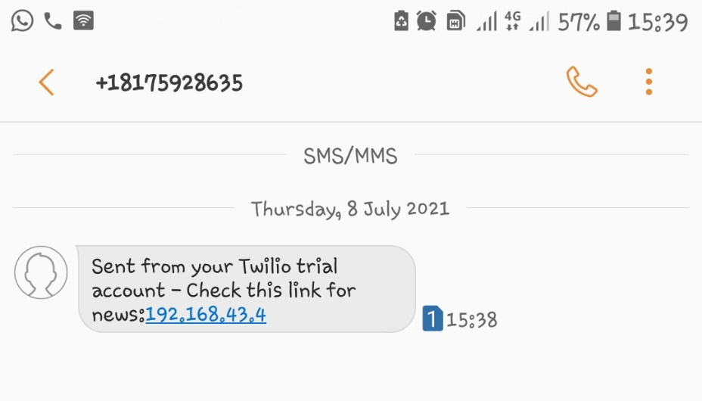
Text Message Notification Preview
Text message is received to the client’s mobile number through Twilio (a cloud communication platform) indicating the Local IP Address of the Client.
Twilio is a good platform, where making phone calls, sending and receiving SMS can be done programmatically.
Clicking the link will redirect the client to the list of Top 5 news items.

Slide 9



Output Preview – Top 5 News items
Top 5 news items for the selected preference are displayed in a web page and easily accessible through a smart phone.
Sample outputs taken for Entertainment as Category and New Zealand as Country

Slide 10
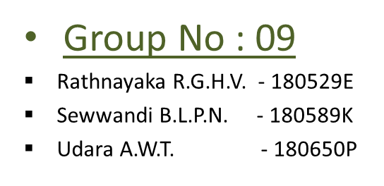
Project Demonstration…
Thank You….!

