Slide 1
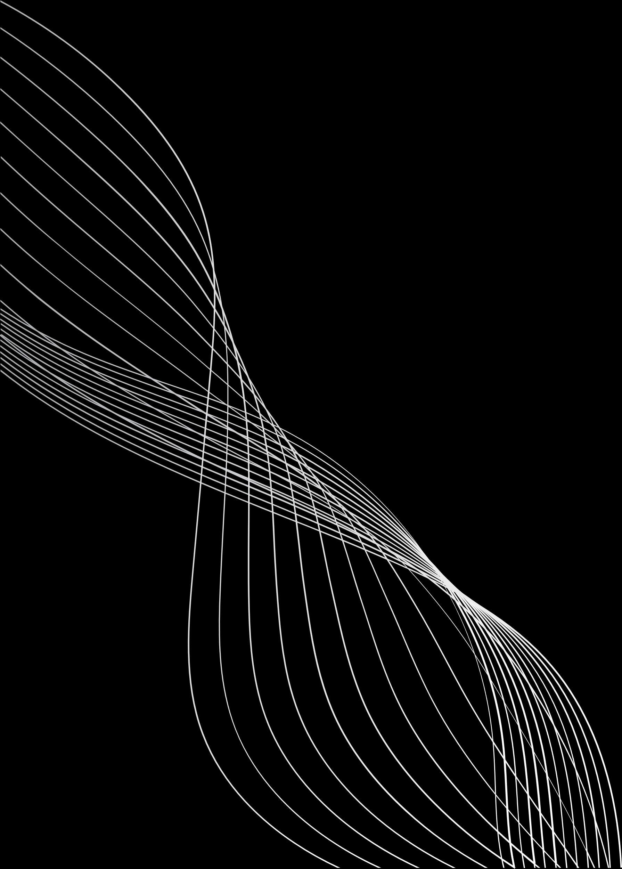


STEAMLENS PROJECT
by HIRWA Ines

Slide 2
INTRODUCTION
🎯 Project Goal:
To uncover behavioral patterns in music consumption using a Spotify streaming history dataset.
🔍 Main Question:
How can we use listening data to improve user experience, artist strategies, and platform performance?
📁 Dataset Used:
Spotify Listening History (CSV) – includes track name, artist, timestamp, ms_played, skipped, shuffle, etc.

Slide 3

PROBLEM STATEMENT
🧩 Identified Problem:
Lack of visibility into user listening behavior limits personalization, artist insights, and platform optimization.
💡 Motivation:
- Users waste time skipping tracks they don’t like
- Artists lack feedback about track performance
- Spotify’s algorithm needs better behavioral data
✅ Solution:
Analyze user activity (when, what, and how they listen) to uncover actionable insights.

Slide 4

🛠️ TOOLS & TECHNOLOGIES
🔹 Python:
- Data cleaning, feature engineering, session detection
- Libraries: pandas, numpy, matplotlib, seaborn, sklearn
🔹 Power BI:
- Dynamic dashboards
- Interactive filtering by artist, day, album
🔹 GitHub:
- Code organization and version control
🔹 Jupyter Notebook:
- Analysis and visual documentation
🔹 GitHub:
- Code organization and version control
🔹 Jupyter Notebook:
- Analysis and visual documentation

Slide 5
PYTHON WORKFLOW
3️⃣ Exploratory Data Analysis:
- Listening frequency by hour/day
- Most-played artists and albums
- Skip behavior analysis
4️⃣ Clustering:
- Grouped similar listening patterns using KMeans
- Evaluated using silhouette score
1️⃣ Data Cleaning:
- Removed nulls, standardized column names, converted timestamps
2️⃣ Feature Engineering:
- Extracted hour, day, and month
- Detected listening sessions using 30-minute gaps

Slide 6
POWER BI DASHBOARD OVERVIEW
📈 Dashboard Features
🔹 Visuals:
- Top artists by listening time
- Skip behavior vs play frequency
- Listening by hour and day
- Shuffle behavior by album
🔹 Filters:
- Day of week
- Artist name
- Album name
- Date hierarchy (Year, Month)
🔹 Interactivity:
- Easy to explore trends
- Focus on specific artists or time periods

Slide 7
KEY INSIGHTS
🔍 Insights from Data
✅ The Beatles and Past Masters albums are highly shuffled
✅ Most skips occur during high listening days (indicates exploration)
✅ Listening peaks in evening hours (around 7–10 PM)
✅ Loyal repeat listening to artists like The Killers and John Mayer
✅ Some songs are frequently skipped despite being frequently played
📊 These patterns can help:
- Users get better recommendations
- Artists understand what works
- Spotify optimize playlists and retention

Slide 8
ECONOMIC IMPACT
💰 Economic Relevance
🔹 Users:
- Save time and enjoy better-curated playlists
🔹 Artists:
- Identify track performance and adjust future releases
🔹 Spotify:
- Improve recommendation engine
- Boost engagement, reduce churn
- Increase ad or subscription revenue

Slide 9
CHALLENGES & LIMITATIONS
⚠️ Challenges Faced
- Dataset did not include user demographics
- No device info to understand listening context
- Limited size (personal history only)
🧪 Future Work:
- Use larger/multi-user datasets
- Apply recommendation models
- Integrate with Spotify API

Slide 10
CONCLUSION
🎯 Conclusion
- Behavioral analysis reveals actionable trends
- Data science improves personal experience and business performance
- This project shows how even small datasets can yield rich insights
Thank you!
📨 hirwaines8@gmail.com | 📍 AUCA

