Slide 1
Digital Portfolio
STUDENT NAME: Gowtham.S
REGISTER NO : 2422k1508 NMID : 9E8F785642EB7C49D494B56E204B2790
DEPARTMENT: B.Sc.,Computer science
COLLEGE: Hindusthan College of Science and Commerce, Erode
Bharathiyar University, Coimbatore

Slide 2
PROJECT TITLE MY PORTFOLIO

Slide 3


AGENDA
Problem Statement
Project Overview
End Users
Tools and Technologies
Portfolio design and Layout
Features and Functionality
Results and Screenshots
Conclusion
Github Link

Slide 4

PROBLEM STATEMENT
In today’s competitive environment, students and fresh graduates face challenges in effectively presenting their skills, achievements, and projects to recruiters, faculty, and industry professionals. Traditional resumes often fail to capture a person’s full potential, creativity, and technical knowledge. Moreover, recruiters prefer quick and visually engaging platforms to evaluate candidates rather than lengthy documents. Without a professional portfolio, there is a gap in communication between the student’s abilities and the recruiter’s expectations. Therefore, there is a need for a personal portfolio website that provides a structured, accessible, and attractive way to showcase an individual’s education, skills, certifications, projects, strengths, and future goals. This project addresses the problem by creating a responsive portfolio website that not only highlights academic and technical knowledge but also serves as a digital identity, making it easier for end users to assess and connect with the candidate.

Slide 5

PROJECT OVERVIEW
This project focuses on designing and developing a personal portfolio website that acts as a digital profile to present academic achievements, technical skills, certifications, projects, and future goals in an attractive and structured way. The portfolio was built using HTML and CSS, ensuring simplicity, responsiveness, and ease of access. The main objective of this project was to create an online identity that represents personal and professional growth. Unlike traditional resumes, the portfolio website provides a visual and interactive platform that highlights creativity along with technical ability. During the development process, the project included key phases such as problem identification, tool selection, design layout, coding, testing, and final deployment. The outcome of this project is a clean and user-friendly portfolio that can be shared easily with recruiters, faculty, and peers. Overall, the project has successfully met its objectives by delivering a functional, well-structured, and engaging portfolio website, which can serve as a foundation for further enhancements like adding JavaScript functionality, animations, or hosting on platforms such as GitHub Pages

Slide 6

WHO ARE THE END USERS?
End Users
The portfolio website is designed to benefit the following end users:
1. Recruiters and Employers – To quickly assess skills, education, and projects in a professional and structured format.
2. Faculty and Academic Mentors – To review academic progress, certifications, and technical contributions.
3. Peers and Collaborators – To connect for project discussions, knowledge sharing, and teamwork opportunities.
4. Personal Branding – Acts as a digital identity that anyone interested in the candidate’s profile can access.
This ensures that the portfolio is not only a resume replacement but also a multi-purpose tool for career development, academic recognition, and personal branding.

Slide 7

TOOLS AND TECHNIQUES
To develop the portfolio website, the following tools and technologies were used:
1. HTML5 – For creating the structure and layout of the web pages.
2. CSS3 – For designing, styling, and adding responsiveness to the portfolio.
3. JavaScript (Basic) – For enhancing interactivity and dynamic elements (if required).
4. CodePen – As the online platform to write, test, and share the code effectively.
5. GitHub – For version control, project hosting, and sharing with recruiters.

Slide 8
PORTFOLIO DESIGN AND LAYOUT
The portfolio website was designed with a clean and modern layout to make it simple and professional. The design follows a section-wise structure for easy navigation:
Header Section – Includes profile photo, name, and a short tagline.
Navigation Bar – Quick access to sections like About, Skills, Education, Projects, and Strengths.
About Me Section – A short introduction with personal details and career aspirations.
Skills Section – A structured list of technical and soft skills displayed with styled boxes.
Education Section – Academic details presented in a highlighted card format.
Projects Section – Detailed explanation of completed projects with hover effects for interactivity.
Strengths Section – Lists qualities such as being a strong person, helping-minded, fast learner, and smart worker.
Footer Section – Contains contact details and copyright note.

Slide 9
FEATURES AND FUNCTIONALITY
The portfolio website is designed not only with a clean layout but also with practical features that enhance usability:
1. Responsive Design – The portfolio adjusts seamlessly across desktops, tablets, and mobile devices.
2. Profile Integration – Displays profile photo, name, and a short introduction in an attractive header section.
3. Navigation Bar – Quick access links to jump directly to different sections (About, Skills, Education, Projects, Strengths).
4. Skills Showcase – Clearly lists technical skills like HTML, CSS, JavaScript, C, C++, and Python.
Education Details – Highlighted education card showing academic background.
Project Highlights – Displays completed projects with hover effects to make it interactive.
Strengths Section – Shows personal qualities such as strong-minded, helping nature, fast learning, and smart working.
Simple Contact Information – Provides email and phone details in a neat footer.
Modern Styling – Uses light blue theme, shadows, and rounded corners for a professional look.
Easy to Update – Content and design are structured, so future updates can be made without difficulty.

Slide 10
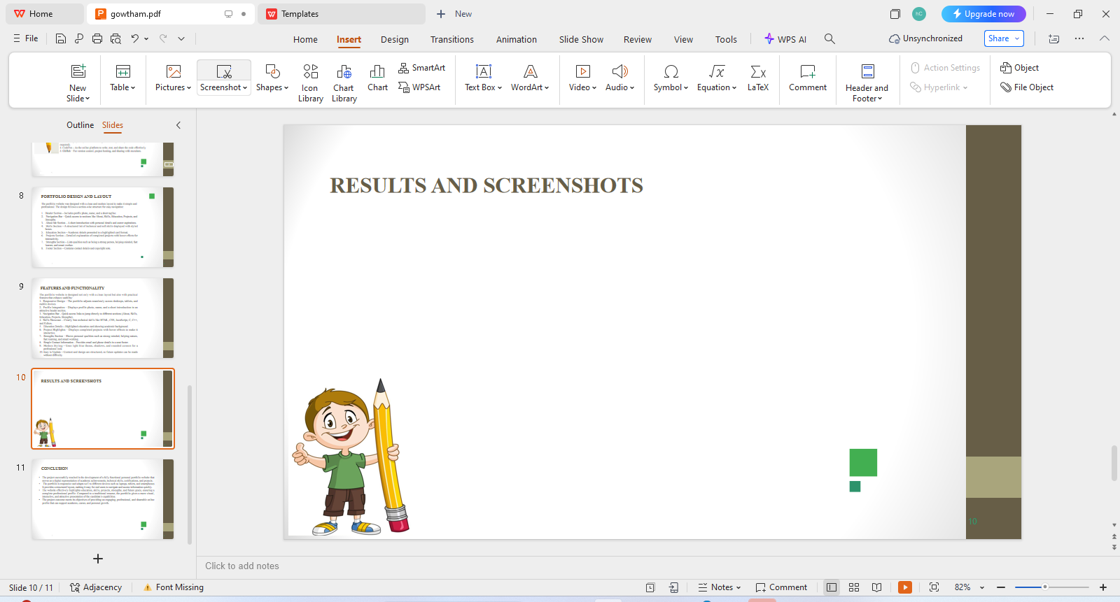
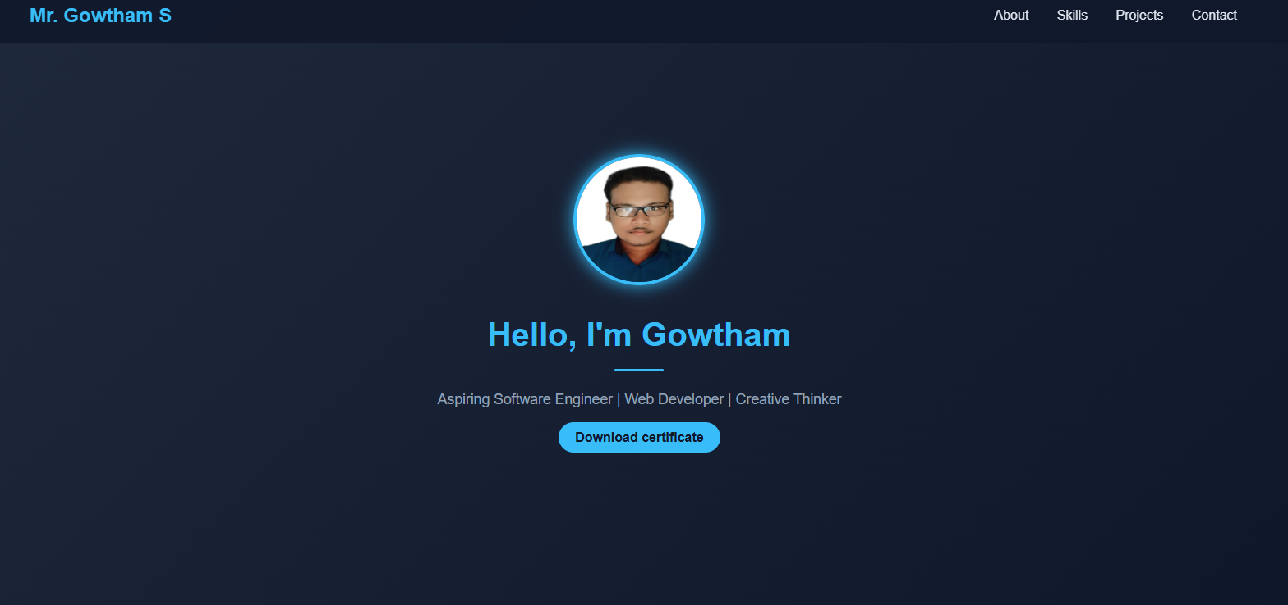
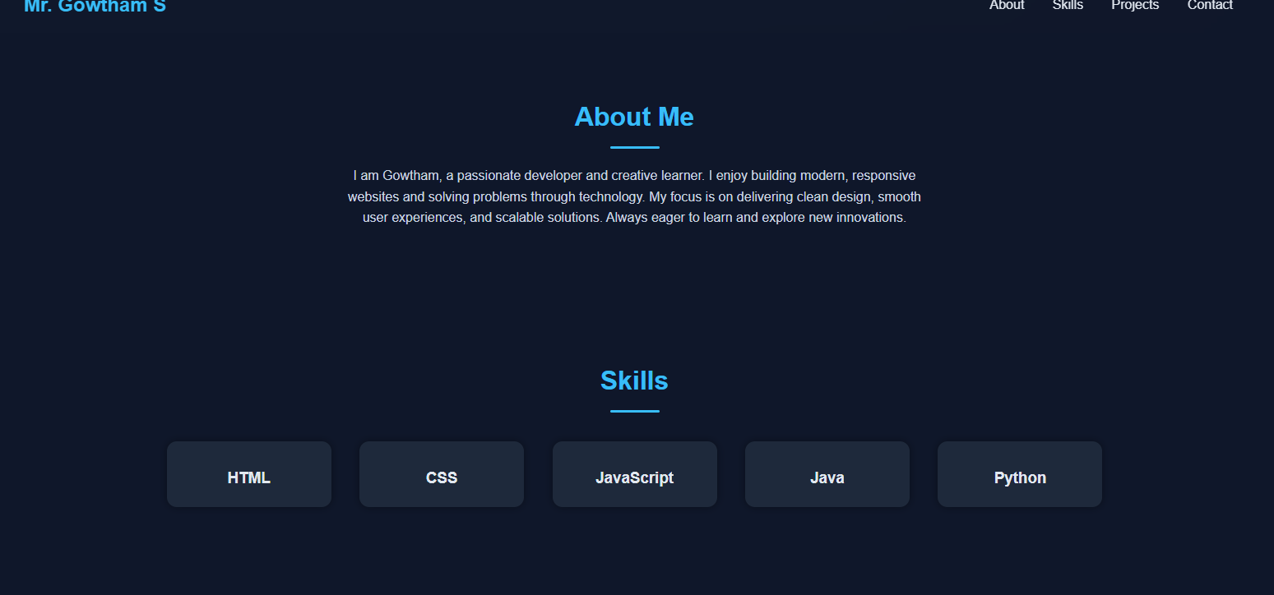

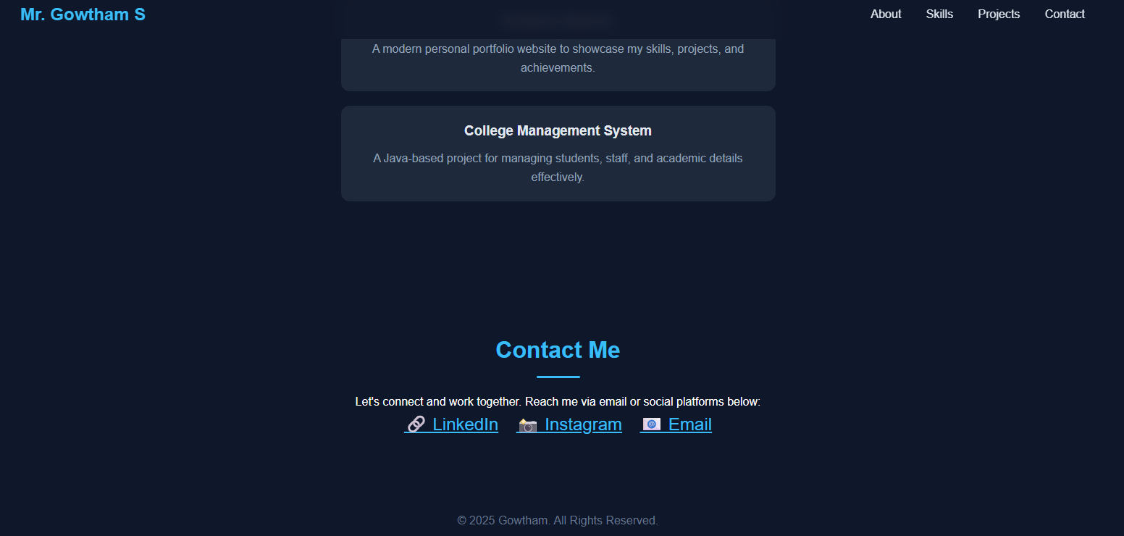
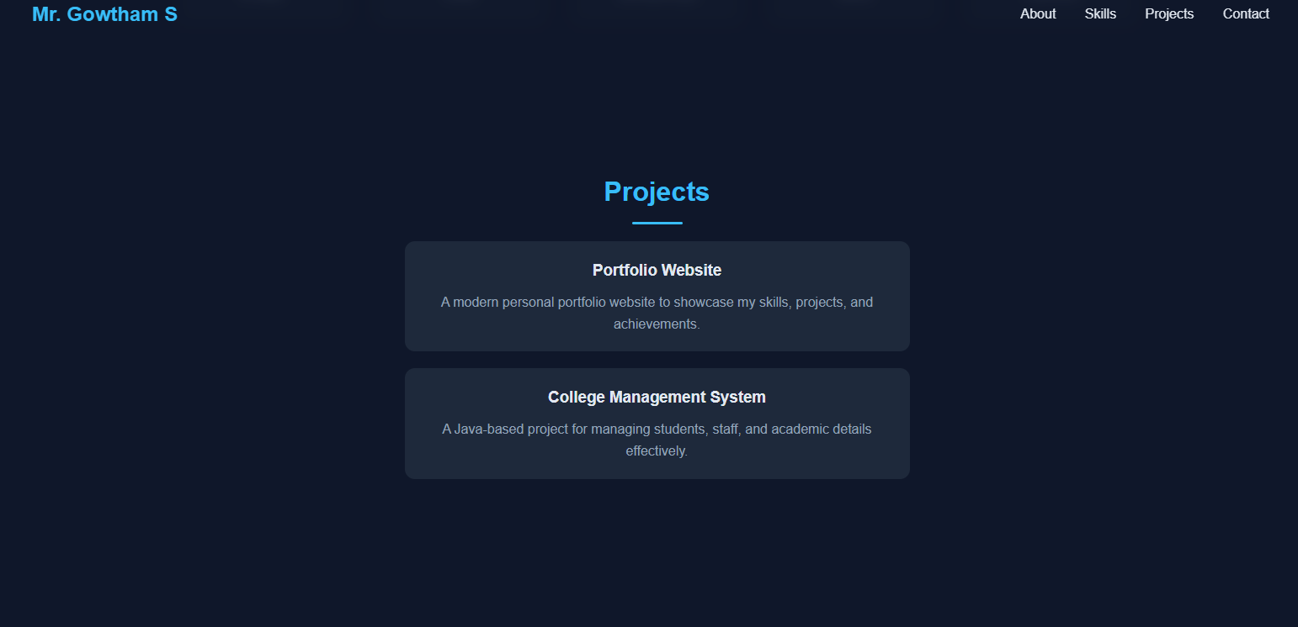
RESULTS AND SCREENSHOTS

Slide 11
CONCLUSION
The project successfully resulted in the development of a fully functional personal portfolio website that serves as a digital representation of academic achievements, technical skills, certifications, and projects.
The portfolio is responsive and adapts well to different devices such as laptops, tablets, and smartphones. It provides a structured layout, making it easy for end users to navigate and access information quickly.
The website effectively highlights education, skills, projects, strengths, and future goals, ensuring a complete professional profile. Compared to a traditional resume, the portfolio gives a more visual, interactive, and attractive presentation of the candidate’s capabilities.
The project outcome meets its objectives of providing an engaging, professional, and shareable online profile that can support academic, career, and personal growth.

