Slide 1
Design and Implementation of Internet of Things Based Smart Energy Monitoring System.
Supervised By
Mr. Saiful Islam
Lecturer, Dept. Of CSE, IIUC
Presented By
S M Hisbullah Hasnat (C163014)
Md. Jahidul Alam ( C163015)
Md. Mustafa Arkan (C163032)

Slide 2
Presentation Outline
Introduction
Literature Review
Objective
Project Approach
Block Diagram
Required Components
Programming Tools
Gantt Chart
Conclusion

Slide 3
Introduction
Power sector plays strategic role in the process of economic development of a country.
Without a proper management of power usage, it is nearly impossible to reduce power shortage, maintain proper billing etc.

Slide 4
Literature Review
Project Title | Author | Remarks
Arduino Based Energy Meter Using GSM (2016) [1] | V. Preethi and G. Harish | A system configured with Arduino microcontroller with a GSM module. No IoT Panel has used in this project.
Design and development of GSM Based Energy Meter {2018) [2] | N.T. Makanjuola, O. Shoewu, L.A. Akinyemi and A.A. Ajasa | An ATMega 81 chip has used as microcontroller which is a very low cost solution.
Smart Energy Meter Surveillance Using IoT (2019} [3] | R. G. Sarangle, U. Pandit, K. Prof, and J. Modi | A basic web panel has introduced in this system to monitor energy consumption. Yet the system lacks an interactive design.

Slide 5
Objective
To design a circuit for measuring voltage, current, and total power for measurement.
To show the result in LCD Display & send the result to authority.
Interpreting system data on display and IoT server.

Slide 6
Project Approach
Block Diagram
Components
Programming Tools

Slide 7
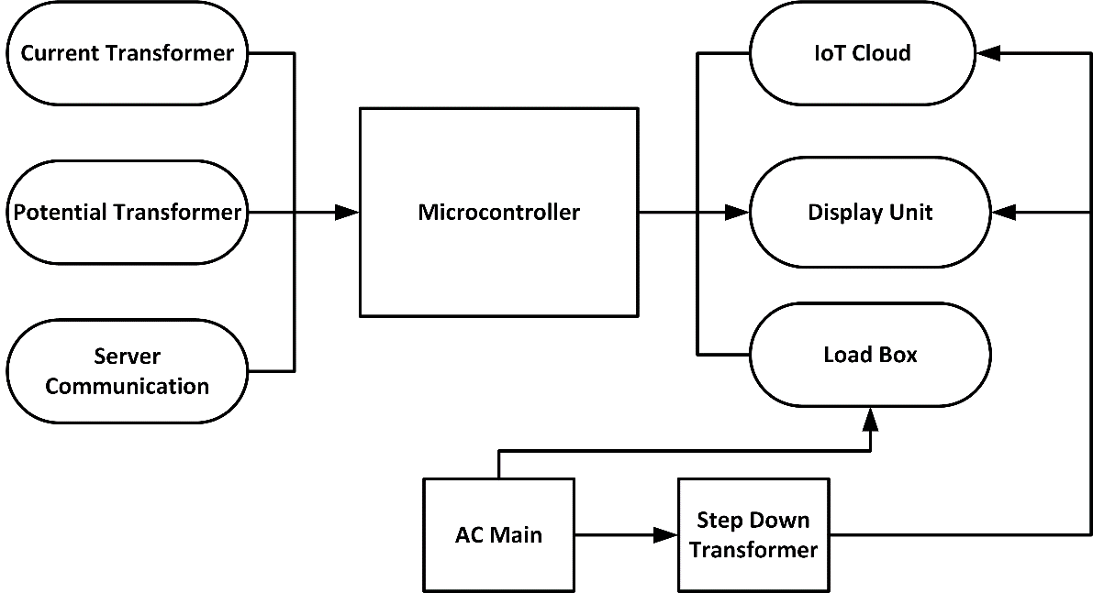
Block Diagram
Input parameters.
Processing.
Output parameters.

Slide 8
Required Components
Arduino UNO
ESP 8266
ACS712 Current Sensor
Voltage Meter
Liquid Crystal Display
I2C Interface
Step Down Transformer (AC)
Bridge Rectifier (AC to DC conversion)
Buck Regulator (DC)
Load

Slide 9
Programming Tools
Arduino IDE-The Arduino Integrated Development Environment-orArduino Software(IDE)-contains a text editor for writing code,a message area,a textconsole,a tool bar with buttons for common functions and a series of menus.It connects to the Arduino and hardware to upload programs and communicate with them.
MQTT- (Message Queuing Telemetry Transport) is a lightweight messaging protocol that was developed by IBM.MQTT has Library for IoT.We will use library name “PubSubClient”. It uses the pub/sub pattern and translates messages between devices, servers, and applications.

Slide 10
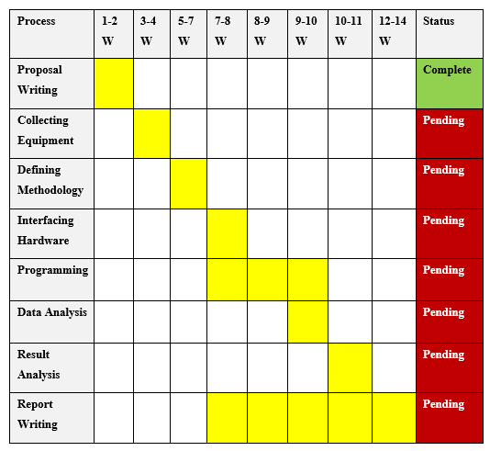
Gantt Chart

Slide 11
Conclusion
This project will play a significant role in energy monitoring.
It will help user to monitor real time consumption.
We are hoping that this system will be a milestone in the power sector of Bangladesh.

Slide 12
References
[1] V. Preethi and G. Harish, “Design and implementation of smart energy meter,” in 2016 International Conference on Inventive Computation Technologies (ICICT), 2016, pp. 1–5.
[2] N.T. Makanjuola, O. Shoewu, L.A. Akinyemi and A.A. Ajasa, 2018. Design and Development of a Microcontroller Based Digital Wattmeter (MIDIWAT).
[3] R. G. Sarangle, U. Pandit, K. Prof, and J. Modi, “Gsm Based Power Meter Reading,” vol. 1, no. 4, pp. 273–279, 2019.

Slide 13
Any Question?

Slide 14
Thank You

