Slide 1

Organiser:
Centre for Applied Informatics, Victoria University, Melbourne, Australia
General Co-Chairs
Yanchun Zhang, Victoria University, Australia
Michael Blumenstein, Griffith University, Australia

Slide 2

Conference Opening
Welcome Speech
Professor Warren Payne
Pro Vice-Chancellor, Research and Research Training

Slide 3
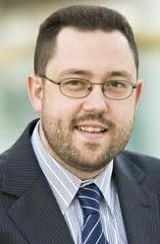
Opening Address
Professor Michael Blumenstein
Griffith University, Australia

Slide 4
Take a conference photo

Slide 5
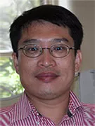
Keynote speech
Title: Bioinformatics for Human Health
Speaker: Professor Jinyan Li
Faculty of Engineering and IT, University of Technology, Sydney, Australia.

Slide 6
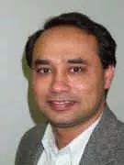
Keynote speech
Title: Computational Intelligence Techniques in Gait Data Modelling
Speaker: Professor Rezaul Begg
College of Sport and Exercise Science, Victoria University, Australia.

Slide 7
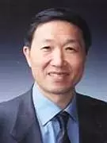
Keynote speech
Title: Build a Cloud Infrastructure to Support Home-Based Care Systems for Elderly People -- Challenges and Solutions
Speaker: Professor Lizhu Zhou
Department of Computer Science and Technology, Tsinghua University, China.

Slide 8
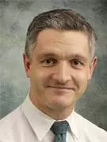
Keynote speech
Title: Evidence Based Medicine: a confusion of numbers – supporting the effective utilisation of information.
Speaker: Professor Michael Steyn
UQ Centre for Clinical Research, University of Queensland, Australia

Slide 9
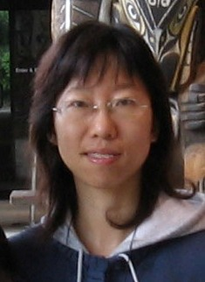
Keynote speech
Title: Big Biological data -- Challenges & Opportunities
Speaker: Professor Xiaochun Yang, College of Information Science and Engineering at Northeastern University, China.

Slide 10
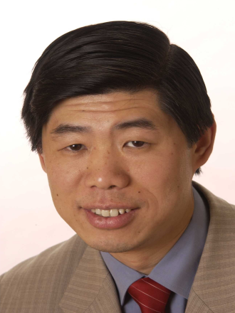
Keynote speech
Title: First-hand Experience of IT use in the Australian General Practice – an update
Speaker: Doctor Stanley C. Chiang
General Practitioner in Australia

