Slide 1
Email: Principles and Etiquettes
Sayed Hisham
Assistant Manager - Operations

Slide 2
Email
Electronic mail is a method of exchanging digital messages between computer users. Email operates across computer networks.
Examples of Email service providers include Gmail, Hotmail, yahoo etc.

Slide 3
Principles of Email Communication
Place important information first
More often than not, your colleagues may not have time to read lengthy e­-mail messages, it is a good idea to put all the important information that you want to convey in the first three lines of the message. Whether you are seeking a clarification, making a request, or giving instructions, it is best to mention this right at the outset, so that it is noticed.

Slide 4
Contd.
Pay attention to the tone
E­mail lacks the personal quality of face­ to ­face communication, where body language and other non­verbal cues may be used to make the communication more positive.
Therefore, you must pay close attention to the tone of the message and ensure that you sound friendly and courteous.
Avoid using humour and sarcasm which might be misunderstood, or sending messages when you are angry or annoyed.

Slide 5
Contd.
Watch the content
E­mail messages are not always confidential and one can never be sure who will read them. The minute an e­mail message is sent, multiple copies are created on your own PC and server and on the recipient’s PC and server.

Slide 6
Contd.
Include a specific subject line
Your e­mail message should always include a subject line that clearly mentions the topic of the e­mail. Since business executives receive several e­mails a day, this would help them to decide which messages are most important to them. They will also have an idea of what the message contains.

Slide 7
Contd.
Explain attachments in the body of the e­mail
Attachments take time to download and should be sent along with an explanation in the body of the e­mail, as to what they are all about. This will make it easier for the recipient of the message to decide whether they should be opened or not. Otherwise it will lead to unnecessary waste of time

Slide 8
Contd.
Pay attention to brevity, emphasis and white space
The look, appearance and language used in the e­mail message can influence the readability of the message.
Some techniques for enhancing readability of e­mail messages include short paragraphs ( six lines maximum), spacing between paragraphs, use of bullet points and numbers for lists, use of paragraph captions, highlighting main points in bold type and use of white space.

Slide 9
Contd.
Proofread your e­mail message ­
Just as it is important to proofread business reports, letters and memos, e­mail messages should also be checked for spelling and grammar mistakes, so as to avoid any embarrassment.
Set aside time to check e­mail
E­mail should not become a substitute for face ­to ­face interaction at the workplace, or cut into valuable time spent on other important jobs.

Slide 10
Email Etiquette
1.Be polite
These refer to the three “magic” words, “Please”, “Thank You” and “Sorry”. They are all the more important in e­mail messages, which have to be extra polite and friendly
2. Avoid “shouting”
Shouting in an e­mail message refers to use of all capital letters in the text. All caps make it difficult to read a message and are therefore considered to be rude, like shouting.

Slide 11
Contd.
3. Avoid symbols and acronyms
Symbolic messages using punctuation marks, known as “emoticons” should be avoided, especially in business related e­ mail messages.
Similarly, It is better to avoid abbreviations such as BTW, by the way since they sound over casual and may not be understood by everyone.

Slide 12
Contd.
4.Respond promptly
Even if you are hard pressed for time, In the case of business related e­mails, prompt responses to emails are always appreciated.
5. Use friendly salutations and sign­offs
Although these are not strictly required in e­mail communication as in business letters, a salutation such as “Dear Mr. X” and a sign­off such as “Warm Regards”, helps to make the tone friendly and personal.

Slide 13
Contd.
6. Avoid sending “junk mail”
Do not send irrelevant messages or messages that are not work related, to people at work. If you overload people with this kind of mail, they will not pay attention to the really important messages.

Slide 14
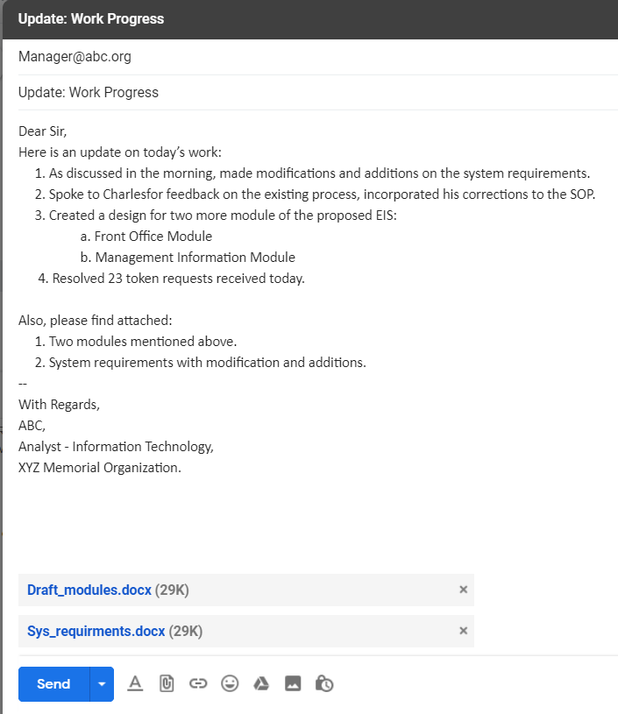
A Sample Email

Slide 15
Thank You

