Slide 1
Oct 5
2026

Slide 2
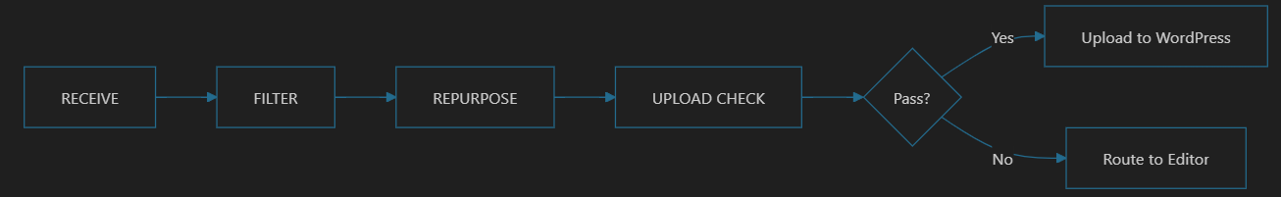

Slide 3
Reply email to “sender” if “checklist” is not complete

Slide 4
Critical Gate
  Is article related to 3R?
  Yes with 80% confidence
Normal Gate
  If article weighted score >= 75% then Accept
Need tuning
OR
Training

Slide 5
Sept 21
2026

Slide 6
AI News
Project scope

Slide 7
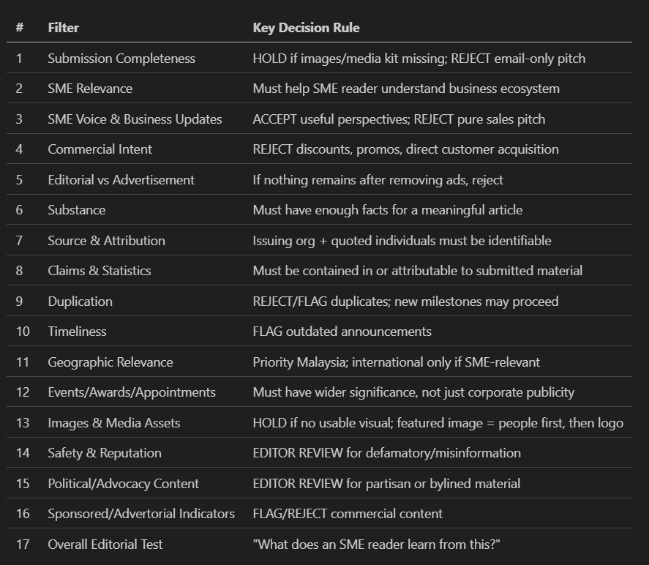

Slide 8
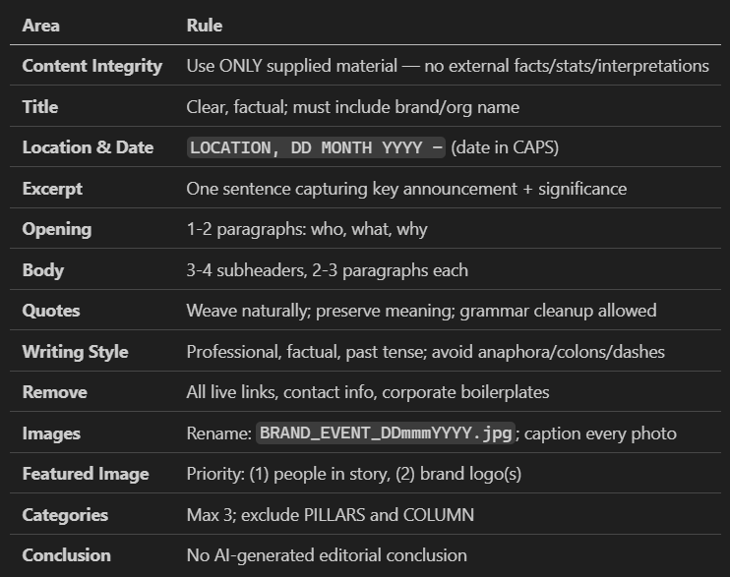
Stage 2 – Content

Slide 9
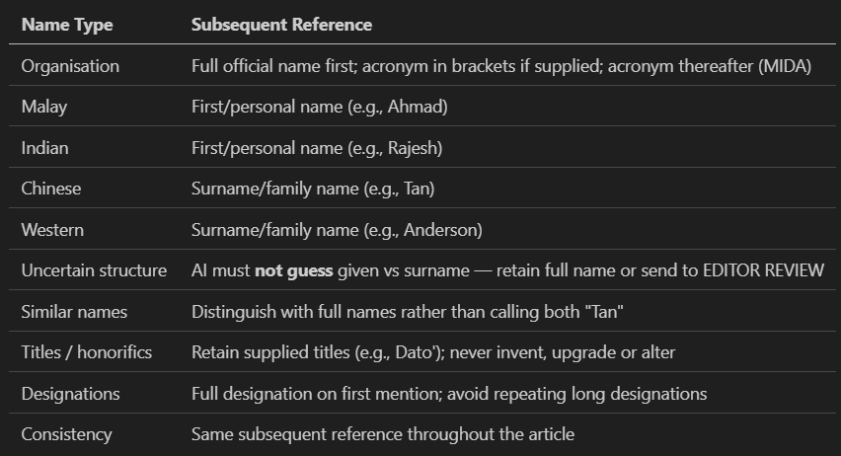
Stage 2 – Cultural

Slide 10
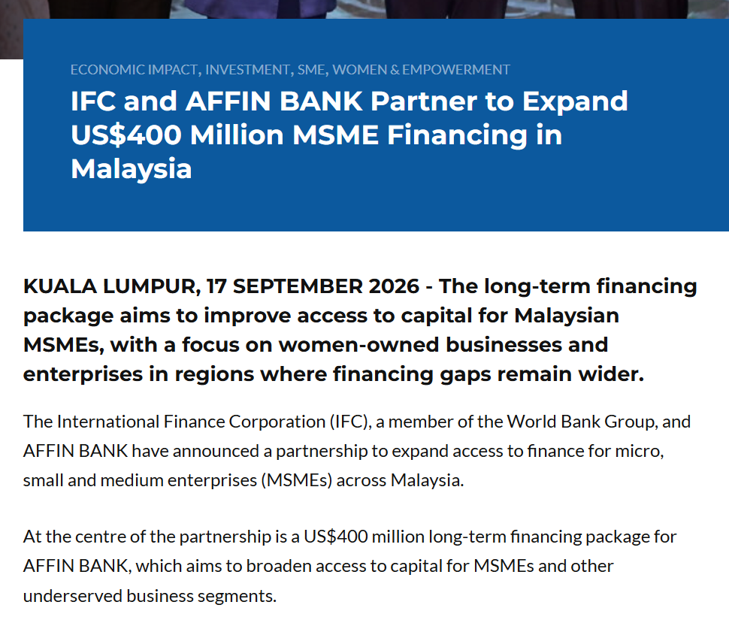
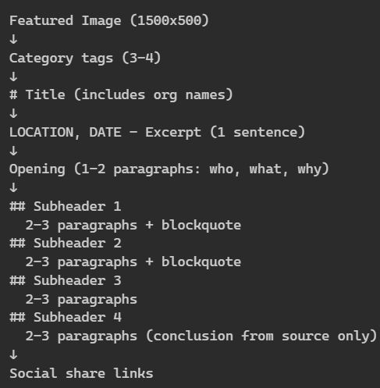

Slide 11
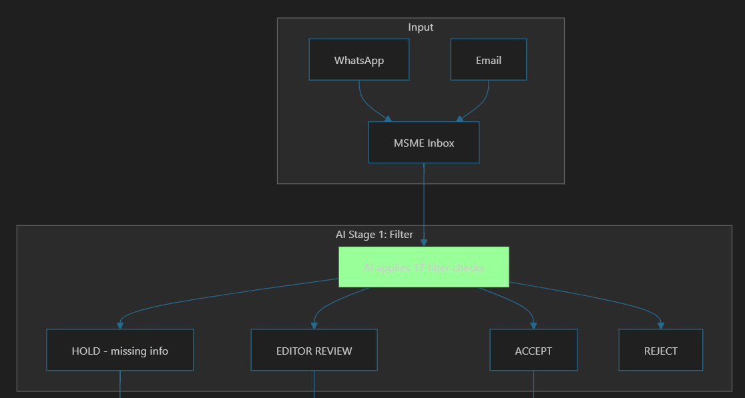
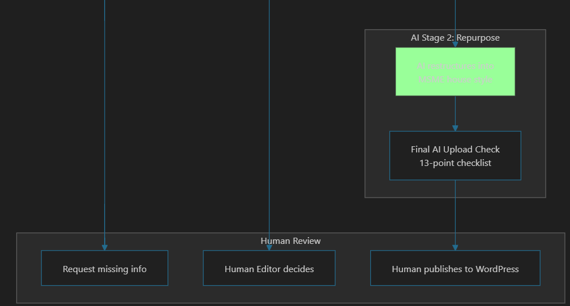

Slide 12
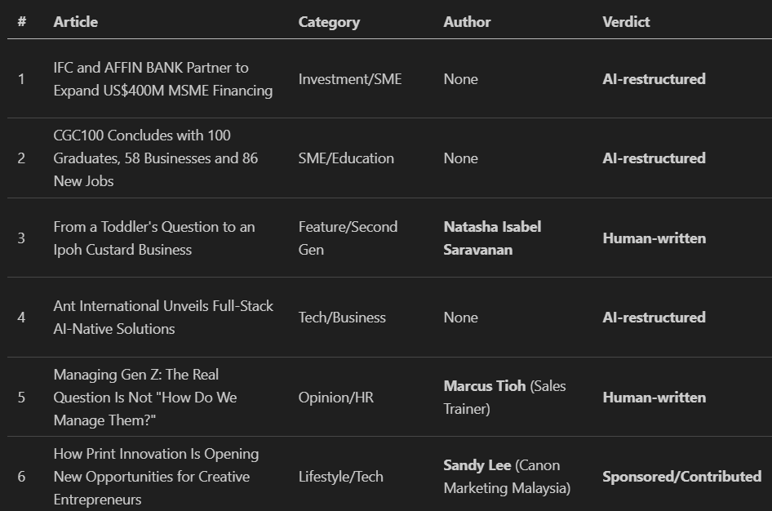

Slide 13
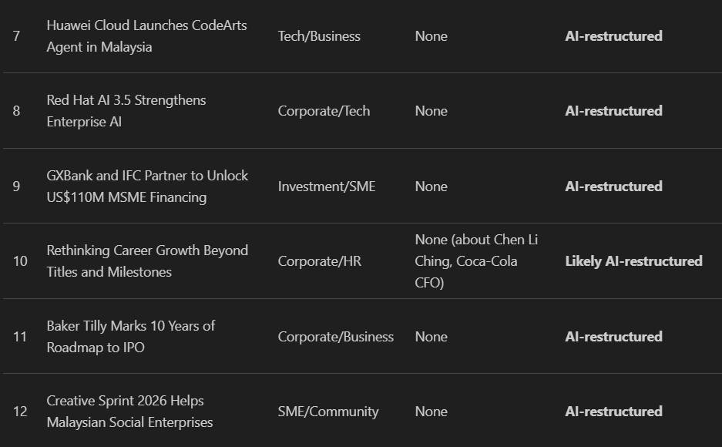

Slide 14
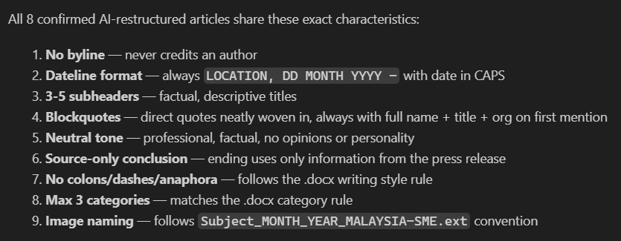

Slide 15
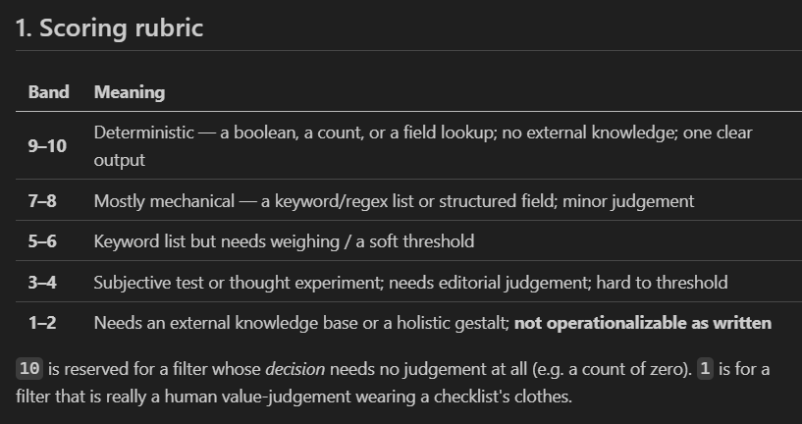
Stage 1

Slide 16
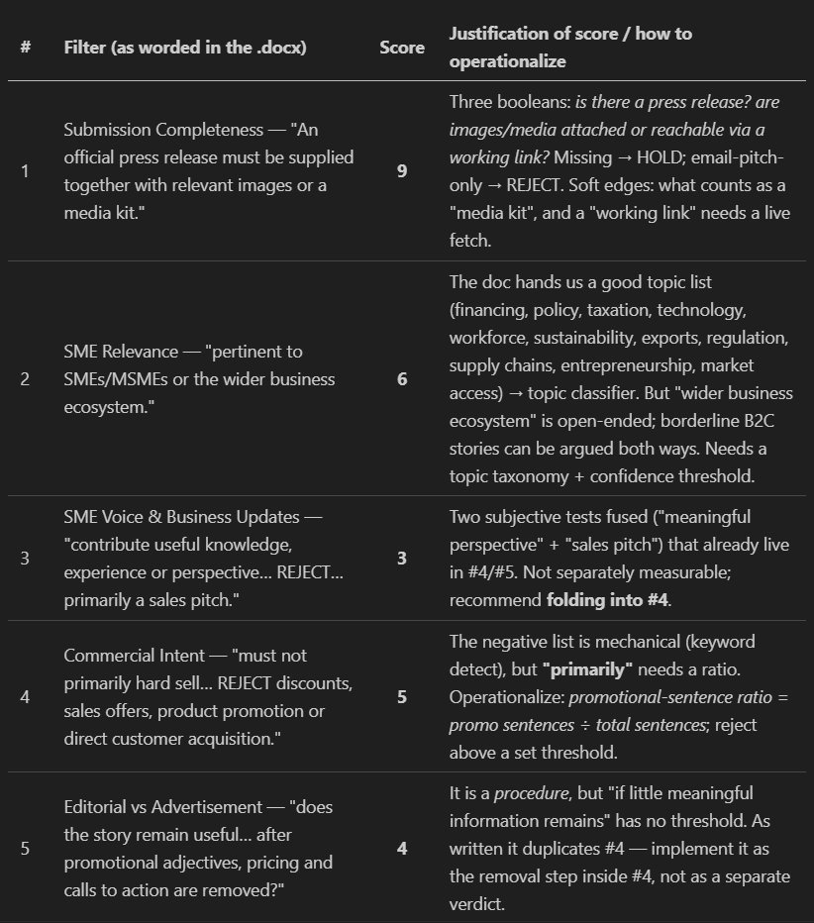

Slide 17
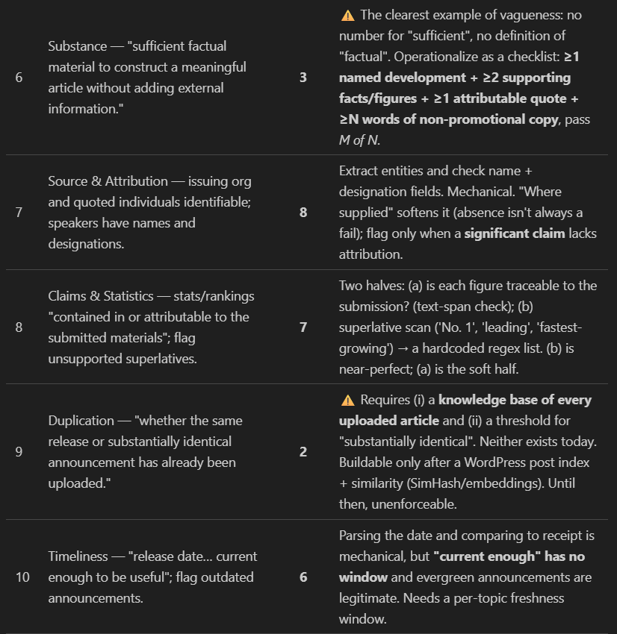

Slide 18


