Slide 1
Dataflow Semantics for
End-User Programmable Applications
Hisham Muhammad
April 28, 2017

Slide 2
End-user programming

Slide 3

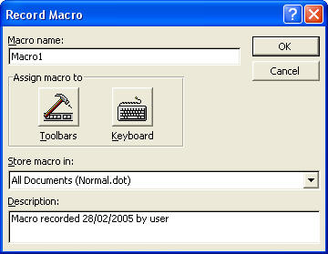
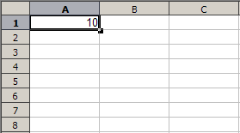
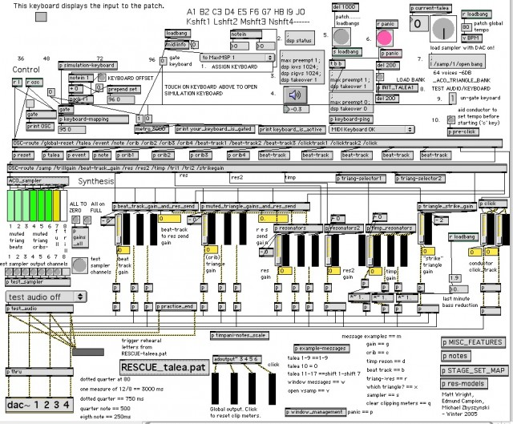
End-user programming
spreadsheets
macros
scripting
node editors
AddEntityCollideCallback("Player","AreaHelp",
"CollidePlayerWithAreaHelp");
void CollidePlayerWithAreaHelp()
{
if(HasItem("cellar_key") == true)
{
SetMessage("Use your inventory to select "+
"key and use on door.", 10);
}
else
{
SetMessage("You will need a key to open "+
"the door.", 5);
}
}

Slide 4
End-user programming
spreadsheets
macros
scripting
node editors
AddEntityCollideCallback("Player","AreaHelp",
"CollidePlayerWithAreaHelp");
void CollidePlayerWithAreaHelp()
{
if(HasItem("cellar_key") == true)
{
SetMessage("Use your inventory to select "+
"key and use on door.", 10);
}
else
{
SetMessage("You will need a key to open "+
"the door.", 5);
}
}

Slide 5
End-user programming
spreadsheets
macros
scripting
node editors
AddEntityCollideCallback("Player","AreaHelp",
"CollidePlayerWithAreaHelp");
void CollidePlayerWithAreaHelp()
{
if(HasItem("cellar_key") == true)
{
SetMessage("Use your inventory to select "+
"key and use on door.", 10);
}
else
{
SetMessage("You will need a key to open "+
"the door.", 5);
}
}

Slide 6
Scripting
"little languages"
eqn
pic
sed
awk
SCUMM

Slide 7
Scripting
"little languages"
custom DSLs
eqn
GraForth
pic
sed
awk
WordBasic
SCUMM
AutoLISP

Slide 8
Scripting
"little languages"
custom DSLs
scripting languages
eqn
GraForth
Tcl
awk
WordBasic
Ruby
pic
sed
Lua
SCUMM
AutoLISP
Python

Slide 9
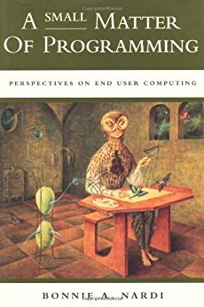

Slide 10
Users and developers
End-users
  Domain specialists
  Care about the domain, not the software
Domain developers
  Domain specialists interested in the software
  Advanced users: “Tinkerers”, “enthusiasts”
Developers
  Software development professionals

Slide 11
Users and architectural layers
End-user | formulas | macro recorder | node editor | Unix shell | level editor
Domain developer | macros | textual macros | scripting | shell script | game scripting
Core app developer | spreadsheet | word processor | 3D app | C utilities | video game

Slide 12
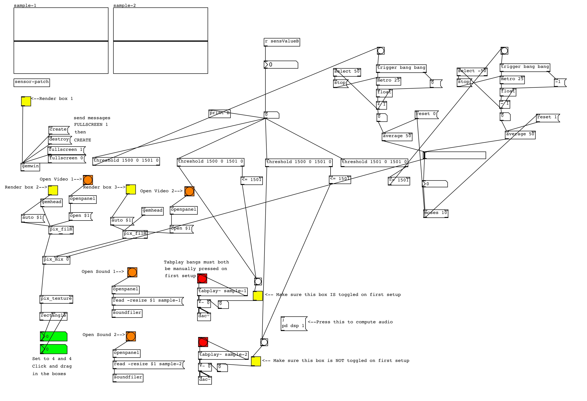
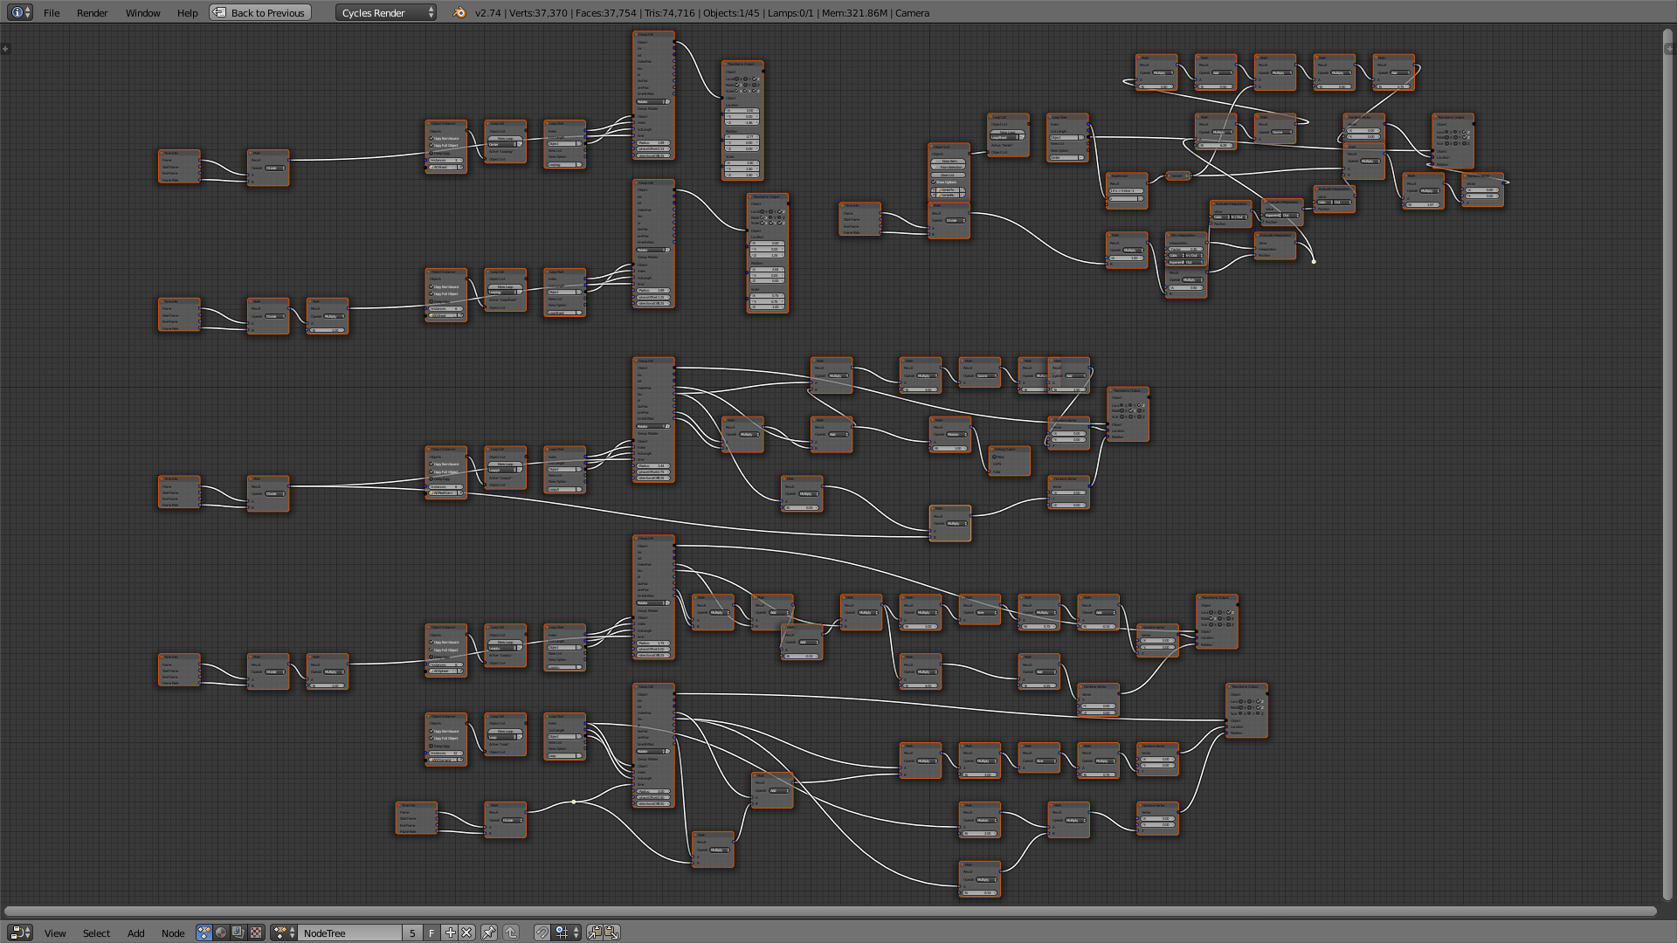
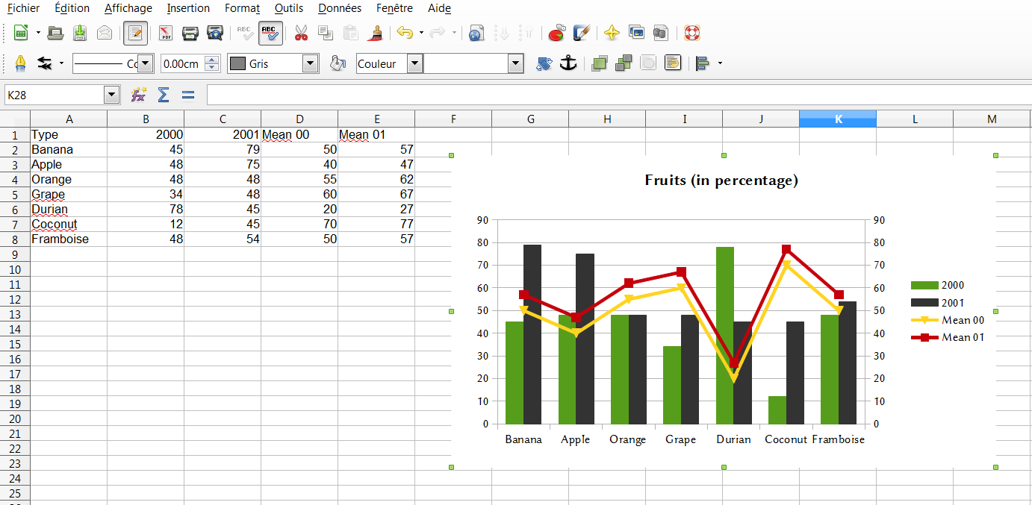
UI-Level languages

Slide 13
Dataflow

Slide 14
UI-Level Languages
ad-hoc languages
Pure Data
Blender
Excel
LabVIEW
Reaktor
VEE

Slide 15
UI-Level Languages
ad-hoc languages
?
Pure Data
?
Blender
Excel
?
?
LabVIEW
?
VEE
?
?
Reaktor

Slide 16
How should UI-level languages evolve?

Slide 17
When designing a dataflow language
for an end-user programmable application,
which design choices
should be taken into consideration
with regard to its semantics
and what are their effects?

Slide 18
When designing a dataflow language
for an end-user programmable application,
which design choices
should be taken into consideration
with regard to its semantics
and what are their effects?

Slide 19
When designing a dataflow language
for an end-user programmable application,
which design choices
should be taken into consideration
with regard to its semantics
and what are their effects?

Slide 20
When designing a dataflow language
for an end-user programmable application,
which design choices
should be taken into consideration
with regard to its semantics
and what are their effects?

Slide 21
When designing a dataflow language
for an end-user programmable application,
which design choices
should be taken into consideration
with regard to its semantics
and what are their effects?

Slide 22
When designing a dataflow language
for an end-user programmable application,
which design choices
should be taken into consideration
with regard to its semantics
and what are their effects?
Case studies
of dataflow end-user programmable applications

Slide 23
When designing a dataflow language
for an end-user programmable application,
which design choices
should be taken into consideration
with regard to its semantics
and what are their effects?
Case studies
of dataflow end-user programmable applications
Design alternatives
pertaining their semantics

Slide 24
When designing a dataflow language
for an end-user programmable application,
which design choices
should be taken into consideration
with regard to its semantics
and what are their effects?
Case studies
of dataflow end-user programmable applications
Design alternatives
pertaining their semantics
Critique
of the effects of these design choices

Slide 25
Case studies

Slide 26
Case studies
Understanding the design of real-world
dataflow UI-level languages
Definitional interpreters in Haskell,
written in the style of operational semantics
Analyze their differences
and their common patterns

Slide 27
Three in-depth studies
Pure Data
Spreadsheet formula language
LabVIEW

Slide 28
Three in-depth studies
Pure Data
  Chapter 4
Spreadsheet formula language
  Chapter 5
LabVIEW
  Chapter 6

Slide 29
Three in-depth studies
Pure Data
  Chapter 4
    http://github.com/hishamhm/puredata
Spreadsheet formula language
  Chapter 5
    http://github.com/hishamhm/spreadsheet
LabVIEW
  Chapter 6
    http://github.com/hishamhm/lv

Slide 30
Pure Data

Slide 31
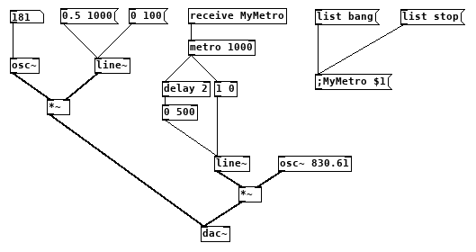
An example
user inputs
user inputs

Slide 32
An example
indirect connection

Slide 33
An example
time-based execution

Slide 34
A demo!

Slide 35
Spreadsheets

Slide 36
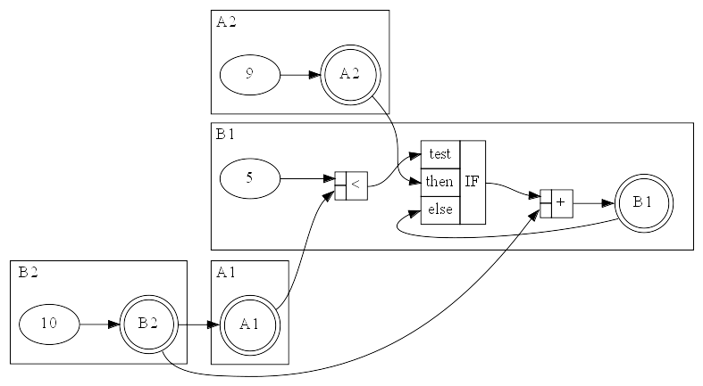
Spreadsheets as dataflow
 | A | B
1 | =B2 | =IF(5<A1;A2:B1)+B2
2 | 9 | 10

Slide 37



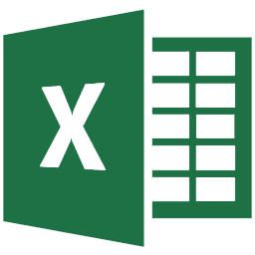

Which spreadsheet?
Microsoft Excel 2010
LibreOffice Calc 5
Google Sheets
Microsoft Excel Online
Microsoft Excel for Android

Slide 38
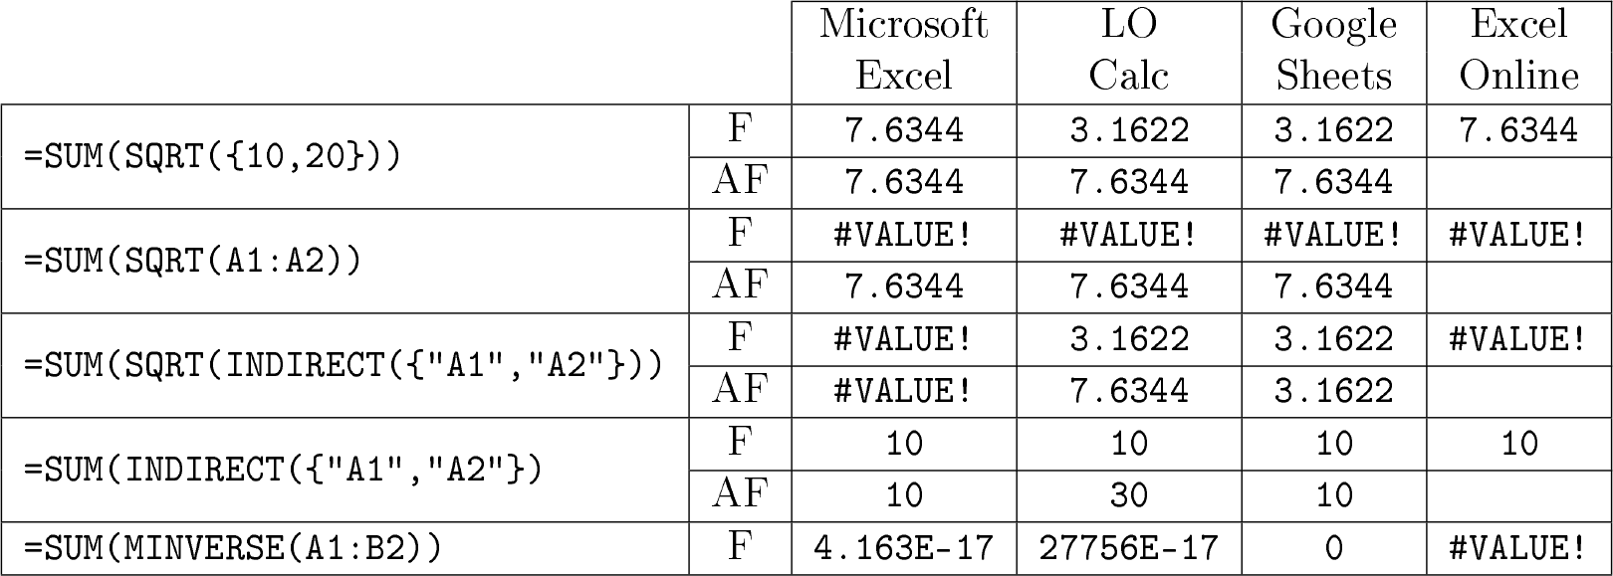
Incompatibilities

Slide 39
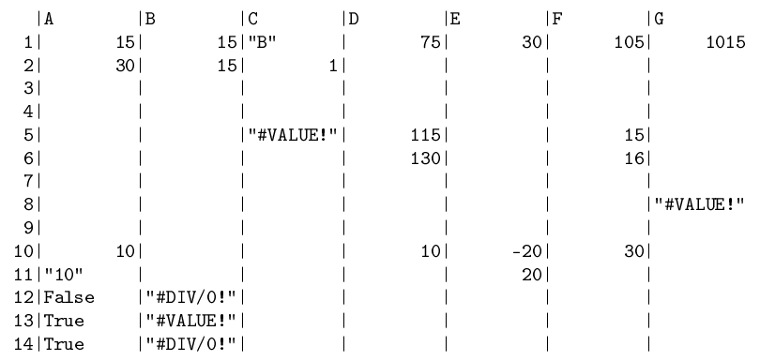
The spreadsheet interpreter
Tests against the ISO and OpenDocument standards in
http://github.com/hishamhm/spreadsheet

Slide 40
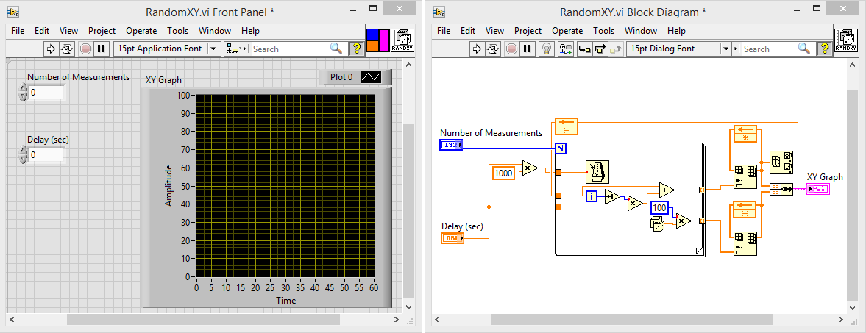
LabVIEW

Slide 41
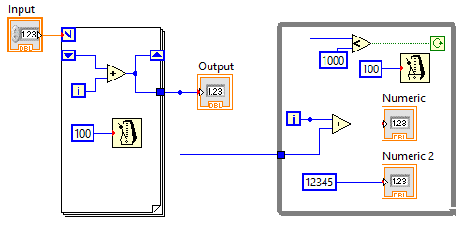
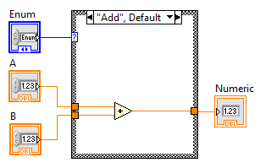
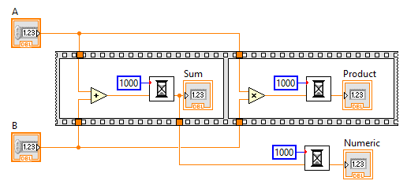
Control structures

Slide 42
Control structures
for loop

Slide 43
Control structures
shift registers

Slide 44
Control structures
while loop

Slide 45
Control structures
case structure

Slide 46
Control structures
sequence structure

Slide 47
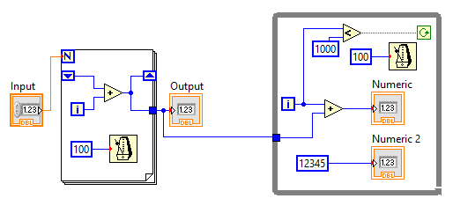
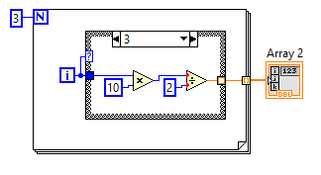
Some demos!

Slide 48
Design alternatives

Slide 49
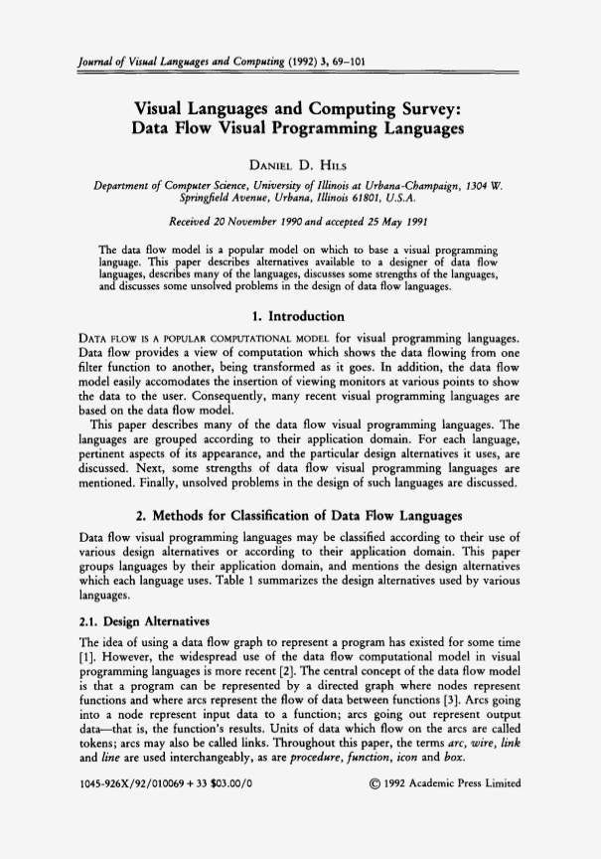

Slide 50
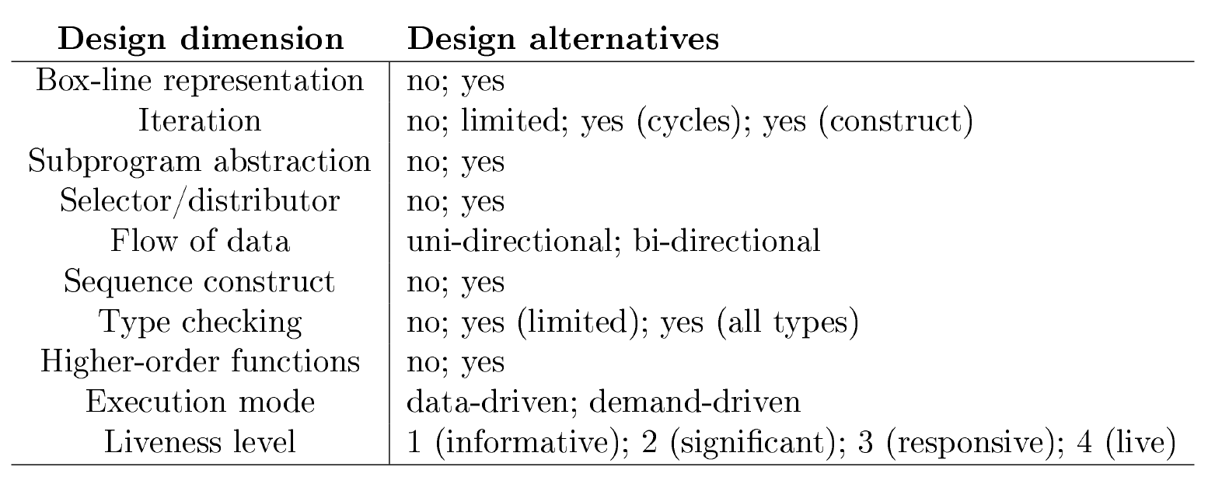
Hils’ design alternatives

Slide 51
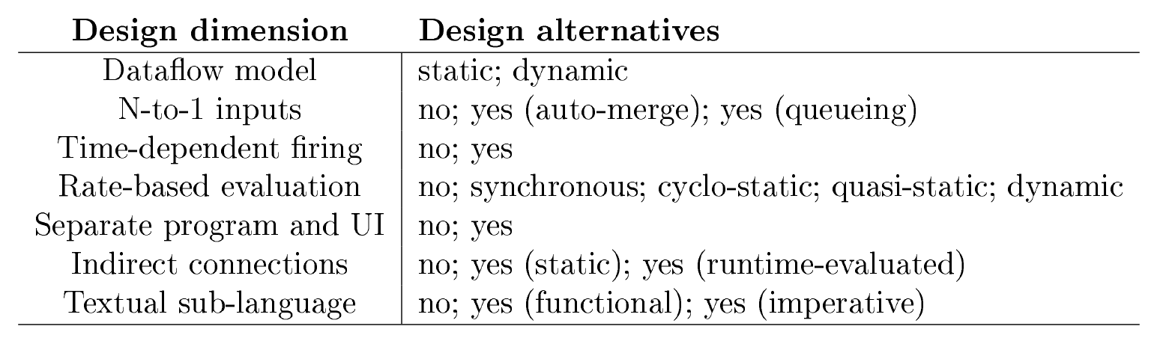
An extension to this categorization

Slide 52
Excercising the categorization
Three additional languages:
VEE
Blender
Reaktor

Slide 53
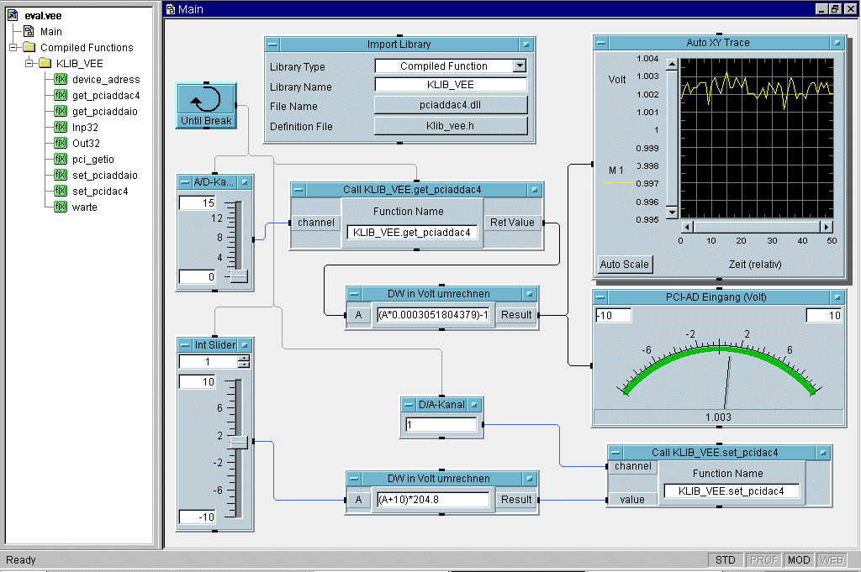
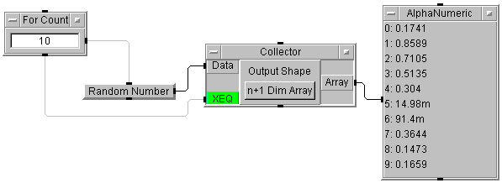
VEE

Slide 54
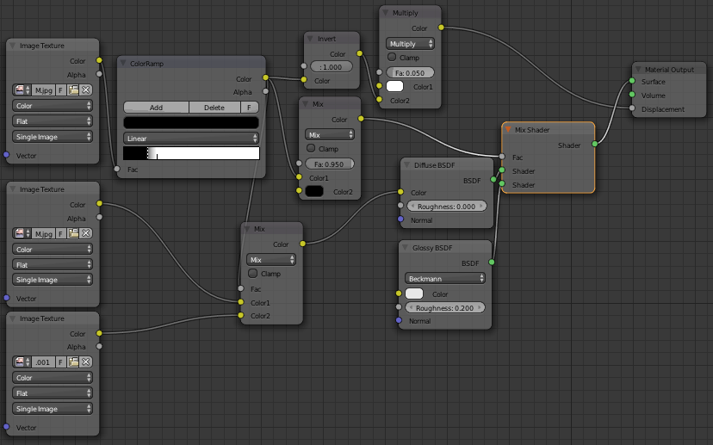
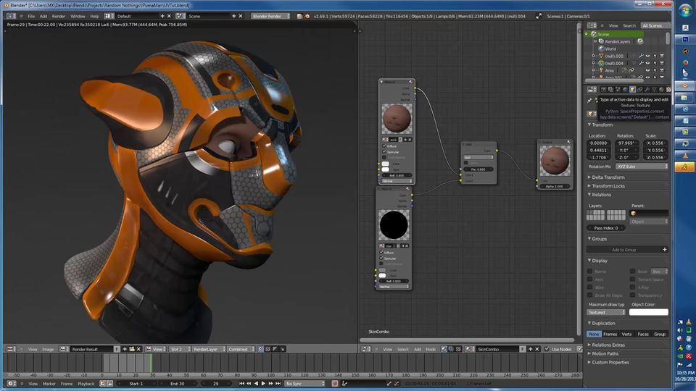
Blender

Slide 55
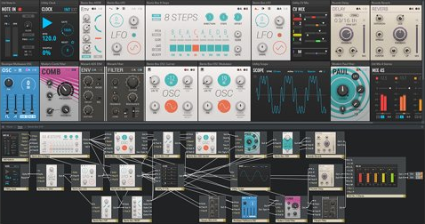
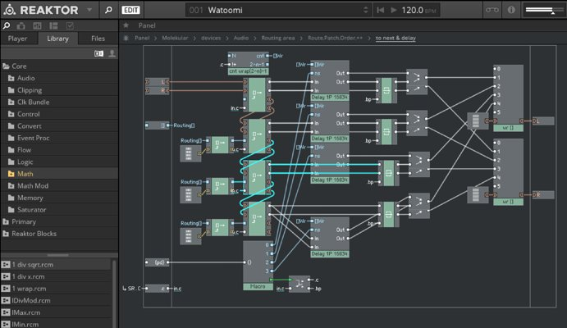
Reaktor

Slide 56
Critique

Slide 57
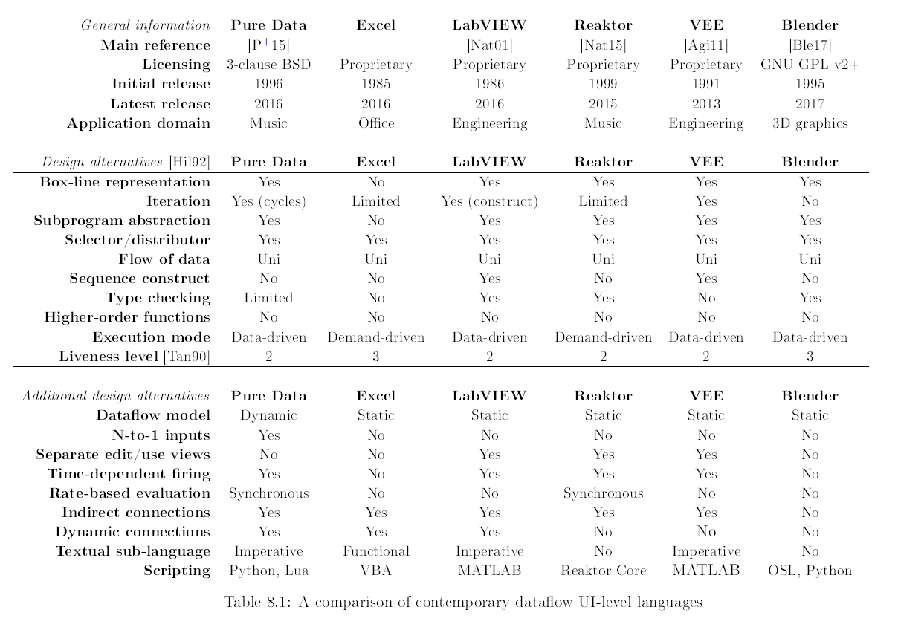

Slide 58
Commonalities in UI-Level languages

Slide 59
Commonalities in UI-Level languages

Slide 60
Feature interactions

Slide 61
Feature interaction in Pure Data
Dynamic dataflow model
  graph loops for building delays and echoes
  triggering and non-triggering inputs
N-to-1 inputs in a port
Naive model for deterministic execution

Slide 62

6
6
5
5

Slide 63
6
6
11
12

Slide 64
Feature interactions

Slide 65
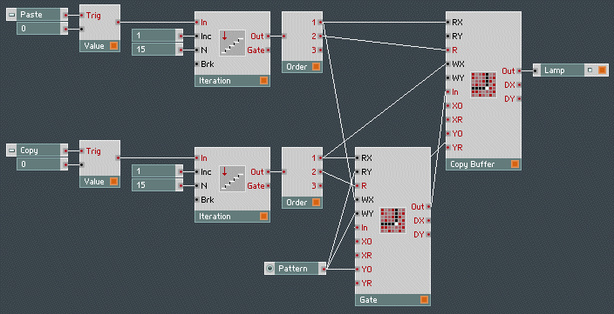
Forcing demand in Reaktor

Slide 66
Feature interactions

Slide 67
User problems with dynamic references
From an Excel forum:
“No #REF! error, the cell just doesn’t update with the new value (just stays exactly the same), even though the reference is correct and the referenced cell is obviously updated.”
“I actually tried rebooting, didn’t help.”
From the LabVIEW docs:
“This is a documented known issue that occurs in LabVIEW Real-Time versions 2014 and 2015. After making a modification to the VI, Error 1055 is thrown from any property node attempting to access the dynamic refnum. In order to resolve this error, close and re-open the VI.”

Slide 68
Subprogram abstraction

Slide 69
Subprograms

Slide 70
Subprograms

Slide 71
Subprograms

Slide 72
Subprograms

Slide 73
Subprograms

Slide 74
After editing
Two options:

Slide 75
Runtime behavior

Slide 76
Runtime behavior

Slide 77
Runtime behavior
Reentrant... ...or not

Slide 78
Liveness

Slide 79
Liveness

Slide 80
Conclusions

Slide 81
Scripting vs. UI-Level languages
UI-Level languages are today where
scripting languages were in the 1980s

Slide 82
Scripting vs. UI-Level languages
UI-Level languages are today where
scripting languages were in the 1980s
We aimed to get a glimpse of possible paths for a similar evolution
  Reusable languages? Building blocks?

Slide 83
Scripting vs. UI-Level languages
UI-Level languages are today where
scripting languages were in the 1980s
We aimed to get a glimpse of possible paths for a similar evolution
  Reusable languages? Building blocks?
We needed to step back to get a better understanding of these languages

Slide 84
Contributions
Mapping the design space of dataflow
end-user language semantics
  Lifting the veil on their underlying complexity

Slide 85
Contributions
Mapping the design space of dataflow
end-user language semantics
  Lifting the veil on their underlying complexity
A critique of design alternatives for
dataflow end-user languages
  A conceptual framework for comparing languages

Slide 86
Contributions
Mapping the design space of dataflow
end-user language semantics
  Lifting the veil on their underlying complexity
A critique of design alternatives for
dataflow end-user languages
  A conceptual framework for comparing languages
Identifying interdependencies in
dataflow design choices
  A sound design cannot be achieved combining building blocks at will

Slide 87
Secondary contributions
A specification of realistic spreadsheet semantics
Executable models of Pure Data and LabVIEW
Insights on multi-language application architecture

Slide 88
In short
End-user programming is more than scripting: UI-level programmability
is often overlooked but it reaches all users

Slide 89
In short
End-user programming is more than scripting: UI-level programmability
is often overlooked but it reaches all users
...but it needs to be approached as
programming language design

Slide 90
In short
End-user programming is more than scripting: UI-level programmability
is often overlooked but it reaches all users
...but it needs to be approached as
programming language design
Dataflow is a proven approach for
programmable UIs, but there is
much room for evolution

Slide 91
Thank you!
http://hisham.hm/thesis

