Slide 1
Everything you always wanted
to know about cameras,
but were afraid to ask

Slide 2
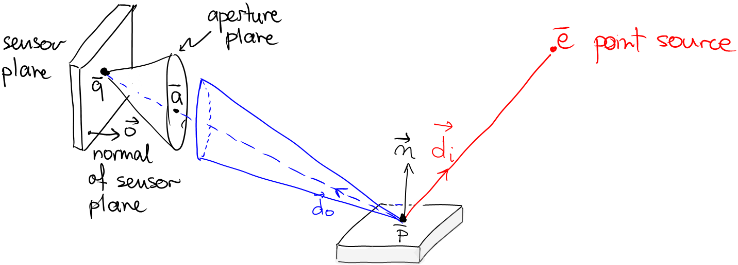
Image Irradiance due to a Lambertian Point
Common Assumption
Sensor plane and aperture plane are parallel

