Slide 1
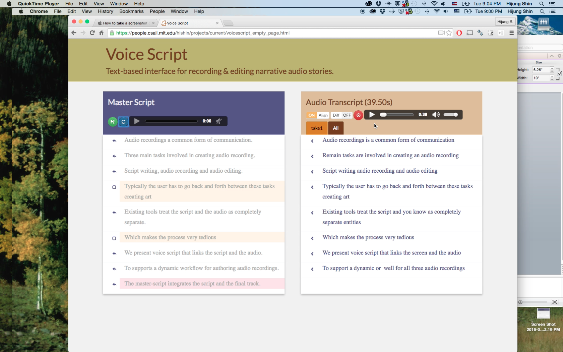
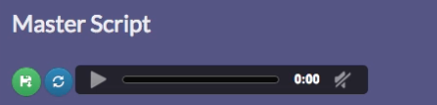
u User starts by writing an outline. Unrecorded text is displayed in grey.
v As the user records, audio is transcribed in real-time to display a verbatim transcript.
x Color codes indicate improvised or missing text.
Improvised: In script / Not recorded
w Transcript is aligned with the master-script.
z Recorded text is displayed in darker color.
Missing: Not in script / Recorded
y Accepting an audio segment inserts it in the final track.

Slide 2
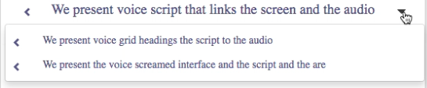
Master-script
Audio Transcript
Similar takes

