Slide 1
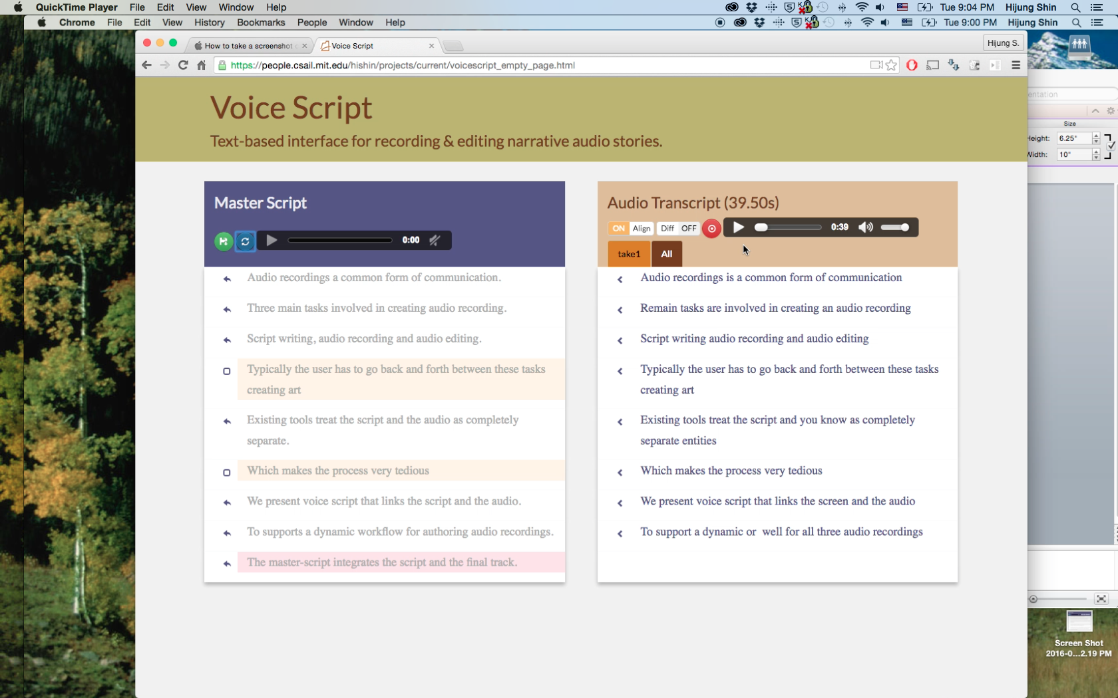
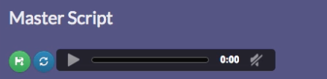
u User starts by writing an outline. Unrecorded text is displayed in grey.
v As the user records, audio is transcribed in real-time to display a verbatim transcript.
x Color codes indicate improvised or missing text.
Improvised: In script / Not recorded
w Transcript is aligned with the master-script.
z Recorded text is displayed in darker color.
Missing: Not in script / Recorded
y Accepting an audio segment inserts it in the final track.

Slide 2
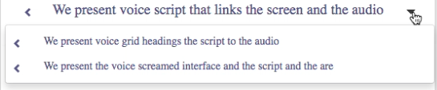
Most Existing tools typically treat the script and the audio as completely separate entities.
Similar takes
Master-script
Most existing tools treat script and audio completely separate.
Audio Transcript
Most Existing tools typically treat the script and the audio as completely separate entities

Slide 3
a
Segmentation using only punctuations master-script: Dark matter is spread throughout space.
transcript: Dark matter is spread throughout the galaxy (pause)
b
Segmentation using only utterance boundaries master-script: Consider the galaxy like a giant merry-go-round.
transcript: A galaxy is like a giant merry-go-round (pause)

Slide 4
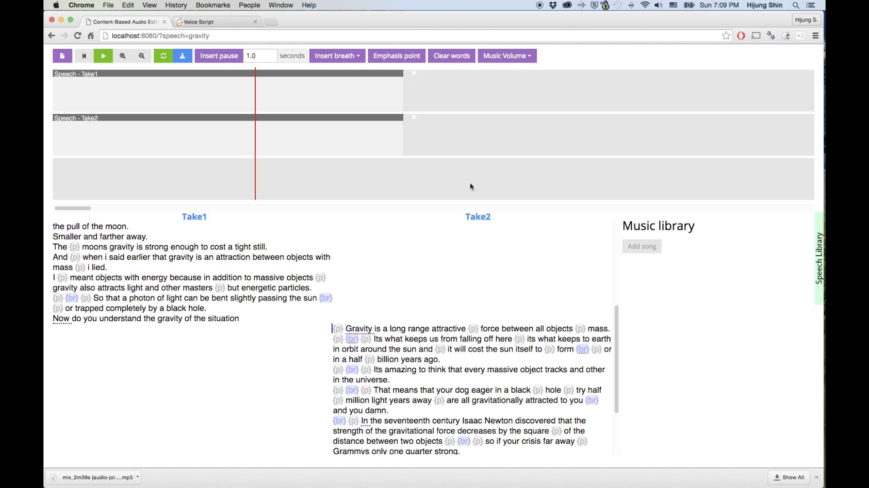
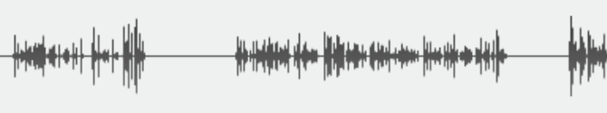
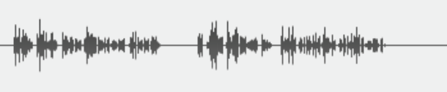
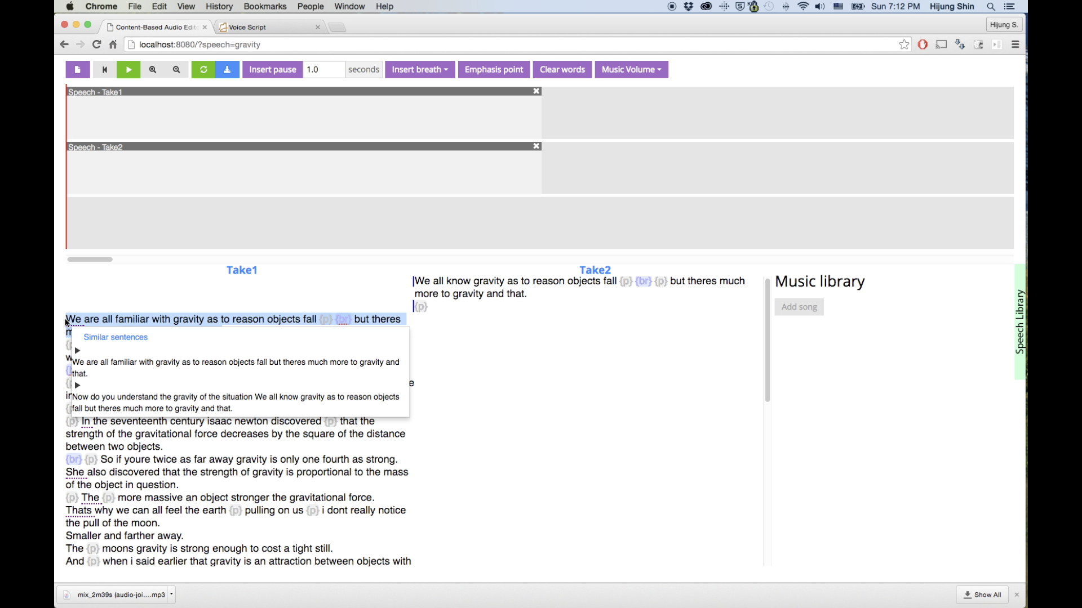
Speech Track 1 / Take 1
Waveform View
Speech Track 2 / Take 2
Transcript View
Alternate Sentences

