Slide 1

PROJECT REVIEW I
Department of Computer Science & Engineering
ResQMesh
A Delay-Tolerant Bluetooth Mesh Network for Autonomous SOS Broadcasting
When the grid fails, the community becomes the network.
M.SHIVA PREETHAM 23J21A0594
PASHAM SHASHANK 23J21A05B4
K.L.TARAK PRATAP 23J21A0578
M.VAISHNAVI 23J21A05A4
Under the guidance of Mrs. P. Swarna Latha

Slide 2
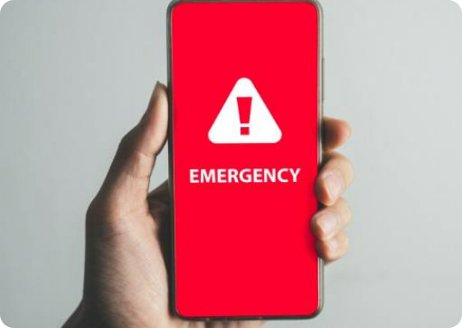
The Problem: The 50-House Scenario
Why traditional alerting systems fail during zero-connectivity events
1. The Grid Collapse
Severe storms, floods, or power grid failures sever cellular towers and fiber backhauls. Citizens are instantly isolated in a total communication blackout.
INFRASTRUCTURE COLLAPSE
2. The Neighborhood Isolation
Imagine 50 houses. House 12 has a medical emergency. Rescue teams are delayed, and capable neighbors 50m away are completely unaware because texts fail.
Cellular Towers (eNodeB) Offline
3. The Hardware Barrier
Satellite phones (Garmin inReach) and custom radios (LoRa mesh) exist, but their prohibitive cost means the average neighborhood has zero penetration.

Slide 3
The Solution: ResQMesh V1
Transforming everyday Android smartphones into an ad-hoc emergency relay network
Infrastructure-Less
Panic-First UX
Local Mobilization
Operates entirely without cellular towers, Wi-Fi routers, or manual Bluetooth pairing using native BLE broadcasting.
Massive, single-tap SOS button. In high-stress situations, cognitive load drops to zero. No forms to fill out.
Wakes up bystander devices, overriding silent mode with a full-screen siren and red navigation map.
Optional Context: Users can tap 3-second smart chips (Medical, Fire, Trapped) before hitting SOS for rapid triage.

Slide 4
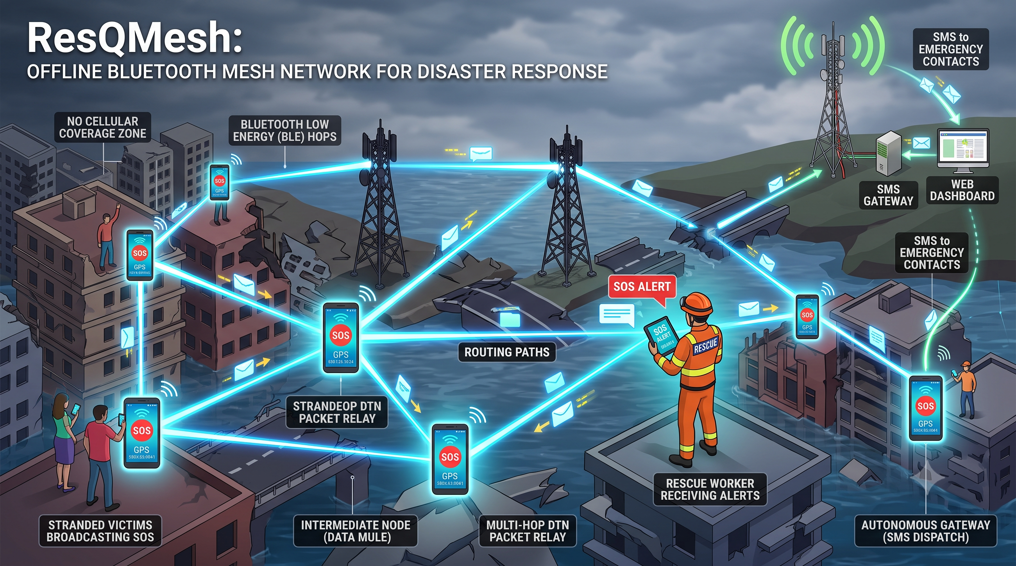
Zero Infrastructure Dependency

Slide 5
Core Technology & Protocols
Architected for zero-configuration, delay-tolerant multi-hop deployment
Google Nearby Connections API
Epidemic Routing (Flooding)
Utilizes the P2P_CLUSTER topology. Enables M-to-N amorphous mesh networks, allowing devices to act as both receivers and broadcasters simultaneously.
A Delay-Tolerant Network (DTN) model. Packets are broadcasted to all nearby peers. Mules store the packet, carry it physically, and forward it to new peers.
Hardware Agnostic Abstraction
Zero-Internet Dependency
Abstracts complex BLE GATT handshakes and MTU sizing, bypassing extreme fragmentation across different Android OEMs (Samsung, Xiaomi, etc.).
Designed to operate natively in pure Airplane Mode. The engine only requires the Bluetooth radio to be active to execute the entire hop sequence.

Slide 6
System Workflow: The 3-Step Hop
Autonomous lifecycle of a disaster packet from victim to responders
STEP 1: ORIGINATOR
STEP 2: DATA MULE
STEP 3: THE GATEWAY
House A (Victim)
House B (Neighbor)
House C (Network Edge)
Victim presses SOS. App captures real-time GPS and battery life, generating the compressed micro-packet. Device is completely offline.
➔
A neighbor's offline phone silently receives and caches the packet via Bluetooth. Local screen wakes up to alert them to help.
➔
Neighbor moves toward an active cell tower. Gateway phone detects internet and automatically dispatches native SMS to dashboard.

Slide 7
Routing & Backend Logic
Preventing infinite loops and broadcast storms in the mesh
➔
➔ NO
➔ YES
INCOMING BLE PACKET
msg_id exist in DB?
TTL > 0?
⬇ YES
⬇ NO
DROP PACKET
(Prevents Storms)
DROP PACKET
(Max Hops Reached)
EXECUTE LOCAL PAYLOAD
1. Decrement TTL by 1 | 2. Save to SQLite Room DB | 3. Trigger Audio Siren UI | 4. Re-broadcast to new peers

Slide 8
Native Android Architecture Stack
Layered software design ensuring autonomous background execution
Presentation UI
Jetpack Compose, FullScreenIntent (Siren Overrides)
Mesh Networking
Google Nearby Connections API (P2P_CLUSTER), BLE Adv.
Persistence Layer
Room Database (SQLite), SHA-256 Deduplication Hashing
Gateway Execution
Foreground Services (START_STICKY), Android SmsManager

Slide 9
Micro-Payload Serialization
Why maintaining a packet size < 350 Bytes is critical for network survival
The Environmental Constraint
In chaos, people move rapidly. Two stranger phones might only be in Bluetooth range for 1 to 2 seconds. A massive packet will drop. A <350 byte JSON/Protobuf payload transfers in under 80 milliseconds, guaranteeing success during fleeting encounters.
msg_id
lat / lon
timestamp
ttl
triage_type
36 Bytes
16 Bytes
8 Bytes
2 Bytes
1 Byte
Total Payload Size: < 350 Bytes

Slide 10
Impact, Advantages & The SDK Vision
Moving from a standalone utility to a systemic disaster protocol
Current State: Standalone App
Future Vision: Mesh SDK
• Requires proactive community installation.
• Zero-Cost Infrastructure: No cell towers, Wi-Fi routers, or custom hardware required.
• Highly effective for closed communities (campuses, residential complexes).
• ResQMesh is built as a modular routing engine.
• If integrated into highly penetrated apps (like WhatsApp or Google Pay), millions of phones instantly become passive relay nodes.
• Transforms ordinary citizens into an autonomous rescue network overnight.

Slide 11
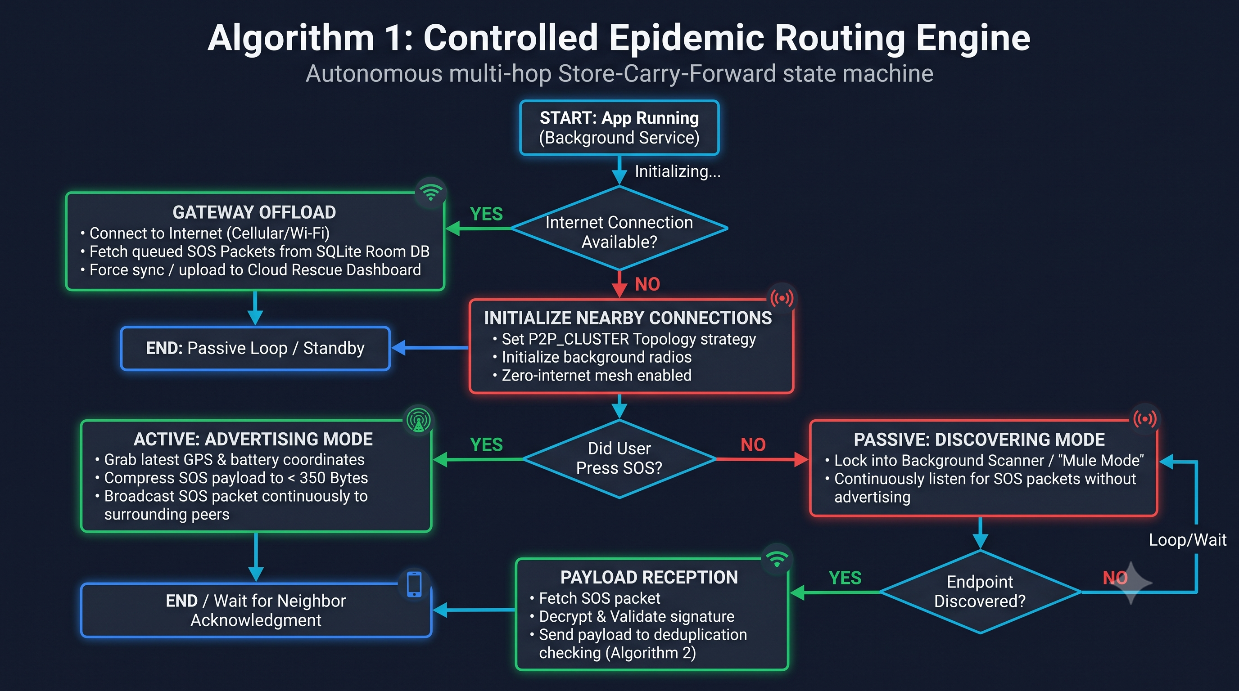

Slide 12
Future Scope: Phase 2 Enhancements
Expanding beyond Public SOS to advanced tactical communications
Targeted Offline SMS
Asymmetric Crypto
AI-Powered NLP Triage
Enabling users to route private, targeted text messages to specific family members via the mesh bridge.
Adding End-to-End Encryption (E2EE) so intermediate 'Data Mules' cannot read private family messages.
AI parses incoming custom messages at the cloud gateway to tag severity and dispatch specific resources.
Smart Routing ML: Implementing dynamic TTL adjustments based on predicted node movement to conserve battery life.

Slide 13

THANK YOU

