Slide 1
Hostel Management System
Computerized Database For Accommodation Division

Slide 2
Problem
No centralized Database
Keeping details in written file System
Data Isolation
Time Consuming
Redundant Data
Manual Registration Process

Slide 3
Requirements
Database for Accommodation division Administration
Database for Hostel Administration
Database for Labors & workers
Database For Hostels
Database for Students
Registration process

Slide 4
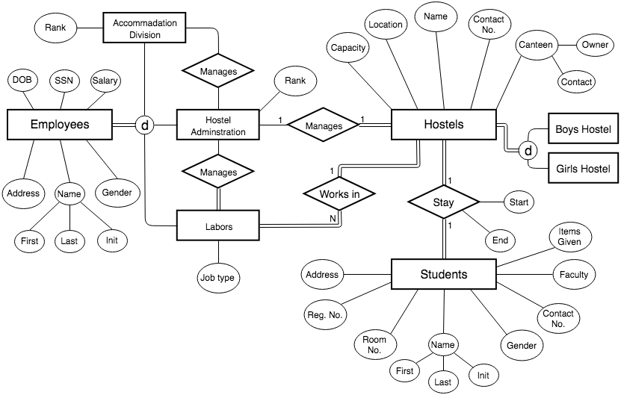
ER Diagram

Slide 5
Thank You
Group Members
E/15/021 - M.M.M.Aslam
E/15/131 - M.H.Hisni Mohammed
E/15/348 – S.Suhail

