Slide 1
Hostel
Management
System
Computerized Database For Accommodation Division

Slide 2
Problem
No centralized Database
Keeping details in written file System
Data Isolation
Time Consuming
Redundant Data
Manual Registration Process

Slide 3
Requirements
Database for Accommodation division Administration
Database for Hostel Administration
Database for Labors & workers
Database For Hostels
Database for Students
Registration process

Slide 4
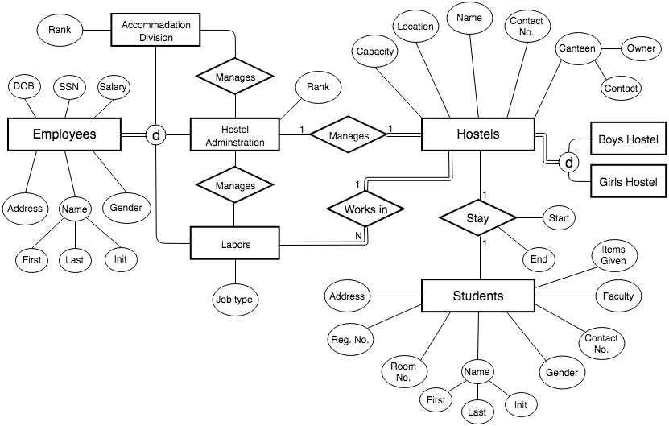
ER Diagram

Slide 5
Thank You

