Slide 1
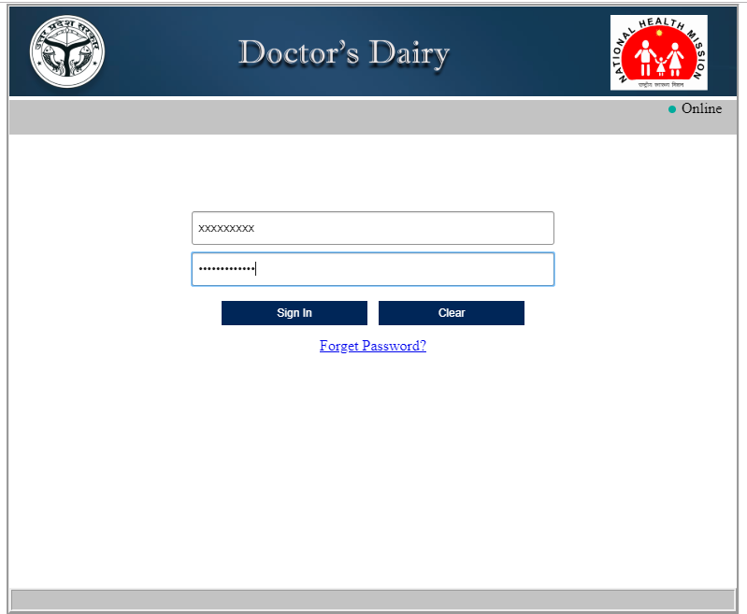
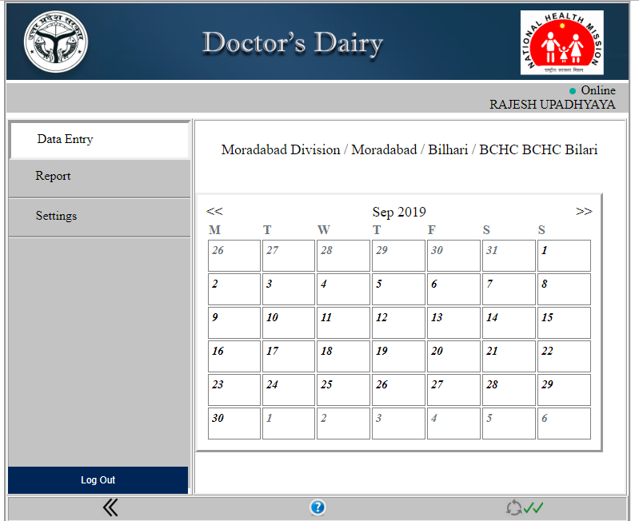
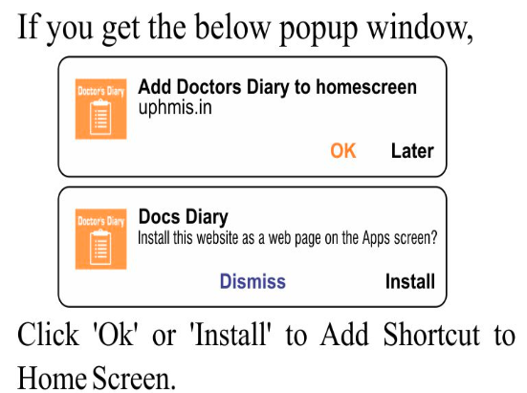
Step 1: Open the browser & URL:uphmis.in/dd
Step 3:Click on a particular date you want to fill data against: No of C-sec / No of Anaesthesia Provided.
Step 2:Login Credential: Sign-in with user name (Ehrms code) & Password as provided.
Calendar will open in your screen

Slide 2
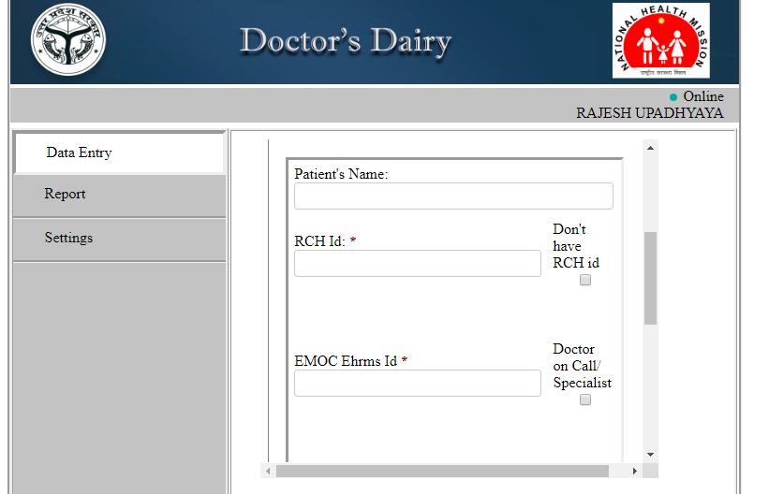
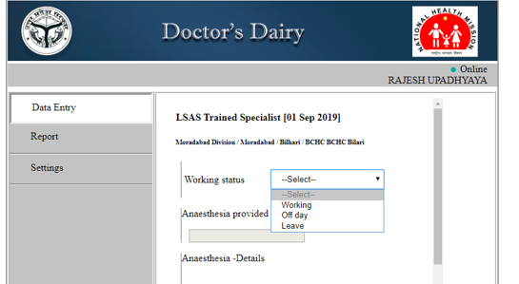
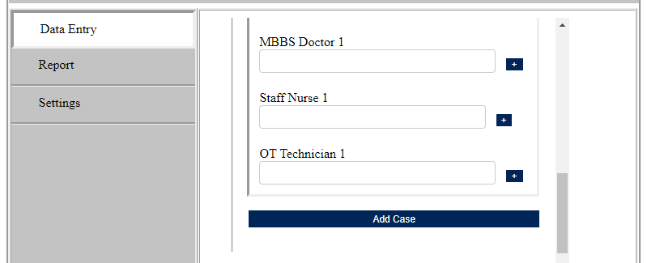
Step 4: Select “Working status” as “Working” to enter data against each listed indicator.
Step 5: Fill the detail as required
Detail Required
working status
“Off Day”: A day in which an employee is not scheduled to work.
“Leave” :It is a period of time that one must be away from one's primary job.
If it is “off day or leave” select accordingly, and click on send button for approval.
If “RCH id” is not available then click on check-box “Don’t have RCH id” then “Case Id” will be open fill the “case I’d”.
Similarly in place of “EMOC/LSAS”, any “doctor on call/Specialist” then fill the detail of that doctor.
If more than one case perform in same date click on “Add Case” and follow the same.

Slide 3
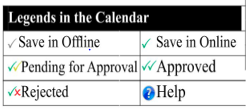
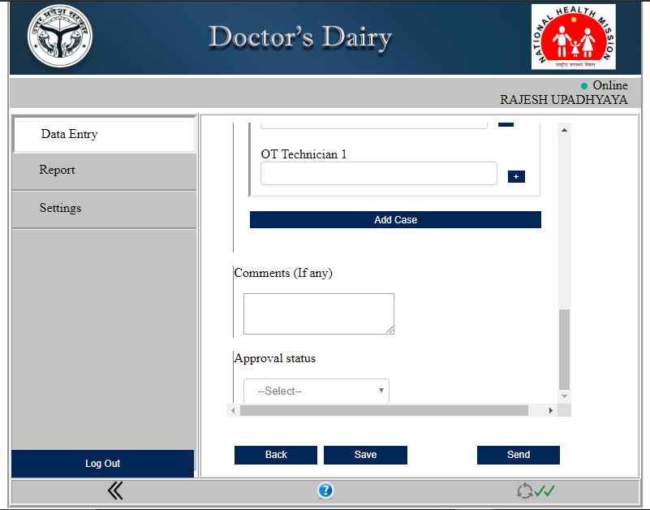
Step 6: Comment box is available where you are able to put any comment regarding case or any similar detail
Final Step
Option provided on the bottom :
“Back”: Click “Back” button to move to the previous page.
“Save”: Click “Save” to save the data entered in the form for a particular date. Note: single tick means data saved .
“Send” :”Click Send” to pass on the entered data for the approval. Note: Double tick means data sync to server.
“Log out”: Click “Log out” to exit .

Slide 4
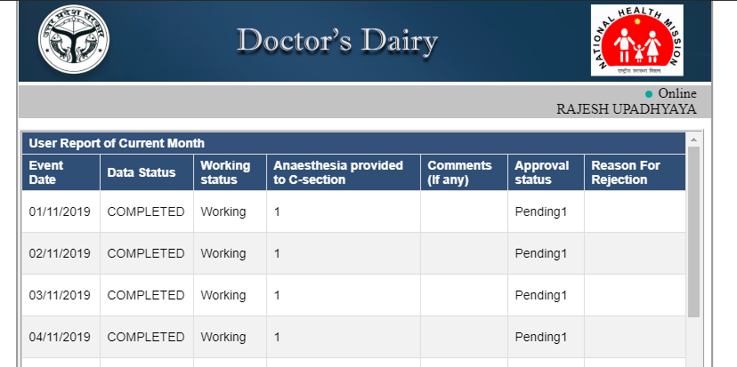
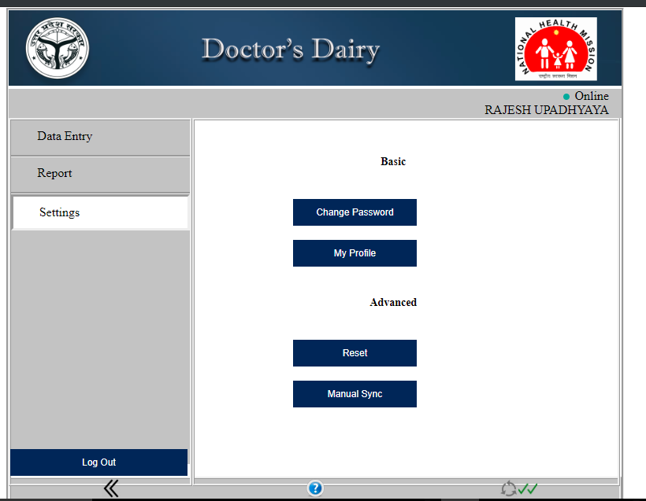
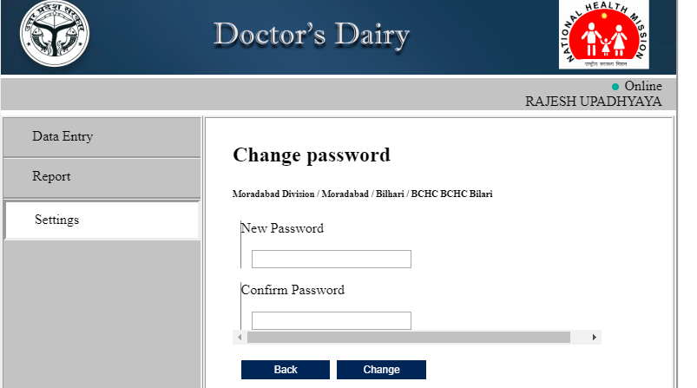
Setting
Report
Setting
Report Section: Click on “Report” and check your report
Settings: In this section you are able to “change your password” & “profile information”
Reset: To clean the cache
Manual Sync: Data saved in offline mode can be synced manually in one go on the availability of internet

