Slide 1
Application Portability through Singularity
Feb 3, 2017 (Fri)
Jaeyoung Chun
Application Portability through Singularity www.MSKCC.org

Slide 2
Agenda
Goals
Virtualization
Docker vs. Singularity at 10,000 ft.
Creating Image
Running Container
Physical Size of Image File
Memory Usage at Runtime
Data Access Issues
with some live demo

Slide 3
Goals
“Workflow/Pipeline Portability”
Being able to run pipeline in various computing environments (Luna Cluster, NYGC, Amazon Cloud, Google Compute Cloud, …)
Being able to easily manage and support different versions of software (bwa, gatk, R, python, Java, …) and avoid dependency conflicts.
Being able to cite the pipeline used in research, allowing others to run the exact same pipeline from their own computing environments which are most times different from the original one.

Slide 4
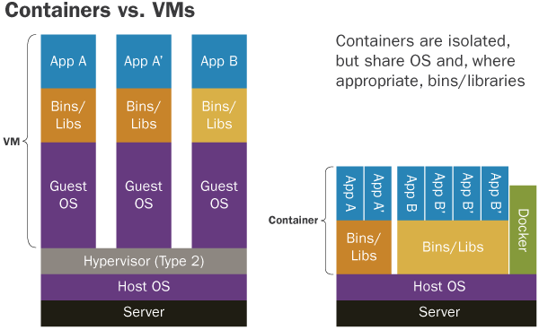
Virtualization

Slide 5
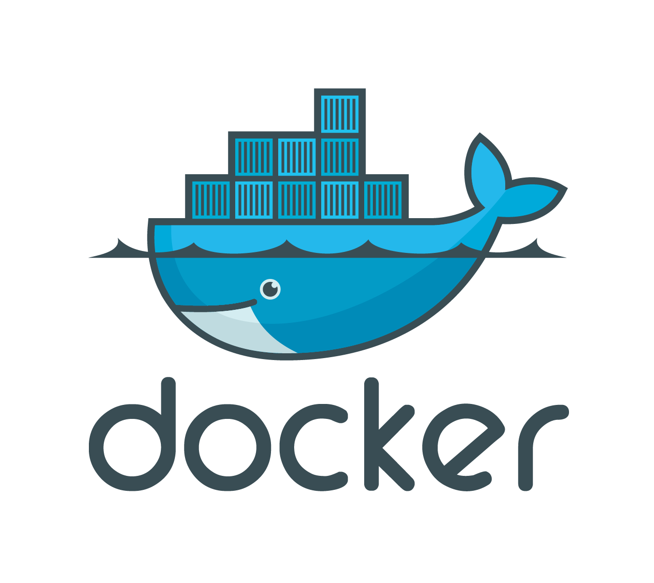
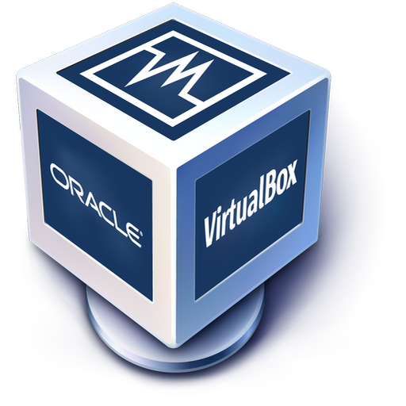


Virtualization
Virtual Machine
VirtualBox (samtools in BioLinux)
Container
Docker (samtools)
Singularity (samtools)
LIVE DEMO

Slide 6
Docker vs. Singularity at 10,000 ft.
 | Docker | Singularity
Goal | DevOps, Microservices | Application Portability
Application Level Virtualization | Good | Good
HPC Friendly | Not Really | Yes
Security | Root Privilege Required for Running Containers | No Change in Security Paradigm
Adopters | Many Internet Companies | UC Berkeley, Stanford, NIH, …
Image Repository | Good Docker Hub | Premature Singularity Hub (can use Docker Hub)

Slide 7
Docker vs. Singularity at 10,000 ft.
 | Docker | Singularity
GPU | Via 3rd Party | Native Access Native Support
MPI | No | Yes (built-in support)
Daemon | Required | Not Required
Unix Pipes | Not Quite As Expected | No Surprise
Version | 1.13 | 2.2

Slide 8
Creating Image
Many Options, but Here Are Some:
Import from Repository and Use As Is
Singularity Hub
Docker Hub
Other Docker private registries (e.g. BioShadock)
Build Your Own
Start from Docker image first and then convert to Singularity image.
Create Singularity image from scratch.

Slide 9
Creating Image
Import from Repository and Use As Is
Go to Docker or Singularity Hub or other image repository.
Search and get image name.
Use “singularity create” command.
User “singularity import” command.
LIVE DEMO

Slide 10
Creating Image
Build Your Own
Make a text document describing how image should be constructed:
Dockerfile
Singularity
Start from a base image (CentOS, Ubuntu, Alpine, …)
Install software into the image
Compile source code
Use package manager such as yum, apt-get, or conda
Use “singularity create” command.
User “singularity bootstrap” command.
Depending on what base image you use and how to install software into the image, the final image size can vary.
LIVE DEMO

Slide 11
Running Container
No user contextual changes
No change in security paradigm
The same file permission on host is respected inside the container.
Bring Your Own Environment (BYOE)
e.g. whoami, pwd, env, home directory
LIVE DEMO

Slide 12
Physical Size of Image File
Container | Author | samtools | bwa
Docker | BioContainers | 1.24 GB | 1.23 GB
Docker | BioShadock | 247 MB | 321 MB
Docker | Jaeyoung @ MSKCC | 15 MB | 9 MB
Singularity | Jaeyoung @ MSKCC | 21 MB | 21 MB
Depending on what base image you use and how to install software into the image (e.g. source compile vs. conda), the final image size can vary even for the same software.
BioContainers uses conda to install tools inside a container, which seems to be one of the reason the image is so big (i.e. image must include conda).
Docker utilizes cache so it doesn’t need to download 1.2GB image every time.

Slide 13
Memory Usage at Runtime
Docker on Ubuntu VM
top - 11:22:43 up 9:11, 1 user, load average: 4.70, 2.63, 1.36
Tasks: 201 total, 2 running, 199 sleeping, 0 stopped, 0 zombie
%Cpu(s): 50.2 us, 43.3 sy, 0.0 ni, 6.1 id, 0.0 wa, 0.0 hi, 0.4 si, 0.0 st
KiB Mem : 1016272 total, 67364 free, 410520 used, 538388 buff/cache
KiB Swap: 1045500 total, 702172 free, 343328 used. 431428 avail Mem
PID USER PR NI VIRT RES SHR S %CPU %MEM TIME+ COMMAND
3433 chunj 20 0 676584 30564 10864 R 33.0 3.0 0:36.23 gnome-termi+
8719 root 20 0 6348 888 704 S 19.0 0.1 0:18.29 samtools
Singularity on CentOS VM
top - 11:27:44 up 9:38, 3 users, load average: 0.37, 0.08, 0.03
Tasks: 157 total, 3 running, 154 sleeping, 0 stopped, 0 zombie
Cpu(s): 42.5%us, 56.9%sy, 0.0%ni, 0.6%id, 0.0%wa, 0.0%hi, 0.0%si, 0.0%st
Mem: 1020072k total, 908664k used, 111408k free, 54960k buffers
Swap: 2064380k total, 2800k used, 2061580k free, 330116k cached
PID USER PR NI VIRT RES SHR S %CPU %MEM TIME+ COMMAND
2762 chunj 20 0 462m 18m 10m R 84.8 1.8 1:58.28 gnome-terminal
10543 chunj 20 0 6288 712 524 S 9.0 0.1 0:01.46 samtools
samtools view sample.bam / 92 MB bam / measured with the top program

Slide 14
Data Access Issues
“How can programs inside container access data files outside container?”
We prefer data path /ifs/… in the host machine to be mapped exactly as /ifs/… inside the container.
This way, we can reuse the existing code base without any further modification.
However, we’d like to achieve portability outside MSKCC.

Slide 15

Data Access Issues
Bind Paths / File Sharing via --bind
Bind point must already exists within the container.
If not, we can enable overlay:
enable overlay = yes in etc/singularity.conf
Some limitations still exists. Sometimes RHEL7 kernel crashes.
Overlay file system required.
root
CONTAINER
HOST
/ifs
/home
root
/ifs/data
/home/john
/ifs
LIVE DEMO
/ifs/data

Slide 16
Data Access Issues
Override User’s Home Directory via --home
The directory that will be configured to be user’s new home directory must belong to that user.
root
CONTAINER
HOST
/home
root
/home/john
/ifs
/ifs/data
LIVE DEMO

Slide 17
Data Access Issues
Store Data Files in User’s Home Directory
Everything user has in his/her directory will be fully accessible within the container.
root
CONTAINER
HOST
/home
root
/home/john
/home
/home/john
LIVE DEMO

Slide 18
Other Notes for Singularity
Portable when binary compatibility is met.
Singularity must be installed and accessible on the system (not daemon).
Dramatic changes even from v2.0 to v2.2 such as image definition file format.
Image creation requires sudo, but running does not.
You have to create an empty image with some size.

Slide 19
QUESTIONS

