Slide 1

Approvals, etc.
or
Approvals, approval acceptances, approval workflows and levels, how they interact with Attribute Option Combos and Category Option Group Sets
Jim Grace dhis2 Nov. 5, 2018, Oslo

Slide 2
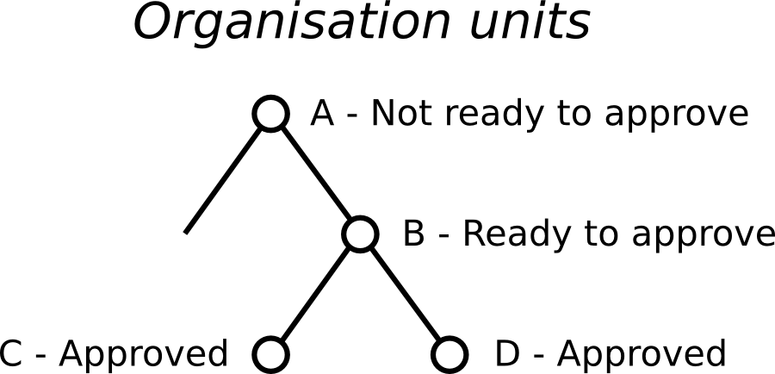
Data approval hierarchy

Slide 3
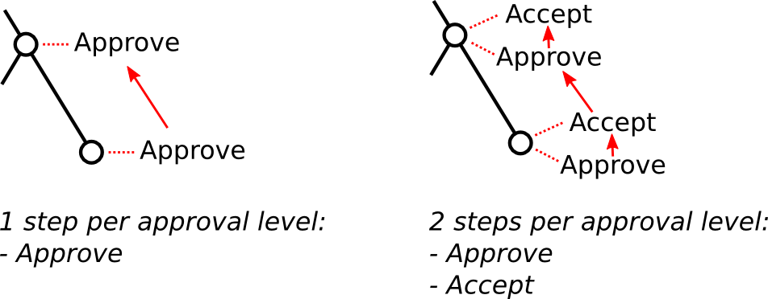
Approving and accepting
Two implementation options (system setting):

Slide 4
Data approval levels
A data approval level specifies an organisation unit level.
An organisation unit level does not need a corresponding data approval level. For example:
org unit level 1 -
org unit level 2 -
org unit level 3 -
org unit level 4 -
org unit level 5 -
Country
Province
District
Subdistrict
Facility
- approval level 1
- approval level 2

Slide 5
Data approval workflows
A data approval workflow specifies a period type and one or more data approval levels.
A data set (optionally) specifies one data approval workflow. Examples:
Workflow | Approval levels | Workflow Period type | Data sets
HIV | 1, 3 | Monthly | HIV Care Monthly, HIV Pediatric monthly summary
Stock | 1, 3 | Monthly | EPI Stock
Admin | 1, 2 | Quarterly | Expenditures, Staffing

Slide 6
Workflow period type vs. data set period type
2018 Q3 (Oct– Dec)
quarterly workflow approval
approves:
2018-10 (Oct)
2018-11 (Nov)
2018-12 (Dec)
monthly data sets
2018 Q3 (Oct– Dec)
quarterly data sets
...
2018
yearly data sets
In short, any data set that ends during the approved period

Slide 7
Aggregate vs. Event approvals
Currently approvals apply only to aggregate data (data sets)
In the future, they could be extended to event data by (optionally) specifying a workflow for a program

Slide 8
What does data approval actually do?
Locks data from being entered or changed for a given organisation unit (and organisation units under it), for a given period, for data elements belonging to any data set in the workflow.
Hides unapproved data from higher-level users (optionally, through a system setting)

Slide 9
Data hiding
A system setting optionally hides unapproved data
from higher-level users:
organisation unit level
country (1)
Approval level 1
User A
province (2)
User B
district (3)
Approval level 2
User C
facility (4)
Approval level 3
User D

Slide 10
How do data approvals apply to data with attribute option combos?
Data for each attribute option combo is always approved independently.
Approval levels can be defined in one of three ways:
(at most) one approval level for an organisation unit level
Two approval levels for an organisation unit level
More than two approval levels for an organisation unit level

Slide 11
1. (at most) one approval level for an organisation unit level
For approvals at different organisation unit levels,
leave the category option group set blank:
Approval level | Organisation unit level | Category option group set
Country (1) | Country (1)
District (2) | District (4)
Facility (3) | Facility (5)

Slide 12
2. Two approval levels for an organisation unit level
Choose a category option group set for the second approval level using the same organisation unit level
Approval level 3 is for partners who are limited to only some category option combos (grouped by partner).
Approval level 2 is for users with no such restrictions.
Approval level | Organisation unit level | Category option group set
Country (1) | Country (1)
District-All (2) | District (4)
District-Partner (3) | District (4) | Project Partners
Facility (4) | Facility (5)

Slide 13
3. More than two approval levels for an organisation unit level (slide 1 of 2)
PEPFAR Requirement
global inter-agency user – all mechanisms
(approval level 4)
country inter-agency user – all mechanisms
(approval level 3)
country agency user
(approval level 2)
country partner user
(approval level 1)
Attribute option combo = attribute option = mechanism

Slide 14
3. More than two approval levels for an organisation unit level (slide 2 of 2)
Choose a different category option group set for each additional approval level using the same organisation unit level.
Users can approve depending on their dimension restrictions (if any) and sharing, and the level of their assigned organisation unit.
Approval level | Organisation unit level | Category option group set
Global (1) | Global (1)
Inter-Agency (2) | Country (3)
Funding Agency (3) | Country (3) | Funding Agency
Implementing Partner (4) | Country (3) | Implementing Partner

Slide 15
Approvals, etc.
or
Approvals, approval acceptances, approval workflows and levels, how they interact with Attribute Option Combos and Category Option Group Sets
The end!

