Slide 1

PEPFAR use case: Complex data modelling
DHIS 2 Experts Academy
June 18, 2018

Slide 2

Jim Grace
DHIS 2 Core Developer

Slide 3

Ben Guaraldi
Technical Lead for DATIM (the PEPFAR installation of DHIS 2)

Slide 4
PEPFAR use case: Complex data modelling
1. Modelling mechanisms:
data set dimensions: Attribute Options
2. Modelling agencies and partners (and subpartners):
category option groups and group sets
3. Modelling data approval:
data approval levels

Slide 5
Modelling PEPFAR mechanisms
1. Modelling mechanisms:
data set dimensions: Attribute Options

Slide 6
Modelling PEPFAR mechanisms
“funding mechanism” – essentially like a project
mechanism:
1234
5678
…
filled data set:
(data set contents)
(data set contents)
…

Slide 7
Modelling PEPFAR mechanisms
data set
dimension
mechanism:
1234
5678
…
data element
dimension
data element
dimension
filled data set:
15-24
…
15-24
…
…
age:
<15
age:
<15
data element:
…
data element:
…

Slide 8
data element dimensions: Category Options
(disaggregations: age, sex, test result, etc.)
data set dimensions: Attribute Options
(extra dimensions: projects, partners, accounts, etc.)

Slide 9
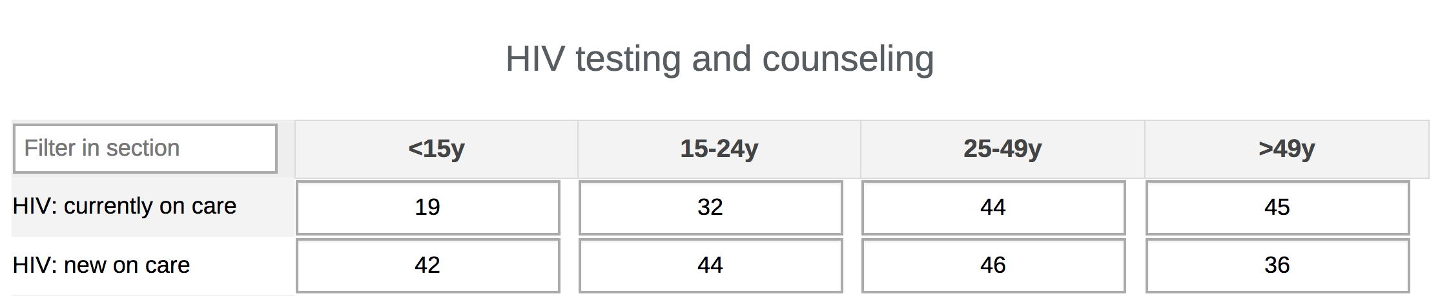
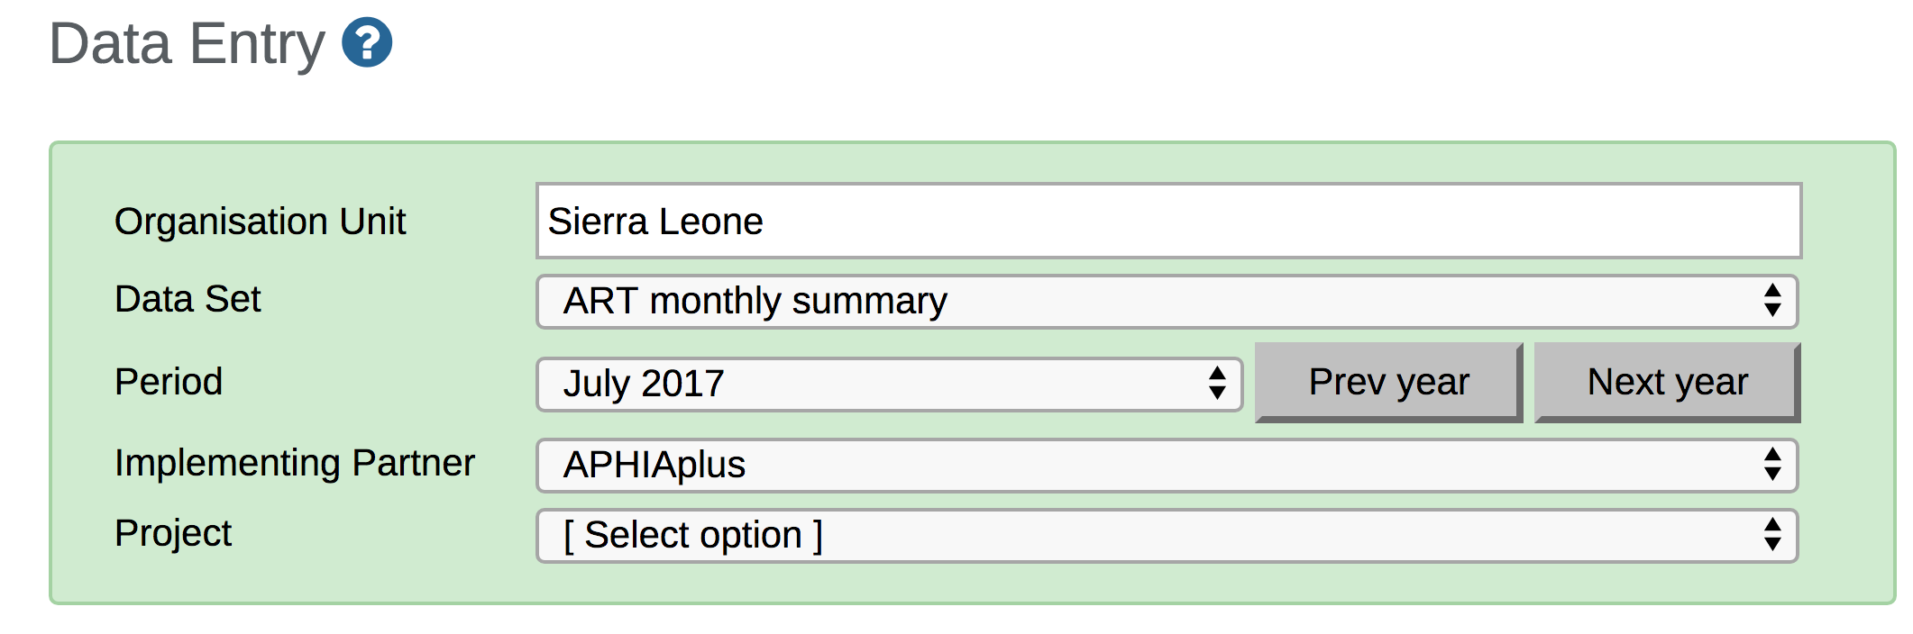
Data Entry
data element dimensions: Category Options
data set dimensions: Attribute Options

Slide 10
data set dimensions: Attribute Options
(extra dimensions: projects, partners, accounts, etc.)
are based on
data element dimensions: Category Options
(disaggregations: age, sex, test result, etc.)

Slide 11
Two data element dimensions: age, sex
data
element
C2.1.D (N, DSD, Age/Sex): PLHIV Min One Service
(PEPFAR DATIM)
category
combination
Age (<15,15+) and Sex
Age (<15,15+)
Sex
category
category option
combination
<15, Female
<15
Female
category option
datavalue
table
…
categoryoptioncomboid
…
data element dimensions: Category Options

Slide 12
One data element dimension: age
data
element
C2.1.D (N, DSD, Age): PLHIV Min One Service
(PEPFAR DATIM)
category
combination
Age (<15,15+)
Age (<15,15+)
category
category option
combination
<15
<15
category option
datavalue
table
…
categoryoptioncomboid
…
data element dimensions: Category Options

Slide 13
Zero data element dimensions
data
element
C2.1.D (N, DSD): PLHIV Min One Service
(PEPFAR DATIM)
category
combination
default
default
category
category option
combination
default
default
category option
datavalue
table
…
categoryoptioncomboid
…
data element dimensions: Category Options

Slide 14
Zero data set dimensions
data
set
Host Country Results: Narratives (USG)
(PEPFAR DATIM)
category
combination
default
default
category
category option
combination
default
default
category option
datavalue
table
…
categoryoptioncomboid
…
attributeoptioncomboid
data set dimensions: Attribute Options

Slide 15
One data set dimension: PEPFAR mechanism
data
set
MER Results: Facility Based
(PEPFAR DATIM)
category
combination
Mechanism
Mechanism
category
category option
combination
1234
1234
category option
datavalue
table
…
categoryoptioncomboid
…
attributeoptioncomboid
data set dimensions: Attribute Options

Slide 16
Two data set dimensions: partner, project
data
set
ART Monthly Summary
(Sierra Leone demo)
category
combination
Partner and Project
Partner
Project
category
category option
combination
UNICEF, clean water
UNICEF
clean water
category option
datavalue
table
…
categoryoptioncomboid
…
attributeoptioncomboid
data set dimensions: Attribute Options

Slide 17
PEPFAR use case: Complex data modelling
1. Modelling mechanisms:
data set dimensions: Attribute Options
2. Modelling agencies and partners (and subpartners):
category option groups and group sets

Slide 18
Modeling PEPFAR agencies and partners
agency
partner
mechanism

Slide 19
PEPFAR partners
category option group set
Partner
category option group
FHI 360
category option
combination
1234
1234
category option
mechanism
datavalue
table
…
categoryoptioncomboid
…
attributeoptioncomboid
category option groups and group sets

Slide 20
PEPFAR agencies and partners
category option group set
Agency
Partner
category option group
USAID
FHI 360
category option
combination
1234
1234
category option
mechanism
datavalue
table
…
categoryoptioncomboid
…
attributeoptioncomboid
category option groups and group sets

Slide 21
Modelling PEPFAR subpartners (possible future)
agency
prime partner
subpartner
mechanism

Slide 22
Possible PEPFAR subpartners (2 dimensions)
category option group set
Agency
Prime Partner
category option group
USAID
FHI 360
category option
combination
1234-ITECH
1234
ITECH
category option
mechanism-subpartner
mechanism
subpartner
datavalue
table
…
categoryoptioncomboid
…
attributeoptioncomboid
Possible future model for PEPFAR Subpartners

Slide 23
Possible PEPFAR subpartners (1 dimension)
category option group set
Funding Agency
Prime Partner
Subpartner
Mechanism
category option group
USAID
FHI 360
ITECH
1234
category option
combination
1234-ITECH
1234-ITECH
category option
mechanism-subpartner
mechanism-subpartner
datavalue
table
…
categoryoptioncomboid
…
attributeoptioncomboid
Possible future model for PEPFAR Subpartners

Slide 24
PEPFAR use case: Complex data modelling
1. Modelling mechanisms:
data set dimensions: Attribute Options
2. Modelling agencies and partners (and subpartners):
category option groups and group sets
3. Modelling data approval:
data approval levels

Slide 25
Modelling PEPFAR Data approval
global level
Global
accept
country level
submit
Interagency
accept
submit
Agency
accept
submit
Partner

Slide 26
PEPFAR Partner users
organisation
unit
category option group set
Kenya
Partner
assigned to
category option group
FHI 360
Kenya FHI 360 users
shared with
user dimension restriction: Mechanism
1234
5678
…
category option
mechanisms (belonging to FHI 360)
Mechanism
category

Slide 27
PEPFAR Agency users
organisation
unit
Agency
category option group set
Kenya
assigned to
category option group
USAID
Kenya USAID users
shared with
user dimension restriction: Mechanism
1234
5678
…
category option
mechanisms (belonging to USAID)
Mechanism
category

Slide 28
PEPFAR Interagency country users
organisation
unit
category option group set
Kenya
Agency
Partner
assigned to
category option group
USAID
FHI 360
Kenya Interagency users
shared with
user dimension restriction: (none)
1234
5678
…
category option
mechanisms (all mechanisms in Kenya)
Mechanism
category

Slide 29
PEPFAR Global users
organisation
unit
category option group set
Global
Agency
Partner
assigned to
category option group
USAID
FHI 360
Global users
shared with
user dimension restriction: (none)
1234
5678
…
category option
all mechanisms
Mechanism
category

Slide 30
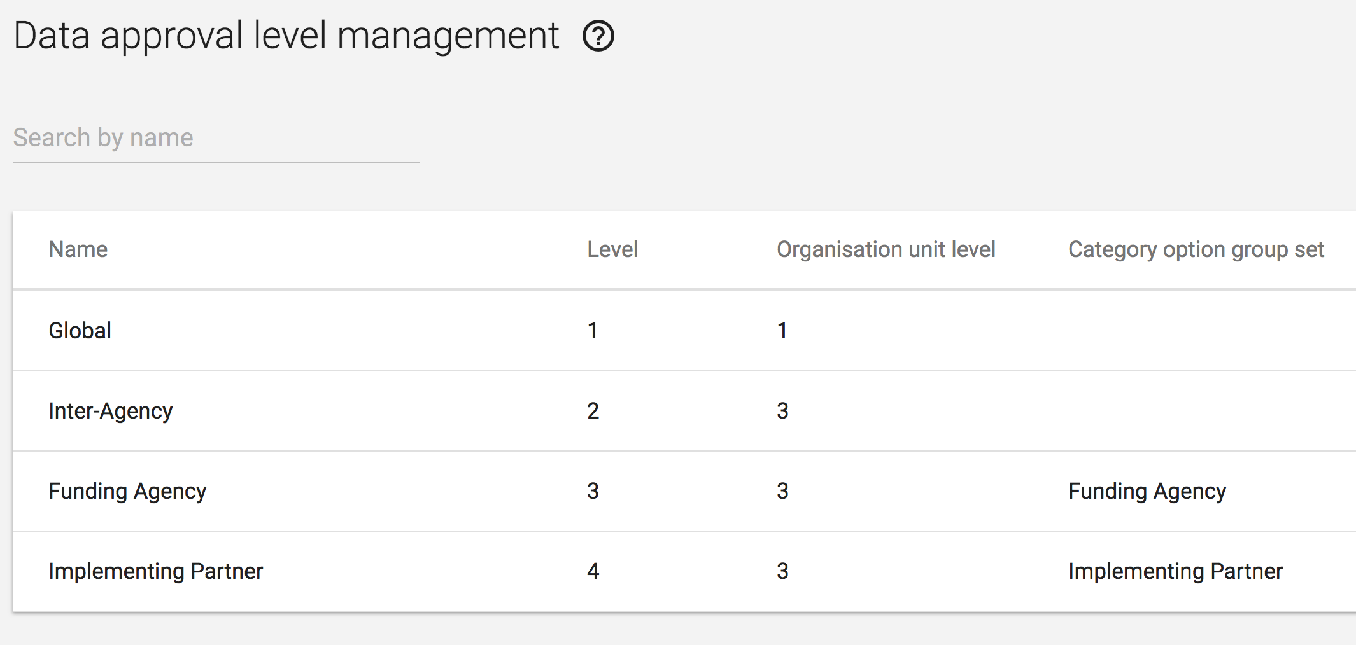
PEPFAR data approval levels

Slide 31
PEPFAR use case: Complex data modelling
1. Modelling mechanisms:
data set dimensions: Attribute Options
2. Modelling agencies and partners (and subpartners):
category option groups and group sets
3. Modelling data approval:
data approval levels
Thank you!

Slide 32
Jim Grace
jim@dhis2.org
Ben Guaraldi
ben@dhis2.org

