Slide 1
The Title of Graduation Project
CSE 496
First Presentation
Ahmet Bitircek
Advisor: Asst. Prof. Alp Arslan Bayrakci
September 2025

Slide 2
Contents
Project Definition
Project Design
Project Requirements
Success Criteria (There will be at least 3)
Project Timeline (with monthly granularity)
References

Slide 3
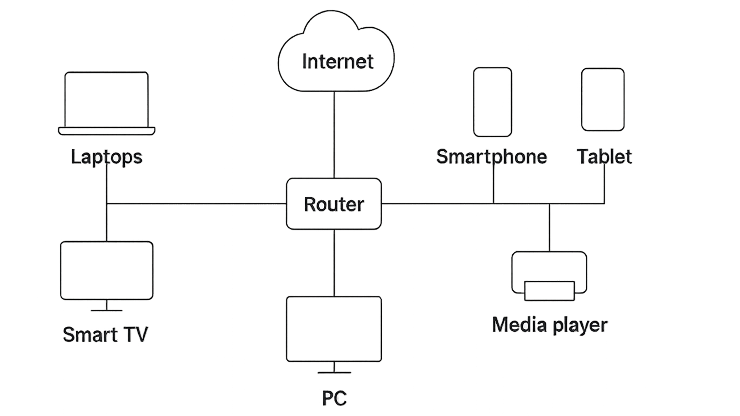
Project Definition
This slide must include a figure that explains your project (like the example on the right).
Keep it simple, clear, and audience-friendly.
Make sure anyone in the room can understand it.
Explain what the project is for / what it does.
No technical details on this slide.

Slide 4
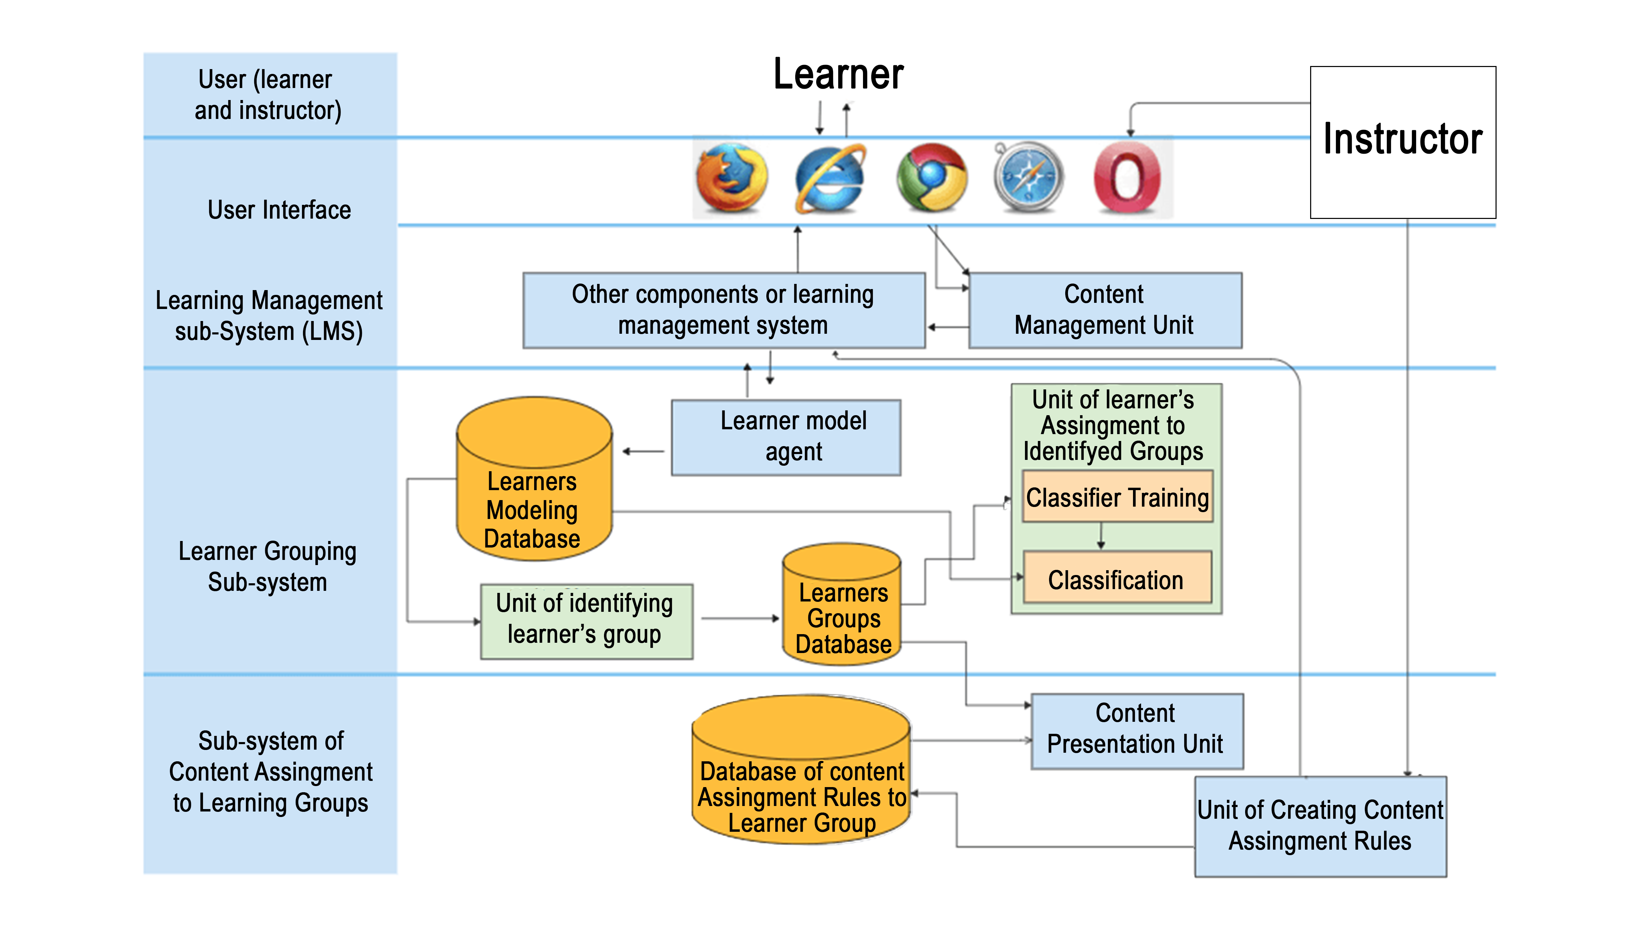
Project Design
On this slide, explain HOW you plan to build the Project.
A diagram like the one on the left is very helpful (components, connections, data/control flow).
UML (use-case, class, sequence) and state diagrams can help describe your design clearly.

Slide 5
Project Requirements
Here, explain what you will need to realize the project—i.e., the resources required to do what you described on the previous slide.
Software: Which programs, frameworks, libraries, toolchains, etc. will you need?
Hardware: Which devices, sensors, boards, interfaces, I/O units, etc. will you need?
Other resources: What else is required to execute the project? (e.g., participants/subjects, datasets such as base-station data, Twitter data, image collections of people, etc.)

Slide 6
Success Criteria
The success criteria must be concrete and testable.
Statements like “the project works fine” or “the advisor is happy” are not valid success criteria.
Not every criterion has to be numeric. For example: “Detect whenever a window is opened", or “When an intruder is detected, send an SMS to the registered phones” can be valid criteria.
The key point: each criterion must be verifiable/testable.
Include quantitative, measurable success criteria with target thresholds (e.g., accuracy ≥ 90%, latency ≤ 200 ms, false alarms < 1/day).

Slide 7
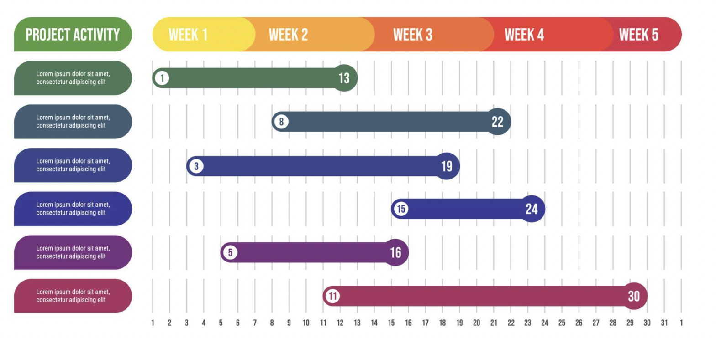
Project Timeline

Slide 8
References
Fujimoto, R. M., “Parallel and Distributed Simulation Systems”, John Wiley & Sons Inc, 2000
Mattern, F., “Efficient Algorithms for Distributed Snapshots and Global Virtual Time Approximation”, Parallel and Distributed Computing, Vol. 18 No. 4, 1993
Bauer, D., Yaun, G., Carothers, C., Yuksel, M., Kalyanaraman, S., “Seven-O'Clock: A New Distributed GVT Algorithm Using Network Atomic Operations”, PADS 2005
MSDN , developer network [online], http://msdn.microsoft.com/en-us/library/dd409390.aspx [Ziyaret Tarihi: 9 Eylül 2013].

Slide 9
More types of slide
To accommodate different needs, multiple examples are enclosed and may be used as required.
Please refer to the subsequent slides for illustrative examples.

Slide 11
DİYAGRAM

Slide 12
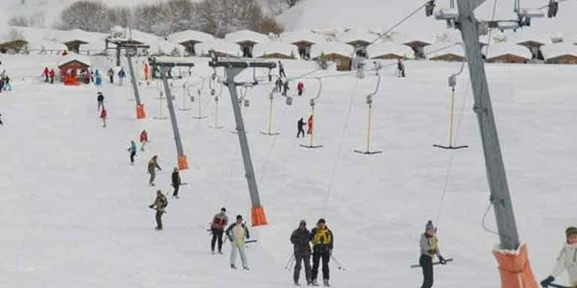
Bozdağ kayak merkezi
Resim ekleme için şablondan resim sayfa düzeni seçilir. Boşluktaki Ikon tıklanınca resim yükleme penceresi açılır.

