Slide 1
Very Exploratory Data Analysis
Bob Morrissey

Slide 2
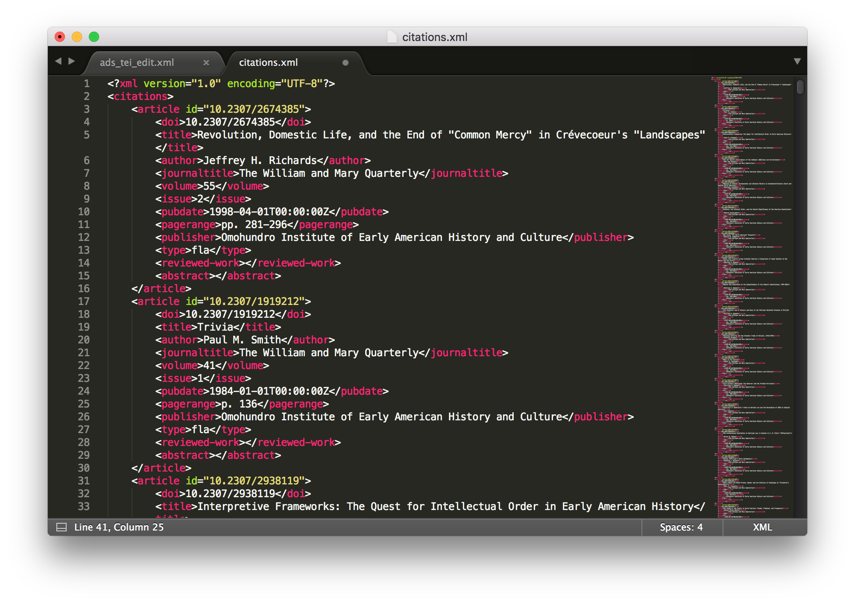
History Journals Content Over Time
JSTOR API: dfr.jstor.org
Provides xml files in batches of 1000 citations / wordcounts/ bigrams
Requested 1000 each of WMQ, JAH, AHR, EH, Ethnohistory (n = ~ 5000)
Plan to use several techniques:
Classifiers (a la Trumpian tweet analysis) to explore differentiation over time, by journal
Geocoding to visualize geography of history scholarship

Slide 3
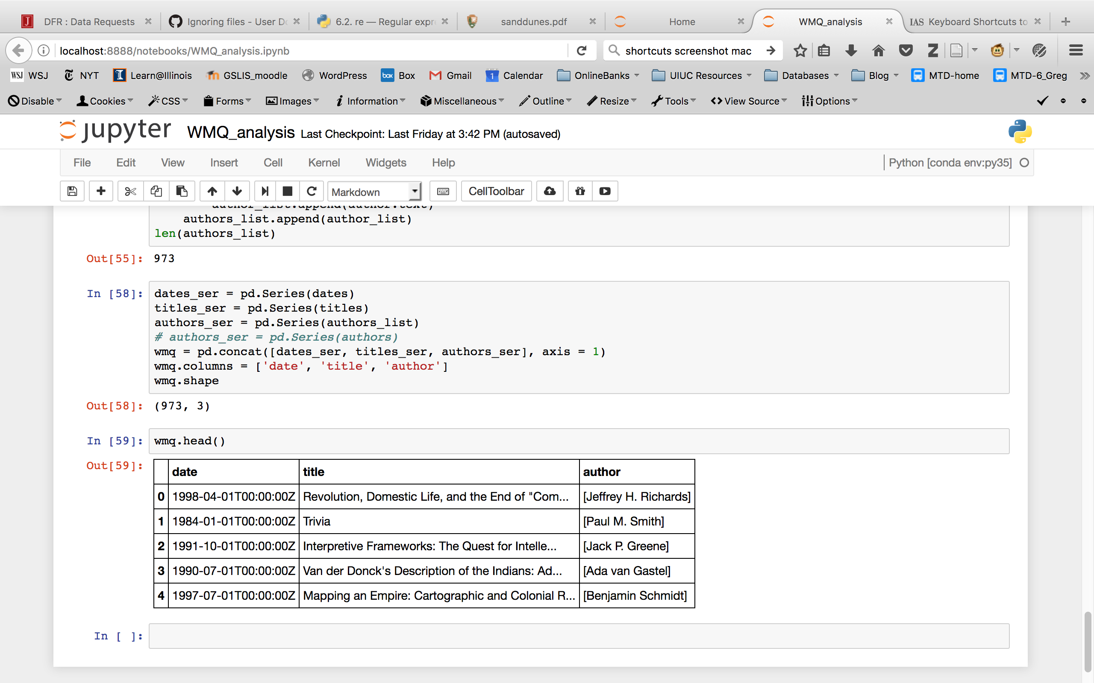
Challenges
Lots of code required just for munging; many frustrations so far!
JSTOR API sent me several different xml formats; have requested tech support
Quite “exploratory”
Not exactly testing a thesis, but exploring whether bayes or clustering (unsupervised) tells me anything about the corpus over time
Using just titles– not a lot of data really

Slide 4
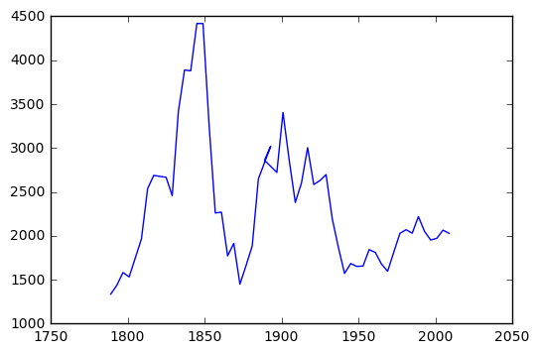
Presidential Inaugural Addresses
Analyze content of inaugural addresses over time
Possibly use classifier to test whether political parties distinguishable, and more or less over time?
Geocode and analyze geography of inaugurations
Topic model and/or unsupervised clustering

Slide 5
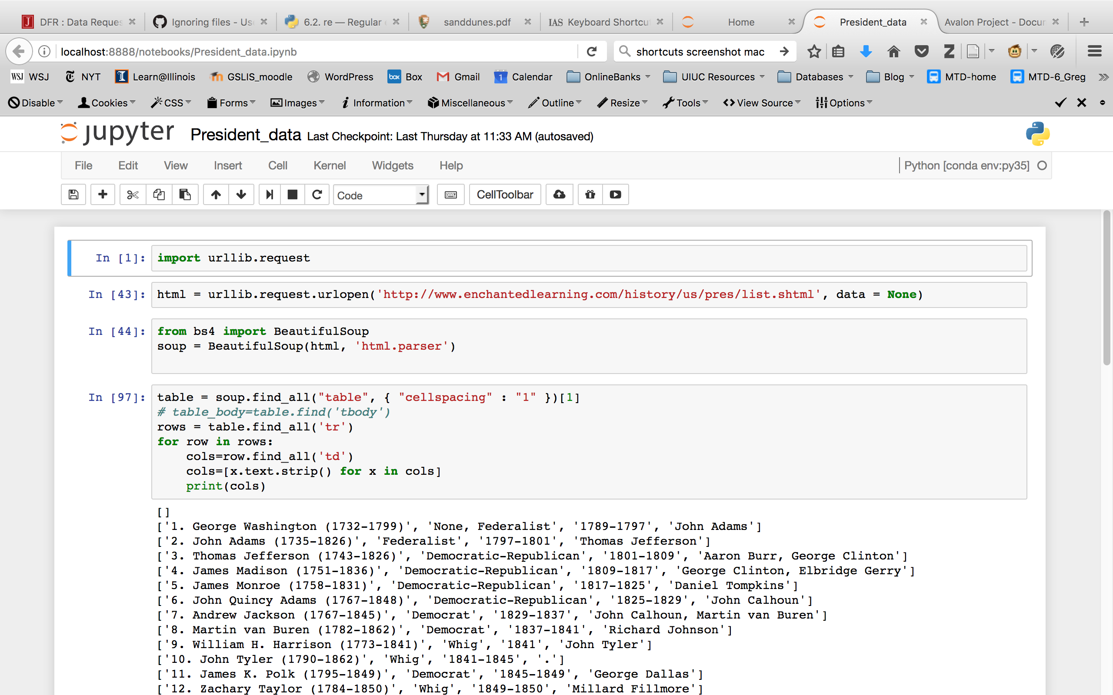
Progress so far
Munging a dataset
No API or ready-made dataset I can find, so I scraped data from Yale Avalon Project (http://avalon.law.yale.edu/)
Built dataframe for analysis
(Like “History Journals” project, this took a long time)
Preliminary/ exploratory Analysis
Plot word counts over time

Slide 6
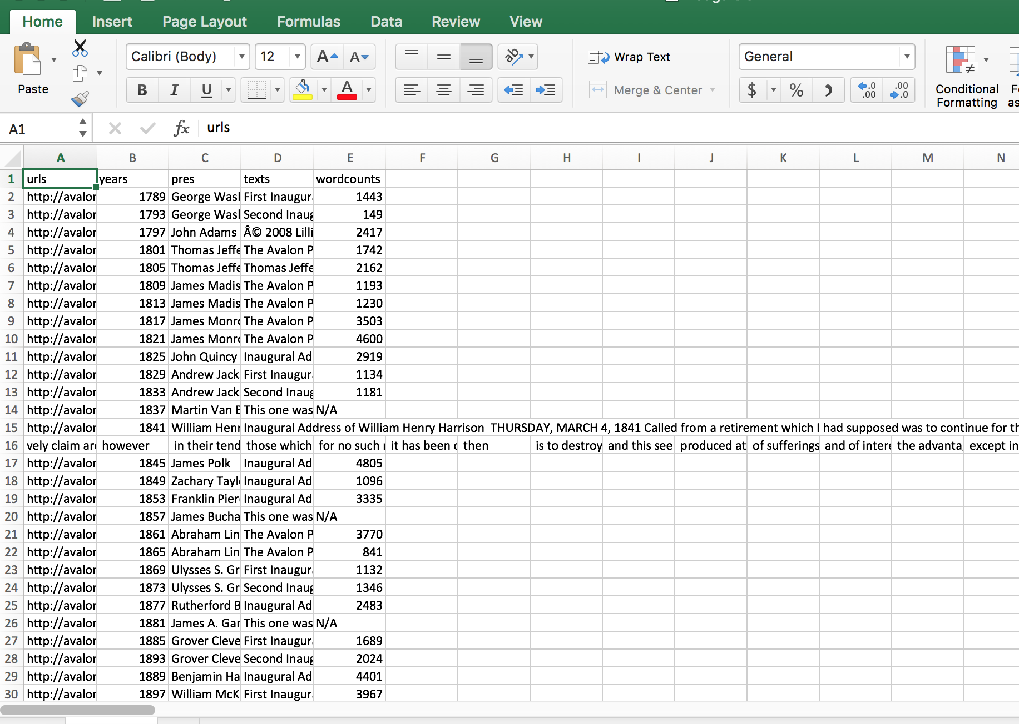
Challenges
Very basic, Very frustrating
Cannot add political parties programatically, need to hard code
But csv output from my simple dataframe is wonky
So… Stuck at not being able to add political parties for my analysis
Also very “exploratory”:
Not sure what this kind of analysis, with so small a dataset, will reveal

