Slide 1
Major Project-I · CSEE-712P
IndexR
A Vectorless Research Assistant with Section- and Page-Level Cited Answers
Bachelor of Technology in Computer Science & Engineering (AI&ML) · 7th Semester
Submitted by
Under the guidance of
Aman | 240104020002
Hemlata | 240104020003
Isaaq Mohammad | 240104020004
Jatin Kharwal | 2040104020005
Nitika Sharma | 240104020007
Er. Shivani Thakur
Assistant Professor
(Computer Engineering)
Department of Computer Science & Engineering (AI & ML)
Jawaharlal Nehru Govt. Engineering College, Sundernagar · Session August–December 2026
Notes:
Introduce the team, the guide and the project: IndexR, a research assistant that answers questions with citations to the exact section and page, built without a vector database.

Slide 2
Problem Statement
Find the right papers for a research question, answer only from them with every claim cited to the exact paper, section and page, and keep the topic up to date, using lexical retrieval instead of a vector database.
1
2
3
Fragmented discovery
Unverifiable answers
Costly vector pipelines
Papers are spread across arXiv, OpenAlex, Semantic Scholar; most tools expect manual uploads
LLMs cite nothing, cite whole documents, or invent references
Embeddings, a separate vector database and re-indexing on model change
4
5
6
Loss of exact terms
Stale knowledge
Isolated from AI tools
Embeddings blur model names, dataset names and numbers like “F1 = 0.95”
Nothing reports new papers, new citations or new versions on a topic
The research corpus is not available inside AI assistants and editors
Notes:
State the problem in one sentence, then walk through the six issues that existing tools leave unsolved.

Slide 3
Objectives
O1
O2
O3
Shared, de-duplicated corpus from arXiv, OpenAlex and Semantic Scholar with section/page chunks
Vectorless retrieval: full-text search, citation and recency boost, query expansion, reranking
Grounded, streamed answers whose [n] markers map to paper, section and page
O4
O5
O6
Two-gate rule that decides when to discover new papers
Responsive web app for workspaces, chat, papers and settings
Private PDF uploads visible only to their owner
O7
O8
O9
MCP server with 11 tools and token authentication for AI assistants
Live tracking of new papers, new citations and new arXiv versions
Thorough validation: 400+ automated tests and constant-query list endpoints
Notes:
Nine measurable objectives; each has a success measure and target week in the report (Table 2.1).

Slide 4
Literature Review and Research Gap
Area | Key work | What it shows
Lexical retrieval | BM25 [1]; BEIR [5] | BM25 is a robust zero-shot baseline; BM25 + reranker is strong
Dense retrieval | DPR [3]; ColBERT [4]; HNSW [26] | Effective, but needs embeddings and a vector index
Reranking | monoBERT [6]; Lin et al. [7] | Cross-encoders are accurate over a short candidate list
RAG | Lewis et al. [2]; Self-RAG [10] | Grounding helps; deciding when to retrieve matters
Citations | ALCE [9]; attributed QA [20] | LLM citations are often coarse or unsupported
Scholarly data | OpenAlex [16]; Semantic Scholar [17] | Open metadata, citation and version data
Research gap
G1 RAG assumes a vector database
G2 Citations are coarse or unreliable
G3 Corpora are static and user-supplied
G4 No awareness of new work
G5 Corpus isolated from AI assistants
IndexR addresses all five in one system.
Notes:
27 references were reviewed (Chapter 3). The table summarises the main areas; the box lists the five gaps IndexR closes.

Slide 5
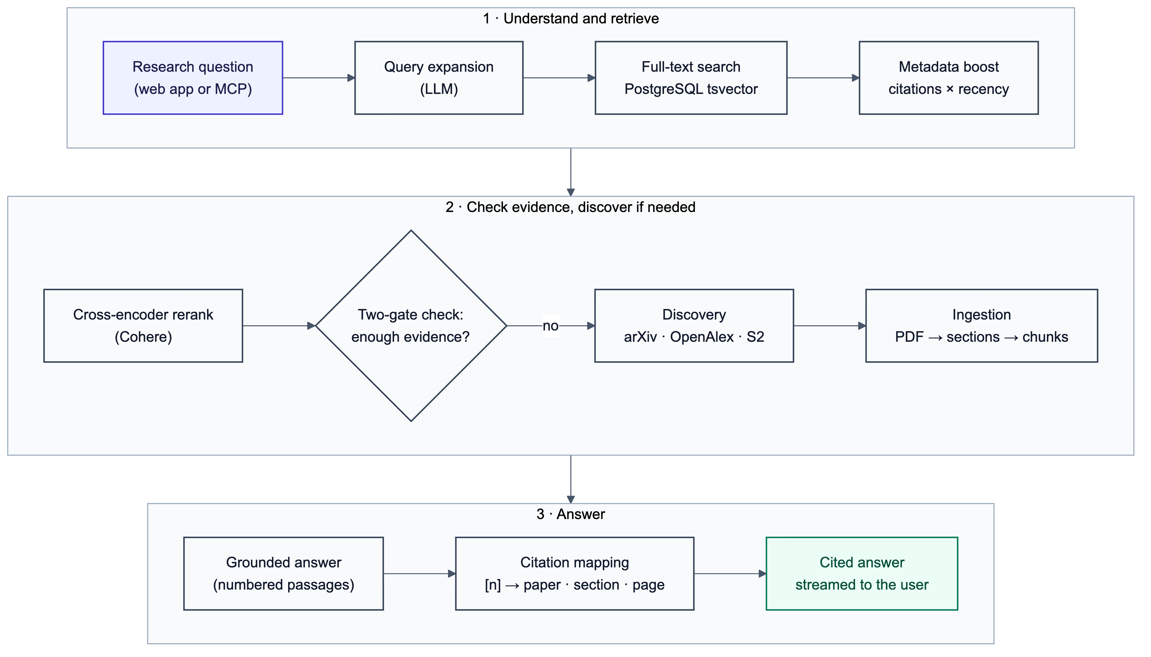
Proposed Approach: Vectorless Retrieval
Section-aware chunks with page ranges, indexed with PostgreSQL full-text search (GIN)
Scores boosted by citation count and recency
LLM expands each question into 3–5 keyword queries
Cohere cross-encoder reranks the top 20 candidates
Two-gate rule triggers discovery when evidence is weak
Answers cite numbered passages; locations come from the database
Notes:
Explain why vectorless: exact terms, low cost, explainable scores. The weakness of keyword search is handled by query expansion and reranking.

Slide 6
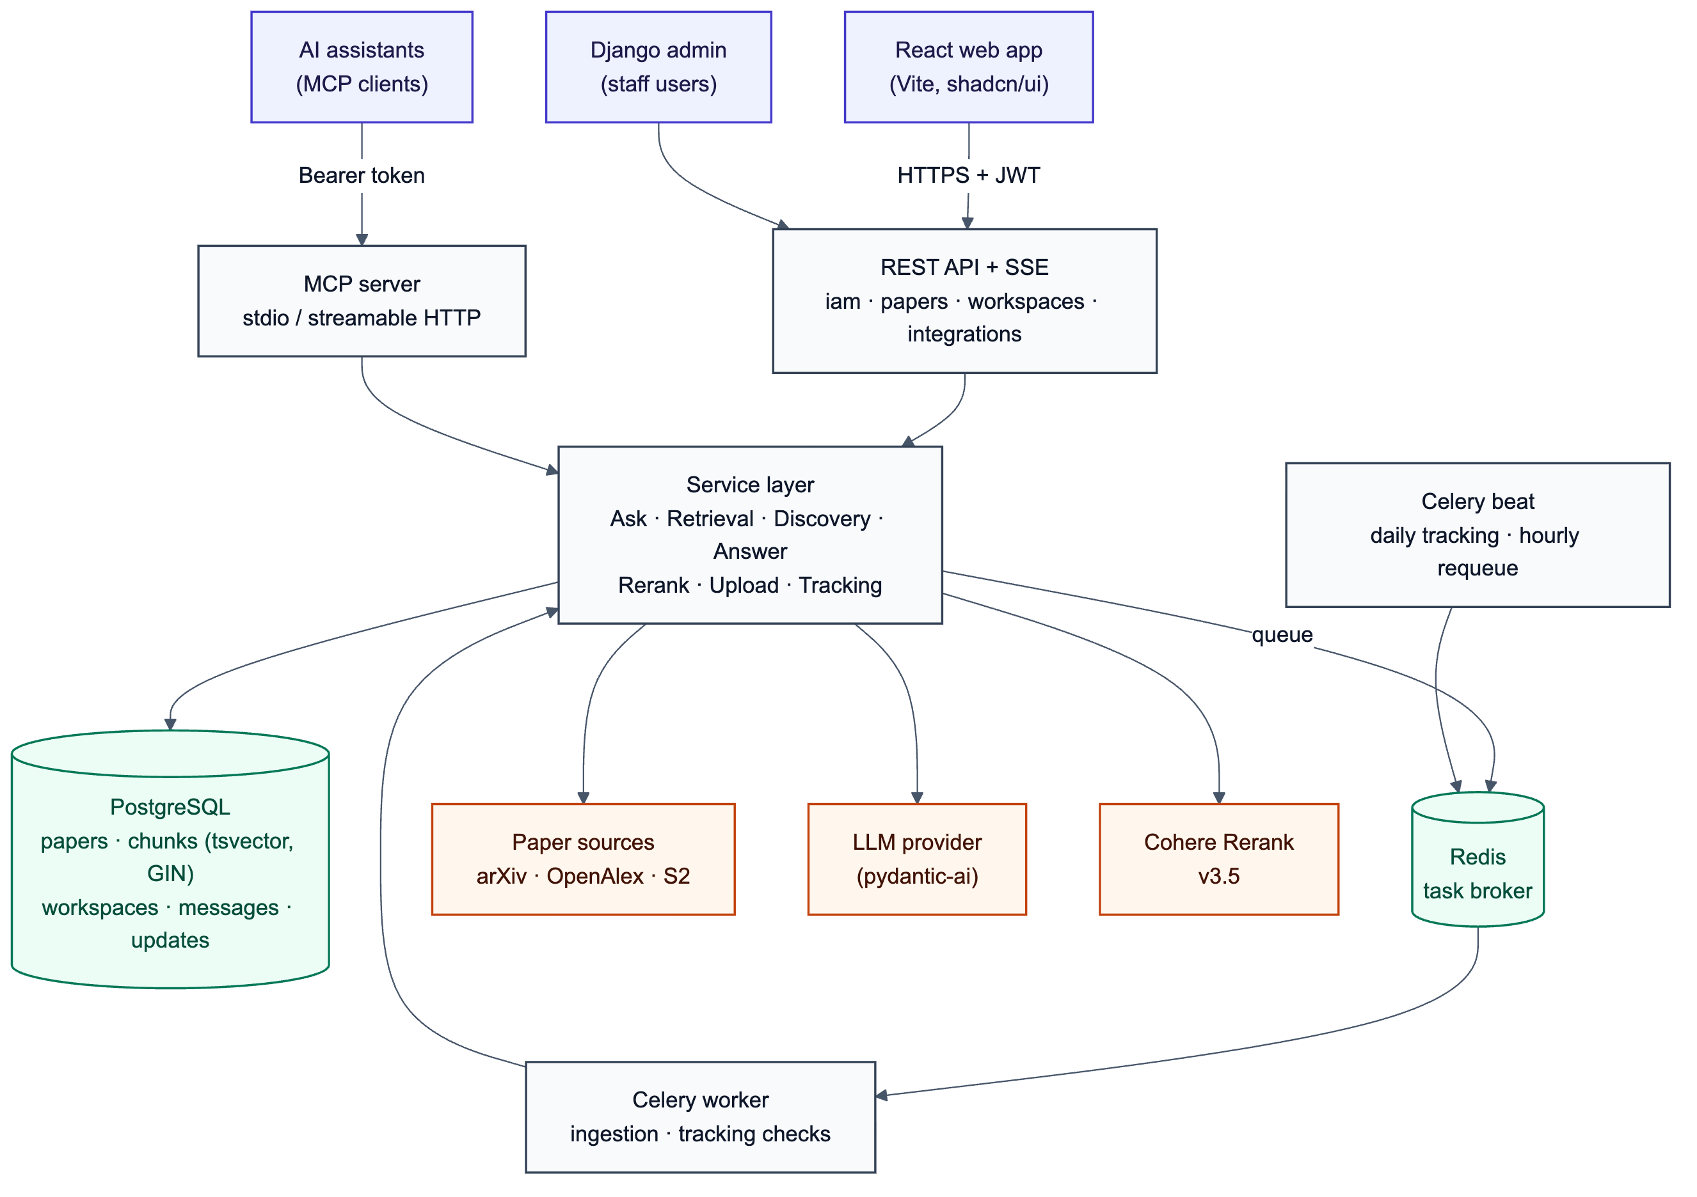
System Architecture
React web app (JWT) and AI assistants (MCP, access tokens) share one service layer
Django REST Framework API with streamed answers (SSE)
Celery worker and beat for ingestion, tracking and requeueing
PostgreSQL stores data and the full-text index; Redis is the broker
External: arXiv, OpenAlex, Semantic Scholar, LLM provider, Cohere Rerank
Notes:
Every entry point (web API, MCP server, background tasks) calls the same services, so retrieval logic and access rules are identical everywhere.

Slide 7
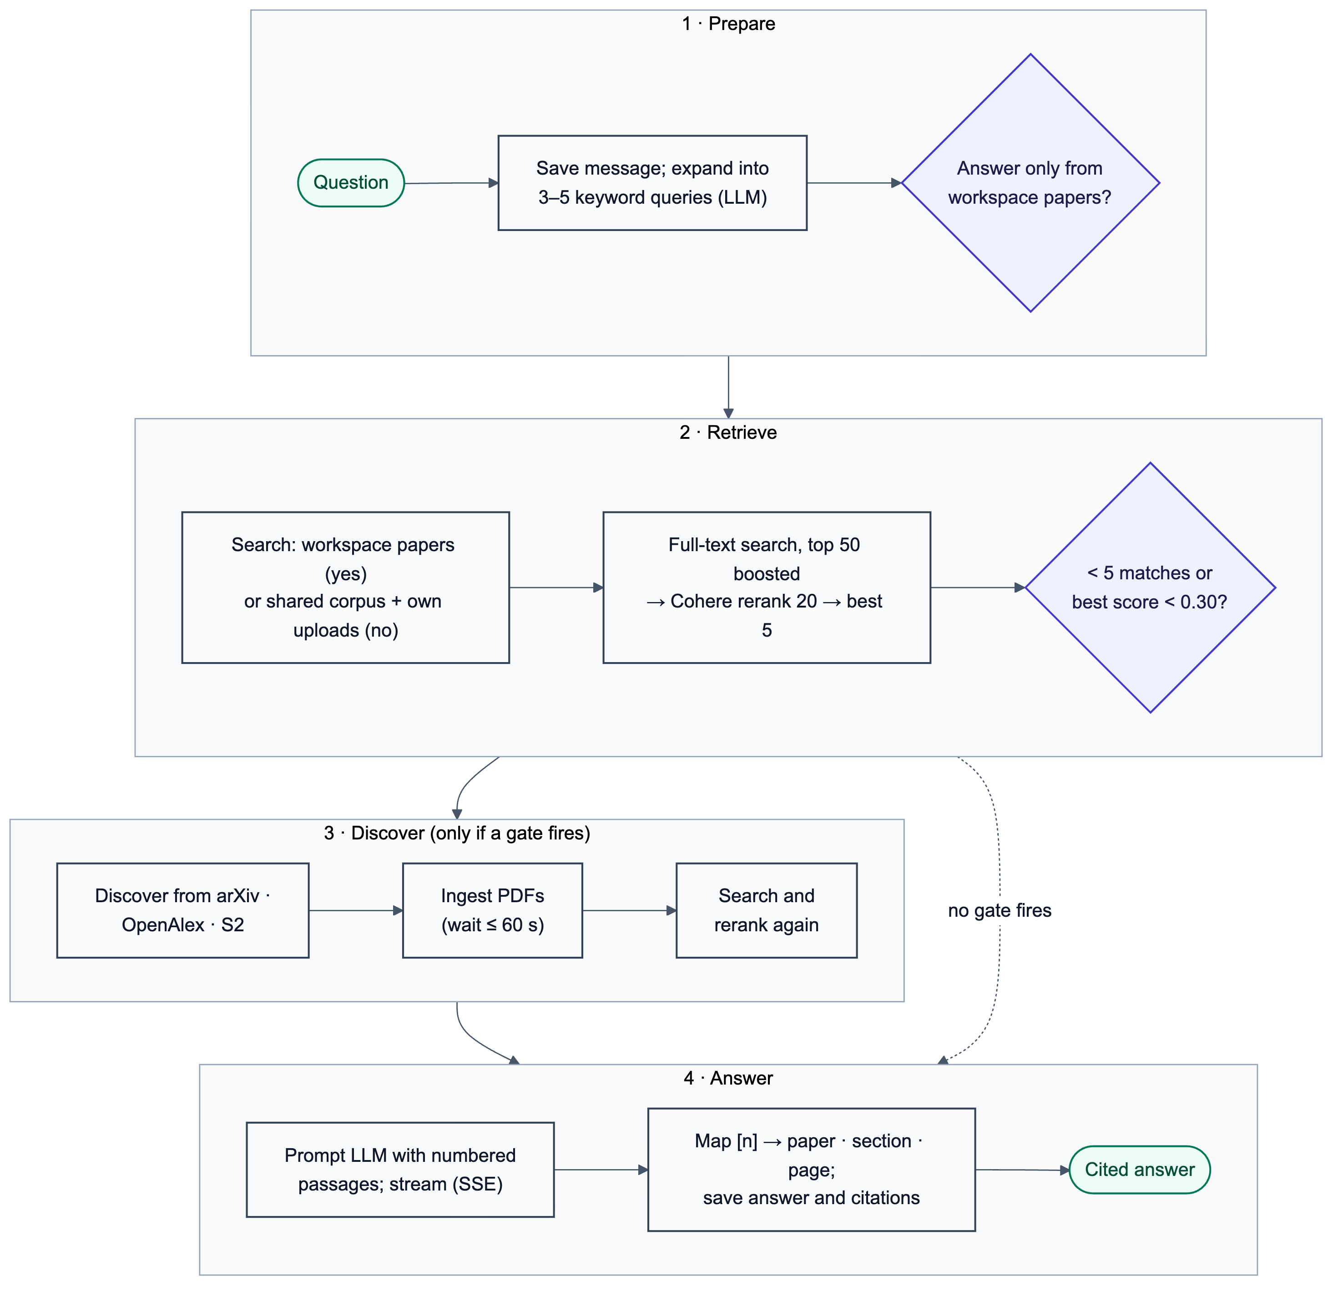
Answering a Question
Two-gate discovery rule
Gate | Discover when
1. Count | Fewer than 5 chunks match
2. Confidence | Best rerank score below 0.30
Pipeline stages
Understanding the question (query expansion)
Looking through papers (search + rerank)
Finding and reading new papers (only if a gate fires)
Writing the answer, streamed live with status updates
Notes:
Walk through the flowchart. Lexical scores are unbounded, so the decision uses a count gate and a cross-encoder confidence gate instead of a fixed score threshold.

Slide 8
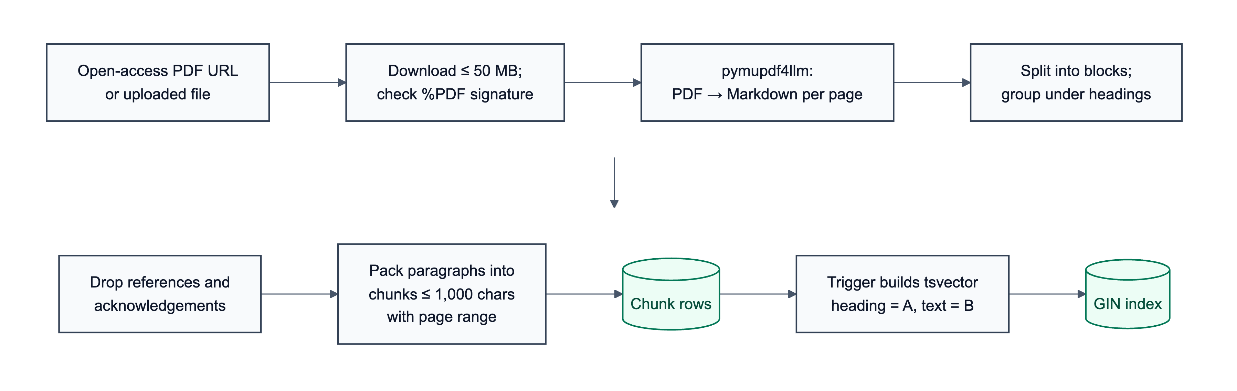
Ranking, Ingestion and Citations
Ranking
Citations
score = rank × B_cit × B_rec
B_cit = 1 + 0.1 × log₁₀(citations + 1)
B_rec = 1 + 0.2 × max(0, 1 − age / 5)
Top 5 passages numbered [1]–[5]; model may cite only these
Each [n] mapped to its stored chunk; unknown numbers dropped
Section and page shown come from the database, not the model
Ingestion and section-aware chunking
Notes:
Citation boost: 1,000 citations gives +30%. Recency: this year's papers +20%, falling to zero at five years. Chunks keep their heading and page range so every citation can point to a section and page.

Slide 9
Live Tracking and MCP Integration
Live tracking (daily, Celery beat)
MCP server (11 tools)
New papers on tracked topics (published since the last check)
New papers citing a tracked paper (OpenAlex)
New arXiv versions of a tracked paper
Each update reported once per workspace
“N updates since date” banner and home-page badge
search_papers
ask
list_workspaces
create_workspace
list_workspace_papers
get_paper
add_paper_to_workspace
remove_paper_from_workspace
track_topic
untrack_topic
list_updates
Limits
Up to 10 topics per workspace; first check looks back 30 days
At most 10 newest citing papers per paper per check
Run on demand with manage.py check_tracking
Personal access tokens (SHA-256 hashed); every tool acts only as the token’s user.
Notes:
Tracking reuses the discovery pipeline with a date filter. The MCP server exposes IndexR to assistants like Claude Desktop and Claude Code over stdio or HTTP.

Slide 10
Tools and Technologies
Backend
Data
Python 3.12, Django 6.1, Django REST Framework, Simple JWT, django-allauth
PostgreSQL 18 (tsvector, GIN index), Redis 8
Background jobs
AI services
Celery 5.6 worker and beat scheduler
pydantic-ai (Gemini / Claude / GPT), Cohere Rerank v3.5, pymupdf4llm
Frontend
Integration and testing
React 19, TypeScript, Vite, TanStack Query, Tailwind CSS, shadcn/ui
MCP Python SDK, Django test runner, Playwright
Notes:
Everything is open source except the hosted LLM and reranker APIs. No GPU or vector database is required.

Slide 11
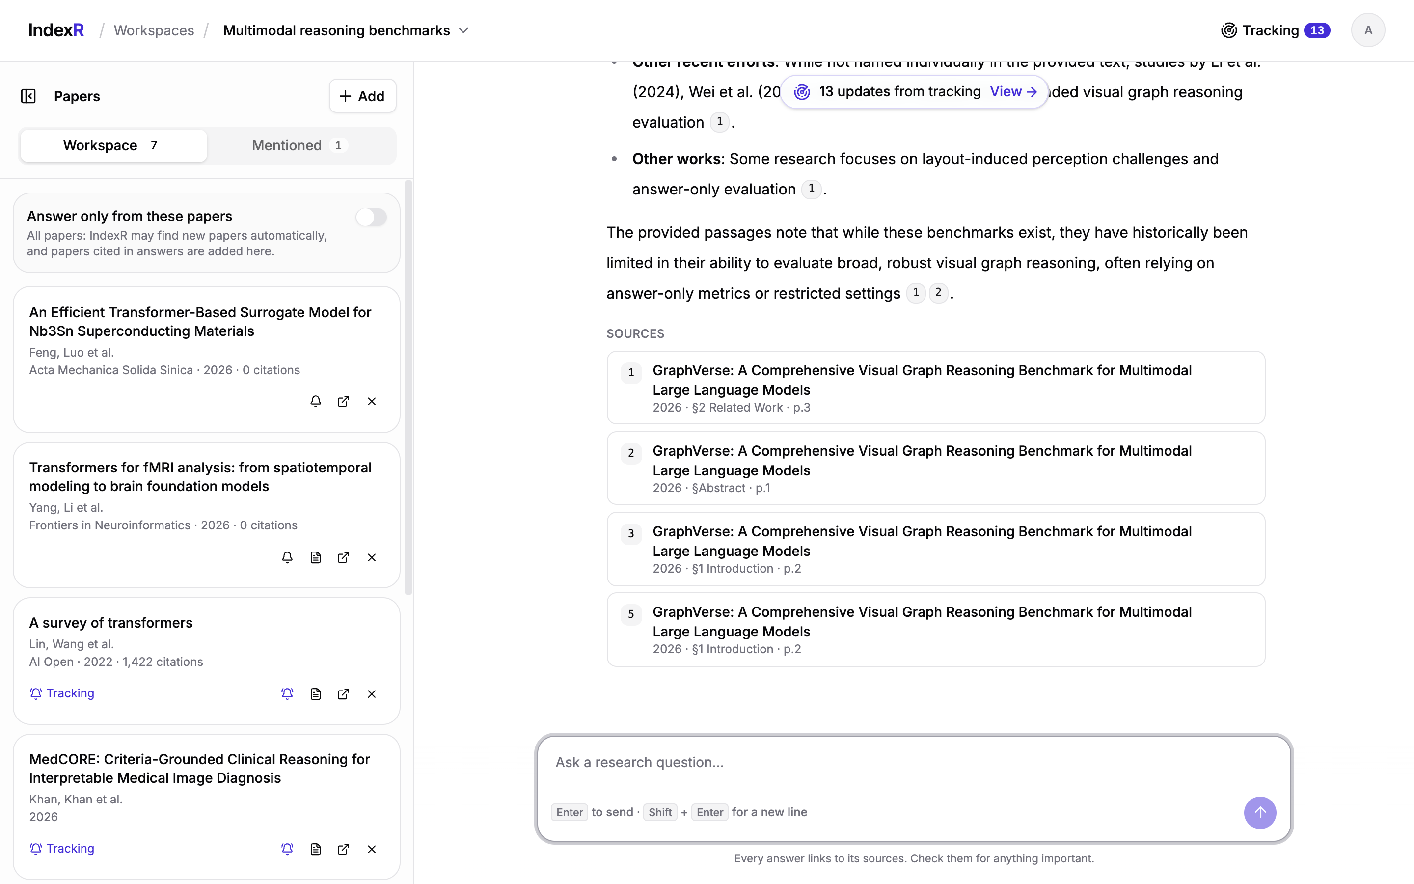
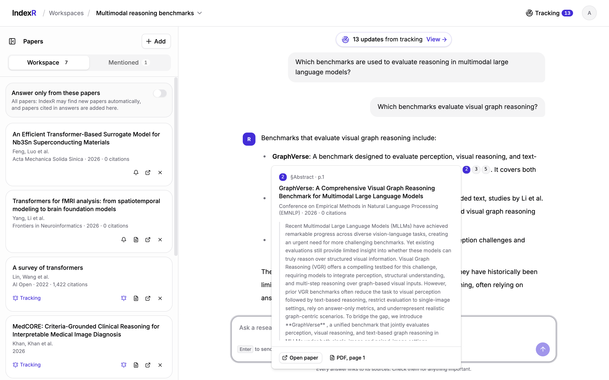
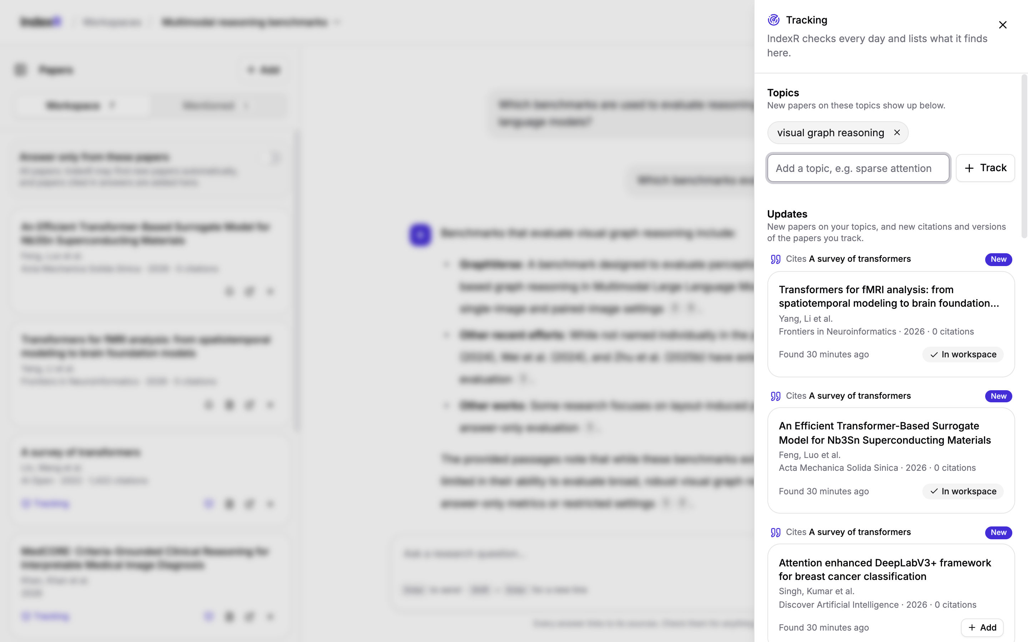
User Interface
Citation preview: section, page and passage
Workspace: papers panel and a cited answer with its sources
Tracking panel with topics and updates
Notes:
Live demo can follow here. More screenshots are in Chapter 6 of the report.

Slide 12
Validation and Results
416
12 / 12
2.2 ms
≈ 11 s
automated tests, all passing
functional requirements verified
median full-text search
answer from the corpus
Live validation
Corpus: 137 papers, 4,930 chunks
MCP: requests without a valid token rejected (HTTP 401)
Tracking: 3 new papers on a topic; 10 new citing papers; re-runs add no duplicates
Every paginated list: same query count for 1 and 5 rows
Two defects found by live runs, fixed with regression tests
Notes:
Measured on an Apple M2 laptop. Almost all answer latency is the external LLM and reranker calls; search itself is milliseconds.

Slide 13
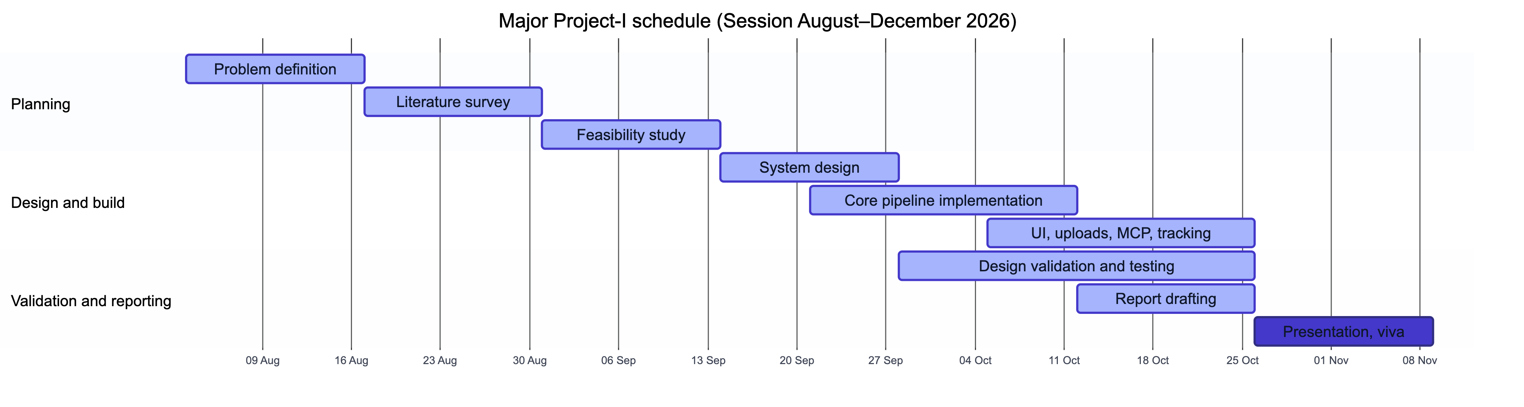
Timeline
Weeks 1–6
Weeks 7–10
Weeks 11–12
Weeks 13–14
Problem, literature survey, feasibility, setup and authentication
Design, fetchers, ingestion, retrieval, answers, web app
Uploads, MCP server, live tracking, validation, report
Presentation and viva
Notes:
The 14-week plan follows the course milestones; implementation ran alongside design and validation in nine short phases.

Slide 14
Conclusion and Future Scope
Conclusion
Future scope (Major Project-II)
Cited, grounded answers without a vector database
Automatic discovery from three open sources
Citations traceable to section and page
Private uploads, MCP integration and live tracking
Backed by 416 tests and live validation
Formal evaluation on 20–30 questions
Citation-graph expansion and visualisation
Table, figure and equation extraction
Version-aware re-ingestion
Email digests and LLM summaries of updates
Shared workspaces and organisation accounts
Lexical retrieval with query expansion and reranking is a practical, inexpensive and explainable foundation for trustworthy, cited answers.
Thank you. Questions?
Notes:
Summarise the central claim: lexical retrieval with query expansion and reranking is a practical, inexpensive and explainable base for trustworthy cited answers.

Slide 15
References
[1] S. Robertson and H. Zaragoza, “The probabilistic relevance framework: BM25 and beyond,” Found. Trends Inf. Retr., 2009.
[2] P. Lewis et al., “Retrieval-augmented generation for knowledge-intensive NLP tasks,” NeurIPS, 2020.
[3] V. Karpukhin et al., “Dense passage retrieval for open-domain question answering,” EMNLP, 2020.
[5] N. Thakur et al., “BEIR: A heterogeneous benchmark for zero-shot evaluation of IR models,” NeurIPS Datasets & Benchmarks, 2021.
[6] R. Nogueira and K. Cho, “Passage re-ranking with BERT,” arXiv:1901.04085, 2019.
[9] T. Gao et al., “Enabling large language models to generate text with citations,” EMNLP, 2023.
[10] A. Asai et al., “Self-RAG: Learning to retrieve, generate, and critique through self-reflection,” ICLR, 2024.
[16] J. Priem, H. Piwowar, and R. Orr, “OpenAlex: A fully-open index of scholarly works,” arXiv:2205.01833, 2022.
[22] Anthropic, “Model Context Protocol specification,” modelcontextprotocol.io.
[26] Y. A. Malkov and D. A. Yashunin, “Efficient and robust approximate nearest neighbor search using HNSW graphs,” IEEE TPAMI, 2020.
Full list of 27 references in the project report.
Notes:
Key references; numbering matches the report. Close with thanks and invite questions.

