Slide 1
Development of prediction website for the hardness and volume
of oleogel-based breads
Dataset
▪ Hardness
X data
Y data
Hyperspectral images |  |  |  |  | Hardness
1 | 2 | 3 | ⋯ | 224
0.195594 | 0.173271 | 0.150947 | ⋯ | 0.078035 | 7.166
0.195779 | 0.173344 | 0.150909 |  | 0.075504 | 7.166
⋯
0.194202 | 0.172094 | 0.149985 | ⋯ | 0.072873 | 5.466
0.19258 | 0.170703 | 0.148827 |  | 0.072245 | 5.466
2997 rows
▪ Volume
X data
Y data
Hyperspectral images |  |  |  |  | Volume
1 | 2 | 3 | ⋯ | 224
0.195594 | 0.173271 | 0.150947 | ⋯ | 0.078035 | 2.78
0.195779 | 0.173344 | 0.150909 |  | 0.075504 | 2.78
⋯
0.194202 | 0.172094 | 0.149985 | ⋯ | 0.072873 | 3.72
0.19258 | 0.170703 | 0.148827 |  | 0.072245 | 3.72
2997 rows

Slide 2
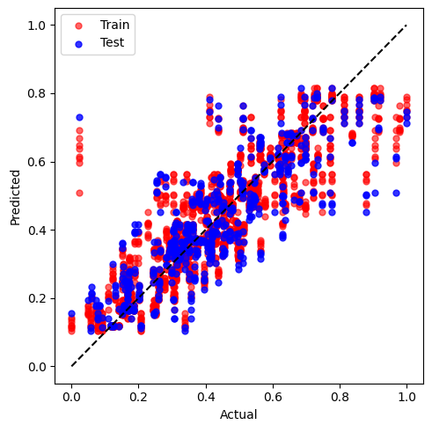
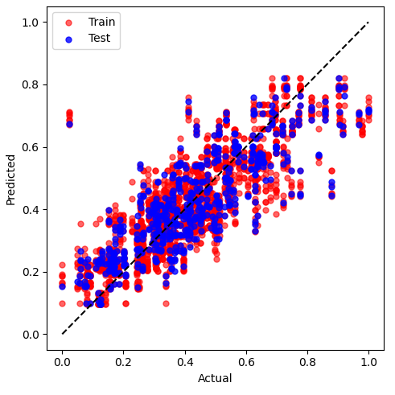
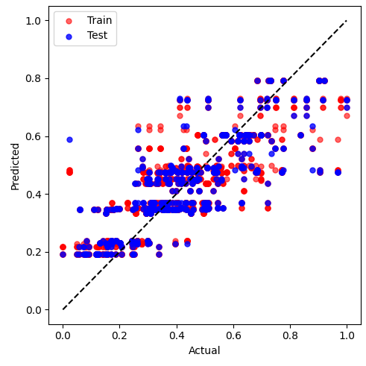
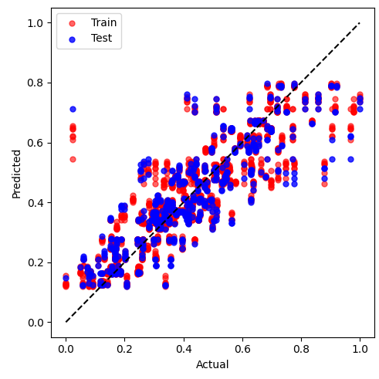

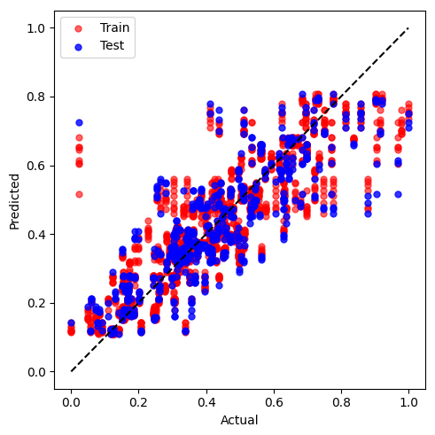
<RandomForest>
<SVM>
<AdaBoost>
R² (train): 0.763052
R² (test): 0.645964
RMSE (train): 0.098240
RMSE (test): 0.120033
R² (train): 0.686520
R² (test): 0.669695
RMSE (train): 0.112997
RMSE (test): 0.115941
R² (train): 0.667813
R² (test): 0.633042
RMSE (train): 0.116320
RMSE (test): 0.122204
<GradientBoosting>
<XGBoost>
<CatBoost>
R² (train): 0.759378
R² (test): 0.687611
RMSE (train): 0.098999
RMSE (test): 0.112752
R² (train): 0.763390
R² (test): 0.645297
RMSE (train): 0.098170
RMSE (test): 0.120146
R² (train): 0.762748
R² (test): 0.660770
RMSE (train): 0.098303
RMSE (test): 0.117497

Slide 3
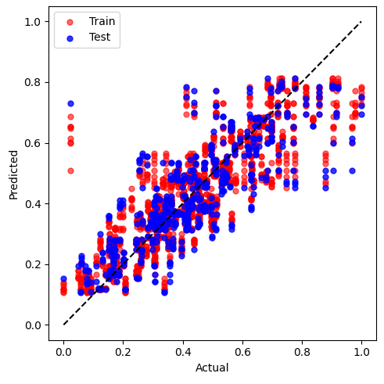
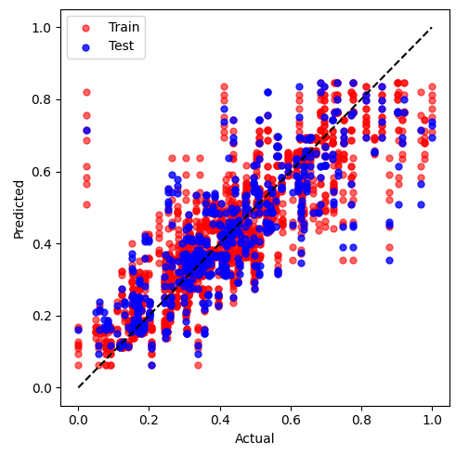

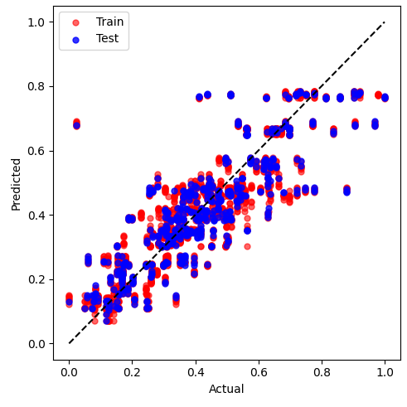
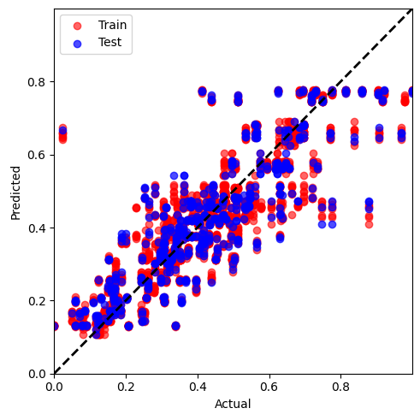
<DecisionTree>
<KNeighbors>
<LightGBM>
R² (train): 0.763392
R² (test): 0.644581
RMSE (train): 0.098170
RMSE (test): 0.120268
R² (train): 0.744749
R² (test): 0.622384
RMSE (train): 0.101964
RMSE (test): 0.123966
R² (train): 0.763368
R² (test): 0.648299
RMSE (train): 0.098175
RMSE (test): 0.119637
<MLP>
<CNN>
R² (train): 0.730049
R² (test): 0.701306
RMSE (train): 0.104859
RMSE (test): 0.110253
R² (train): 0.721645
R² (test): 0.720331
RMSE (train): 0.106189
RMSE (test): 0.107586

Slide 4
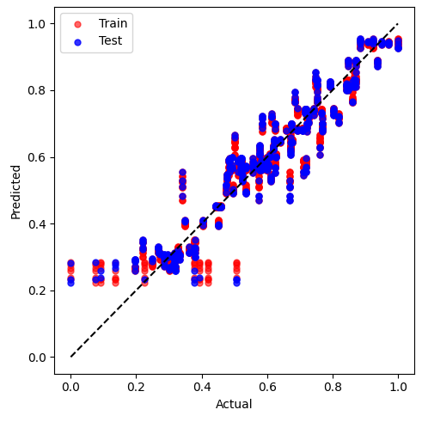
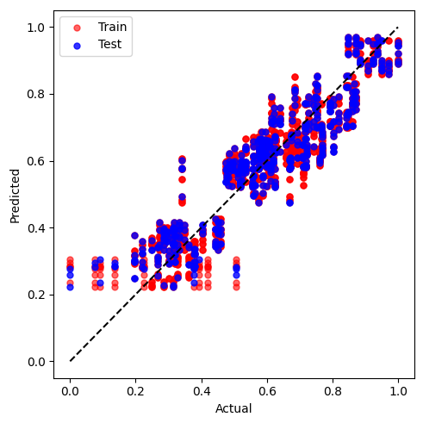
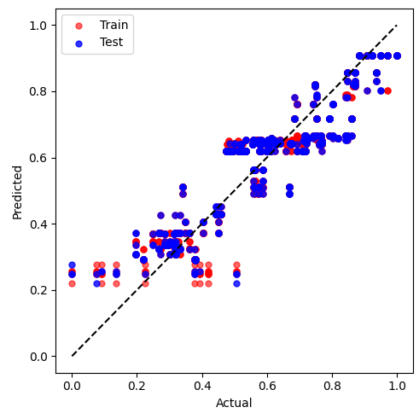
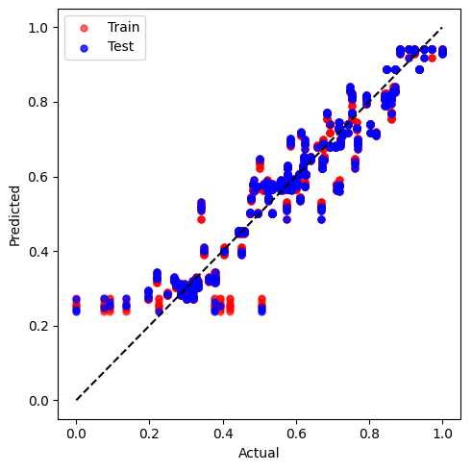

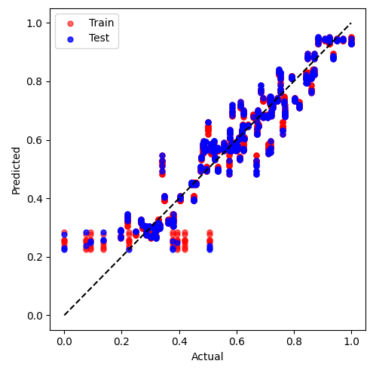
<RandomForest>
<SVM>
<AdaBoost>
R² (train): 0.903569
R² (test): 0.887232
RMSE (train): 0.061137
RMSE (test): 0.068309
R² (train): 0.825544
R² (test): 0.839371
RMSE (train): 082232
RMSE (test): 0.081527
R² (train): 0.815377
R² (test): 0.813784
RMSE (train): 0.084594
RMSE (test): 0.087780
<GradientBoosting>
<XGBoost>
<CatBoost>
R² (train): 0.902309
R² (test): 0.898858
RMSE (train): 0.061535
RMSE (test): 0.064692
R² (train): 0.903752
R² (test): 0.888672
RMSE (train): 0.061079
RMSE (test): 0.067872
R² (train): 0.903492
R² (test): 0.892732
RMSE (train): 0.061161
RMSE (test): 0.066623

Slide 5

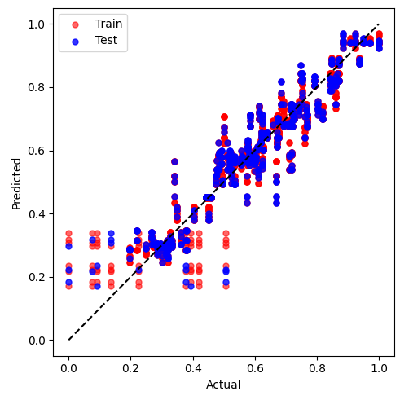

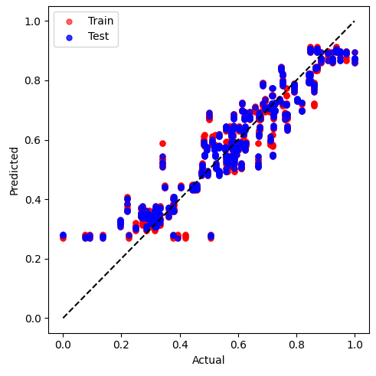

<DecisionTree>
<KNeighbors>
<LightGBM>
R² (train): 0.903754
R² (test): 0.888236
RMSE (train): 0.061078
RMSE (test): 0.068004
R² (train): 0.897849
R² (test): 0.879340
RMSE (train): 0.062924
RMSE (test): 0.070659
R² (train): 0.903750
R² (test): 0.888801
RMSE (train): 0.061080
RMSE (test): 0.067832
<MLP>
<CNN>
R² (train): 0.871875
R² (test): 0.881458
RMSE (train): 0.070472
RMSE (test): 0.070036
R² (train): 0.886550
R² (test): 0.891800
RMSE (train): 0.066313
RMSE (test): 0.066916

