Slide 1
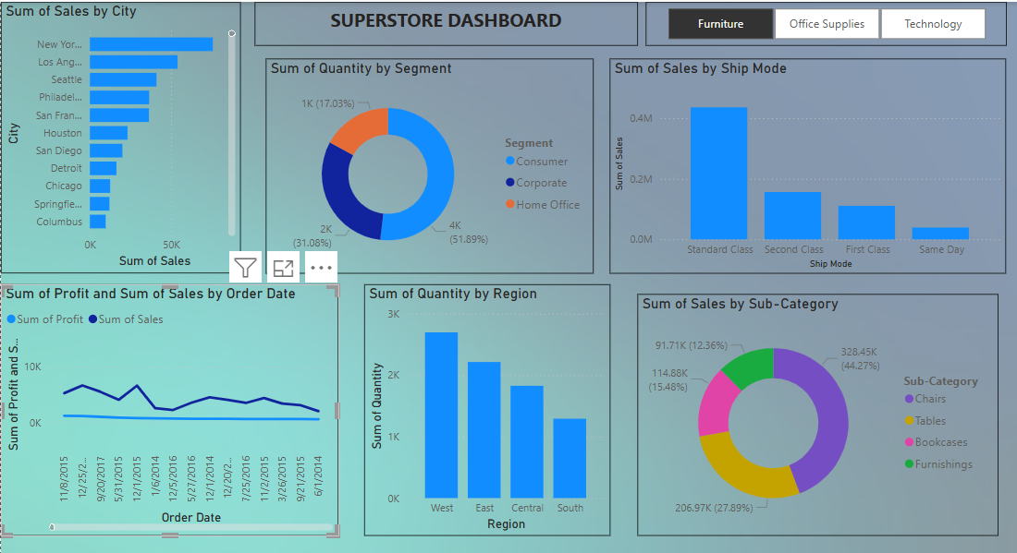
Superstore Performance Summary — Key Insights

Slide 2
Superstore Performance Summary
— Key Insights
Top Cities Driving Sales: • New York, Los Angeles, and Seattle lead in total sales.
Customer Segments: • Consumer segment accounts for ~52% of sales volume.
Shipping Preferences: • Standard Class is the most used shipping method.
Sales and Profit Trends: • Sales show seasonal fluctuation, profit remains flat — check for discount issues.
Regional Sales: • West region has the highest quantity sold. South underperforms.
Sub-Category Insights: • Chairs dominate sub-category sales (~44%).
Recommendations: • Focus on top cities, optimize logistics, target Consumer segment, promote top categories.

