Slide 1
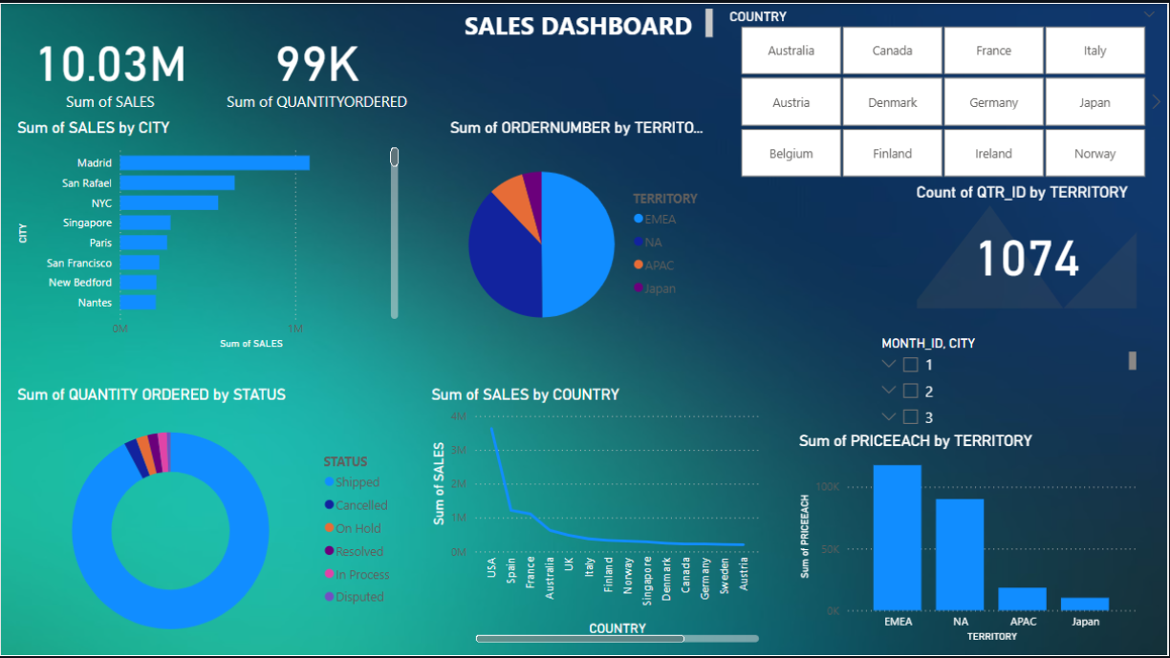
SALES DASHBOARD

Slide 2
SALES DASHBOARD
Total Sales:
The dashboard reports a total sales value of $10.03M.
Quantity Ordered:
Displays a total of 99K units ordered.
Top Performing Cities:
Madrid, San Rafael, and NYC are leading in terms of total sales.
Order Distribution by Territory:
Majority of orders come from the EMEA region, followed by NA, APAC, and Japan.
Sales by Country:
The USA shows the highest sales, followed by Spain, France, and others.
Order Status Analysis:
Most orders are Shipped, with smaller segments in statuses like Cancelled, On Hold, etc.
Territory Pricing Overview:
EMEA has the highest cumulative item pricing, followed by NA.
Filter Options:
The dashboard includes dynamic filters by Country and Month, allowing for customized views.

Slide 3
SALES DASHBOARD
Dashboard Summary
Total Sales: $10.03M
Total Quantity Ordered: 99K units
Top Cities by Sales: Madrid, San Rafael, NYC
Highest Order Volume: EMEA region
Leading Sales Countries: USA, Spain, France
Predominant Order Status: Shipped
Highest PriceEach Territory: EMEA
Filters Available: Country, Month

