Slide 1
研究生专业英语文献阅读报告
学生 喻京昊
学号 140660
指导教师 赵新胜

Slide 2
Paper Index
LTE-advanced: next-generation wireless broadband technology
Multi-Cell MIMO Cooperative Networks: A New Look at Interference
Self-Organizing Networks: State-of-the-art, challenges and perspectives
An overview of downlink radio resource management for UTRAN long-term evolution
Multisite field trial for LTE and advanced concepts
Scaling up MIMO: opportunities and challenges with very large arrays
On capacity of large-scale MIMO multiple access channels with distributed sets of correlated antennas
Multi-Cell MIMO Downlink With Cell Cooperation and Fair Scheduling: A Large-System Limit Analysis
Energy-Efficient Resource Allocation in OFDMA Systems with Large Numbers of Base Station Antennas
Full- dimension MIMO (FD-MIMO) for next generation cellular technology

Slide 3
LTE-advanced: next-generation wireless broadband technology
The architecture of this paper is as follows:
An overview of the LTE Release 8 physical layer(PHY) and evolved UMTS terrestrial radio access(E-UTRA) LTE-A requirements
A discussion on carrier aggregation
An overview of DL and UL spatial multiplexing and fundamentals of DL CoMP design
Introduction to the concept of heterogeneous networks, withy an emphasis on LTE relays
Comparison between the performance of LTE Release 8 and LTE-A in the context of IMT-A requirements

Slide 4
2. Multi-Cell MIMO Cooperative Networks: A New Look at Interference
The architecture of this paper is as follows:
an overview of the theory and currently known techniques for multi-cell MIMO (multiple input multiple output) cooperation in wireless networks.
In dense networks where interference emerges as the key capacity limiting factor, multi-cell cooperation can dramatically improve the system performance.
Multicell MIMO cooperation concepts are examined from different perspectives.
A few promising and quite fundamental research avenues are also suggested.

Slide 5
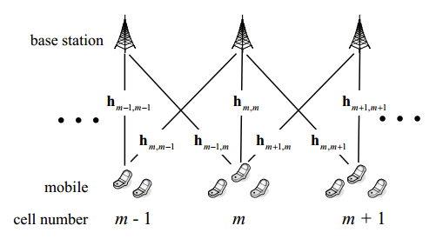
2. Multi-Cell MIMO Cooperative Networks: A New Look at Interference
A linear Wyner-type model with inter-cell interference spans L =Lr = 1 and K = 3 MSs per cell.

Slide 6
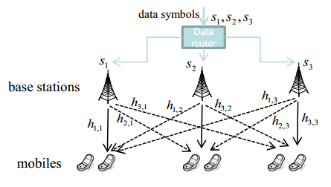
2. Multi-Cell MIMO Cooperative Networks: A New Look at Interference
Illustration of interference coordination for the downlink. The BSs acquire and exchange channel state information (but not the data symbols) pertaining to all relevant direct and interfering links, so as to optimize jointly their transmission parameters (time-frequency scheduling, power level, beamforming

Slide 7
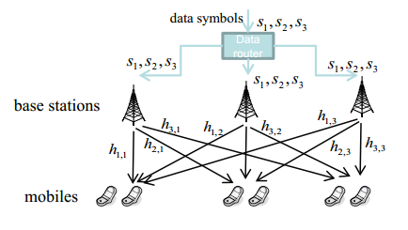
2. Multi-Cell MIMO Cooperative Networks: A New Look at Interference
Illustration of multi-cell MIMO for the downlink. The BSs, each equipped with J antennas, acquire and share channel state information and user data, so as to mimic the behavior of a large MIMO array with MJ antennas

Slide 8
3. Self-Organizing Networks: State-of-the-art, challenges and perspectives
Abstract
In this paper, a general overview of Self-Organizing Networks (SON), and the rationale and state-of-the-art of wireless SON are first presented. The technical and business requirements are then briefly treated, and the research challenges within the field of SON are highlighted. Thereafter, the relation between SON and Cognitive Networks (CN) is covered. At last, the application of Algorithmic Information Theory (AIT) as a possible theoretical tool to support SON in addressing the growing complexity of networks is discussed.

Slide 9
3. Self-Organizing Networks: State-of-the-art, challenges and perspectives
The article mainly describe
Introduction to self-organizing networks
Self-organizing wireless networks and their rationale
State-of-the-art
Requirements and challenges

Slide 10
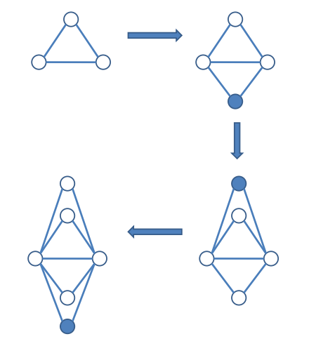
3. Self-Organizing Networks: State-of-the-art, challenges and perspectives
SON growth and preferential attachment properties.

Slide 11
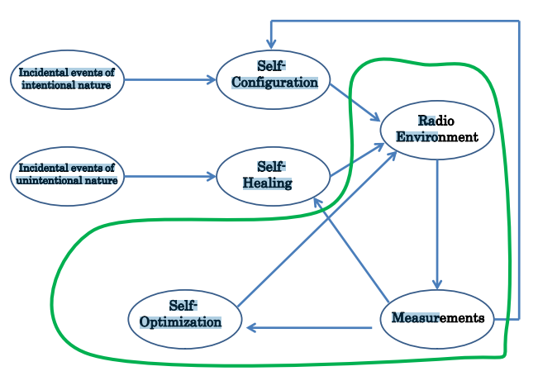
3. Self-Organizing Networks: State-of-the-art, challenges and perspectives
SON cycle.

Slide 12
4. An overview of downlink radio resource management for UTRAN long-term evolution
Abstract
Radio resource management algorithms ranging from bearer admission control to semi-persistent and dynamic packet scheduling, fast link adaptation, and transmission control of multi-antenna transmission modes are addressed in this article for UTRAN long-term evolution
High-level system overview of LTE is given, with special emphasis on the important components related to RRM.
The quality of service parameter framework is outlined
It is demonstrated how the collocation of the RRM algorithms at the base station with easy access to air interface measurements offers opportunities for efficient cross-functional optimization between layers 1, 2, and 3

Slide 13
4. An overview of downlink radio resource management for UTRAN long-term evolution
The article mainly describe
Summary of the Layer-1 to Layer-3 protocol structure, including an overview of the air interface characteristics and the 3GPP terminology for the LTE/FDD downlink mode based on FDD mode
Description of the base station semi-dynamic RRM functionalities at layer 3
Discussion on the fast dynamic RRM features at layers 2 and 1
Recommendations for operating the plurality of RRM options under different load and traffic conditions
Examples of typical performance results for different traffic mixes and antenna configurations in dense urban macrocellular environments

Slide 14
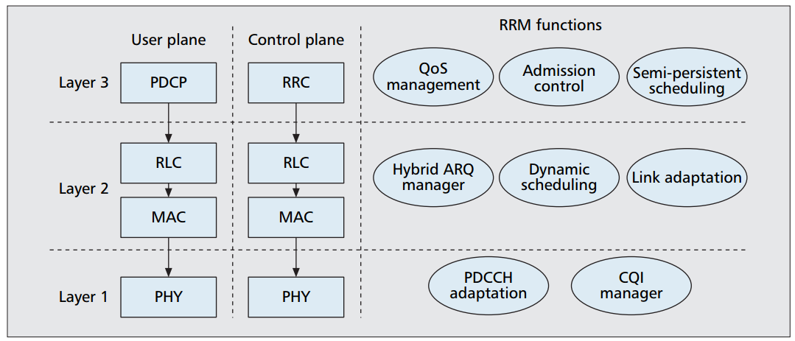
4. An overview of downlink radio resource management for UTRAN long-term evolution
Overview of the base station user-plane and control plane protocol architecture, and the mapping of the primary RRM functionalities to the different layers.

Slide 15
5. Multisite field trial for LTE and advanced concepts
Abstract
The 3GPP LTE standard is stable now in its first release (Release 8), and the question is how good its performance is in real-world scenarios. LTE is also a good base for further innovations, but it must be proven that they offer performance advantages for the price of their complexity. This article evaluates the performance of LTE Release 8 as a baseline and advanced concepts currently in discussion such as cooperative MIMO based on system-level simulations, and measurements in the laboratory and a multisite field testbed within the EASY-C project.

Slide 16
5. Multisite field trial for LTE and advanced concepts
The article mainly describe
Overview of LTE release 8.
Evaluation of next-generation networks.
EASY-C:A field testbed in dresden, filed testbed area and measurement scenario.
System-level simulation results: baseline LTE release 8, optimized codebooks for 4*2 SU-MIMO in the downlink.
Evolution of LTE beyond the initial release 8: LTE-Advanced

Slide 17
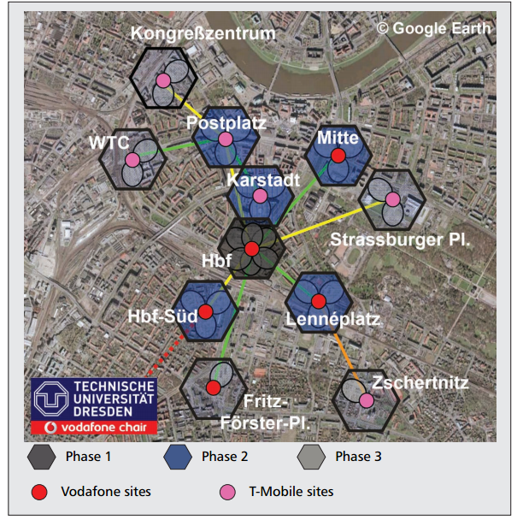
5. Multisite field trial for LTE and advanced concepts
Field test area in Dresden.

Slide 18
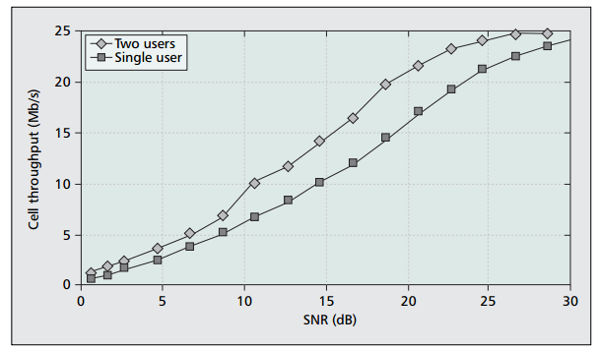
5. Multisite field trial for LTE and advanced concepts
Downlink cell throughput vs. SNR with one or two SISO users in 10 MHz system bandwidth.

Slide 19
6. Scaling up MIMO: opportunities and challenges with very large arrays
Abstract
Multiple-input multiple-output (MIMO) technol ogy is maturing and is being incorporated into emerging wireless broadband standards like long-term evolution (LTE)
The price to pay for MIMO is increased complexity of the hardware [number of radio frequency (RF) chains] and the complexity and energy consumption of the signal processing at both ends.
With very large MIMO, we think of systems that use antenna arrays with an order of magnitude more elements than in systems being built today, say 100 antennas or more.
In very large MIMO systems, each antenna unit uses extremely low power, in the order of milliwatts.
Several things happen when MIMO arrays are made large.
Discuss ultimate information-theoretic performance limits, some practical algorithms, influence of channel properties on the system, and practical constraints on the antenna arrangements.

Slide 20
6. Scaling up MIMO: opportunities and challenges with very large arrays
The article mainly describe
Information theory for very large MIMO arrays.
Point-to-point MIMO channel model, achievable rate, limiting cases.
MU-MIMO propagation, reverse link, forward link.
Spatial focus with more antennas.
Antenna aspects.
Real propagation-measured channels.
Precoding in the forward link: collection of results for single-cell systems.
Precoding in the forward link: the ultimate limit of noncooperative multicell MIMO with large arrays.
Detection in the reverse link: survey of algorithms for single-cell systems.
Summery.

Slide 21
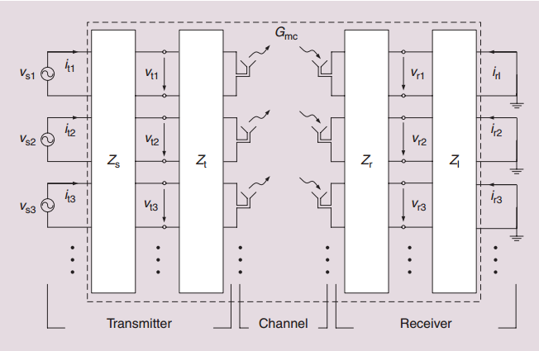
6. Scaling up MIMO: opportunities and challenges with very large arrays
diagram of a MIMO system with antenna impedance matrices and matching networks at both link ends (freely reproduced from [23]).

Slide 22
7. On capacity of large-scale MIMO multiple access channels with distributed sets of correlated antenna
Abstract
A deterministic equivalent of ergodic sum rate and an algorithm for evaluating the capacity-achieving input covariance matrices for the uplink large-scale multiple-input multiple-output (MIMO) antenna channels are proposed.
The research consider a large-scale MIMO system consisting of multiple users and one base station with several distributed antenna sets
The derivations are based on novel techniques from large dimensional random matrix theory (RMT) under the assumption that the numbers of antennas at the terminals approach to infinity with a fixed ratio.
In addition, they are shown to be invariant to several types of fading distribution.

Slide 23
7. On capacity of large-scale MIMO multiple access channels with distributed sets of correlated antenna
The article mainly describe
Information theory for MIMO systems.
Channel model and problem statement.
Deterministic equivalents and ergodic capacity.
Simulation results
Conclusion

Slide 24
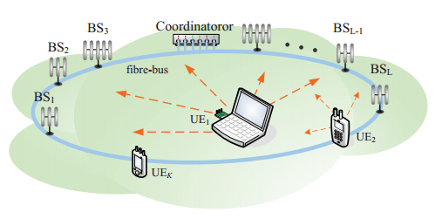
7. On capacity of large-scale MIMO multiple access channels with distributed sets of correlated antenna
A vision for a possible large-scale MIMO system.

Slide 25
8. Multi-Cell MIMO Downlink With Cell Cooperation and Fair Scheduling: A Large-System Limit Analysis
Abstract
The paper consider the downlink of a cellular network with multiple cells and multi-antenna base stations
The model includes distance-dependent pathloss, arbitrary clusters of cooperating cells, and general “fairness” requirements.
The paper develop an analytic framework based on the combination of results from large random matrix theory and convex optimization.
The system ergodic throughput, subject to per-base station power constraints and to general fairness criteria, is obtained via the iterative solution of a system of fixed-point equations.

Slide 26
8. Multi-Cell MIMO Downlink With Cell Cooperation and Fair Scheduling: A Large-System Limit Analysis
The article mainly describe
Present the MU-MIMO downlink system model with inter-cell cooperation and formulate the fairness scheduling problem
Develop the numerical solution for the input covariance maximizing the weighted average sum rate in the large-system limit
Obtain a semi-analytic method to calculate the optimal ergodic fairness rate point in the asymptotic regime
Show the asymptotic rates in 2-cell linear and 7-cell planar models and compared with finite-dimensional simulation results obtained by the combination of DPC and the actual dynamic scheduling scheme based on stochastic optimization

Slide 27
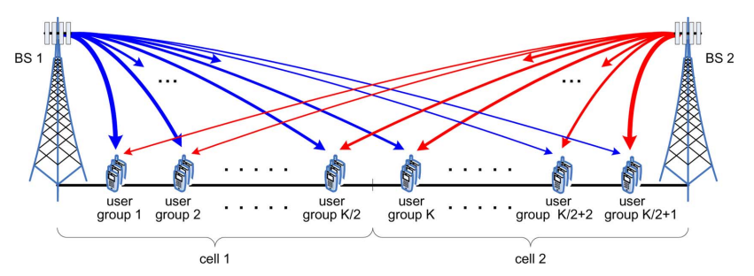
8. Multi-Cell MIMO Downlink With Cell Cooperation and Fair Scheduling: A Large-System Limit Analysis
Linear cellular layout with two cells and symmetric user groups.

Slide 28
9. Energy-Efficient Resource Allocation in OFDMA Systems with Large Numbers of Base Station Antennas
Abstract
The resource allocation for energy-efficient communication in an orthogonal frequency division multiple access (OFDMA) downlink network with a large number of transmit antennas is studied.
The power allocation, data rate adaptation, antenna allocation, and subcarrier allocation policies are optimized for maximization of the energy efficiency of data transmission
By exploiting the properties of fractional programming, the resulting non-convex optimization problem in fractional form is transformed into an equivalent optimization problem in subtractive form

Slide 29
9. Energy-Efficient Resource Allocation in OFDMA Systems with Large Numbers of Base Station Antennas
The article mainly describe
Outline of the signalling model and circuit power consumption model for downlink OFDMA systems
Definition of the performance metric and formulate the resource allocation with imperfect CSIT as an optimization problem
Solution of the non-convex optimization problem via an iterative algorithm and presents numerical performance results

Slide 30
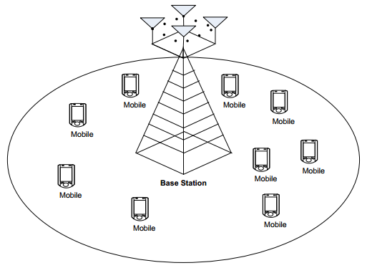
9. Energy-Efficient Resource Allocation in OFDMA Systems with Large Numbers of Base Station Antennas
Illustration of an OFDMA downlink network. There are one BS with a large number of antennas and K = 9 desired users equipped with a single antenna.

Slide 31
10. Full- dimension MIMO (FD-MIMO) for next generation cellular technology
Abstract
This article considers a practical implementation of massive MIMO systems
Although the best performance can be achieved when a large number of active antennas are placed only in the horizontal domain, BS form factor limitation often makes horizontal array placement infeasible
To cope with this limitation, this article introduces full-dimension MIMO (FD-MIMO) cellular wireless communication system, where active antennas are placed in a 2D grid at BSs.
For analysis of the FD-MIMO systems, a 3D spatial channel model is introduced, on which system-level simulations are conducted

Slide 32
10. Full- dimension MIMO (FD-MIMO) for next generation cellular technology
The article mainly describe
Two-dimensional active antenna array for FD-MIMO.
Three-dimensional spatial channel model.
Performance evaluation of FD-MIMO
1D vs. 2D antenna configurations: insights from line-of-sight channels
Performance evaluation using the proposed 3D-SCM
Channel estimation for FD-MIMO

Slide 33
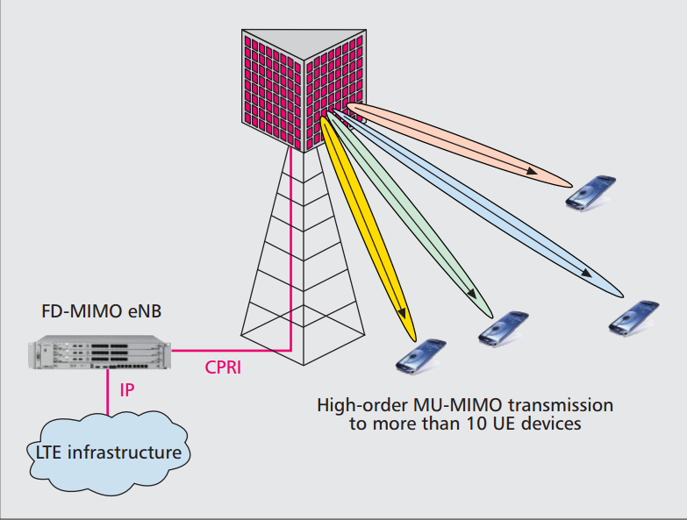
10. Full- dimension MIMO (FD-MIMO) for next generation cellular technology
The FD MIMO system.

