Slide 1

OMIS 697 – Digital Transformation Strategy November 28, 2022

Slide 2

Group Members
Bramma Sakthi Panneerkai Perumal (Z1938932)
Hita Gurunath Kadam (Z1908140)
Rahul Kumar Vellaturi (Z1937768)
Sri Sai Surya Gutta (Z1937378)
Vishnu Sai Teja Swarna (Z1975087)

Slide 3
Agenda
Introduction
Company Background
Part A – Digital Challenges
Part B – Digital Vision
Part C – Self Assessment
Where to go from here?
Recommendations
Conclusion

Slide 4
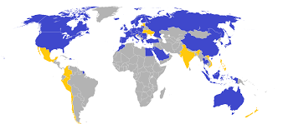
Introduction
IKEA - Ingvar Kamprad Elmtaryd Agunnaryd
“Creating a better everyday life for many people”
474 IKEA stores in 64 market places
70000 employees in 42 countries
€41.9 Billion
IKEA

Slide 5
Company Background
Who?
When?
Where?
Why?
How?
What?
IKEA is a Swedish company
Headquarters in Netherland.
Its manufactures furniture, kitchen appliances, home accessories.

Slide 6
Company Background
Who?
When?
Where?
Why?
How?
What?
Founded in 1943
First started with selling matches, pens etc.
First showroom in 1953

Slide 7
Company Background
Who?
When?
Where?
Why?
How?
What?
-IKEA was started in 1958 in Almult with name of “Mobel - IKEA”.
-Started in Norway as first store outside of Sweden in 1963.

Slide 8
Company Background
Who?
When?
Where?
Why?
How?
What?
The main vision of IKEA is to sell a wide range of furniture options to customers focusing mainly on the cost.
IKEA sells almost all household amenities at a very affordable price which are attractive yet simple.

Slide 9
Company Background
Who?
When?
Where?
Why?
How?
What?
IKEA started concentrating on interior design, furniture, kitchen appliances, and other home accessories.
They started expanding their range of products from matches to furniture.

Slide 10
Company Background
Who?
When?
Where?
Why?
How?
What?
Ingvar came up with the idea of making furniture and furnished products.
The reason behind the birth of IKEA is the presence of fewer manufacturers in Smaland.
In 1953, IKEA started the flat pack policy.
Products were sold without assembling the parts

Slide 11
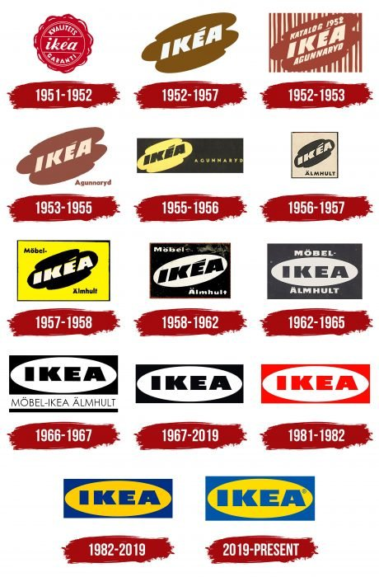
Company Background
World’s largest furniture retailer.
Offers 9500 products

Slide 12
Digital Transformation in IKEA
Progress:
Increased the sales about 12 times from 2015 to 2022.
Achievements:
Reason for good sales is providing good customer service.
Vision:
Their main vision is to provide well designed furniture to the people with an affordable price.

Slide 13
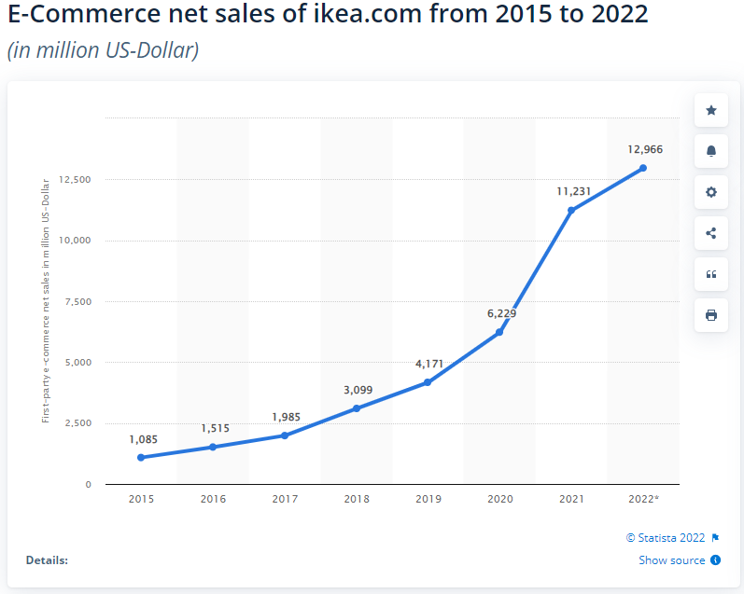
E-commerce net sales

Slide 14
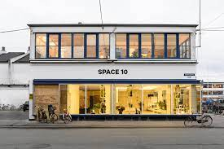
New Channels and New tools
Geo magical labs
IKEA Kreativ
IKEA place app
Task Rabbit
Space 10

Slide 15
Challenges
Spending more time in IKEA.

Slide 16
Digital Challenges
The customer experience inside the store is one of the challenges. Where real time monitoring is not happening.
The burden of selecting and carrying the products is an important challenge.
Long waiting queues while shopping and while billing is also one of the critical problems.
Difficulties in maintaining and handling the products.
Not making sure weather the products needs are satisfied or not

Slide 17
Digital Vision
We want to give the customer inside the Ikea store a wonderful digital experience by fully utilizing the capabilities of digital technology.
Real time customer monitoring to help various fields of customers.
Enhancing the backend automation process using the SAP technology to deliver the products to the customer.
We want the customer to visualize the selected products to see if they fit them better or not.
We encourage the scan and go method to reduce the waiting period at the queues.

Slide 18
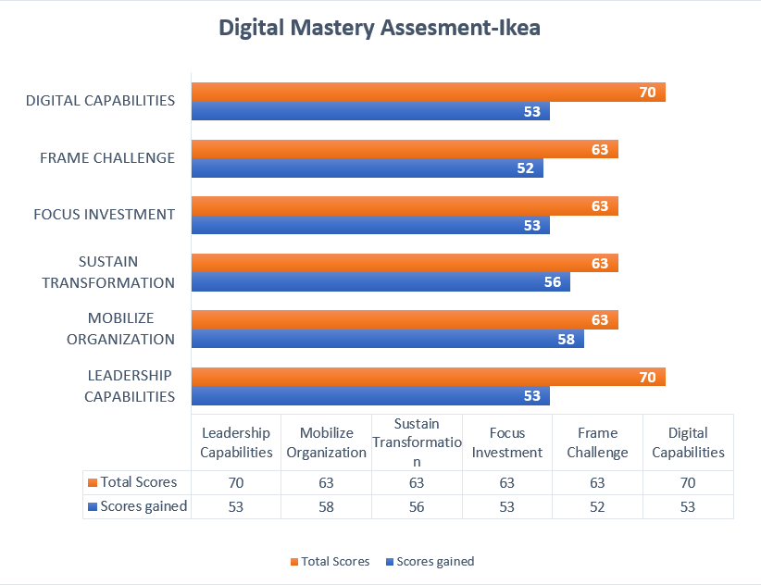
Digital Mastery Assesment

Slide 19
Digital Mastery Assesment

Slide 20
Digital Capabilities
How well does Ikea building its digital capabilities?
ARKit app for iOS 11
Email Marketing and Mobile marketing
AI chatbots, emails, and websites
Product recommendation using smarter analytics

Slide 21
Leadership capabilities
How well is Ikea building leadership capabilities?
Transformative vision
Investing in Digital skills
Digital initiatives across silos
Promotes cultural changes for digital transformation
IT and business leaders

Slide 22
Frame Challenge
Do they understand starting point?
Is the top team aligned around a shared digital vision?
Do they understand their starting point?

Slide 23
Focus Investment
Translating vision into action
Choosing right governance model
Funding models for the transformation

Slide 24
Mobilizing organization
Does Ikea make its ambition clear enough?
Are they creating sufficient momentum within the organization?
Do they actively encourage a digital cultural shift across the organization?

Slide 25
Sustaining transformation
Does Ikea have the foundational capabilities?
Reward structure and transformation goals
Measuring and monitoring digital progress

Slide 26
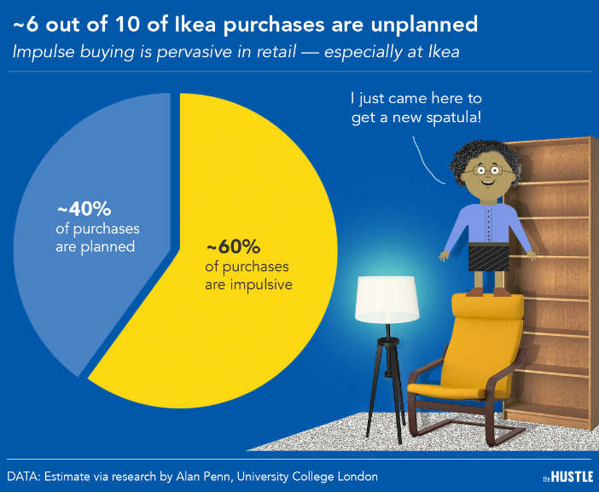
Where do you go from here?
They are on a mission to become a circular business by 2030.
Recently invested in Optoro, a tech company that will support us in optimizing returns.
Good for both business and the planet.
Industrial design – Industry 4.0 in generative design.
Enhance customer experience & engagement.
Having a strategic roadmap can make the percentages vice-versa.

Slide 27
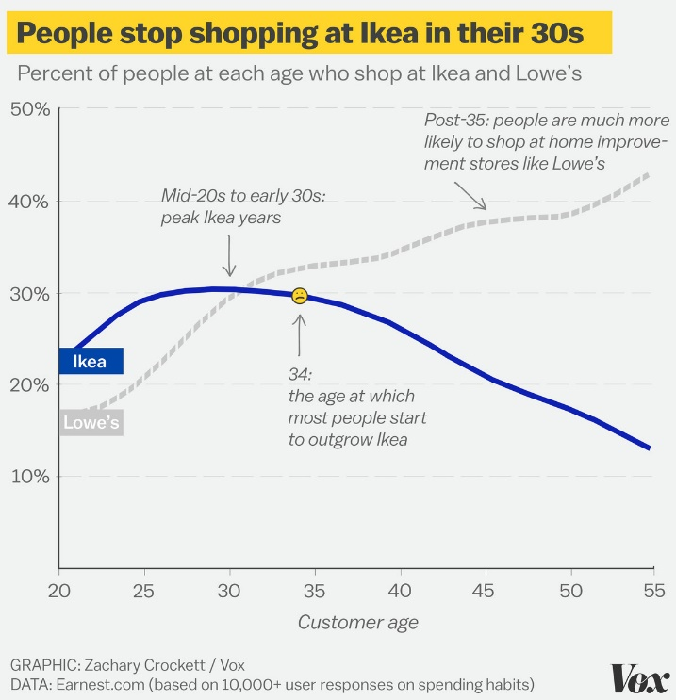
Where do you go from here? cont.
Analyze and repair existing processes rather than build a new ones.
Few reasons for this curve to fall are long queues, difficulty in carrying out products which could be improved through smart shopping, e-commerce, etc.
Double the online sales contribution from 26% of the total sales.
Implement SAP Intelligent RPA.

Slide 28
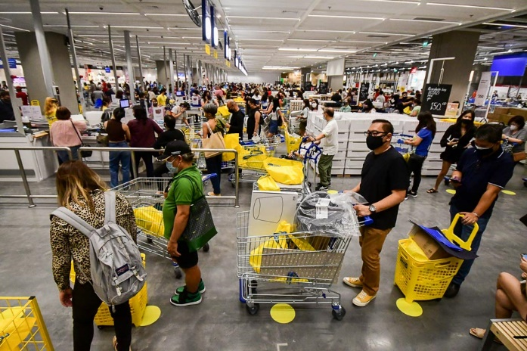
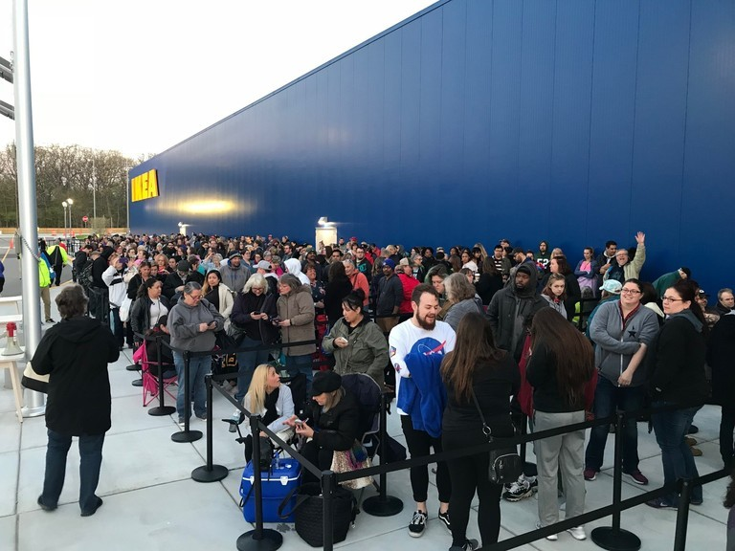
Recommendations
Accessible stores in urban areas with self-checkout options.
Opting for cloud solutions like SAP EWM (Extended Warehouse Management) to digitize their complete distribution center and warehouse operations to get rid of complex logistics execution.
Build sophisticated crowd management, a system with an omnichannel strategy.
Reduce customer footprint inside the stores with digital platforms and ecosystems.

Slide 29
Conclusion
Currently IKEA is on the way to becoming a digital master in a few years.
With strong leadership capabilities, growing themselves to increase their digital capabilities.
Glad we choose IKEA which helped us learn how a non-IT company can implement digital transformation.

Slide 30


